Slide 1
FLU VACCINE ADMINISTRATION 2023-24

Slide 2
What is Influenza?
Influenza is a highly contagious respiratory viral illness
Caused by various types of influenza viral strains
Rates of infection are highest among children
Rates of serious illness and death are highest among persons aged >65 years, children aged <2 years, and persons of any age who have medical conditions that place them at increased risk for complications

Slide 3
Human Influenza Viruses
4 antigenic types – A, B, C and D
Epidemics caused by types A and B
C is never in Vaccine and D is primarily affect cattle

Slide 4
Influenza Antigenic Changes
Influenza A viruses subtyped by 2 surface antigens, hemagglutinin (H1,H2,H3) and neuraminidase (N1,N2)
Antigenic drift: Slight change-frequent small mutations in the H and N antigens
Antigenic shift: Major change-marked change in the H or N antigen due to replacement with a different one from another virus, or introduction of new virus strain
Notes:
4
Diarrhea & vomiting are more common in children.
Many illnesses, including the common cold, can have similar symptoms.

Slide 5
Seasonal
vs
Pandemic

Slide 6
Seasonal is expected.
Pandemic is something that we have never seen or have not seen in a long time.

Slide 7
CDC Naming Flu Virus
The antigenic type (e.g., A, B, C)
The host of origin (e.g., swine, equine, chicken, etc. For human-origin viruses, no host of origin designation is given.)
Geographical origin (e.g., Denver, Taiwan, etc.)
Strain number (e.g., 15, 7, etc.)
Year of isolation (e.g., 57, 2009, etc.)
For influenza A viruses, the hemagglutinin and neuraminidase antigen description in parentheses (e.g., (H1N1), (H5N1)

Slide 8
2023-2024 Quadrivalent
A/Victoria/4897/2022 (H1N1) pdm09-like virus
A/Darwin/9/2021 (H3N2)-like virus
B/Austria/1359417/2021- like virus (B/Victoria lineage)
B/Phuket/3073/2013-like virus (B/Yamagata lineage)
Notes:
Phuket Thailand

Slide 9
Influenza Type A (Pandemics)
Year | Subtype | Severity
1889 | H3N2 | Moderate
1918 (Spanish) | H1N1 | Severe
1957 (Asian) | H2N2 | Severe
1968 (Hong Kong) | H3N2 | Moderate
1977 | H1N1 | Mild
2009 | H1N1 | Moderate

Slide 10
Major Difference: Sudden Onset
Fever
Sore Throat
Headache
Rhinitis (runny nose)
Myalgia (muscle pain)
Diarrhea & Vomiting
Non-productive Cough
Notes:
Otitis media (infection or inflammation of the middle ear) and nausea are also commonly reported among children

Slide 11
Let’s talk Flu
Respiratory transmission
Viral shedding in respiratory secretions for 5-10 days.
Shedding begins BEFORE onset of symptoms
Incubation period 1-3 days
Abrupt onset of fever, myalgia (muscle pain), sore throat, nonproductive cough, headache

Slide 12
Transmission of Influenza
Primarily droplet (spread by coughing, sneezing, talking)
Can survive on hard, non-porous surfaces for 24-48 hours (such as doorknobs)
Survive on cloth paper and tissue for 8-12 hours
Survives on hands for 5 minutes
*

Slide 13
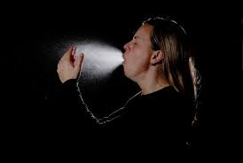
*

Slide 14
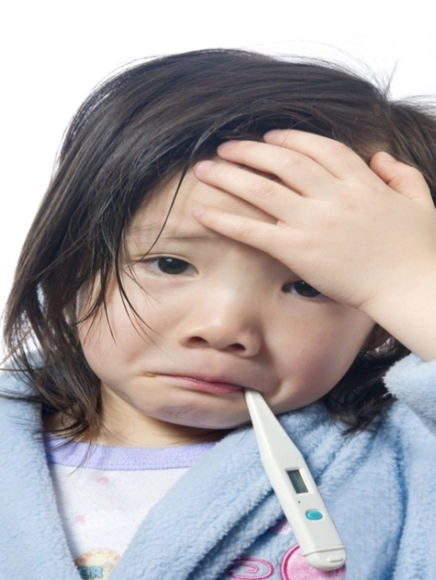
Treatment
Rest
Adequate fluid intake
Antipyretics and analgesics (fever and pain reducers)
Stay at home

Slide 15
Primary Prevention
Yearly vaccination is most important!
-Cover your nose and mouth when you cough or sneeze
-Wash your hands often with soap and water (Alcohol-based hand cleaners are also effective)
-Avoid close contact with sick people
-If you are sick, stay home and limit contact with others
-Avoid touching your eyes, nose, or mouth
-Take anti-virals – if recommended by healthcare provider.
*

Slide 16
Injectable
Quadrivalent inactivated influenza vaccine (QIV)
>6 months of age
Not a live virus
IM 0.5ml-Pre-filled syringes
Latex Free

Slide 17
Who can take it?
Any person who wishes to reduce the likelihood of becoming ill or transmitting influenza.
Inactivated influenza vaccine can be given to anyone 6 months of age or older, including breastfeeding and pregnant women.

Slide 18
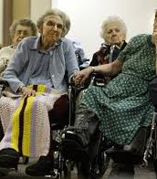
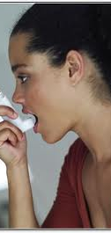
People at Increased Risk of Influenza Complications
Children ages 6 months through 5 years
Adults 65 years of age and older
Pregnant women ( and up to 2 weeks post partum)
Residents in nursing homes and other long-term care facilities
People who have chronic medical conditions immunosuppressed

Slide 19
Transmission Sources
Health Care Providers:
People who provide home care to persons in groups at high risk
People working in health-care settings include physicians, nurses, and other workers in hospitals, long term care facilities, assisted living and outpatient-care settings
Medical emergency response workers
Students in these professions who will have contact with patients

Slide 20
Influenza Vaccine Clinic in the School or Mass Setting
*
Notes:
Influenza viruses undergo frequent antigenic change (i.e., antigenic drift) and vaccine is updated annually. Persons recommended for vaccination must receive an annual vaccination against the influenInza viruses forecasted to be in circulation.
If vaccine supply is limited, priority for vaccination is typically assigned to persons in specific groups and of specific ages who are, or are contacts of, persons at higher risk for influenza complications
20

Slide 21
Injectable Vaccine Fast Facts
Antibodies develop approximately 2 weeks after vaccine
Common reactions (Injectable)
Soreness/erythema/induration at site lasting 1-2 days (15-20%)
Fever/chills/malaise/myalgias lasting 1-2 days (<1%)
Rare: Immediate hypersensitivity allergic reactions (hives/angioedema/allergic asthma/systemic anaphylaxis)

Slide 22
Contraindications for all Influenza Vaccine
People who had a severe (anaphylactic) reaction to chicken eggs
People who had a severe reaction to a flu vaccination in the past
Children <6mo of age
People who developed Guillain-Barre' syndrome following influenza vaccination (requires a consultation with patient’s physician)
*

Slide 23
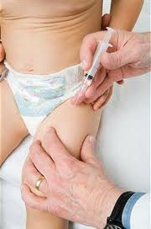
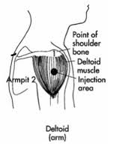
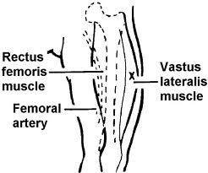
Vaccine Administration
Sites:
Infants (birth to 11 months old): vastus lateralis (anterolateral thigh)
Young children over the age of 12 months-anterolateral aspect of the thigh may be used if the deltoid is underdeveloped
Adults and older children: deltoid (upper arm)
*

Slide 24
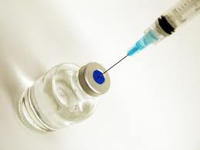
Injection Technique “Nursing 101”
*
Notes:
24

Slide 25
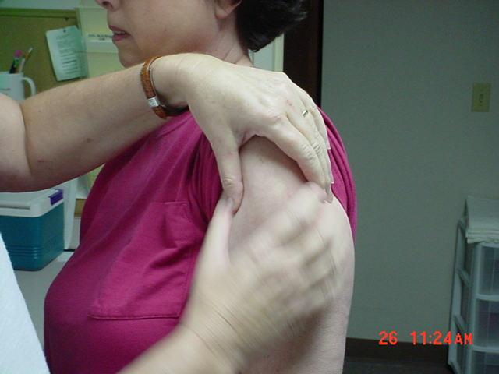
Injection Technique “Nursing 101”
Determine appropriate
injection site

Slide 26
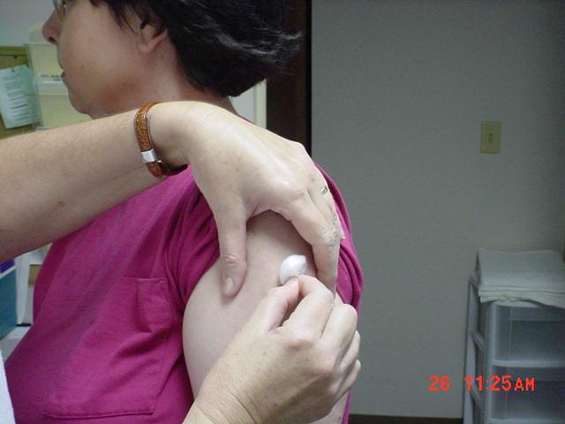
2. Prep site with alcohol wipe/cotton ball
3. Using circular motion/wipe from center out/allow to dry
*

Slide 27
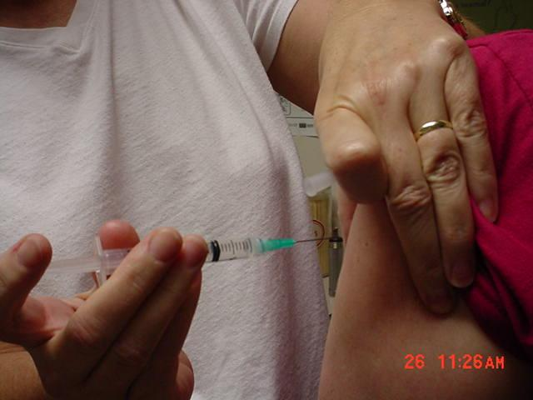
4. Spread skin taut between thumb and forefinger OR grasp tissue and “bunch up” muscle. (acceptable for pediatric and geriatric patients)
5. Insert needle fully into muscle at 90 degree angle and inject vaccine quickly.
*
Notes:
The most frequent complication of influenza is pneumonia, most commonly bacterial pneumonia (like Staph and Strep pneumonia)
Complications of flu can include bacterial pneumonia, ear infections, sinus infections, and worsening of chronic medical conditions, such as congestive heart failure, asthma, or diabetes.
Other possible serious complications triggered by flu can include inflammation of the heart (myocarditis), brain (encephalitis) or muscle (myositis, rhabdomyolysis) tissues, and multi-organ failure (for example, respiratory and kidney failure). Flu virus infection of the respiratory tract can trigger an extreme inflammatory response in the body and can lead to sepsis, the body’s life-threatening response to infection. Flu also can make chronic medical problems worse. For example, people with asthma may experience asthma attacks while they have the flu, and people with chronic heart disease may experience a worsening of this condition triggered by flu.

Slide 28
Aspiration
Aspiration is the process of pulling back on the plunger of the syringe prior to injection to ensure that the medication is not injected into a blood vessel.
Although this practice is advocated by some experts, the procedure is not required with immunizations because no large blood vessels exist at the recommended injection sites.
ADH Policy and Procedures require aspiration with giving injections…..except Immunizations.
Note: Effective 08/01/2008 Policy – “When giving immunizations, aspiration is at the nurse’s discretion”.
Patient Care & Laboratory Services Volume 2 –
PATIENT CARE SERVICES – Page PRO-24a, #13.
*

Slide 29
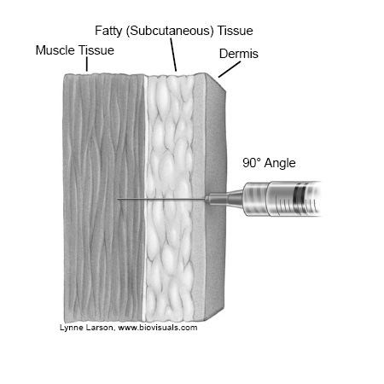
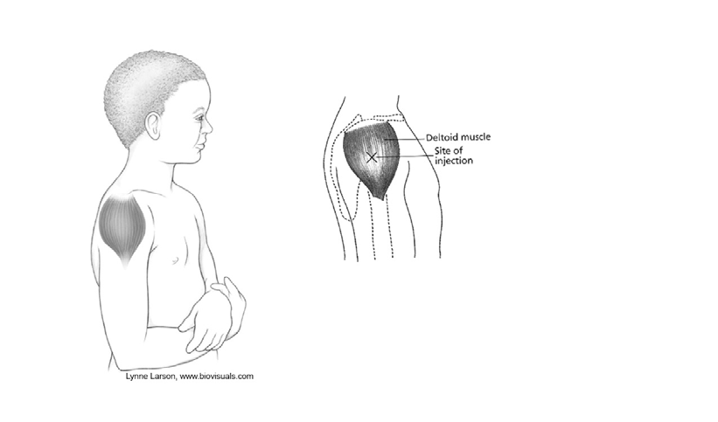
2-3 finger breaths below top of shoulder
*

Slide 30
• Intramuscular (IM)
injections are administered into muscle tissue below the dermis and subcutaneous
tissue.
Needle Gauge & Length
- 1 inch
- 23- to 25-gauge
needle
Muscle Tissue
Fatty (Subcutaneous) Tissue
Dermis
90° Angle
30

Slide 31
Needle Safety
ADH utilizes prefilled syringes with safety needles
NEVER recap, remove or break used needles
If a needle stick injury occurs-report IMMEDIATELY to the nursing coordinator
Dispose of the entire unit in biohazard container

Slide 32
“Nursing 101”
Withdraw needle and apply light pressure to site for several seconds with dry cotton ball or gauze
Dispose of needle in sharps container. It is recommended each nurse have a sharps container (not shared).
Take your time……Needle sticks require source testing as well as vaccinator
Notes:
32

Slide 33
Mild problems
Some children and adolescents 2-17 years of age have reported:
Some adults 18-49 years of age have reported:
Runny nose, nasal congestion or cough
Fever
Headache and muscle aches
Wheezing
Abdominal pain or occasional vomiting or diarrhea
Runny nose or nasal congestion
Sore throat
Cough, chills, tiredness/weakness
Headache

Slide 34
Severe problems
Life-threatening allergic reactions to vaccines are very rare. If they do occur, it is usually within a few minutes to a few hours after the vaccination.

Slide 35
Review Flu Form

Slide 36
Infection Control
Healthcare providers should follow “Standard Precautions” to minimize the risks of spreading disease during vaccine administration.
Hand washing - The single, most effective disease prevention activity is good hand washing. Hands should be washed thoroughly with soap and water or cleansed with an alcohol-based waterless antiseptic between patients, before vaccine preparation, or any time hands become soiled.
Gloving - Gloves are not required to be worn when administering vaccines unless the person administering the vaccine is likely to come into contact with potentially infectious body fluids or has open lesions on their hands. Remember gloves cannot prevent needle stick injuries.
36

Slide 37
Infection Control
Needle stick Injuries - should be reported immediately to the site supervisor.
Equipment Disposal - All used syringe/needle devices should be placed in puncture proof containers to prevent accidents or reuse.
37

Slide 38
Remember…
If you need more vaccine, supplies, etc., be sure to let your instructor know and he/she will report to an ADH staff person.
Any needle sticks must be reported immediately.
Any wasted vaccine must be reported.
Add needle to syringe when patient presents to your table.

Slide 39
Flu Clinic Day
An ADH nursing coordinator will be at each clinic site for your assistance
Locate emergency kit at each site
Adjust your work area to accommodate you-place your sharps container readily accessible
Review each form for consent and contraindications
All questions should be answered
Complete and sign form
Wear your ID
39

Slide 40
THANK YOU!
You have now been a part of our Flu initiative
You have helped make Arkansas a healthier state
We appreciate you being a part of our team and welcome feedback on how to improve
40

