Slide 1
Always Changing Boys and Puberty
Middle School Boys

Slide 2
Today’s Class Guidelines
Don’t be afraid to ask questions
Be respectful of your peers
No personal stories
We will use appropriate medical terms

Slide 3
Class Agenda
Puberty
Video
Personal Hygiene
Healthy Bodies
Questions

Slide 4
VIDEO

Slide 5
Most boys begin puberty by the age of 13
Some sooner, some later…
Boys will begin to notice changes in their voice and may feel funny.
Their friends and family may think they are quiet or cranky.

Slide 6
Testosterone: The MALE hormone
Your body will start producing larger amounts of this hormone when you begin puberty.
It is responsible for the majority of changes that will happen to your body such as deepening of your voice, muscle growth, and facial hair.

Slide 7
Testosterone: The MALE hormone
This hormone will cause your vocal chords to thicken. Once this begins, your voice will get much lower and sometimes even raspy.
It isn’t uncommon for your voice to crack and squeak.

Slide 8
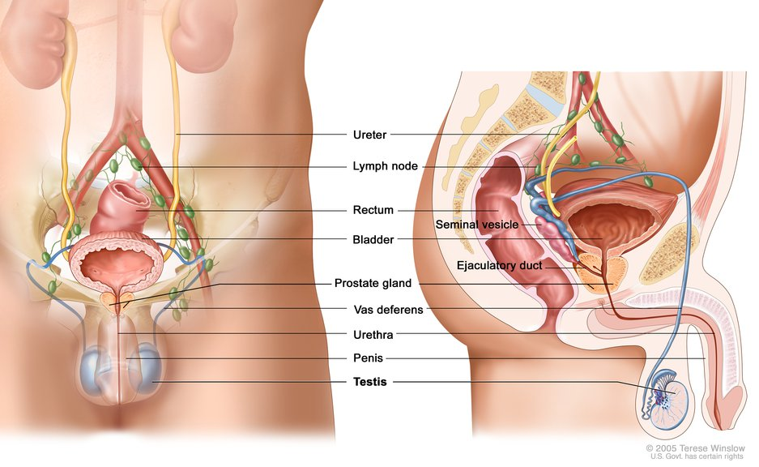
Puberty: Male Reproductive System
Examine testicles monthly.
Become familiar with how your body feels. That way if something changes you will know.
If something feels different, tell you doctor.
It is normal for one testicle to be slightly higher than the other.

Slide 9
Erections:
When the penis becomes engorged (full of) blood causing it to become hard.
Completely normal and doesn’t have to have anything to do with thinking about sex
Nocturnal emissions are normal and commonly known as “wet dreams”. Those will become less frequent as you get older. This happens often in some young men and not at all in others.

Slide 10
Why is Personal Hygiene Important?
You are less likely to get sick
You will feel better about yourself
Others will enjoy having you around

Slide 11
Personal Hygiene
Sweating
Body produces more sweat; body odor. (2.6 million glands)
Why you sweat:
Helps to regulate body temperature.
Bathe/shower with soap daily
Change sweaty clothes.
Control underarm odor and wetness with deodorant or antiperspirant

Slide 12
Personal Hygiene
Skin Care
Oil glands become more active
Oil and dead skin cells lead to acne
Cleanse twice a day
Don’t worry! Acne is a normal part of puberty, and you can do things to reduce it.

Slide 13
Personal Hygiene
Healthy Hair
Shampoo hair regularly (daily if you want to)
Shampooing helps remove dirt, oil and styling products
Massage conditioner into your hair
If hair is cut short, use sunscreen on your scalp

Slide 14
Personal Hygiene
Healthy Hair
You will begin to notice that you are getting hair in places that you haven’t had hair before….
Face
Underarms
Pubic Area
This is all part of the puberty process…. And one of the reasons you need to STAY clean

Slide 15
Personal Hygiene
Oral Health (care of your teeth)
Brush teeth and gums with a fluoride toothpaste at least twice a day
Floss teeth daily
See your dentist on a regular basis (Cleanings 2x per year)
Drink fluoridated water (if available)
Fluoride treatment available at Local Health Units

Slide 17
Personal Hygiene
Hand Washing
The One thing YOU can do to prevent the spread of germs such as cold, flu, stomach bugs and more
Keep your fingernails trimmed
Wash hands for 20 seconds with SOAP and water:
WHEN???
Before and after eating
After using the bathroom
After sneezing or coughing
After playing with an animal
Anytime your hands are dirty

Slide 20
Personal Hygiene
Foot and Shoe Care
Let your shoes air dry
Wear socks to help absorb odor
Use foot powder or spray for your feet and shoes (especially if you have athlete’s foot)
Keep your toenails trimmed and clean
Inspect your feet when taking a shower or bath for cuts or abrasions (especially if you go barefoot)
Always wear shower shoes or flip-flops in gym showers
Keep shoes away from pets.

Slide 21
Healthy Bodies
Stay active
Eat nutritious foods
Good hygiene
Personal Safety
Plenty of sleep (but not in class)
Do not use drugs of any kind, including tobacco, alcohol, street (illicit) drugs, over-the-counter medication or prescription drugs

Slide 22
Who to Talk to:
Family member:
Mom, Dad, Grandma, Grandpa, Uncle, etc.
(Just make sure it is someone old enough to give you
good advice.)
Teacher, school nurse, coach, counselor
Doctor
Any trusted adult

Slide 23
Take PRIDE In Who You Are… Thank you for your attention!!!

Slide 24
Resources:
Proctor and Gamble Always Changing and Growing Up Program

