Slide 1
BMI Data Entry eSchool

Slide 2
eSchool Manual
Go to apscn.org
Click SMS
Log In box will appear- User name: apscn
Password: docs
Click Student Management System eSchool- 4.0 Training Documentation
Scroll down to Medical section
Click Medical Training Guide
Manual will open, can print or read online

Slide 3
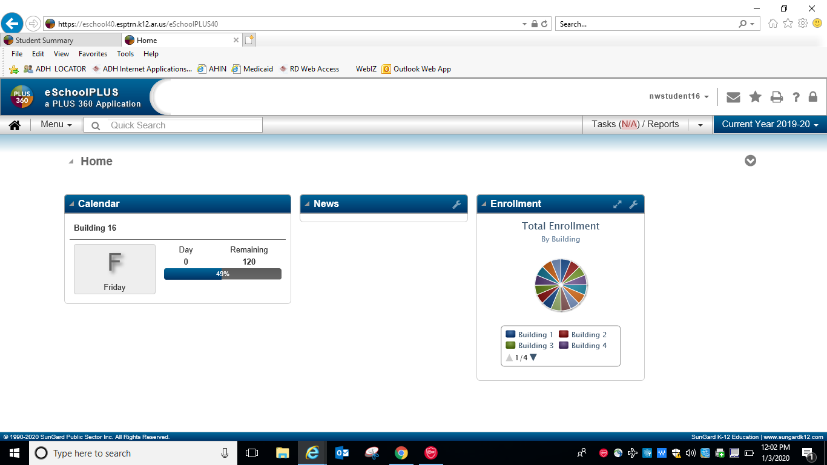

Slide 4
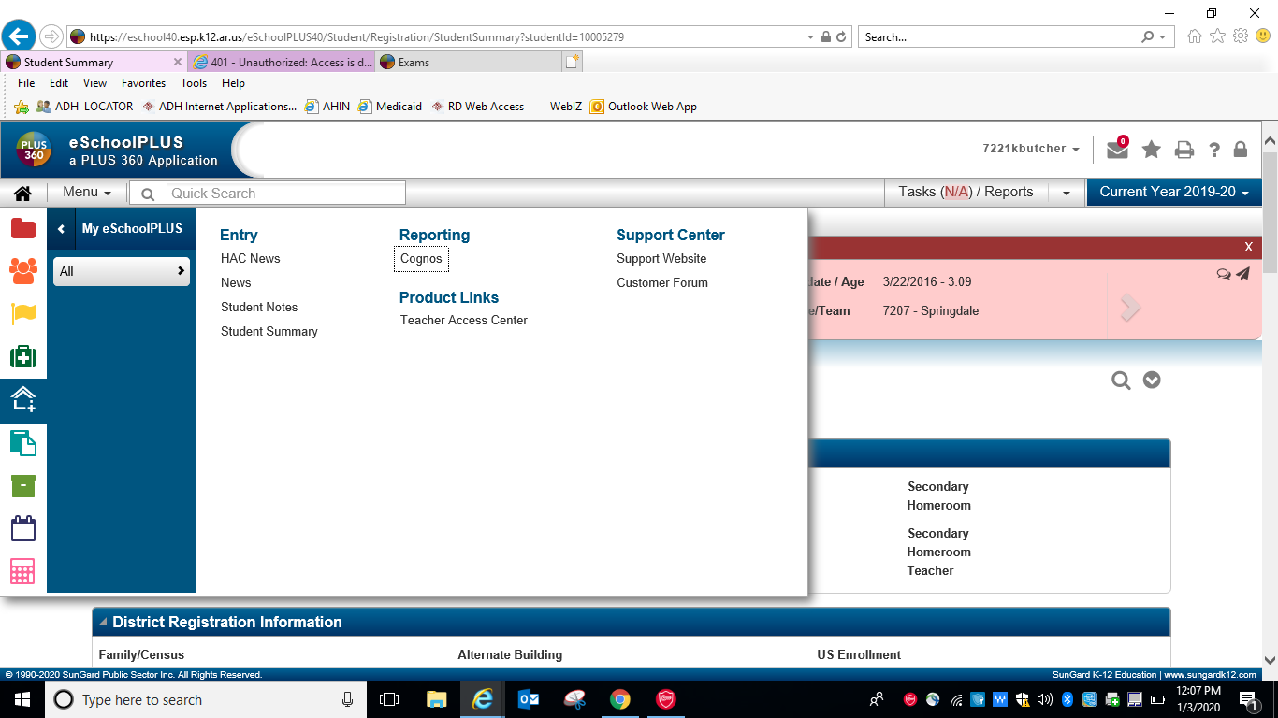

Slide 5
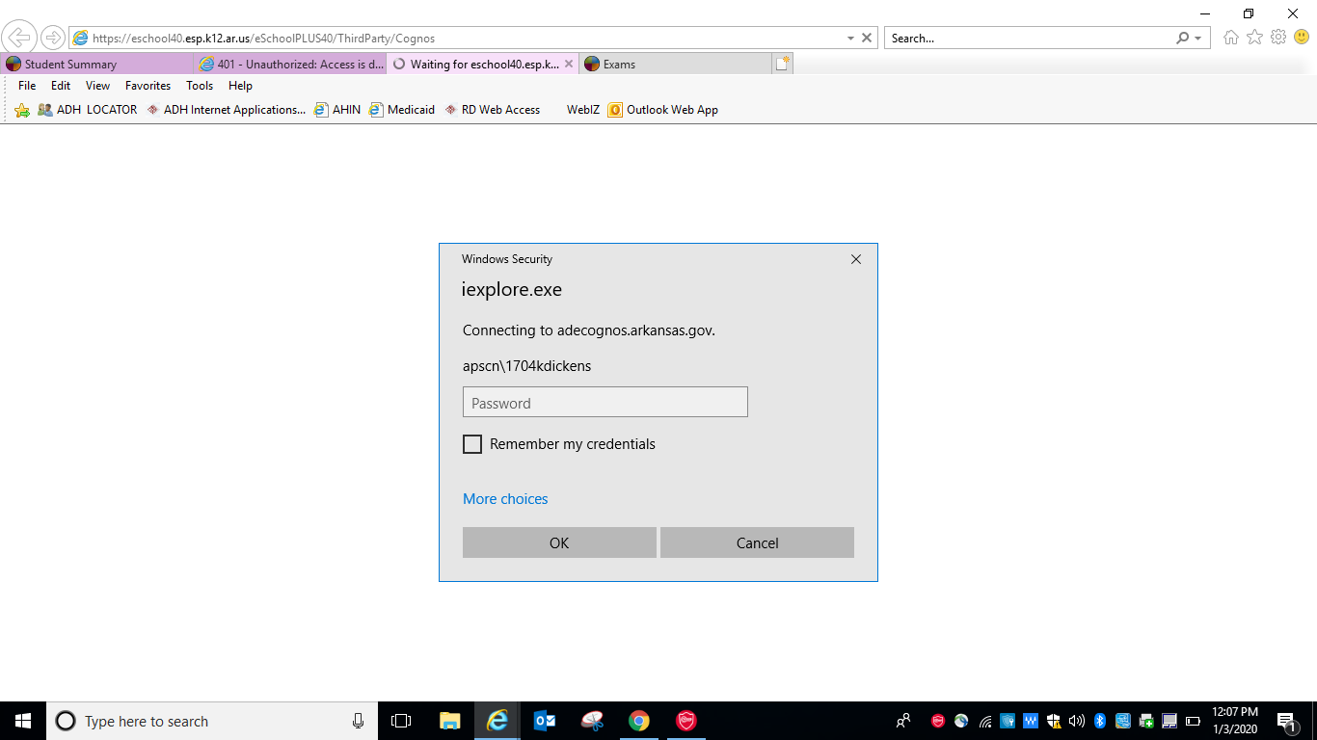
Notes:
Log in using same credentials as eschool

Slide 6
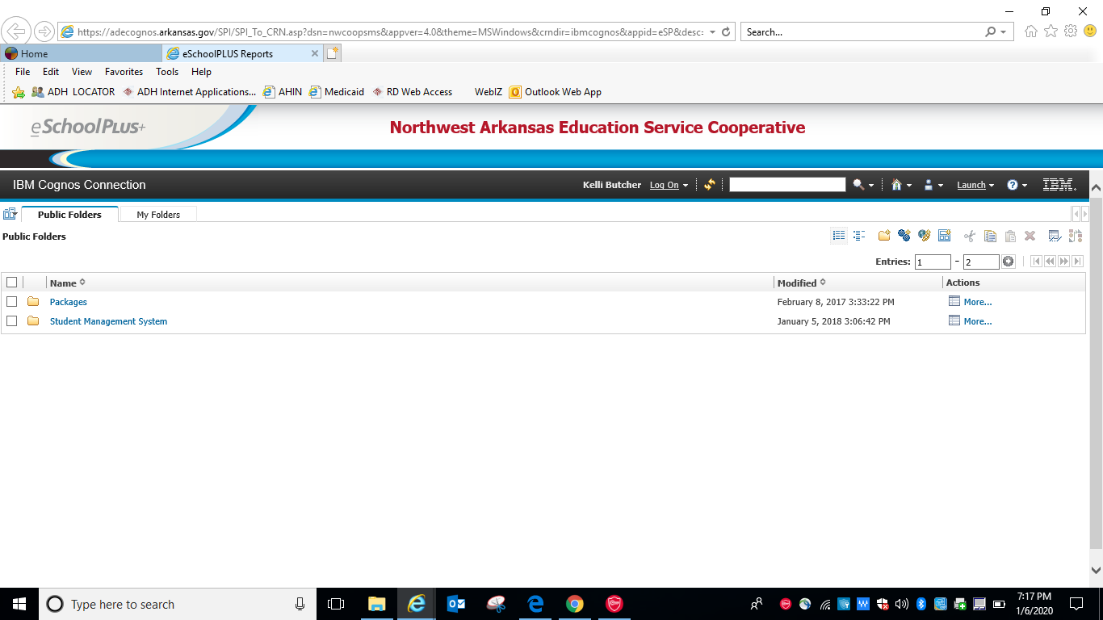

Slide 7
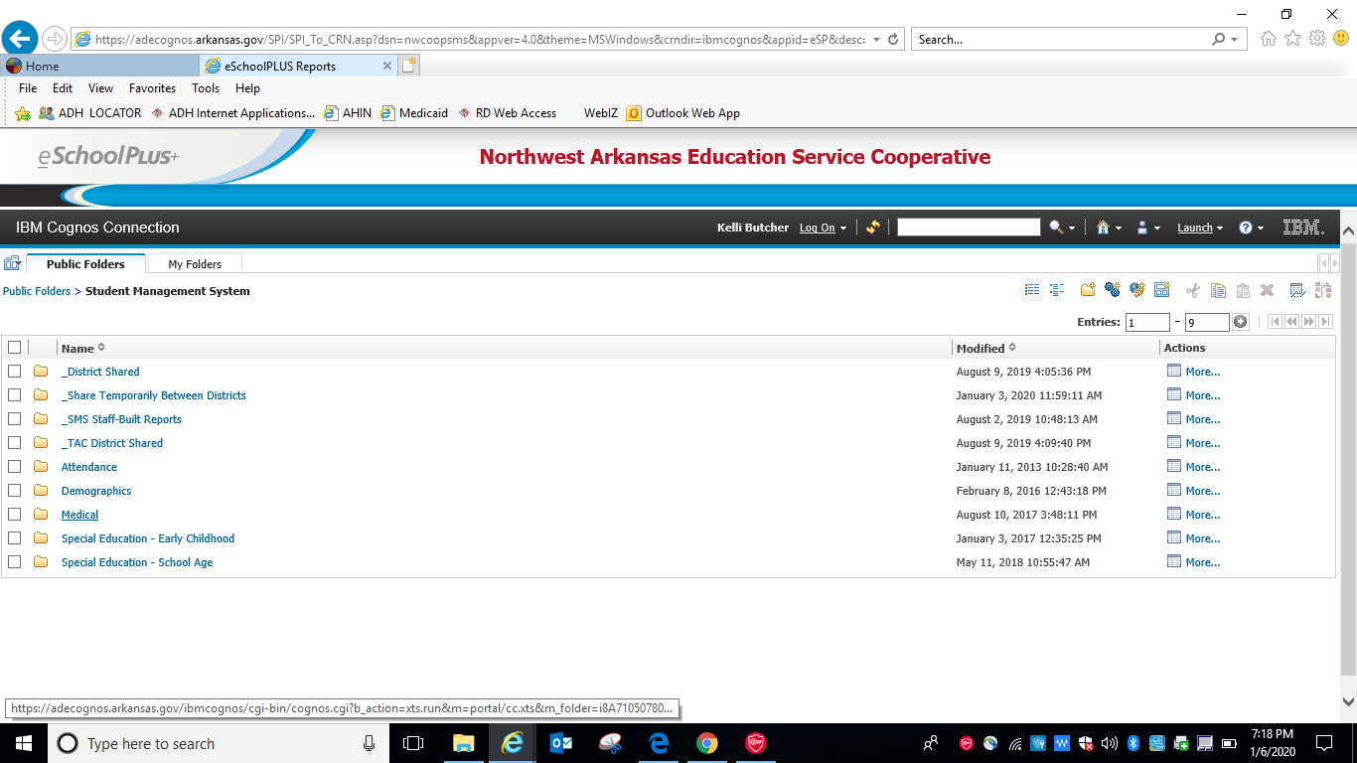

Slide 8
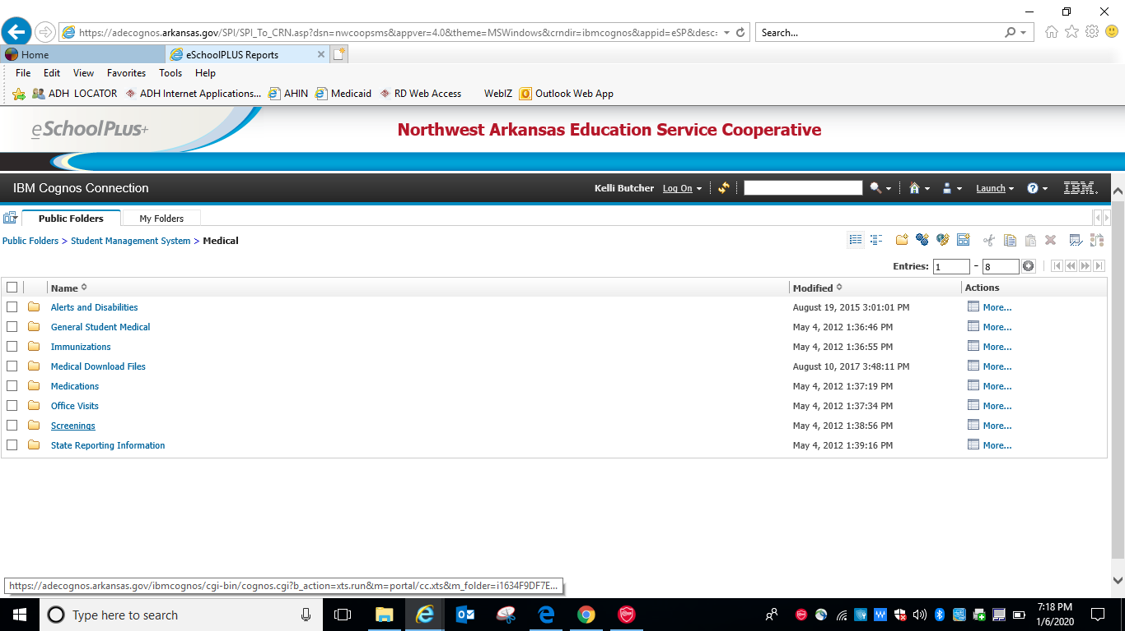

Slide 9
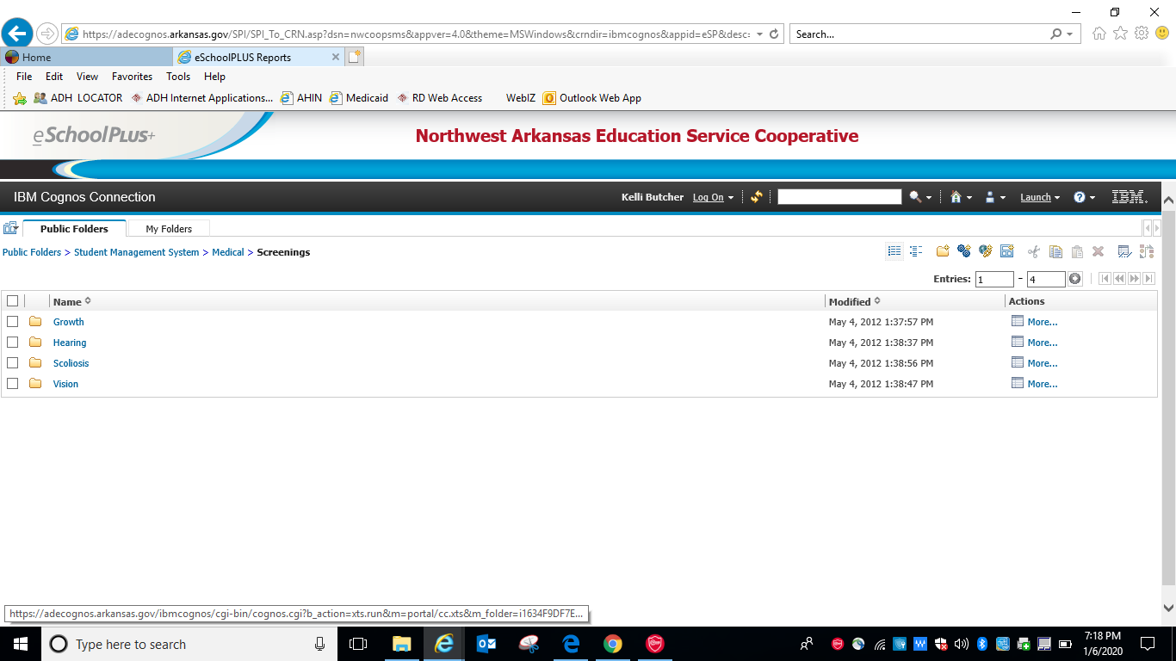

Slide 10
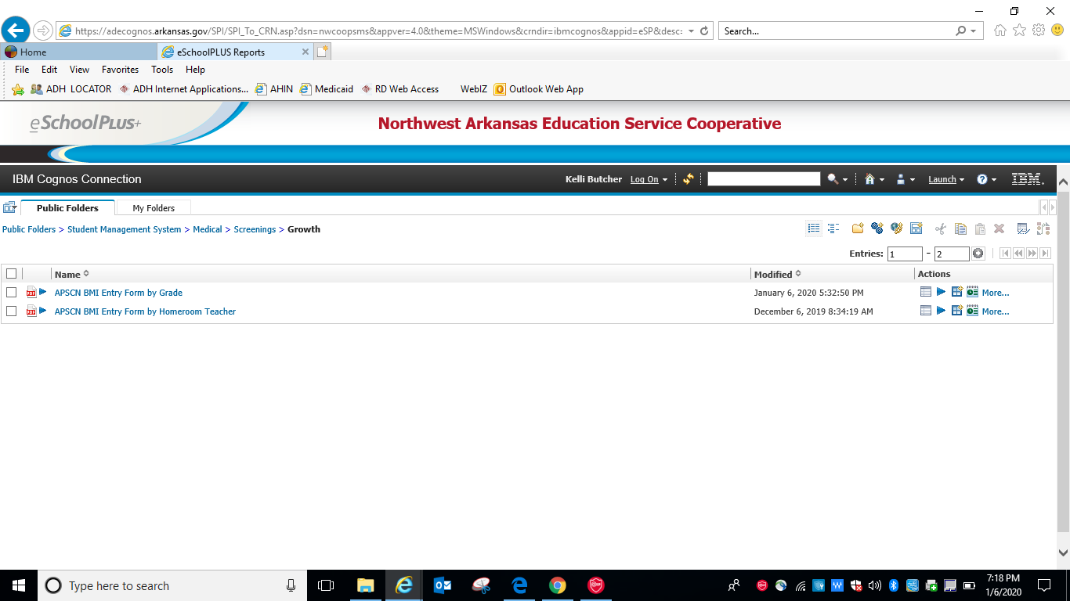
Notes:
Pick by grade or homeroom based on how the nurse is screening

Slide 11
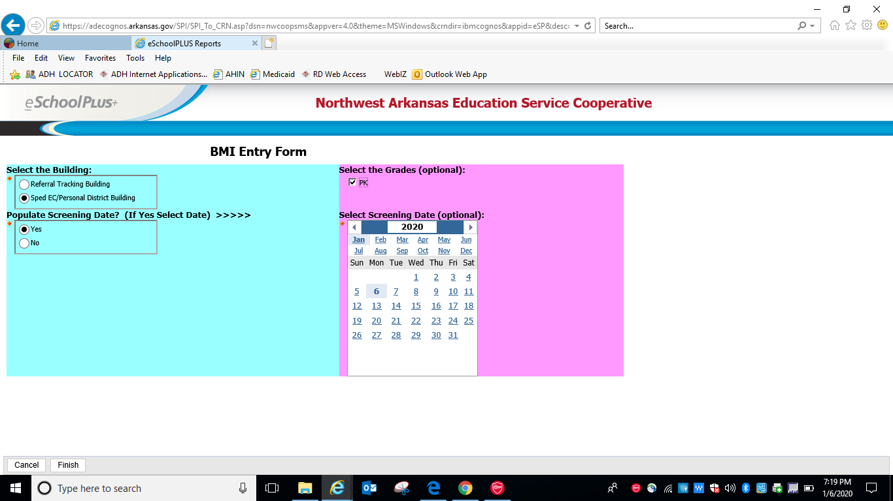
Notes:
Complete selections then click finish

Slide 12
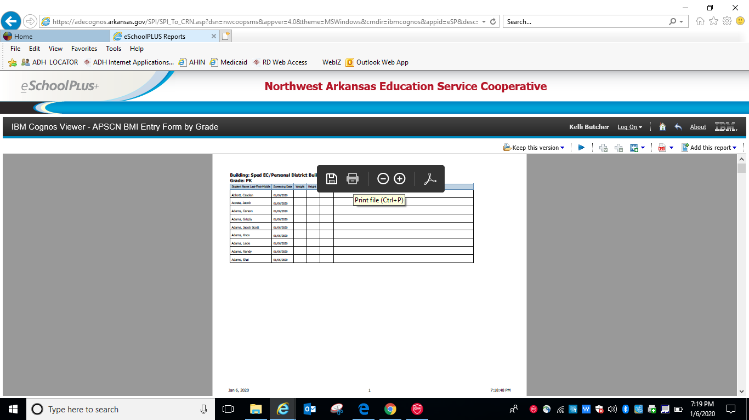

Slide 14
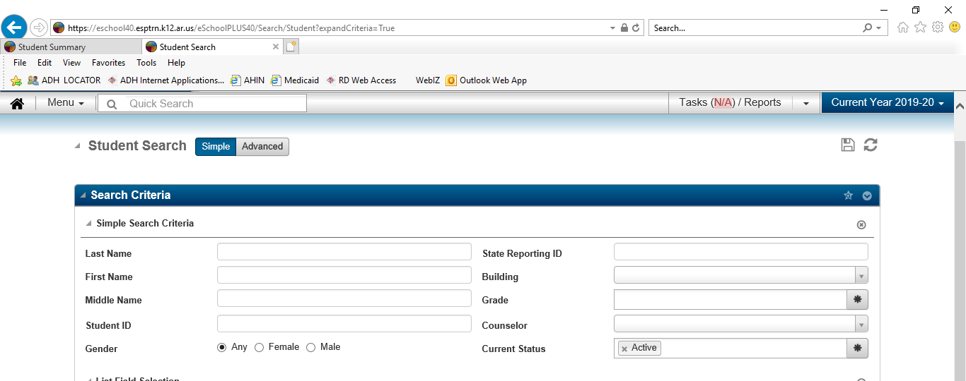
Notes:
Put in building and grade

Slide 15
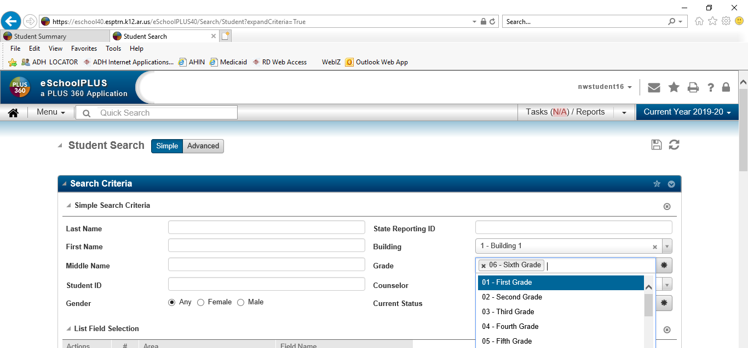
Notes:
Click where red circle is located to load names

Slide 16
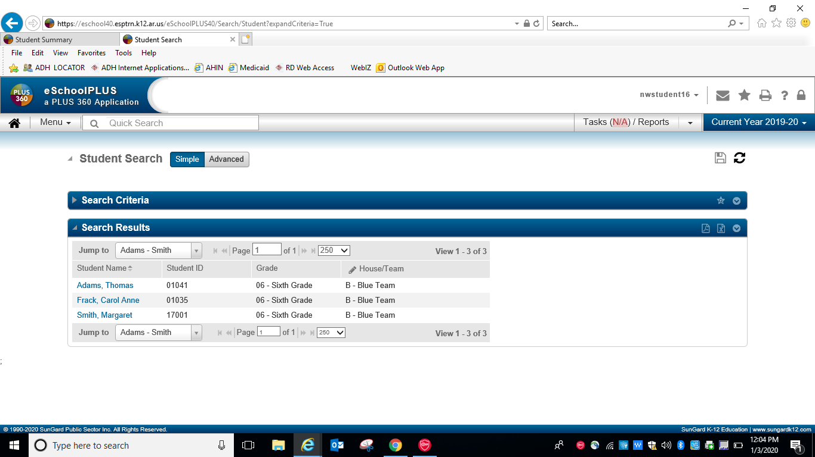

Slide 17
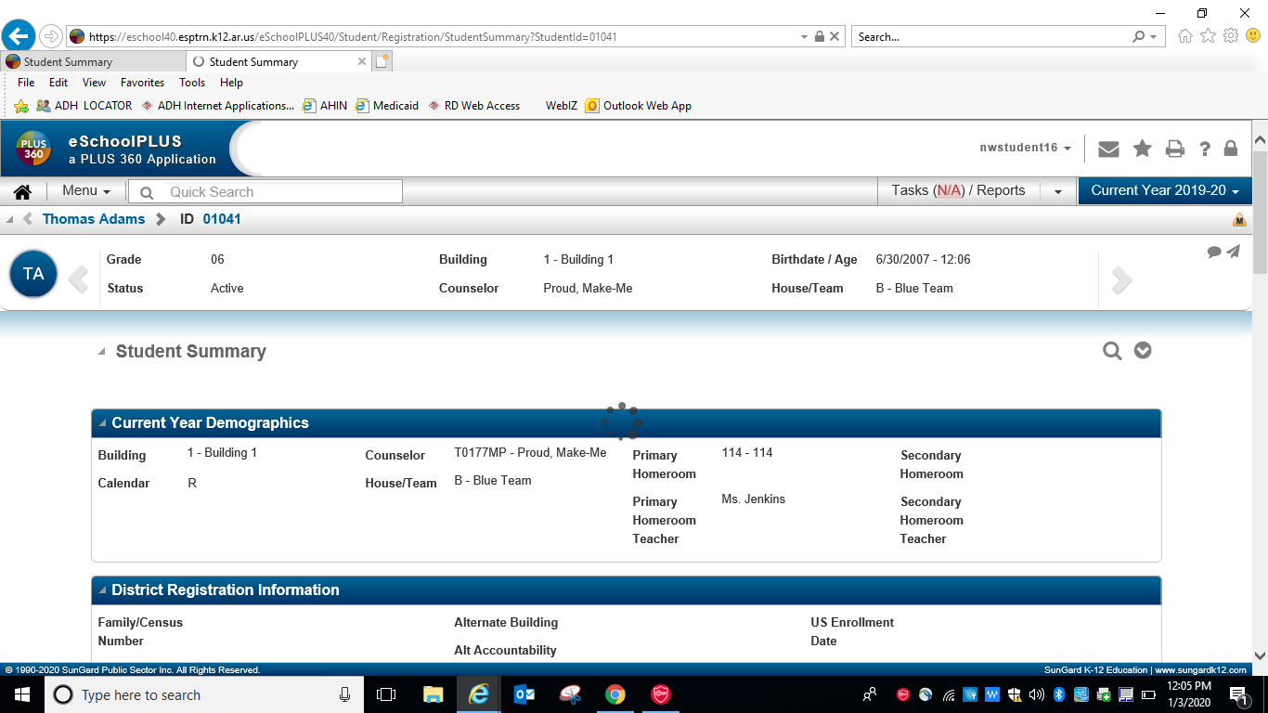

Slide 18
Notes:
Now on Thomas Adams page

Slide 19
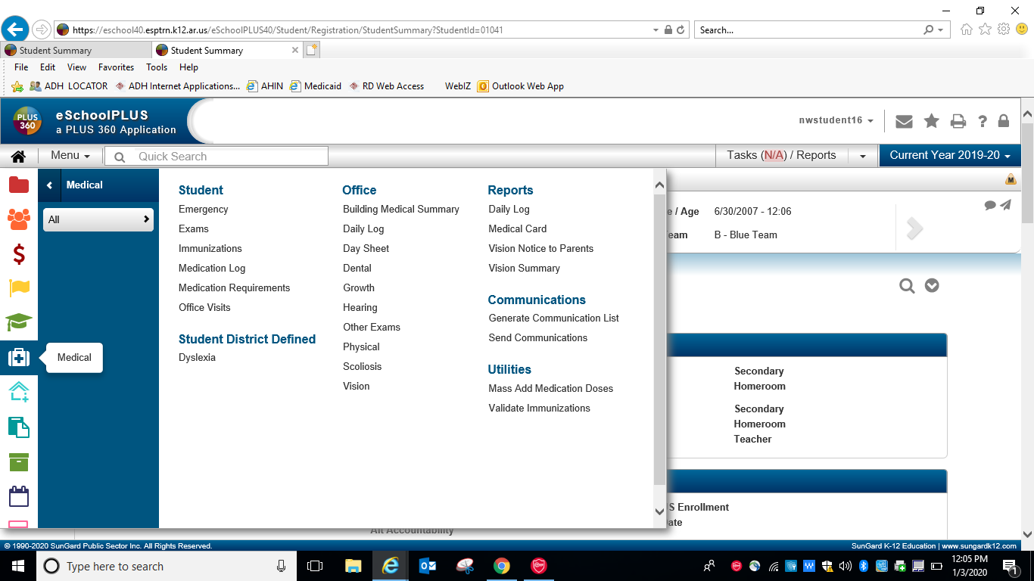

Slide 20
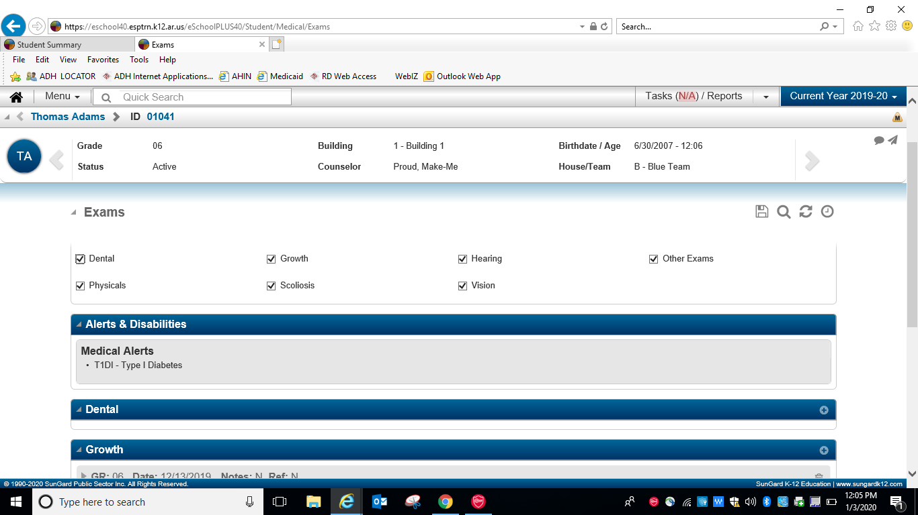

Slide 21
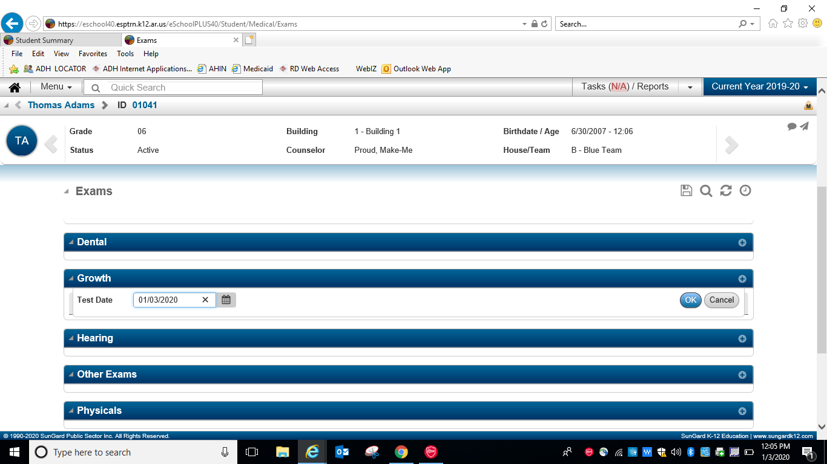

Slide 22
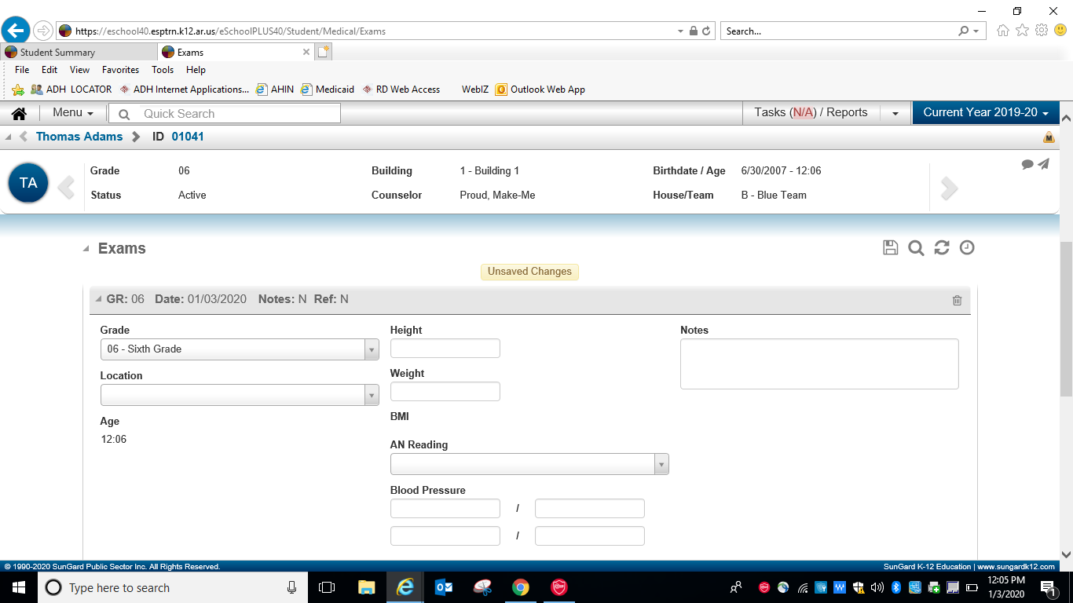
Notes:
Enter height in inches with decimal ie 56.25 inches and weight in pounds, enter in notes reason code if not measured

Slide 23
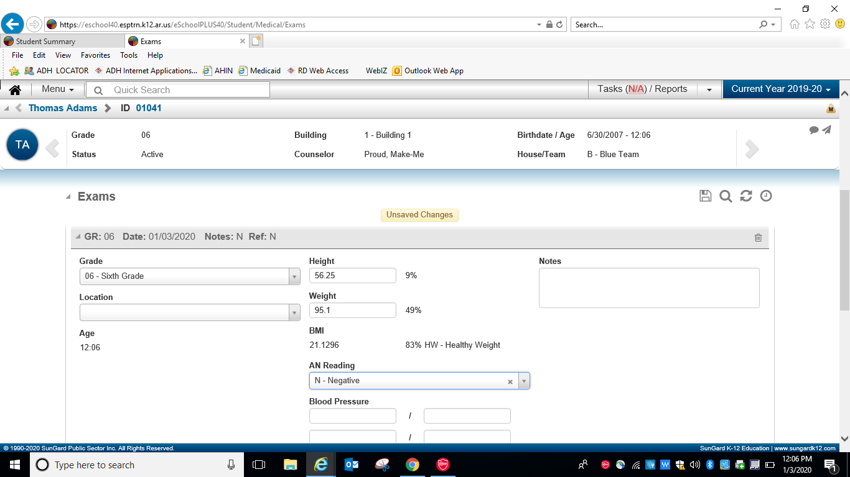
Notes:
Enter positive or negative for AN reading

Slide 24
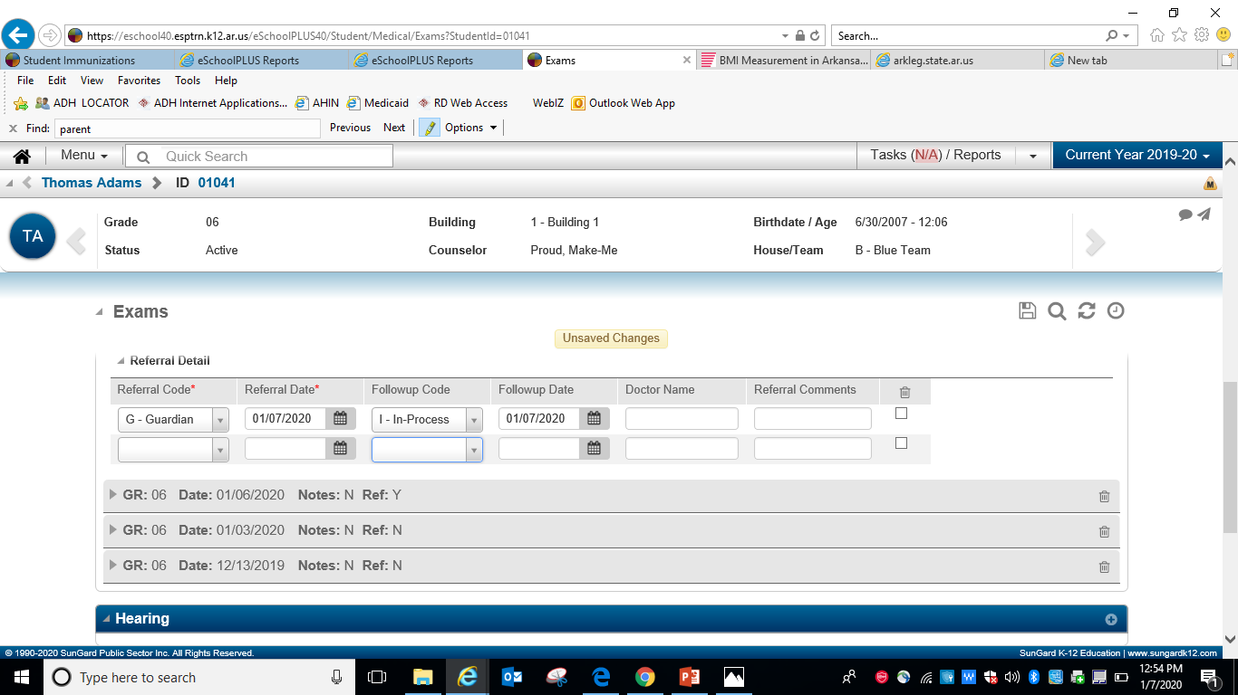
Notes:
Type a “t” in the date box and todays date will appear

Slide 25
Notes:
If AN is positive make a referral, then click arrow in red circle to advance to next student

Slide 26
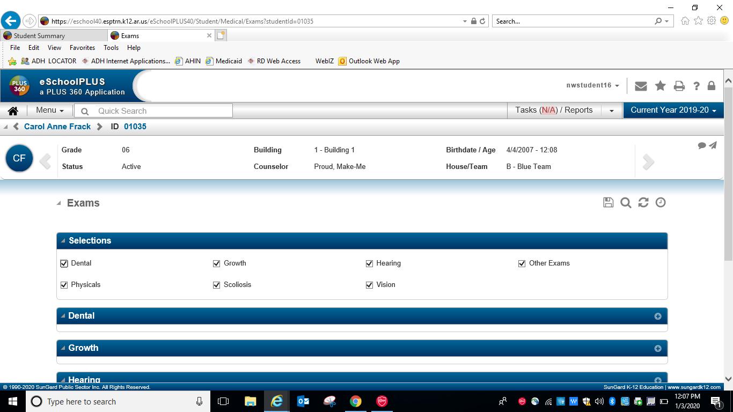
Notes:
Now on next student enter their data, remember you can hit the letter t to enter today’s date

Slide 27
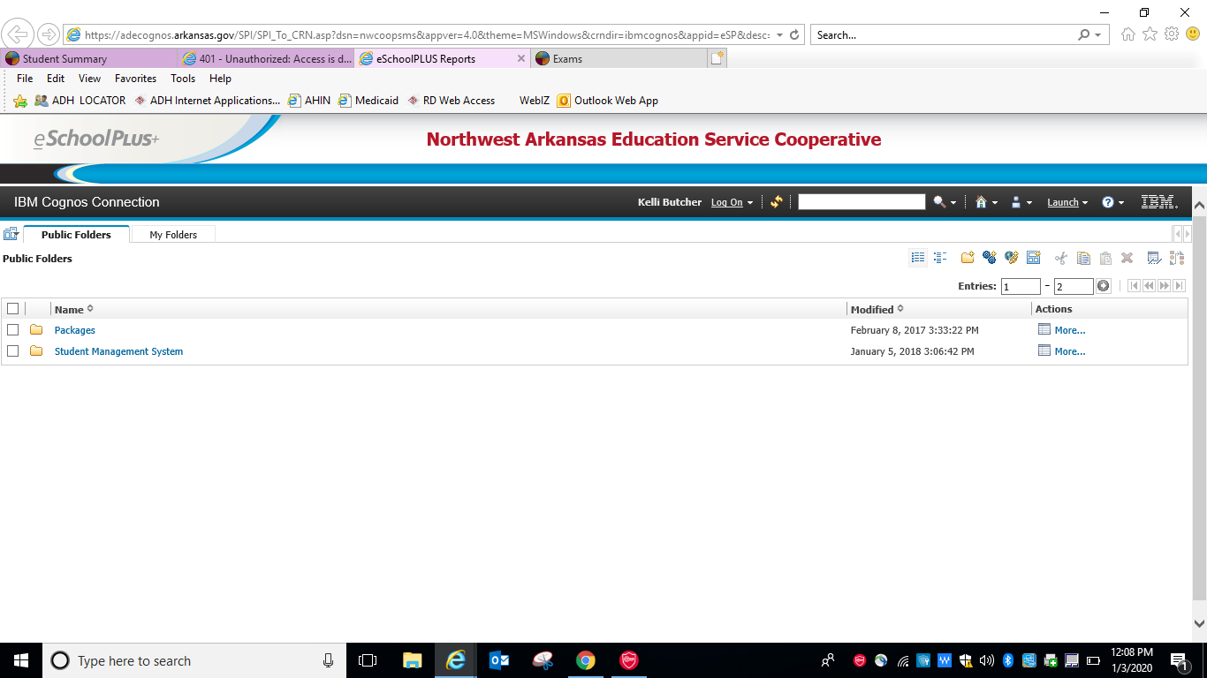
Notes:
To print parent letter

Slide 28
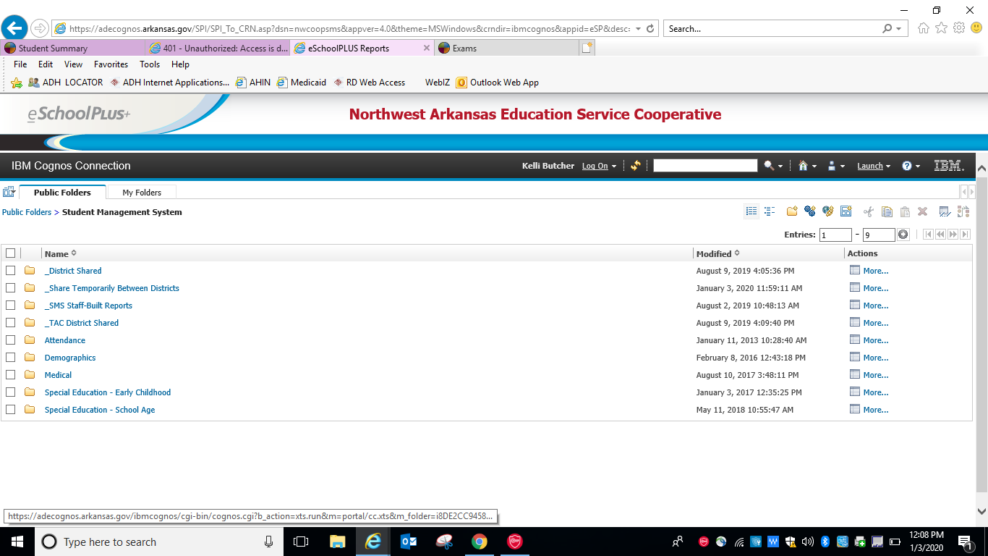

Slide 30
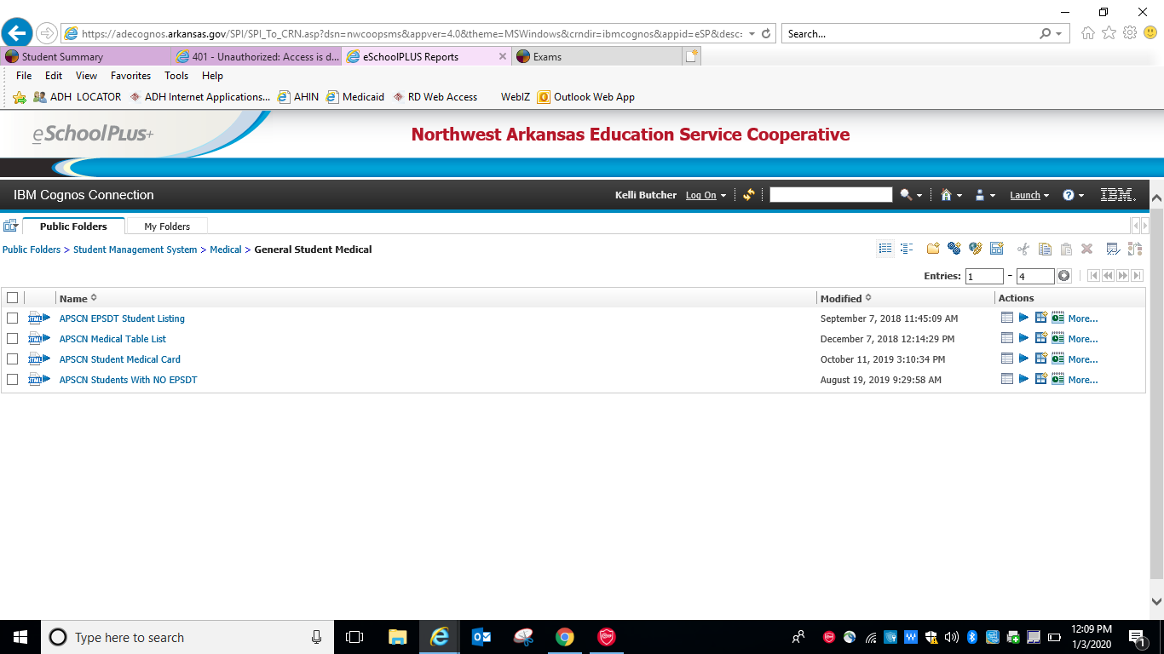
Notes:
Letter is not yet available

Slide 31
Questions??

