Slide 1
Poison Prevention & Medication Safety
Lori Arnette, BSN, RN
Arkansas Department of Health

Slide 2
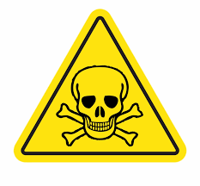
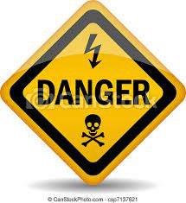
What is Poison?
A poison is anything that can make you sick!
A poison can be something that can make you sick if you…
Touch It!
Taste It!
Smell It!
Notes:
Example:
If I look at a spider, will it hurt me? NO
But if I TOUCH a spider it might sting (hurt) me ….some bugs, insects, snakes, and spiders have poison in their bites!

Slide 3
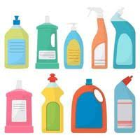
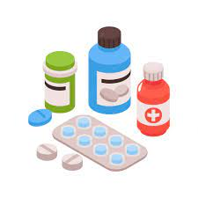
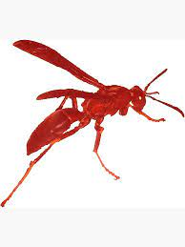
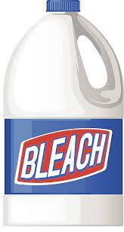
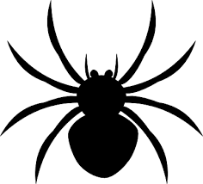
Name a Poison
Cleaning Products
Medicine
Bees or Wasps
Gasoline
Bleach
Spiders or Snakes
Notes:
Do LOOK-A-LIKE Activity!!!
Just have about 3 examples to show how many common liquids that could be dangerous look like common drinks we all like.

Slide 4
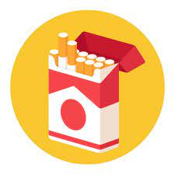
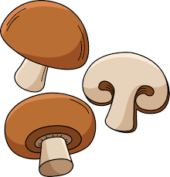
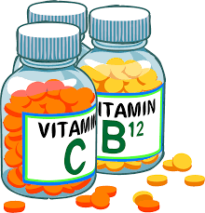
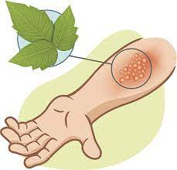
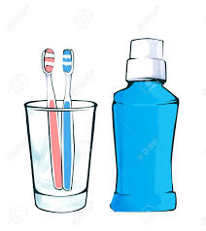
Name a Poison
Vapes
Cigarettes
Wild Mushrooms
Vitamins
Plants
Toothpaste/Mouthwash

Slide 5
Should I Taste It, Touch It or Smell It?
Look-A-Like Activity

Slide 6
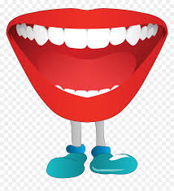
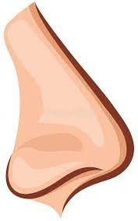
Safety Rules!!
Remember, if you’re not sure what it is…DON’T
TOUCH IT!
TASTE IT!
SMELL IT!
ASK
FIRST !
Notes:
Who should you ask before touching, smelling, or tasting something that you’re not sure of ?
Parent
Teacher
Grandparent
Trusted Adult (grown-up)

Slide 7
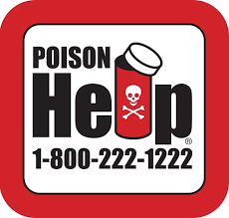
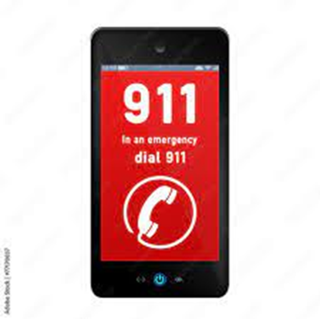
OH NO! What should I do?
If you have an accident with a poison, who should you tell?
Parent
Teacher
Grandparent
Trusted Adult
Who can they CALL?
Arkansas Poison Hotline!
1-800-222-1222
9-1-1
Notes:
Everyone is getting this magnet today, please take it home ask your parent or adult you live with to post it on the refrigerator
Tell them the Poison Safety Rules you learned today and show that you are Poison Safety SMART!!

Slide 8
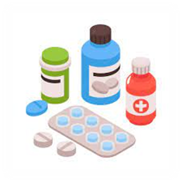
Medicine Safety
Where do we get medicine from?
Doctor
Nurse
Store
Parent
Can medicine be a Poison?
Can medicine look like candy?
https://ymiclassroom.com/wp-content/uploads/2023/09/2_sidelined.mp4
Notes:
Ask the students if the medicine we get from our Doctor is always safe?
Ask the students if the medicine we can buy at the store is always safe?
How can medicine be a poison…allow time for answers
If we take too much
If we take medicine that isn’t ours
If we take medicine for a sickness or a problem we don’t have
All of these can lead to medicine being a poison to us…remember a poison is anything that can hurt the body if we Smell it, Touch it or Taste it without knowing what it is.
Never take medicine by yourself! Make sure you check with an adult before you take any kind of medicine
Medication can look like candy, and this can be very dangerous. We can eat something we think is good and safe, but it could really be a medication or poisonous drug
Show students a few examples of candy that looks like a medication/drug
Then play the Candy vs Medicine game at the end of lesson
Never take anything that looks like candy from someone you don’t know, not adults, not older kids or not even your friends!
Remember, ASK FIRST before you TASTE, TOUCH or SMELL!!

Slide 9
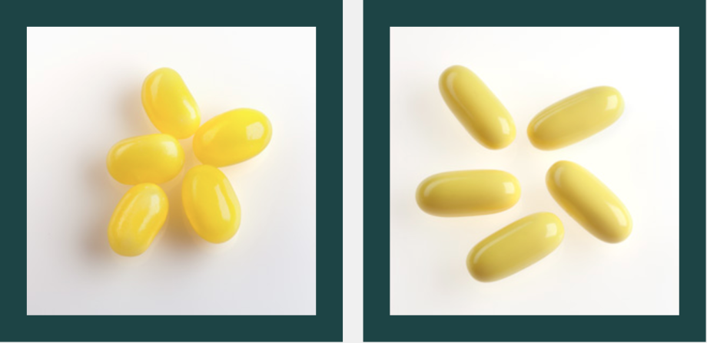
Is It Candy or Is It Medicine?
Activity
https://calpoison.org/you/pills-or-candy

Slide 10
Remember… Safety First!
Help protect yourself and others from poison & medicine!

