Slide 1


Dangers of Energy Drinks Among Youth
Presented by the Arkansas Department of Health

Slide 2

Notes:
Knowledge Check- I would ask the 5 questions. Let the students answer them True/False. Don’t give the correct answer or explanation until the next knowledge check. At the end of the presentation, I would re-ask the questions giving the students the answers with explanations.
1. It is ok to drink as many energy drinks as you want.
False- If you drink energy drinks you should limit the amount.
2. Energy drinks and sports drinks are the same thing
False- They are NOT the same
3. Energy drinks can increase your heart rate.
True- Due to the increased caffeine and other caffeine like ingredients, energy drinks can make your rate go up, cause palpations and even chest pain.
4. Energy drinks may give you quick energy but can cause you to crash later.
True- They may give you a quick energy burst but later your can crash feeling more tired than you did before you drank the energy drink.
5. Energy Drinks contain legal but unregulated supplements .
True- Energy drinks are not FDA approved and their ingredients are unregulated.

Slide 3


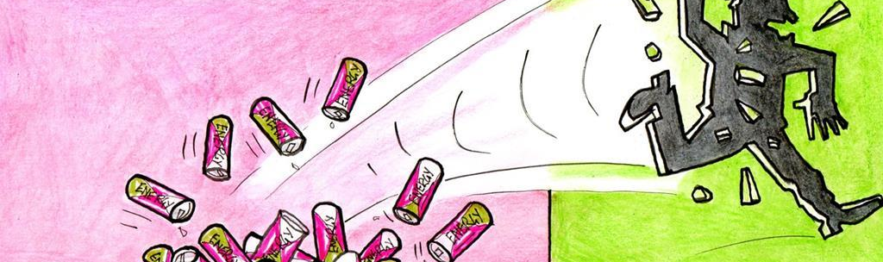
Energy Drinks and You
Do YOU drink energy drinks?
What are the benefits and downsides of energy drinks?

Slide 4

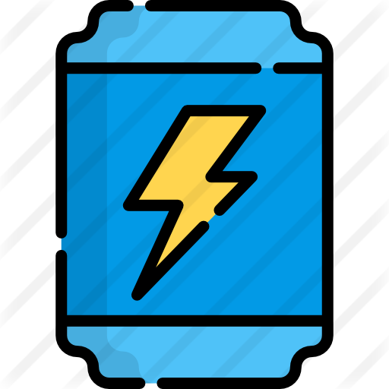
Learning Objectives
To understand what energy drinks and their ingredients are
To understand the health effects of energy drinks
To understand healthy ways of maintaining energy

Slide 5
Are Energy Drinks Really that Bad?
Notes:
Video

Slide 6
What is an Energy Drink?

Slide 7
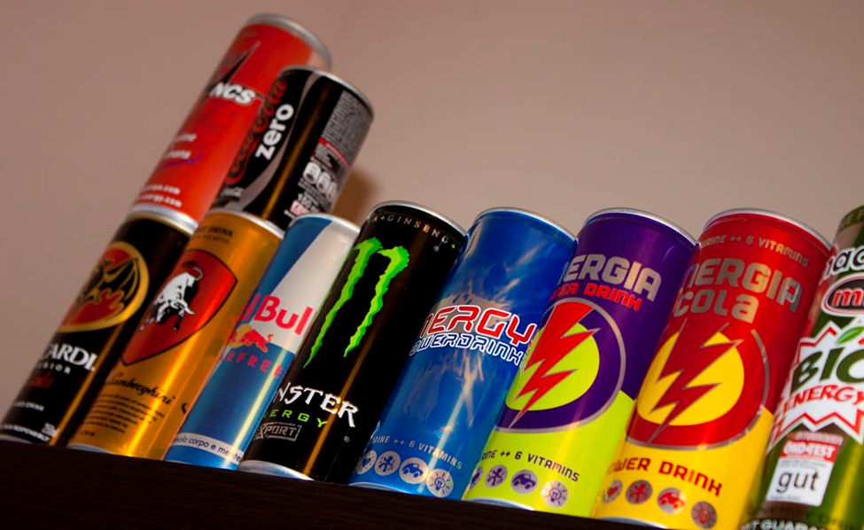
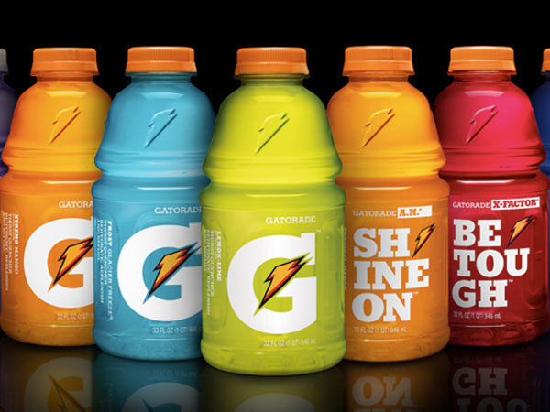
What is an Energy Drink?
They are beverages that are marketed to increase energy, mental alertness, and physical performance.
Contain large amounts of added sugars
Contain large amounts of added caffeine
Contain legal but unregulated supplements such as guarana, taurine, and L-carnitine.
Non-Hydrating
NOT a sports drink
Energy Drinks
Sports Drinks
Notes:
Presenter: An Energy drink is any beverage that contains high levels of a stimulant ingredient, usually caffeine, as well as sugar and often supplements such as vitamins or carnitine. They are promoted as a product capable of enhancing mental alertness and physical performance.

Slide 8
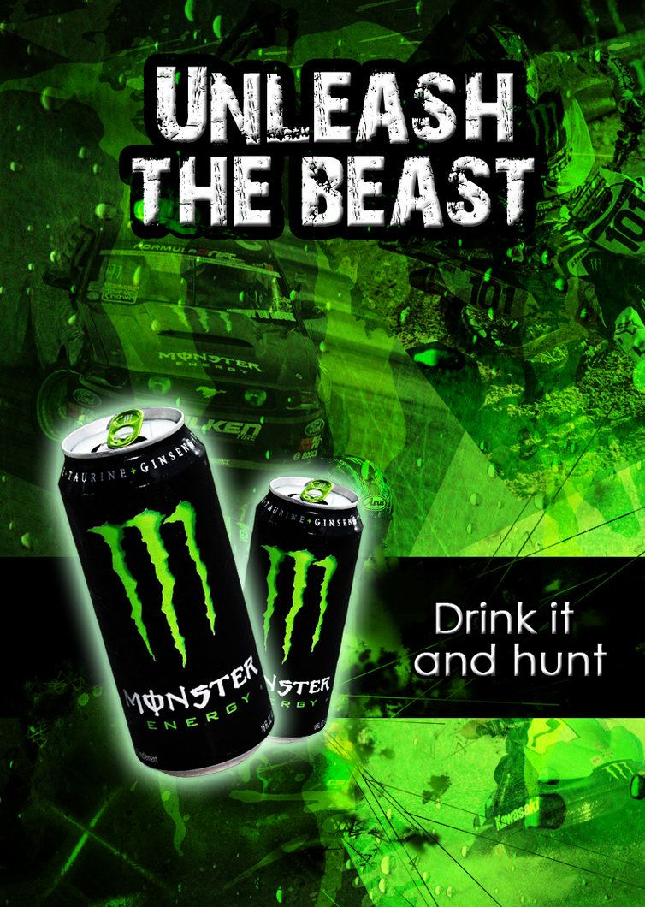
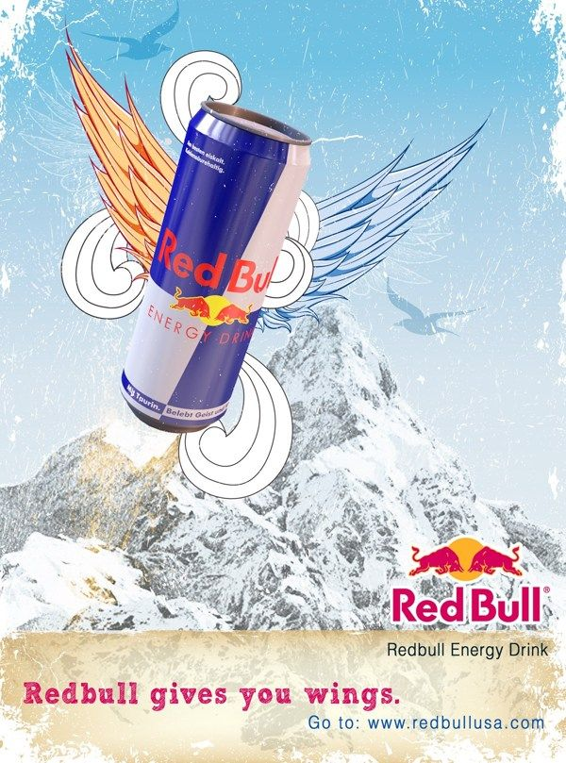
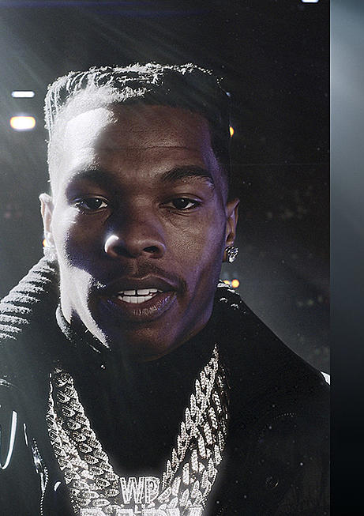
Leading Energy Drinks
Notes:
Presenter: Ultimately, popular brands of energy drinks such as Red Bull, Monster, Rockstar, etc. simply want to sell you something. They use strategies to especially appeal to teenagers such as using certain colors and graphics to catch your attention and make you want to pick it up.
Some strategies used to make energy drinks more appealing to teens include:
Bright colors and graphics
Claims to be good for your health
Social media/tv advertisements
Made easily accessible in grocery stores, gas stations, etc.
The advertisements and commercials are also strategically planned to make you want to buy the products using popular athletes or celebrities to endorse them, and by using graphics and phrases which imply the drink makes you physically better/stronger. Ex. “Red Bull gives you wings” “Unleash the beast” “Live a life without limits”
(The person in the ad on the far right is Lil’ Baby, a rapper. This was his 2022 Super Bowl ad for Rockstar energy drink.)

Slide 9
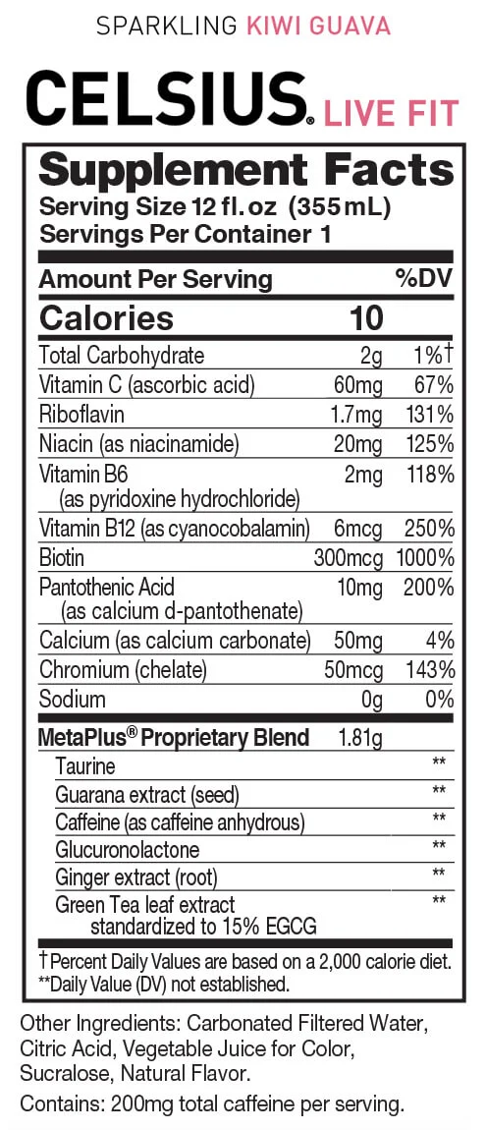
What is in an Energy Drink?
To find out, look at:
Nutrition fact label
Ingredient list
FDA does not require energy drinks to list caffeine content
Notes:
Presenter: Always read the nutrition facts and ingredients list of any products you are consuming! It’s important to know what you are putting into your body.

Slide 10
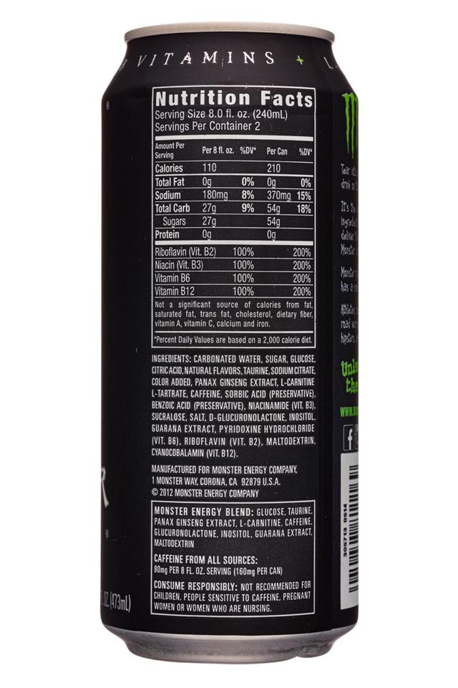
What is in an Energy Drink?
One can provides 14 teaspoons of sugar, nearly two times the daily value for adults.
“Monster Energy Blend” refers to a proprietary blend specific to this manufacturer, so you can’t tell the exact amount of each ingredient in the product.
  Product contains caffeine, as well as guarana seed extract, which is more concentrated caffeine.
Energy drink cans may carry a warning. Be sure to read carefully.
Notes:
Presenter: Caution statements may vary from brand and product - always read labels carefully!
Most energy drinks:
Contain HIGH amounts of sugar - there could be up to 14 teaspoons of sugar in a 16 oz can, which is double the amount recommended for adults!
Contain a lot of caffeine which range from 70 mg to 240 mg in a 16oz drink or 113 to 200 mg in a shot. There are also several ingredients in most energy drinks which are simply just more concentrated caffeine
Contain added ingredients that may not be tested or regulated.
Note: Sports drinks (Gatorade, Powerade, Body Armor, etc.) are ALSO high in sugar and sodium, just not as high as energy drinks. You should also pay attention and be careful about the amount of sports drink you consume.

Slide 11
Can Energy Drinks Make Your Heartbeat Abnormally?
Notes:
Video

Slide 12
Ingredients
Ingredients: Carbonated water, sucrose, glucose, citric acid, naturally sourced flavors, taurine, sodium, citrate, grape skin extract (natural color), panax ginseng root extract, caffeine, sorbic acid, benzoic acid, niacinamide, sodium chloride, d-glucuronolactone, guarana seed extract, inositol, pyridoxine hydrochloride (vit B6), sucralose, riboflavin (vit b2), maltodextrin, cyanocobalamin (vit b12).
Sugars: sucrose, glucose, sucralose
Herbs, Vitamins, Amino Acids: taurine, panax ginseng root extract, niacinamide, d-glucuronolactone, inositol, pyridoxine hydrochloride (vit B6), cyanocobalamin (vit b12)
Notes:
Presenter: Taurine: consuming just one 8-ounce energy drink can boost your daily intake of taurine 6 to 16 times. Combined with the caffeine in energy drinks, taurine may boost blood pressure and heart rate. High amounts of taurine may also impact the development of the adolescent.
Niacin: The water-soluble vitamin B3 known as niacin has been shown to increase good HDL cholesterol and lower LDL (bad) cholesterol and triglycerides, another blood fat. However, some people may be particularly sensitive to this vitamin found in many energy drinks. These beverages usually contain 40 milligrams of niacin, while the recommended intake is 16 milligrams for men and 14 for women. Chances of niacin toxicity are low, but they can happen. Signs of niacin toxicity include flushing, dizziness, low blood pressure, fatigue, headache, upset stomach, nausea, blurred vision, and inflammation of the liver.
Guarana seeds: Guarana is a fruit whose seeds are used as a caffeine additive in many energy drinks. In a study on the stimulating effects of guarana, researchers found that the fruit's seeds have highly concentrated amounts of caffeine, about four times the amount of caffeine found in coffee beans.
Ginseng extract: while ginseng is usually well tolerated, it causes some people to experience hypertension, disrupted sleep, diarrhea, and more when consumed in high amounts. Ginseng in large quantities has also been shown to negatively interact with caffeine, alcohol, and prescription medications, including blood-thinners, diabetic medications, immunosuppressants, and antidepressants.

Slide 13
Nutritional Facts Table: % Daily Value
What to look for:
% Daily Value tells you if product has a little (5%) or a lot (20%) of a nutrient.
Serving size and servings per container
Notes:
Presenter:
According to the nutrition label on the can of Monster to the right, there are 2 servings per can (8 fl oz = 1 serving). The label also shows the amount of ingredients for 8 fl oz (1 serving) and per can (2 servings).
According to the Daily Value percentage, this energy drink has 200% of the recommended daily value of several B vitamins, accounts for 15% daily value of sodium, and 18% of carbohydrates you need in a day if you drink the full can.
Ask students to pull out their energy drinks (assuming they have one at the time) and ask them to read what the label says.

Slide 14
What are the Health Effects of Drinking Energy Drinks?
Notes:
Presenter: Caffeine and sugar combined in energy drinks actually work against our body's natural mechanism for providing energy. Although energy drinks provide you with a quick burst of energy, you will eventually crash later, leaving you feeling more tired than before. Excess caffeine and sugar in energy drinks can lead to obesity, diabetes, dental problems and many other long term effects.

Slide 15
Health Effects
Short Term:
Increases heart rate (sometimes to the point of palpitations), systolic blood pressure, body temperature, and blood sugar
Nausea, vomiting, and other digestive problems
Disturbs sleep patterns or causes restlessness, nervousness, anxiety, or agitation
May harm children’s still-developing cardiovascular and nervous systems
Dehydration
May be associated with increased risk-taking behavior
Seizures
Notes:
Presenter:
Was any of this information new to you?
Has your perception of energy drinks changed?

Slide 16
Health Effects
Long Term:
Chronic dehydration which can lead to kidney stones
Excessive vitamin-b can cause blood problems and non-alcoholic fatty liver disease
Increased risk of cancer, diabetes, gout, cardiovascular disease, Type 2 diabetes
Unintentional weight gain and increased risk of obesity
Increased dental erosion, cavities, and tooth decay
Notes:
Presenter:
Was any of this information new to you?
Has your perception of energy drinks changed?

Slide 17

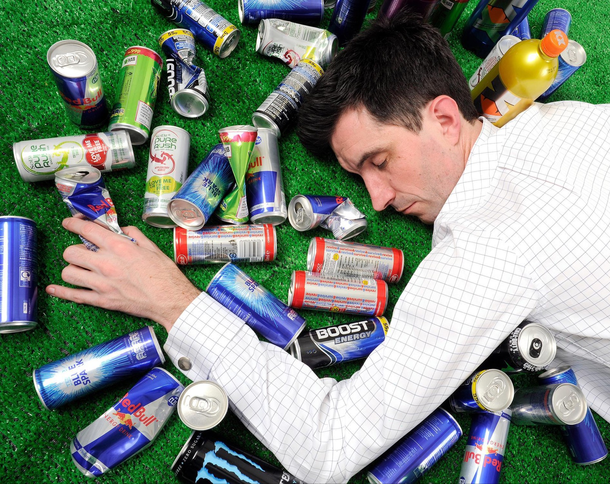
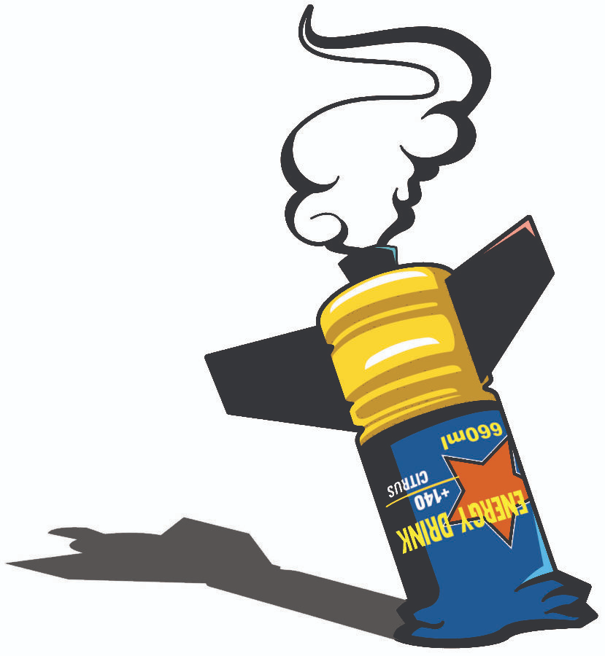
Are you getting “energy” from these drinks?
Notes:
Presenter: The primary ingredients (sugar and caffeine) in almost any energy drink only give you a temporary boost in energy and increased alertness. ¹ Other ingredients aimed to increase energy level include B-vitamins and herbs such as ginseng and guarana, which contains even more concentrated caffeine.¹ They provide quick bursts of energy, but you will crash later, leaving you feeling more tired than before. ⁸ Considering all the negative effects following the consumption of high caffeine and sugar, how long do energy drinks really last? Anything that is damaging your health doesn’t justify the meager 2-5 hours of rush. ¹

Slide 18
Energy Drinks Effects on the Heart
Notes:
Video

Slide 19



How do I maintain energy without Energy Drinks?
Physical Activity
Drink Water
Sleep
Notes:
Presenter: You can boost your body’s energy without energy drinks in healthy and natural ways, including:
A balanced diet consisting of a variety of fruits, vegetables, whole grains, etc. The USA Center for Nutrition Policy and Promotion developed a personalized food plan based on your age, sex, height, weight, and physical activity level called MyPlate. It helps you figure out how many calories you need each day and shows you food group targets—what and how much to eat within your calorie allowance. You can download the app on your smart phone! App link: Start Simple with MyPlate | MyPlate
At least 60 minutes of moderate- intensity physical activity each day (i.e. walking your dog, cleaning your room, taking the stairs). Consistent physical activity encourages your body to store more energy. The physical activity pyramid is helpful to guide you on how physically active you should be. Visit Physical Activity Pyramid | Home & Garden Information Center (clemson.edu) to learn more!
Proper sleep to refresh and replenish yourself. It is recommended people aged 6-12 need 9 -12 hours of sleep, and people aged 13-18 need 8-10 hours.
Energy drinks cannot replace the energy that food, consistent physical activity, and proper sleep gives you!

Slide 20
Notes:
Ask the knowledge questions again. This time, after each questions, tell them the correct answer with explanation.
1. It is ok to drink as many energy drinks as you want.
False- If you drink energy drinks you should limit the amount.
2. Energy drinks and sports drinks are the same thing
False- They are NOT the same
3. Energy drinks can increase your heart rate.
True- Due to the increased caffeine and other caffeine like ingredients, energy drinks can make your rate go up, cause palpations and even chest pain.
4. Energy drinks may give you quick energy but can cause you to crash later.
True- They may give you a quick energy burst but later your can crash feeling more tired than you did before you drank the energy drink.
5. Energy Drinks contain legal but unregulated supplements .
True- Energy drinks are not FDA approved and their ingredients are unregulated.
Name 3 ways to increase your energy level.
Drink more water
Exercise
Get more sleep

Slide 21

Thank you!
Thank you for your participation today.
Each county in Arkansas has a Local Health Department.
For more information or to find out about services near you, please scan the QR Code.

Slide 22
References
Above the Noise. (2017, December 12). Are Energy Drinks Really Bad? [Video]. YouTube. https://www.youtube.com/watch?v=5l0cjsZS-eM
Awoods. (2021, February 4). Lil Baby does his first Super Bowl Ad. XXL Mag. Retrieved May 26, 2022, from https://www.xxlmag.com/lil-baby-super-bowl-ad/
The Active Times. (2015, December 30). Pros and cons of Energy Drinks. The Active Times. Retrieved May 20, 2022, from https://www.theactivetimes.com/fitness/nutrition/pros-and-cons-energy-drinks
Cause & Effect Rack Card: Energy Drinks (n.d.). Primo Prevention. Retrieved May 17, 2022, from https://www.primoprevention.com/product/cause-effect-rack-card-energy-drinks/
cbstvdinsideedition. (2017, May 16). Doctor explains how teen died after drinking 3 caffeinated drinks in 2 hours. YouTube. Retrieved May 23, 2022, from https://www.youtube.com/watch?v=I_bWKpl-VQE
Centers for Disease Control and Prevention. (2021, February 15). Childhood nutrition facts. Centers for Disease Control and Prevention. Retrieved May 17, 2022, from https://www.cdc.gov/healthyschools/nutrition/facts.htm
Centers for Disease Control and Prevention. (2021, March 17). Physical Education and physical activity. Centers for Disease Control and Prevention. Retrieved May 17, 2022, from https://www.cdc.gov/healthyschools/physicalactivity/index.htm
Centers for Disease Control and Prevention. (2019, May 29). Sleep and health. Centers for Disease Control and Prevention. Retrieved May 17, 2022, from https://www.cdc.gov/healthyschools/sleep.htm
DeMarino, J. (2021, March 23). The most dangerous ingredients in energy drinks, according to Dietitians. Eat This, Not That! Retrieved May 20, 2022, from https://www.eatthis.com/news-dangerous-ingredients-energy-drinks/

Slide 23
References
Energy Drinks 2018. National Center for Complementary and Integrative Health. Retrieved May 17, 2022, from Energy Drinks | NCCIH (nih.gov)
The Energy Drink Buzz. Retrieved May 17, 2022, from https://www.albertahealthservices.ca/assets/info/nutrition/if-nfs-energy-drinks-ppt.pdf(insider.com)
Frito-Lay North America, Inc. a Division of PepsiCo. (2022). CHEETOS® Crunchy Cheese Flavored Snacks. CHEETOS® Crunchy Cheese Flavored Snacks. https://www.cheetos.com/products/cheetos-crunchy-cheese-flavored-snacks
Garrity, T. (2020, November 16). What's the healthiest sports drink? we asked a nutritionist. InsideHook. Retrieved May 20, 2022, from https://www.insidehook.com/article/food-and-drink/healthiest-sports-drinks-ranked-by-nutritionist
Gould, C. (2018, April 17). 16-year-old's death linked to energy drink, caffeine products. WBMA. Retrieved May 20, 2022, from https://abc3340.com/news/abc-3340-news-iteam/energy-drink-and-other-caffeine-products-linked-to-16-year-olds-death
Heger, E. (2021, January 13). 4 reasons why energy drinks are bad for you — and healthier ways to boost your energy. Health. Retrieved May 17, 2022, from 4 Reasons Why Energy Drinks Are Bad for Your Health
Hettinger, D. A. (2013, September 26). Binging on energy drinks? don't crash and burn. The Oak Leaf. Retrieved May 20, 2022, from https://www.theoakleafnews.com/opinion/2013/09/26/binging-on-energy-drinks-dont-crash-and-burn/
Hunter, O. A. J. G., Hunter, J. G., Cason, K. L., & Lane, E. (2021, July 16). Physical Activity Pyramid. Home & Garden Information Center | Clemson University, South Carolina. Retrieved June 23, 2022, from https://hgic.clemson.edu/factsheet/physical-activity-pyramid/ ​
Judson College. (n.d.). What is exercise? Judson College Fitness Program. Retrieved May 26, 2022, from http://wilsonbiology.org/webspinner/spinner/fitness/exercise.html
Jennifer L. Harris, Christina R. Munsell, Energy drinks and adolescents: what’s the harm? Nutrition Reviews, Volume 73, Issue 4, April 2015, Pages 247–257, https://doi.org/10.1093/nutrit/nuu061
Manaker L. (2021, February 16). 12 Dangerous Side Effects of Energy Drinks, According to Science. Healthy Eating. Retrieved May 17, 2022, Dangerous Side Effects of Energy Drinks, Science Says — Eat This Not That

Slide 24
References
The Nutrition Source. (n.d.). Harvard T.H. Chan | School of Public Health. Retrieved May 16, 2022, from https://www.hsph.harvard.edu/nutritionsource/energy-drinks/
Rah India Technologies Pvt. Ltd. (n.d.). Red Bull: For the big bull-game - IPR online. IPR Online. Retrieved May 20, 2022, from https://ipronline.com/red-bull-for-the-big-bull-game/
rev5046. (2015, November 8). Nutr 360. Rachel VonArx. Retrieved May 17, 2022, from https://sites.psu.edu/rvonarxnutrition/2015/11/08/where-do-you-fit-on-the-physical-activity-pyramid/
Science Photo Library Limited. (2022). red bull - Search - Science Photo Library. Science Photo Library. https://www.sciencephoto.com/search?q=red+bull
SHARP. (2020, February 5). Are Energy Drinks Bad for teens? Are Energy Drinks Bad for Teens? – San Diego –. Retrieved May 20, 2022, from https://www.sharp.com/health-news/are-energy-drinks-bad-for-teens.cfm
Short Term Effects (n.d.). Brown Well Health Promotion. Retrieved May 17, 2022, from Short term effects | Health Promotion | Brown University
Shuttershock Inc. (2022). Young African American Student Woman Wearing Stock Photo 1816477199. Shutterstock. https://www.shutterstock.com/image-photo/young-african-american-student-woman-wearing-1816477199
Shuttershock Inc. (2022b). Young African American Woman Wearing Casual Stock Photo 2158785657. Shutterstock. https://www.shutterstock.com/image-photo/young-african-american-woman-wearing-casual-2158785657
Sleep Foundation. (2022, March 25). What to do when you can't sleep. Sleep Foundation. Retrieved May 17, 2022, from https://www.sleepfoundation.org/insomnia/treatment/what-do-when-you-cant-sleep
USDA Department of Agriculture. (2022). Are you making every bite count? MyPlate. Retrieved May 17, 2022, from https://www.myplate.gov/
U.S. Department of Health and Human Services. (n.d.). Energy drinks. National Center for Complementary and Integrative Health. Retrieved May 17, 2022, https://www.nccih.nih.gov/health/energy-drinks
Wickman, G. (2019, October 15). Long-Term Effects of Energy Drinks. Health Guidance. Retrieved May 17, 2022, Long-Term Effects of Energy Drinks |HealthGuidance.org

Slide 25
Knowledge Check
Notes:
Optional
Google Form
This knowledge check can be for older students who may need a grade for the presentation.

Slide 26

Let’s Take a Quiz!
Survey Monkey Trivia link: https://www.surveymonkey.com/r/J7C36TZ
Notes:
This slide was in the original ppt. You can use this if you want to. It is opitional.
Speaker Notes: So we have learned about the dangers of energy drinks. Let’s take a 10-question quiz and test our knowledge of what we learned.
Username: johndoe.adh@gmail.com
Password: A123456!
[Click on link and if needed, utilize username and password to login to see results and correct answers]

