Slide 1
Distress Tolerance for Students
Notes:
Instructors: Introduce yourself and thank the school/teacher for allowing you to be there and share this information with the students.
Share the background of this particular project, namely that this training is the result of a partnership between Project AWARE and the Dept of Health.
Make sure you complete this google form so we know about the training and can correctly process the data. https://forms.gle/y7r1GscwrKHQssBF7
Today we’re going to talk about distress tolerance.
We will define the terms, talk about exactly what we mean by distress tolerance, and explore how to increase your capacity for it.
Why are we talking about this? Well, we know that mental health challenges are common in adolescence and we know that things intensified with the pandemic. (Fegert et al., 2020)
We have more students reporting difficulty with depression and anxiety.
Now – let’s be clear.
We’re talking about these skills because they can benefit everyone, whether you are having, or have had, a mental health challenge, or not. These skills are good for everyone.
Sometimes we face challenges that don’t require mental health treatment. Sometimes we can’t get access to mental health treatment, for any number of reasons.
We’re talking about distress tolerance because … say it with it me … it’s good for everybody.
Data References:
Data from the 2019 Youth Risk Behavior Survey (YRBS) showed an increase in all mental health indicators it measures (i.e., suicidal ideation and attempt, and symptoms of depression) from the previous administration of the survey in 2017. Specifically, in 2019, 36.7% of U.S. high school students felt so sad in the prior two weeks that they stopped doing some of their normal activities, and 18.8% of students had seriously contemplated suicide in the previous year—an increase from 31.5% and 17.2%, respectively in 2017 (CDC, 2018; CDC, 2020).
Centers for Disease Control and Prevention (2018). Youth Risk Behavior Survey: Data Summary and Trends Report. 2007– 2017. Retrieved from https://www.cdc.gov/healthyyouth/data/yrbs/pdf/trendsreport.pdf.
Centers for Disease Control and Prevention (2020). Youth risk behavior survey data summary & trends report 2009-2019. Retrieved from https://www.cdc.gov/healthyyouth/data/yrbs/pdf/YRBSDataSummaryTrendsReport
2019-508.pdf.
Fegert, J. M., Vitiello, B., Plenner, P. L., & Clemens, V. (2020). Challenges and burden of the coronavirus 2019 (COVID-19) pandemic for child and adolescent mental health: A narrative review to highlight clinical and research needs in the
acute phase and the long return to normality. Child and Adolescent Psychiatry and Mental Health, 14(20), 1–11. https://doi.org/10.1186/s13034-020-00329-3
Linehan, M., M., (2014). DBT Training Manual. New York, NY: The Guilford Press.
Saulsman, L., & Nathan, P. (2012). Facing Your Feelings: Learning to Tolerate Distress. Perth, Western Australia: Centre for Clinical Interventions. https://www.cci.health.wa.gov.au/Resources/For-Clinicians/Distress-Tolerance
https://dbt.tools/resources.php

Slide 2
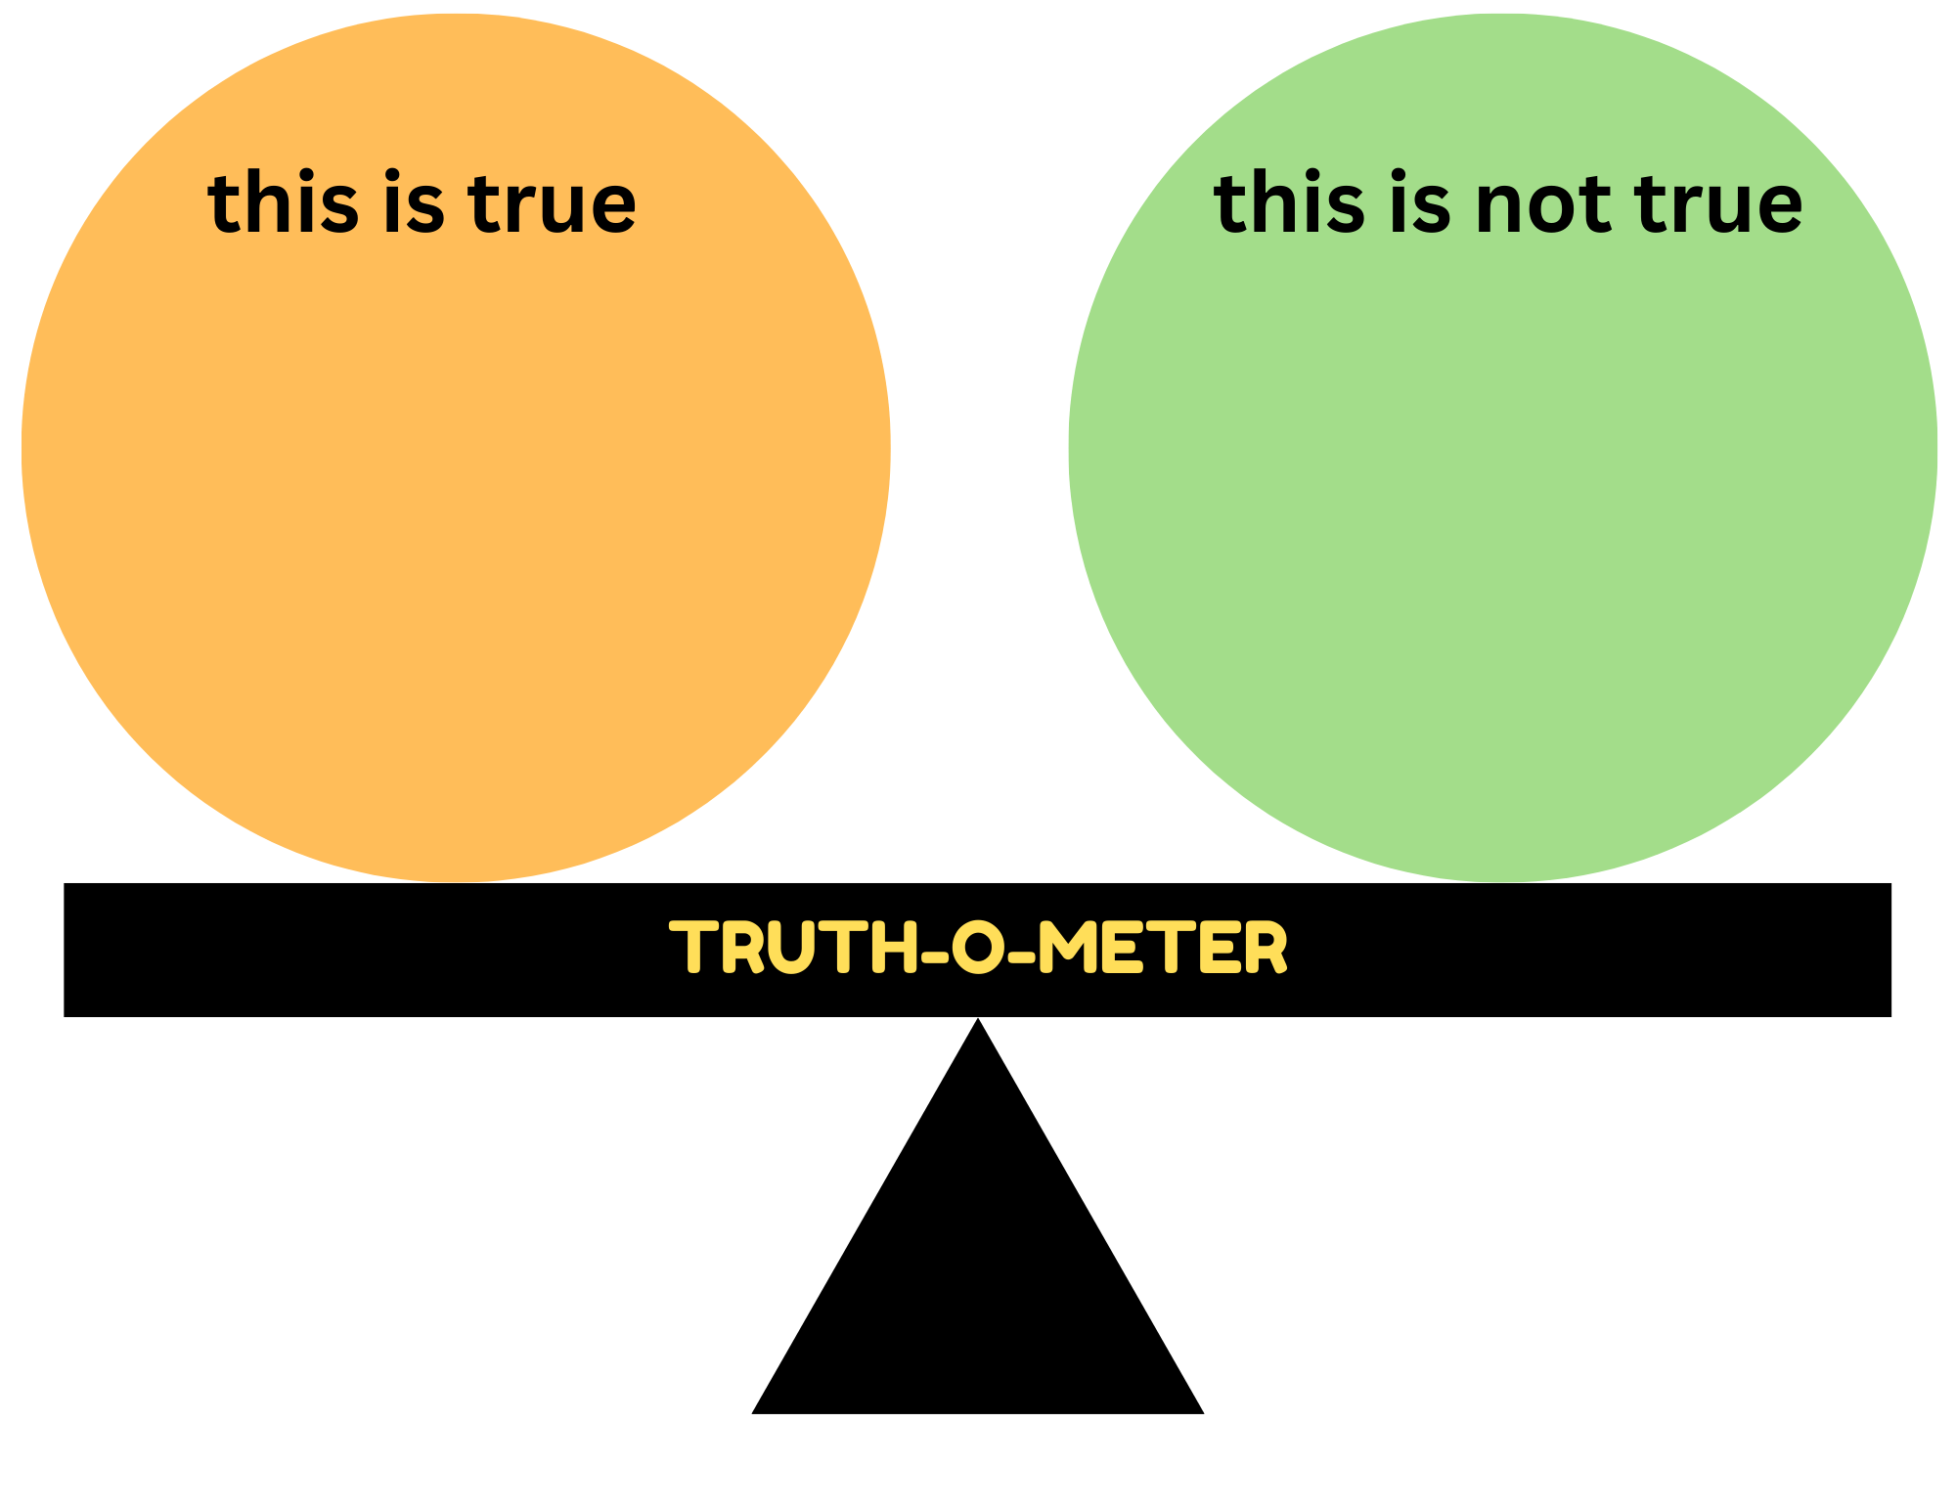
Notes:
We’re going to start by introducing a truth-o-meter. During our time together I would like to ask you to track whether or not what you’re hearing is true in your experience.
Just use tally marks. Anytime you hear something that has been true in your life, put a mark in the yellowish orange circle. Anytime you hear something that tends to disagree with your experiences, put a mark in the greenish circle.
If you like what I say, you are always welcome to give it snaps. I like that and it tells me we’re on the right track.

Slide 3
Let’s define the terms.
Distress → unpleasant, uncomfortable, or upsetting
Tolerate → accept, endure, experience, withstand
Notes:
Let’s begin by defining the terms we’ll be using today. What do we mean by the word distress? What do we mean when we say tolerate?
When we say distress we mean having emotions that are experienced as unpleasant, uncomfortable and upsetting.
Question: What kinds of distress do you all experience? What kids of things do you find unpleasant, uncomfortable, or upsetting?
The gap between not knowing how to do something, and knowing how do it, will likely include some distress.
Can you remember learning how to do something for the first time? It was difficult and uncomfortable, and then once you got the hang of it, it was great. But that time in the middle, it included some distress right?
Procrastinating.
Figuring out relationships, fitting in, or not fitting in.
Breaking up.
The school dance.
Annoying behaviors by others that you can’t do anything about.
Notice that when we say tolerate distress we DON’T mean: enjoy the distress, celebrate it, call it good, LIKE IT. We mean experience it, acknowledge it, allow it to be present even if it’s not fun.
The trouble is this: when we have distressing emotions and we start to fear them, or fight them, they usually gets worse. This is a good time to check that statement out with the truth-o-meter. I’ll repeat it.
The trouble is this: when we have distressing emotions and we start to fear them, or fight them, they usually get worse.
We’re also NOT saying that you should just be okay with abuse or being in dangerous situations. If those kinds of things are occurring, then we want to make sure you talk with a trusted adult about what is going on.
Sometimes people can become overly tolerant. Maybe you never take action to change unhappy circumstances that need to be changed. Maybe you don’t set the boundary that really needs to be set. That’s the other extreme and we’re not calling that distress tolerance. That’s actually another way to avoid distress. The discomfort of the confrontation would be greater than the discomfort of the current situation, so you just become overly tolerant of the situation. Overly tolerating abuse or neglect or danger is not good and it’s not what we want you to do.
What we mean is this: when emotional discomfort does arise you can respond by acknowledging, accepting and taking appropriate action to improve your emotional experience.

Slide 4
Why would we want to be able to tolerate distress?
Notes:
So, now that we’ve defined the terms, let me ask:
Why would we want to be able to tolerate distress? And even, to get better at it…?
Ask for reasons from the students but this list might be helpful to get them started.
Here are some examples I’ve heard from students….
To not look awkward
To be able to move on and enjoy life
So people don’t ask questions and make it worse.
So I control my emotions and they don’t control me.
So I can get through it without making it worse.
Instructors: Use white chart paper or the white board to list the major concepts participants share.
Summarize what has been noted by the students.
For instance, one of the statements from a student was “so people don’t ask questions and make it worse” Tolerating discomfort is helpful in the moment, but let’s think about an ultimate goal. If I am able to process and manage my emotions in a healthy way, then when someone does ask me about it I can handle the wave of emotion that might bring. So even if they do ask me about it, the discomfort isn’t in charge. I can handle it.
I also think about goals. Goals you all have for yourself and your future. I would imagine that any goal you are working towards requires some discomfort or distress in order to make progress.

Slide 5
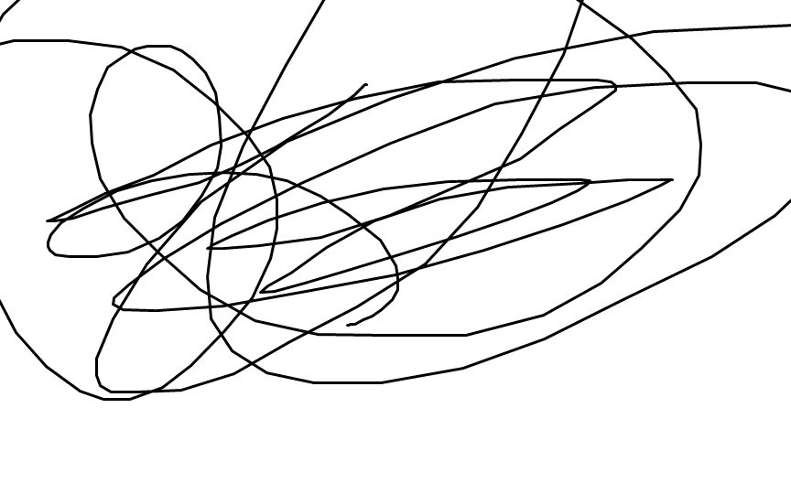
I can’t stand this
This is hopeless
This isn’t going to get better
I’m losing control
I’m a mess
I hate this feeling
I have to stop this
I need to get out of here
Notes:
Here are some examples of the kinds of thoughts a person might have about distressing emotions.
We might call these distress intolerant beliefs. When these beliefs are lurking under the surface, and you combine it with a big negative emotion, then you will likely have intolerance of the distress. A lack of ability to handle it, to make healthy decisions in that moment.
Question: When these thoughts go unchallenged, or unnoticed, what happens?
Possible answers might include
I try to escape it
People get frustrated with me
I do something I’ll regret later

Slide 6
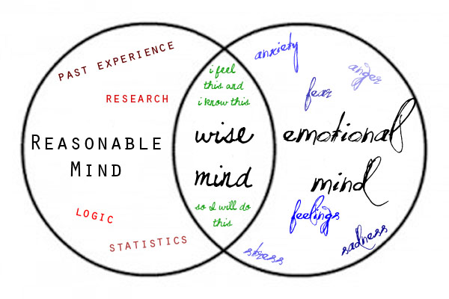
Notes:
The distress intolerance beliefs we just looked at might be based in our past experience, or they might be based in our emotions.
Take a look at this graphic with me. This is called a venn diagram. The Reasonable Mind circle represents making decisions, or taking action, based on logic, facts, research, past experience.
(For example: thinking with my reasonable mind I consider that when I put off writing an message for English class that I ended up being stressed out and not doing well. Also, logic tells me that the sooner I get started the happier I will be later on as the deadline approaches.)
The Emotional Mind circle represents making decisions, or taking action, based on your feelings. Acting out of fear, or stress, or anger, or anxiety.
(For example: thinking with my emotional mind I consider that writing a whole essay stresses me out and makes me anxious. I feel like I am doing something wrong so I would rather just not think about it right now and put if off until later to avoid those negative feelings.)
The Wise Mind is where these circles overlap. This is where the balance is. When you make decisions, or take action, based on the wise mind then you are factoring in both reason and emotion. You’re in control and not being led by emotions, or hiding behind logic.
(For example: Although I know writing an essay stresses me out and I often ruminate about all the mistakes I am going to make and fret about how I am not going to perform well and get a bad grade . . . . I also consider that in the past when I have put this off, I have regretted it and I was probably even more stressed being on a short timeline - plus waiting so long probably meant that I did not end up turning in my best work. So . . . . maybe if I start now I can ask for help and feel more confident about my finished work AND avoid feeling super stressed out later on.)
Where do you normally land? Draw these circles on the back of your truth-o-meter and mark where you tend to roam.
Here’s an example of how the wise mind might be helpful.
Imagine that you are in trouble with your parents.
Reasonable Mind: My past experience here tells me that my parents yell at me more than my siblings. They expect more from me and want me to always “take the higher ground.” My research says that if I argue back, then I’ll get it more trouble so I’m going to shut down.
Emotional Mind: I hate when they do this. It makes me so angry. I don’t want to talk about it, but it also makes me incredibly sad and I feel alone with that sadness.
Wise Mind: I am sad and angry, and my past research says that I’ll get in trouble if I argue back…. But that isn’t my only option. I might need to wait until my parents emotions aren’t as big, and mine have also calmed down, but I might need to tell them how I feel and how it makes me want to shut down. Or, I have other options. Maybe if I talk this out with a friend I can come up with a way to deal with my emotions about this. Or if it’s too much for my friends, maybe I can talk to a teacher, or the school counselor. I might need some people to help me think through this.
Here’s another, maybe more distant, example of how the wise mind might be helpful.
Imagine you are the president of a large company and you have a plant in a small town. You are the primary employer for the small town, but the plant has not been functioning well or making your company money.
What kind of decisions would you make if you were only in the reasonable mind? ….. Only in the emotional mind?...... What can happen in the wise mind?.... (brainstorming, out of the box thinking, collaborating, etc)
Reasonable Mind: Welp, this plant isn’t making money, that’s what we do, we have to look out for our shareholders. We obviously need to close the plant down.
Emotional Mind: Oh my goodness! This is terrible. All those people, all those jobs, kids will go hungry, how else will people make a living?
Wise Mind: We do need to make money and we have an obligation to shareholders, but we also have an obligation to this town and those who work for/rely on us. Maybe we can consider ways to restructure our work here. Can we build or make something different? Can we sell to like-minded business? Etc.

Slide 7
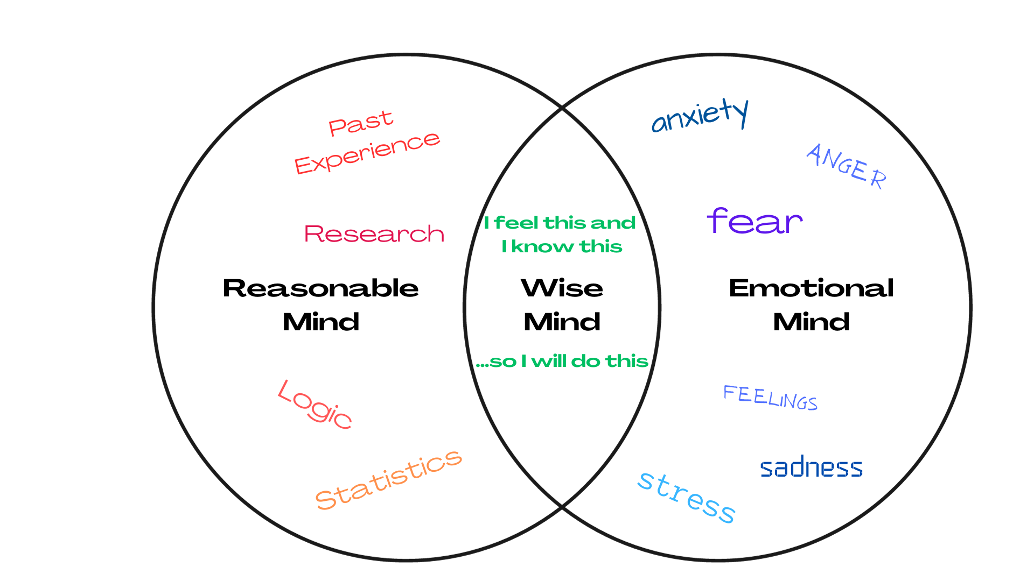
Notes:
The distress intolerance beliefs we just looked at might be based in our past experience, or they might be based in our emotions.
Take a look at this graphic with me. This is called a venn diagram. The Reasonable Mind circle represents making decisions, or taking action, based on logic, facts, research, past experience.
(For example: thinking with my reasonable mind I consider that when I put off writing an message for English class that I ended up being stressed out and not doing well. Also, logic tells me that the sooner I get started the happier I will be later on as the deadline approaches.)
The Emotional Mind circle represents making decisions, or taking action, based on your feelings. Acting out of fear, or stress, or anger, or anxiety.
(For example: thinking with my emotional mind I consider that writing a whole essay stresses me out and makes me anxious. I feel like I am doing something wrong so I would rather just not think about it right now and put if off until later to avoid those negative feelings.)
The Wise Mind is where these circles overlap. This is where the balance is. When you make decisions, or take action, based on the wise mind then you are factoring in both reason and emotion. You’re in control and not being led by emotions, or hiding behind logic.
(For example: Although I know writing an essay stresses me out and I often ruminate about all the mistakes I am going to make and fret about how I am not going to perform well and get a bad grade . . . . I also consider that in the past when I have put this off, I have regretted it and I was probably even more stressed being on a short timeline - plus waiting so long probably meant that I did not end up turning in my best work. So . . . . maybe if I start now I can ask for help and feel more confident about my finished work AND avoid feeling super stressed out later on.)
Where do you normally land? Draw these circles on the back of your truth-o-meter and mark where you tend to roam.
Here’s an example of how the wise mind might be helpful.
Imagine that you are in trouble with your parents.
Reasonable Mind: My past experience here tells me that my parents yell at me more than my siblings. They expect more from me and want me to always “take the higher ground.” My research says that if I argue back, then I’ll get it more trouble so I’m going to shut down.
Emotional Mind: I hate when they do this. It makes me so angry. I don’t want to talk about it, but it also makes me incredibly sad and I feel alone with that sadness.
Wise Mind: I am sad and angry, and my past research says that I’ll get in trouble if I argue back…. But that isn’t my only option. I might need to wait until my parents emotions aren’t as big, and mine have also calmed down, but I might need to tell them how I feel and how it makes me want to shut down. Or, I have other options. Maybe if I talk this out with a friend I can come up with a way to deal with my emotions about this. Or if it’s too much for my friends, maybe I can talk to a teacher, or the school counselor. I might need some people to help me think through this.
Here’s another, maybe more distant, example of how the wise mind might be helpful.
Imagine you are the president of a large company and you have a plant in a small town. You are the primary employer for the small town, but the plant has not been functioning well or making your company money.
What kind of decisions would you make if you were only in the reasonable mind? ….. Only in the emotional mind?...... What can happen in the wise mind?.... (brainstorming, out of the box thinking, collaborating, etc)
Reasonable Mind: Welp, this plant isn’t making money, that’s what we do, we have to look out for our shareholders. We obviously need to close the plant down.
Emotional Mind: Oh my goodness! This is terrible. All those people, all those jobs, kids will go hungry, how else will people make a living?
Wise Mind: We do need to make money and we have an obligation to shareholders, but we also have an obligation to this town and those who work for/rely on us. Maybe we can consider ways to restructure our work here. Can we build or make something different? Can we sell to like-minded business? Etc.

Slide 8
Ways we tend to try to
escape from distress:
AVOID
WITHDRAW
NUMB
Notes:
What we mean by distress intolerance is a perceived inability to fully experience unpleasant, aversive or uncomfortable emotions, and is accompanied by a desperate need to escape the uncomfortable emotions.
Give examples of each
Avoidance
avoiding people, places, conversations, challenging environments.
You just don’t go to the school dance. You just don’t go to the cafeteria or the gym. You don’t talk to that person. You don’t talk about that topic.
reassurance seeking or checking – here you’re trying to avoid the emotion by using someone else’s approval, or with checking you’re trying to calm the fear by the constant checking for safety.
Are you sure?
distraction or suppression – telling yourself to stop it, distracting yourself – the problem here is you can’t keep it up for long.
Numbing – mindless games or social media scrolling, shopping, food, substances, self-harm like cutting, picking, head banging, hair pulling.
Withdrawal – excessive sleep, pulling away from everyone
Again, our definition of distress tolerance is the perceived capacity to withstand negative emotional and/or other aversive states (e.g. physical discomfort), and the behavioral act of withstanding distressing internal states elicited by some type of stressor.

Slide 9
Pain + Non-Acceptance = Suffering Pain + Acceptance = Ordinary Pain
Notes:
Let these equations sink in for a moment.
Research does tell us that when we fear or fight a negative emotion it hangs on and causes us more suffering.
Have you ever thought about pain being ordinary?
It’s not something we like to dwell on, but pain is a normal human experience. It happens to all of us.
What would it be like to just have ordinary pain?
Have you ever heard an adult say something like, “lots of people have it worse than me”? Have you ever heard someone paralyzed from the neck down say that? I have! It’s sign of their victory and hope – they have accepted the current situation and they will not let it keep them down or define them. Ordinary pain.
Accept it. Not that you enjoy it. Not saying it doesn’t matter. You’re detaching from the sting of the emotion.
You are observing the emotion and allowing yourself to feel it, knowing that it won’t last forever. This is a part of life.
Just a reminder – we’re not talking about accepting situations that are dangerous, life-threatening or abusive.

Slide 10
1
2
3
4
5
6
Not every stressful situation has to be distressing. It is when we judge it to be.
The greatest weapon against stress is our ability to choose one thought over another. – William James
One must survive the short term, without making it worse, in order to improve in the long term.
Feel the feeling but don’t become the emotion. Witness it, allow it, release it.
Emotions are not permanent. There are like waves … at times increasing and becoming intense, but at some point they reach a plateau and subside.
You can’t control the waves but you can learn to surf.
Notes:
This is a good time to check the truth-o-meter.
I’m going to put a few statements on the screen and I want you to check it with the truth-o-meter.
Now that you’ve seen them all, I’m wondering if there is one you like the best?
I’m going take a poll here.
I need everyone to stand up.
We’re going to vote with our feet.
I’ll say each statement. If you love it go to this side of the room. If you don’t like it or don’t agree go to this side of the room. And you could be anywhere in-between.
Instructors: If the group is willing and you have time, you could ask a student why they stood where they stood on a particular statement.

Slide 11
Radical Acceptance
It is what it is.
Rejecting reality does not change it.
Radical means all the way – completely.
Feelings are just feelings.
Notes:
One of the tools you can use to tolerate distress is Radical Acceptance. The developer of these distress tolerance skills says this one is the favorite of students your age.
Radical means all the way. You just accept things as they are.
“This does not mean we roll over and become helpless; rather, we acknowledge that denying the facts of reality will not change the facts, but keeps us stuck in thoughts such as “this is unfair”, “why me?”, and “why now?” – Linehan
Go ahead and check your truth-o-meter against these statements before we move on.
Sometimes, it just is what it is.

Slide 12
Notes:
https://www.youtube.com/watch?v=y9r_pZL4boE
The kids will know this meme. It’s 8 seconds long. Play it once, then play it again and they’ll naturally say it with them.

Slide 13
IMPROVE
Imagery
Meaning
Prayer
Relaxation
One thing in the moment
Vacation
Encouragement
Notes:
We want to take away the sting of the big emotion. Sometimes we can radically accept the circumstances. Sometimes we want to IMPROVE them.
IMPROVE is an acronym that gives us 7 skills to use in the moment to to replace an immediate event that has caused distress with a more positive act. When we do that we start to make the moment more pleasant and easier to tolerate.
Let’s break these down.
Imagery
Close your eyes and imagine yourself at the beach, or a mountain lake, or a river, or stream, or hilltop. Somewhere outside that is beautiful and calming. Imagine and immerse yourself in how it looks, smells, sounds, feels.
You might also use imagery as a trial run - imagine successfully entering the school dance. Imagine taking the ACT confidently.
Meaning
This is when you connect to a deeper sense of purpose. For instance, if I have a purpose I tolerate the discomfort much better – tolerate discomfort of studying because you’ve got a goal.
Some examples might include tolerating the discomfort of studying because you need an A. Tolerating the discomfort of conditioning in sports because you want to be a starter.
Reminding yourself of you WHY when you are in distress can really help you to keep on going.
Prayer
Prayer could mean literally praying. It could also mean reciting a favorite quote, or a helpful thing your grandma says to you.
Relaxation
There are a couple of things that can be helpful in relaxation. One is correct deep breathing. The trick with deep breathing is to take a slow breath out. So we’ll see how you all do with this. We’ll all take a deep breath and then we’ll see who can let their breath out the slowest. Everyone stand up, take a deep breath, and sit down when you take your next breath.
Another type of relaxation is when you intentionally relax your muscles. We can do that by something as simple as pulling our shoulders down from around our ears.
Here is another fun thing you can do. I need a volunteer who is willing to show us how to make your arms float. Have the volunteer stand in a door frame and press their arms against the doorframe as hard as they can for at least 40 seconds. Then step forward and let your arms do what they want. If done correctly, they will float.
Our muscles can hold a lot of tension but when we intentionally tighten them and then release we can help them to become more relaxed.
One thing at a time
This is when we break it down. There’s one part of you that feels this way, is there another part of you that feels differently? The first step, the next thing, etc.
Let’s say you have no motivation to get your English homework down. Just write one sentence. You don’t want to clean the kitchen. Just wash one dish. Ok, now one more.
When we break it down we can begin to cope better.
Vacation
Take a vacation! …. From your negative thoughts. Take a vacation! … from the stress.
Can you give yourself permission to step away from thoughts and emotions that are overwhelming?
Encouragement
This is when you offer yourself come encouragement. I’m doing my best. I am getting better.
Or it could mean that you reach out to a loved one and let them know you need some encouragement.
Let’s add in a bonus tip:
Humor – what about humor? Have you ever used humor to tolerate distress? You could tell a dad joke… a good, clean one…
Activity: Instructors we are going to set the students up for a brief pair and share.
SAY: Let’s consider a scenario and I want you to think about which one of these IMPROVE skills you might use. You will pair up and discuss with a peer nearby.
Imagine that you have just been rejected. Could be by a friend or by someone you wanted to date, could by rejected in athletics, or in an academic program. You’re facing rejection. What IMPROVE skills would you use?
https://dbt.tools/distress_tolerance/improve.php

Slide 15
Notes:
Music
Ask the students if they have a sad playlist that they listen to when they’re sad, to be sad and stay sad.
Or a rage playlist, or a hype playlist?
Some students will say that they just have them all together and skip around.
Listening to music that is consistent with our mood is helpful and validating.
The key point is that music can have a profound effect on our mood! Let music do some of the hard work for you. If you’re sad and you need to switch, listen to happy music. Even if you don’t feel happy, so that you’ll be more likely to feel happy.
How does music help you to tolerate distress?

Slide 16
Negative emotions are normal and nothing to be feared.
Feeling distressed doesn’t have to lead to disaster.
Negative emotions pass if you don’t fight or avoid them.
I can sit with upsetting emotions.
Distress is uncomfortable, but I can deal with it.
Notes:
Earlier we showed some distress intolerance beliefs. Things like, “I can’t stand … to do homework when I’m not in the mood.” or “I hate this feeling and I have to stop this.” (slide 5)
On the screen we have examples of beliefs that are more tolerant of distress.
These ones aren’t necessarily inspirational quotes, but they can be things you choose to say to yourself when things get difficult.
Size them up with your truth-o-meter.
Let’s say the last one together. Distress is uncomfortable, but I can deal with it.
How did that go for you? Let’s say it one more time. Distress is uncomfortable, but I can deal with it.
Let’s change it up. Life is uncomfortable, but I can deal with it.
How about School work is uncomfortable, but I can deal with it.

Slide 17
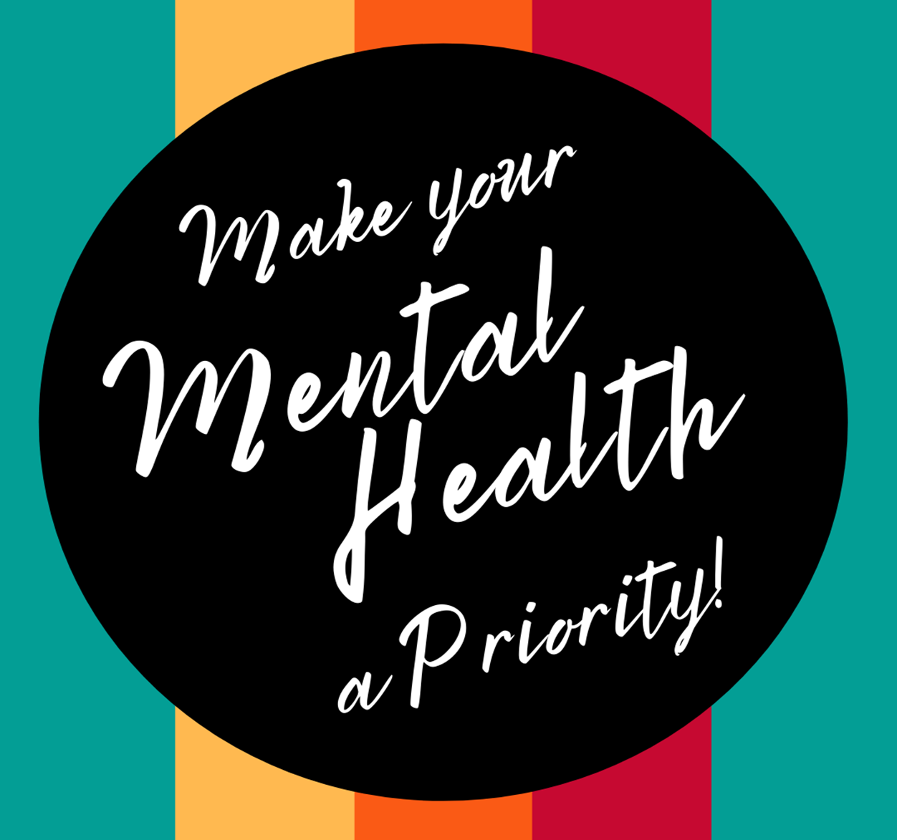
Notes:
Above all, we want you to make your own mental health a priority.
We took class time to prioritize it today and I hope that you find it valuable, if not today, then maybe you’ll remember some of this when you need it.
If you do need to reach out about your mental health, please remember that you have a school counselor, a school nurse, teachers and administrators who care about you. Reach out and ask for help if you need it. Really.

Slide 18
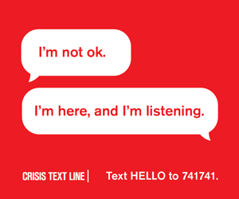
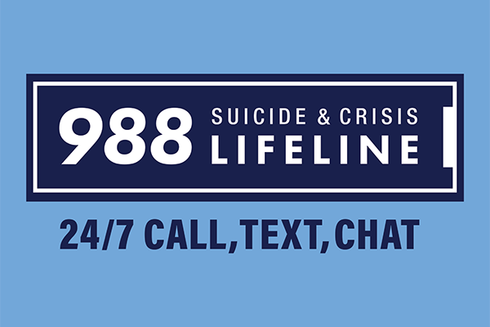

Slide 19
Notes:
Now it’s time for rewards.
Count up your total tally marks. Find out who has the most tally marks and reward them.
If there is a classroom reward system, utilize it.
If not then simply recognize the effort and thank the students for their attention and interaction.

Slide 20
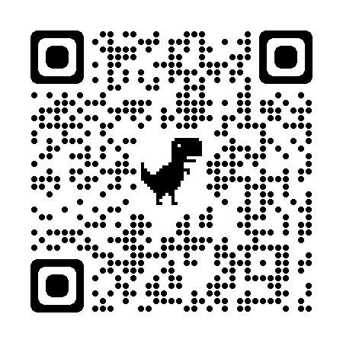
Notes:
https://astate.qualtrics.com/jfe/form/SV_8r00W3wwji3CZjE
Now it’s time for you all to give us some feedback!
If the students are allowed to have phones - have them use the QR code to do the quick evaluation.
If the students are NOT allowed to have phones - email the link to the teacher so they can share the link with the students. Teachers can put this in Google Classroom, Canvas, or their LMS, as an assignment for the students to complete.
Ideally this will happen during the class time and before they leave.

