Slide 1
HEARING SCREENING CERTIFICATION FOR ARKANSAS SCHOOL NURSES
Updated 2023
Notes:
This education session is intended as a certification for all nurses in Arkansas schools who are performing hearing screenings. Updated 03/10/23

Slide 2
Learning Outcomes
Participants will have an increase in knowledge of the hearing screening procedure for the school-aged child.
The participant will demonstrate the correct use of an audiometer for hearing screening and documentation of findings.

Slide 3
School Nurse will be able to
Explain the importance of hearing screening for the school-aged child
Identify the components of a hearing screening and the pass/fail criteria for each
Apply age appropriate screening techniques and procedures
Demonstrate the use of an audiometer
Identify the steps of the recording, referral and reporting process
Notes:
Objectives of this course (for CNE purposes) are to be able to:
Explain the importance of hearing screening for the school-aged child
Identify the components of a hearing screening and the pass/fail criteria for each
Apply age appropriate screening techniques and procedures
Demonstrate the use of an audiometer
Identify the steps of the recording, referral and reporting process

Slide 4
Outline for Training
Why are hearing screenings performed in Arkansas schools?
What is needed to perform appropriate hearing screenings?
How is a pure-tone hearing screening performed?
What should happen when a student doesn’t pass the hearing screening protocol?
Do’s and Don’ts of hearing screenings
Notes:
The outline for this hearing screening training (or re-training in some cases) is as follows:
Why are hearing screenings performed in Arkansas schools?
What is needed to perform appropriate hearing screenings?
How is a pure-tone hearing screening performed?
What should happen when a student doesn’t pass the hearing screening protocol?
Do’s and Don’ts of hearing screenings

Slide 5
Arkansas Code Annotated 6-18-701
Arkansas Code Annotated 6-18-701 states that each school district shall employ a physician or nurse to make such physical examinations. The exam shall be only such as to detect contagious or infectious diseases or any defect of sight, hearing or condition that would prevent a pupil from the benefits of school work.
Notes:
First, because it is the law. Arkansas Code Annotated 6-18-701 states that each school district shall employ a physician or nurse to make such physical examinations. The exam shall be only such as to detect contagious or infectious diseases or any defect of sight, hearing or condition that would prevent a pupil from the benefits of school work.

Slide 6
Importance
Approximately 15% of children in the U.S. have hearing loss in one or both ears
Hearing loss can seriously impede learning
Early identification and treatment can prevent or at least alleviate the consequences of many hearing problems
Notes:
Second, we perform hearing screenings because it is important! If student’s can’t hear, they can’t learn (more than 45% of the school day is spent listening to instruction)
*According to Niskar and colleagues, approximately 14.9% of children in the United States have hearing loss of some kind in one or both ears. (Reference: Niskar, A.S., Kieszak, S.M., Holmes, A., Esteban, E., Rubin, C., & Brody, D.J. (1998). Journal of the American Medical Association, 279(14), 1071-1075.)
*Hearing loss can have detrimental effects on the development of speech and language which in turn can affect a child’s ability to benefit from his/her education (learning)
*Early identification and appropriate intervention (which may include amplification and treatment) can prevent or at least alleviate the negative consequences of many hearing problems.

Slide 7
Purpose
1
2
3
Identify those children likely to have hearing problems from those not likely to have hearing problems
Screen a large number of children in a short amount of time
Refer those children who do not pass the screening or who are suspected could have hearing problems
Notes:
Besides the fact that hearing screenings are mandated by law AND we know that they are important, what are the other purposes of performing hearing screenings in AR Schools?
To identify those children likely to have hearing problems from those not likely to have to have hearing problems.
To screen a large number of children in a short amount of time. Even though we are moving students through quickly, we must have a quality screening program (and follow the protocols that have been established)
Last, we need to refer those children who do not pass the screening or who are suspect for hearing problems. If you cannot screen a child (example: they are not able to respond to your screening technique), that child needs to be referred for further testing to ensure that he/she does not have a hearing problem.

Slide 8
Background Knowledge

Slide 9
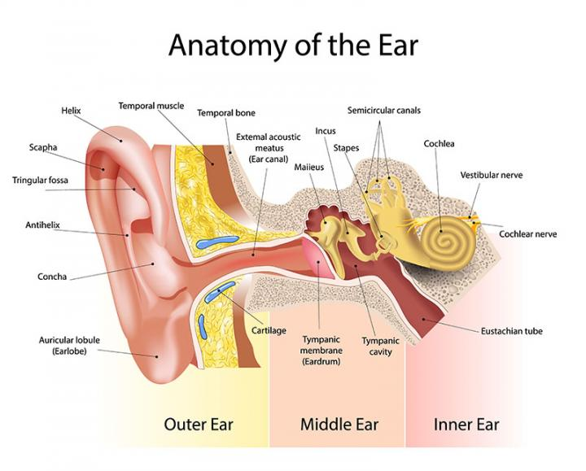
Anatomy
Notes:
The human ear is divided into the external (or outer) ear, the middle ear, and the inner ear and is connected to the brain by the VIIIth cranial nerve (auditory nerve). The tympanic membrane separates the external ear from the middle ear – sometimes you will see the tympanic membrane (or eardrum) classified as being in the outer ear and sometimes you may see it classified as being in the middle ear. It can really be either – but it does divide the 2 areas and in a healthy state, it should be solid (no holes or tears).
Quick reminder about HOW we hear:
Sound travels down the ear canal, striking the eardrum and causing it to move or vibrate. Vibrations from the eardrum cause tiny bones in the middle ear to vibrate, which, in turn, creates movement of the fluid in the inner ear. Movement of the fluid sends electric signals from the inner ear up the auditory nerve (also known as the hearing nerve) to the brain. The brain then interprets these electric signals as sound.
***Include this as basic review of ear anatomy

Slide 10
Sound & Sound Measurement
Frequency:
Measured in Hertz (Hz)
Human Range is 20 to 20,000 Hz
Psychological correlate = Pitch
Intensity:
Measured in decibels (dB)
Normal conversation = 50-70 dB HL
Psychological correlate = Loudness
Notes:
Pure tones are sounds that are unique in the environment and are used to test the ability to hear. The physical attributes of a pure tone are frequency and intensity.
Frequency is measured in Hertz (Hz). It is how many times a vibration occurs per second. Pitch is the “psychological” correlate to frequency. When you are screening hearing, you are at a certain frequency (cycle per second) and the person has the perception of the sound having a certain pitch. The terms are NOT interchangeable but we often use the term pitch when talking to kids or parents. The human ear can hear frequencies from 20 to 20,000 Hz. However, most speech information is between 250-8000 Hz.
Intensity is measured in decibels (dB). Loudness is the psychological correlate of intensity. When you are screening hearing, you are at a certain intensity level and the person has the perception of loudness. The terms are not interchangeable but we often use the term loudness when talking to kids or parents. A young healthy ear can hear at 0 dB (HL). Zero dB (HL) is not the absence of sound. Normal conversation is typically between 50-70 dB HL. You may wonder why we screen hearing at 20 dB HL. In order to understand speech, it needs to be both audible (“hearable”) and intelligible which means that we can discriminate the different sounds of speech. In order for speech to be intelligible, we need to not only “hear” it, but be able to discriminate. So we need that intensity between the screening level (20 dB HL) and normal conversation (50-70 dB HL) in order to discriminate the sounds.

Slide 11
Types of Hearing Loss

Slide 12
Notes:
Hearing loss can be described as conductive, sensorineural, or mixed (e.g., both a sensorineural and a conductive hearing loss)
Review the slide with differences, causes and shared characteristics.

Slide 13
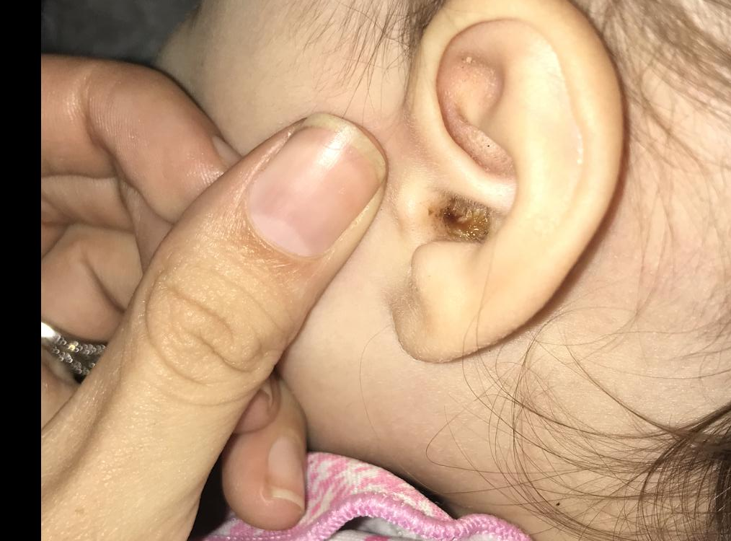
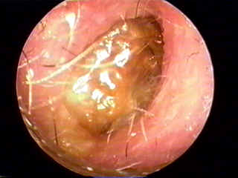
Wax Impaction
Notes:
Example of wax impaction
The old adage to never put anything in your ear SMALLER than your elbow holds true. The ear is self-cleaning. As the skin in the ear canal sheds, it propels the wax slowly to the outer surface where it tends to dry and flake off or can be wiped away. Putting an object into the ear to clean it just pushes it deeper into the ear canal and can become packed against the eardrum resulting in a loss of hearing.
Installation of softening drops may be needed to remove wax build up and restore hearing. It is wise to refer students to a physician before putting in drops to be sure the eardrum is intact. If a perforation or puncture is present and liquid is put into the canal, infection of the middle ear may occur.

Slide 14
Otitis Media Middle Ear Infections
24.5 million visits to doctors’ offices yearly
Most frequently cited reason for taking child to the emergency room
Most common surgery for children is a Tympanostomy, 110,000 per year
Health care costs are reported between $3 and $5 billion/year
Notes:
How big is the problem? Here are a few statistics to show just how big the problem really is:
24.5 million visits to dr’s offices yearly
Source: Zhou, F., Shefer, A., Kong, Y., & Nuorti, J.P. (2008). Trends in acute otitis media-related health care: Utilization by privately insured young children in the United States, 1997-2004. Pediatrics, 121(2).
Otitis media is the most frequently cited reason for taking a child to the emergency room
Source: emedicine.medscape.com/article/858777-overview
Most common surgery for children is tympanostomy (placement of PE tubes) = 110,000/year
Source: emedicine.medscape.com/article/858777-overview
Health care costs are reported between $3-$5 billion/year
Source: Alsarraf, R., Jung, C.J., Perkins, J., Crowley, C. & Gates, G.A. (1998). Otitis media health status evaluation: A pilot study for the investigation of cost-effective outcomes of recurrent acute otitis media treatment. Annals of Otology, Rhinology and Laryngology, 107: 120-128
Most importantly these ear infections are happening during the critical period for language development

Slide 15
Secondhand Smoke
Increased ear infections and hearing problems
Increased rate of upper respiratory infections
Increased bronchitis and pneumonia
Higher rate of SIDS
Increased cases of asthma
More severe symptoms in children who already have asthma
Notes:
One of the biggest contributors to otitis media in children is secondhand smoke. You may have heard the old myth that if you blow smoke in someone’s ear who has an earache – it will help the earache – NOT TRUE!
Secondhand smoke causes:
More ear infections and hearing problems
More upper respiratory infections
More bronchitis and pneumonia
Higher rate of SIDS
More cases of asthma
More severe symptoms in children who already have asthma
There’s more…………….

Slide 16
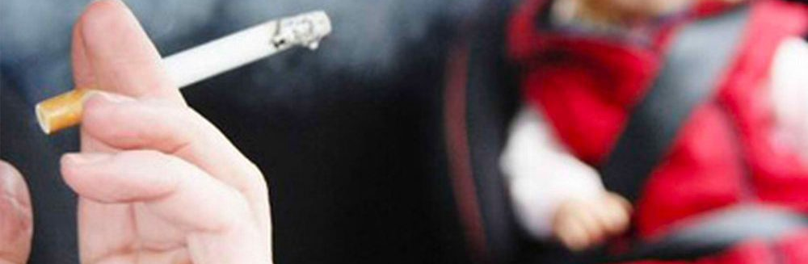
Secondhand Smoke
Children living in households where more than three packs of cigarettes were smoked per day were more than four times as likely to be hospitalized for placement of PE (pressure equalization) tubes.
Notes:
Children living in households where more than three packs of cigarettes were smoked per day were more than four times as likely to be hospitalized for placement of PE tubes.
SOURCE: Kraemer MJ, Richardson MA, Weiss NS, et al.(1983) Risk factors for persistent middle-ear effusions: otitis media, catarrh, cigarette smoke exposure, and atopy. JAMA. 249:1022–1025
As you can see, SHS causes many illnesses including ear infections. Ear infections are one of the most common PREVENTABLE illnesses seen in children.

Slide 17
Other Hearing Disorders
Notes:
We have discussed the most common types of hearing loss – conductive, sensorineural and mixed. BUT it is important for you to have some information about a few other types of hearing disorders that you may encounter in your school setting.

Slide 18
Auditory Neuropathy
A hearing disorder in which sound enters the INNER ear normally but the transmission of the signals from the inner ear to the brain is impaired
May exhibit “normal” hearing sensitivity to pure tones or hearing loss ranging from mild to severe
Usually have poor speech-perception abilities
Diagnosis is usually made with several tests including auditory brainstem response and otoacoustic emissions
Can be very complex and confusing diagnosis
Notes:
The reason for discussing this information as a part of our training is because auditory neuropathy (AN) is NOW listed in the AR Special Ed Guidelines under the Hearing Impairment section. It has to be diagnosed by an audiologist and it not something you will see everyday – but you do need to be aware of it.
Auditory neuropathy is a hearing disorder in which sound enters the inner ear normally but the transmission of the signals from the inner ear to the brain is impaired. Although there are several places where the problem may occur, it is generally thought that the location of the problem is either in the inner hair cells of the cochlea or with the auditory nerve itself. (Just as a point of reference, when we talk about sensorineural hearing loss, the damage is most typically in the outer hair cells of the inner ear – damage to these hair cells is much more common)
Individuals with AN may:
Exhibit “normal” hearing sensitivity to pure tones or hearing loss ranging from mild to severe
Usually have poor speech-perception abilities regardless of the “amount” of hearing loss
Diagnosis is usually made with several tests including auditory brainstem response and otoacoustic emissions
Can be a very complex and confusing diagnosis
The presenter is referred to the following website for a more thorough explanation of the Auditory Neuropathy:
http://www.nidcd.nih.gov/health/hearing/pages/neuropathy.aspx

Slide 19
(Central) Auditory Processing Disorders
These children will usually pass the hearing screening administered by the nurse
Difficulty understanding speech in noise is the most common symptom
Maturation is a factor (most audiologists agree that a child needs to be 7 years or older for appropriate diagnosis)
Normal or near-normal hearing sensitivity
Diagnosis should be made by an audiologist
Notes:
Auditory processing is a term used to describe what happens when your brain recognizes and interprets the sound around you. Audiologists often say that in person with an auditory processing disorder (APD) the sound gets to the brain okay, but then, what the brain does with it in processing it, is messed up.
These children will pass the pure tone hearing screening, however, the teacher may report that the student is not following directions, has problems carrying out multi-step directions, has “poor listening skills”, has difficulty with reading and spelling and other academic performance and/or has trouble “hearing” or understanding speech in noise.
Maturation of the auditory system is a factor and many children who come to kindergarten with what appear to be poor listening skills, learn better skills as the year goes on. The tests that are used to diagnosis APD are not easy – and so most audiologists will tell you that children need to be 7-8 years of age before formal testing can take place.
In the end, if this issue is presented to you as a school nurse, definitely involve the speech-language pathologist in your building. If you school accesses school-based audiology services, discuss the concern about APD with the audiologist. Ultimately, an APD needs to be diagnosed by an audiologist who will use information from speech/language testing along with psycho-educational testing to supplement their auditory tests.
APD is NOT a handicapping condition in the AR SPED guidelines – in order to have an IEP, a student will need to qualify under another category (SLD or Speech/lang typically). However, APD diagnosis could qualify child for a 504 plan (to allow classroom accommodations)
Children with autism are sometimes diagnosed with APD – this is controversial – from an audiological standpoint, it is difficult to “differential diagnosis” APD when other disorders are there (ASD, ADHD, ADD). Many child have difficult processing auditory information b/c of another disorder BUT don’t have true APD. This is a very complex and often controversial issue.
The presenter is referred to the following website for a more thorough reading of APD:
http://www.nidcd.nih.gov/health/hearing/Pages/auditory.aspx

Slide 20
Audiometers

Slide 21
Portable Audiometer
A portable audiometer is needed
Conduct a biological (or listening) check everyday that it is used
Calibrate the audiometer on a yearly basis (see http://chs-support.weebly.com/training-packets-bmi-scoliosis-vh.html for sources of calibration services)
Use extreme caution when moving audiometer around from school to school – be gentle
Notes:
A portable audiometer is needed
Conduct a biological (or listening) check everyday that it is used – this means…put the headphones on and present tones to yourself to ensure that sound is coming through each headphone and sounds appropriate for indicated intensity and frequency
Calibrate the audiometer on a yearly basis
Use extreme caution when moving audiometer around from school to school – be gentle. Also, be careful leaving the audiometer in places where it will get very cold or very hot. Especially older audiometers – the temperature will affect the calibration. Examples are leaving the audiometer in your car in extreme heat or cold. Another example would be storing your audiometer in a storage unit during the summer months that does not have air conditioning.
Headphones are calibrated to a specific audiometer, they are not interchangeable without recalibraton

Slide 22
Examples of approved audiometers
Notes:
Examples of appropriate audiometers – these are examples of audiometers that are appropriate for use in school hearing screening programs. These examples are NOT exhaustive but do at least give you an idea of what you are looking for if you need to purchase an audiometer.
Audiometers can be purchased from school nursing supply companies such as MacGill and School Nurse Supply Inc. In addition, several of the companies who may provide calibration services also sell equipment (Audiometrics and Gordon Stowe)

Slide 23
Earscan 3M
Notes:
This is the EarScan 3M. It has all of the features that you will need to screen in a school setting. It can work via an electrical cord BUT it can also be charged so that you can be cordless for screenings.

Slide 24
Maico 27
Notes:
This is the Maico 27 and looks more like a traditional audiometer. It also has all of the features that you need for performing hearing screenings in the school setting.

Slide 25
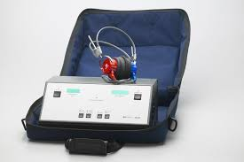
Maico 39
Notes:
This is the Maico 39 – again, it has what you need.

Slide 26
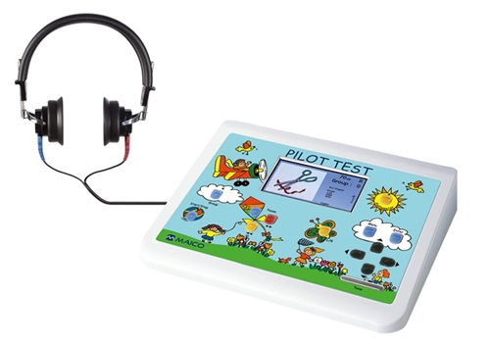
Maico Pilot Audiometer (*this is MORE than you need)
Notes:
If you have this audiometer – you can use it. However, we would NOT recommend anyone buy it for school screenings. It not only will allow you to screen pure tones, but it has a feature that allows for speech audiometery. This audiometer will cost you more b/c of a feature that you will not use.

Slide 27
Examples of audiometers that are NOT approved
Notes:
Examples of audiometers that are NOT appropriate for use in school hearing screening programs.
These are examples of audiometers that are NOT appropriate for use in school hearing screening programs.
This is not an exhaustive list but represent the types of problems that you may encounter with inappropriate equipment.

Slide 28
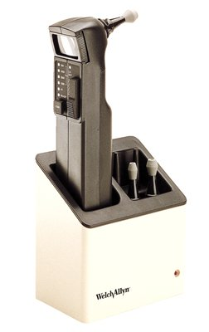
Allyn AudioScope 3 Screening Audiometer
Not appropriate for school screening
Notes:
The Welch Allyn AudioScope 3 Screening Audiometer is not appropriate because it is handheld. When you present the tone you could “tip” the kid off by the movement of your hand that you are presenting the tone.

Slide 29
OtoScreen I
by Handtronix
Not appropriate for school screening
Notes:
The OtoScreen I by Handtronix has the same issue – you hold this headphone against the child’s ear and have to “push” in on the area that says “scan”. So you may actually “tip” the student off by your hand movement against their head.
Also, it only has 2 intensities: 20 dB HL and 40 dB HL. Sometimes, in order to train a student, we need to be able to get louder than this.
If you are using this audiometer, you need to purchase something different.

Slide 30
Screening Protocol

Slide 31
Protocol Summary
Pure Tone Screening
Rescreening (if did not pass 1st screen)
Referral
Follow-up
Annual summary or enter into APSCN/eSchool
Notes:
This is the outline of protocol:
perform your pure tone screening
complete your rescreening for children who did not pass the 1st screen
make referral
follow-up on those referrals
Complete your annual summary or enter into APCSN/eSchool

Slide 32
Who to screen
Pre-K, K, 1, 2, 4, 6, 8 & transfer students
Special education students & teacher referrals
Notes:
Students in grades pre-k, kindergarten, 1st, 2nd, 4th, 6th and 8th should be screened every year. In addition, any students that transfer into your district/building need to be screened upon entry. If no documentation of screening at transferring school of hearing screen for appropriate grade level.
(*Your responsibility for screening your pre-K will vary from district to district; check with your administration to see what the district’s relationship/responsibility is for the preschool program in your district)
If a child is suspected of having a hearing problem based on teacher, parent or even student report – it would be good to screen these students.
Students who are being NEWLY referred to special education will require a hearing screening. If you have already completed within that school year, those results should be fine.
Students who are already enrolled in special education but are up for a 3 year re-evaluation will have to be screened (again if you have completed a screening that school year, you can report those results)

Slide 33
Who NOT to screen
Students who wear hearing aids
Students who have cochlear implants
Students with documented hearing loss (by an audiologist/MD)
Notes:
There are always questions about what to do with kids who have known/identified hearing losses. If you have a student who wears hearing aids or has a cochlear implant or bone anchored implant – don’t screen them (UNLESS the hearing loss is known to be in JUST one ear – if this is the case, you should screen the other ear). If a student REPORTS hearing loss, but you are not aware of it or have no documentation, then you should screen them and refer appropriately.
SO – very important - students who wear hearing aids, who have cochlear implants or have documented hearing loss (by an audiologist/MD) should NOT be screened – BUT you do need to know that the child is being followed on a regular basis by an audiologist/MD and noted in eSchool
Special NOTES:
1. Children who have a COCHLEAR IMPLANT – will have severe/profound hearing loss in BOTH EARS
2. Children who have a BONE ANCHORED IMPLANT (sometimes referred to as a BAI or BAHA) may have “typical” hearing in their other ear (depends on WHY they have it) – so you could screen the other ear – but will need to know whether documented hearing loss is in both ears or if it is “single-sided deafness”

Slide 34
Example of Hearing Aids
Notes:
Examples of hearing aids that you might see on kids

Slide 35
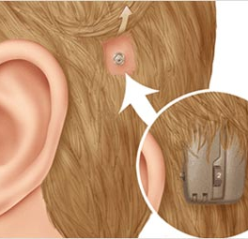
Bone Anchored Implant
A BAI uses a titanium implant, which is placed in the skull bone behind the ear
An abutment connects the sound processor with the implant in the bone, creating direct bone conduction
Direct bone conduction, provided by a BAI, gives improved access to sound when compared to traditional bone conductors since sound is not weakened when passing through the skin
Can be worn on a headband
Notes:
A BAI uses a titanium implant, which is placed in the skull bone behind the ear.
An abutment connects the sound processor with the implant in the bone, creating direct bone conduction.
Direct bone conduction, provided by a BAI, gives improved access to sound when compared to traditional bone conductors since sound is not weakened when passing through the skin.
Can be worn on a headband

Slide 36
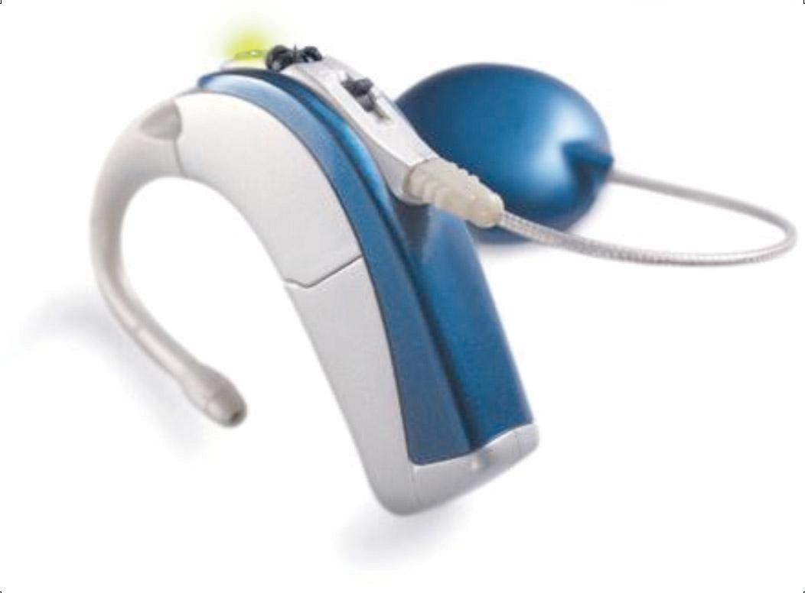
Cochlear Implant-(Advanced Bionics)
Built-in multi-function LED status indicator
Head piece/coil
Processor: holds 3 listening programs that can be used for FM and/or different listening environments
Additional external
microphone
&
Rechargeable Battery
Designed withstand rain, sweat and moisture
Notes:
This is a picture of the external portion of one of the CI’s available on the market. There are 3 companies and each processor looks a little different.

Slide 37
When to Screen
NOT the first week of school
Choose the older students first, if possible
Usually in September or October
Don’t wait too long- Student may have hearing loss
Cold and Flu season- Hard to screen sick students
Need time for follow-up
Notes:
Avoid screening the 1st week of school for children entering school for the 1st time. They will need to adjust to the school environment. However, you don’t want to wait too long if a child does have a hearing loss – you want to get the process started so that no time is wasted. Be mindful of waiting too long also b/c of cold/flu season and you need time to follow up before your reporting is due.
While screening is an important component of the educational program, school personnel may only see it as an interruption. Seek cooperation. Teachers appreciate knowing about planned screenings in advance so they can schedule their activities.
Seek volunteers. Screening in teams has the advantage of speed and skill. Volunteer parents can assist with escorting students, etc..
The speech-language pathologist assigned to the school may be an experienced screener who may be available to help. Also there may be a local audiologist in private practice or a school-based audiologist who could be of help.
The more screenings that are done before school starts, the better for the nurse – BUT screenings completed prior to Aug 1st can be problematic – Screenings can be started as early as APSCN can rollover students to the next year
Kindergarten round up done in spring prior to entry – those kids won’t be in APSCN until Aug 1st

Slide 38
Audiometer Controls
Power (on/off)
Ear indicator (right/left)
Intensity selector (dB; e.g. 20 dB HL)
Frequency selector (Hz; e.g. 4000 Hz)
Signal selector
(use continuous or pulsed tone only)
Presentation function
(how you present the tone)
Notes:
(NOTE to trainers: If your trainees have brought their audiometers, this would be a good time for them to get them out and see where the controls are for their specific model; you can also have YOUR audiometer there to demonstrate)
The following controls are necessary for the operation of the audiometer. Prior to screening students you need to make sure you are familiar with all of these functions on your audiometer
Power – on/off
Ear indicator – you should be able to change from left to right and vice versa
Intensity selector – dB – 0 to 100 dB
Frequency selector – 250-8000 Hz typically on audiometer used for screening
Signal selector – ONLY use continuous or pulsed tone (do NOT use warble tones which is an option on some audiometers - – it actually modulates the tone between 2 frequencies and you don’t want that for your purposes).
Presentation function – how do you present the tone? Usually involves pressing a button or touchpad.
Just a reminder – Listen to the audiometer at the beginning of each test day to assure it is functioning correctly. AND make sure to get the audiometer calibrated once a year.

Slide 39
Headphone Placement
Place the headphones on student (red on right ear; blue on left ear)
Hair behind ears
Remove large earrings
May want to remove glasses
Diaphragm of headphones over ear canal
Adjust head band for snug, even fit
Head band on top of head is preferred
Notes:
Headphone placement is very important. Some research suggest that inappropriate headphone placement is a big factor in failed hearing screenings. Think about it like your cell phone – when the earpiece is not centered or positioned correctly to your ear, you can’t hear the person you are talking to.
Place the headphones on student (red on right ear; blue on left ear)
Hair behind ears
Remove large earrings
May want to remove glasses
Diaphragm of headphones over ear canal
Adjust head band for snug, even fit (so you don’t want the earphone headband to be lopsided)
Head band on top of head is preferred
You may allow the students (older) to place the headphones on their ears but you should check adjustment/fit of them yourself

Slide 40
How to screen
Instruct student for the task (e.g. raise hand when they hear the beep)
Condition the student to the task (i.e. present a tone in one ear at one frequency ABOVE the screening level – example: 50 dB)
Once the student is conditioned – start the screening protocol @ 20 dB
Notes:
How to screen:
1. Instruct student for the task (e.g. raise your hand when you hear the beep or say yes when you hear the beep)
Condition the student to the task (i.e. present a tone in one ear at one frequency ABOVE the screening level – example: 50 dB – to ensure that the student knows what they are listening for)
Once the student is conditioned – start the screening protocol

Slide 41
Screening Protocol
Right Ear 1000 Hz 20 dB
2000 Hz 20 dB
4000 Hz 20 dB
Left Ear 1000 Hz 20 dB
2000 Hz 20 dB
4000 Hz 20 dB
Repeat
NOTE: Need to obtain 2 responses in each ear at each frequency for a pass
Notes:
For those of you who have been screening for many years, PLEASE NOTE SOME CHANGES HERE.
Same as in the past: We will be screening the right ear and left ear individually. We will screen at the frequencies 1000, 2000, and 4000 Hz
Maybe different than what you have done in the past:
1. Screen at 20 dB HL. Do NOT increase the intensity above 20 dB for the actual screening. If the room is too noisy – move to another room. Do not turn up the intensity b/c your screening environment is too noisy. Going above 20 dB HL could miss some children who have minimal/mild hearing losses that ultimately could affect their ability to learn.
2. Present tone for at least 3 seconds at each presentation
3. Need to get 2 responses at each frequency in each ear. If you only get one response at each frequency, in each ear, it could have been a chance response.
4. Don’t get into a pattern. There is no set order that you must get these responses in – sometimes it may depend on your audiometer. For example, some of you may want to screen 1000 Hz in the right ear and screen 1000 Hz in the left ear, etc. OR some of you may want to screen 1000, 2000 and 4000 Hz in the right ear and then move to the left ear.
You are not doing tympanograms OR otoscopy as a part of the standard hearing screening protocol -
Don’t get into a pattern – it may allow a child to pass the screening who shouldn’t
It is not recommended that you require a student to raise the hand of the ear where the tone is. Sometimes when we are close to a person’s threshold (softest sound they can hear 50% of the time), the sound is more in the middle of the head – so a child may hesitate to respond b/c they aren’t sure which ear it is in when in fact they did hear the sound.
BOTTOM LINE – don’t ASSUME that a child heard it if you can’t get a consistent response.

Slide 42
Pass/Fail Criteria
Student must pass all frequencies in an ear for that ear to be classified as a “pass”
If a student does not pass ALL frequencies in each ear, he/she should be re-screened in 2-4 weeks
Notes:
A student must pass all frequencies in an ear for that ear to be classified as a “pass”.
If a student does not pass ALL frequencies in each ear, he/she should be re-screened in 2-4 weeks
The 2-4 week waiting period allows students to clear of any middle ear issues IF they are going to clear on their own. Middle ear issues will be a big contributor to failed hearing screenings especially in younger students.
If a student does not pass the hearing screening the 2nd time around, then you will make a referral.

Slide 43
Rescreening Protocol
Right Ear 1000 Hz 20 dB
2000 Hz 20 dB
4000 Hz 20 dB
Left Ear 1000 Hz 20 dB
2000 Hz 20 dB
4000 Hz 20 dB
Repeat
NOTE: Need to obtain 2 responses in each ear at each frequency for a pass
Notes:
The protocol for re-screening is exactly the same as screening; Pass/fail criteria are the same also

Slide 44
Referral
Refer immediately if you observe physical abnormalities that are not documented in the student’s file
Refer immediately if child does not pass and there is serious concern regarding hearing or speech/language development
Refer to MD or Audiologist if child fails rescreen
Refer to MD or Audiologist if child passes, but there is concern regarding hearing
Notes:
Referral
Important – if you note a significant problem during observation or the initial screening, you can refer the child immediately for follow up (example: Child does not respond at all in one ear but the other ear is fine; you cannot get a screening on a child b/c he/she can’t respond)
Typically, after a child fails the 2nd screening, you will refer to MD or audiologist
May occasionally refer even if child passes screen because of behavior exhibited and change in school performance, etc. (may have hearing loss at higher frequencies not screened – may have fluctuating hearing loss and you are not catching it; may have a [central] auditory processing disorder as discussed earlier)

Slide 45
Follow-up
Send letter, referral form, financial assistance information and list of appropriate professionals to the parent/guardian
(School nurse contact info must be on referral form)
If no response from parent/guardian in 2 weeks, follow-up with a phone call or personal contact
Notes:
This applies to both vision and hearing screenings…
1. Send letter, referral form, financial assistance information and list of appropriate professionals to the parent/guardian (make sure school nurse contact info is on referral form)
2. If no response from parent/guardian in 2 weeks, follow-up with a phone call or personal contact

Slide 46
Follow-up Continued
Review
Review information received from examining professional
Rescreen
Rescreen after medical treatment
Collaborate
Collaborate with special education personnel if indicated
Notes:
3. Review information received from examining professional
4. Rescreen after medical treatment if indicated (antibiotic therapy for ear infections)
5. Collaborate with special education personnel if indicated
If your district uses school-based audiology services, then you should make contact with your audiologist once your 2nd screenings are complete and you will devise a plan. Many schools who use school-based audiology services offer the parent the option for the school audiologist to test the child after the 2nd screen OR to take the child to an outside MD or audiologist. Most parents opt for having the school audiologist do the testing.
Always review results of exam and share with teacher when appropriate
If student is treated for disease/condition, rescreen after treatment to be sure problem has been resolved

Slide 47
Tips and Tricks to Perform Hearing Screenings
Notes:
Here are some tools and tips that you might find useful in your hearing screening protocol. Most students can perform a standard hearing screening but sometimes we need to use some “tools” to get a screening.

Slide 48
Play Audiometry
Students who are difficult-to-test, who are developmentally delayed, or who are non-English speaking
Use play task (drop blocks in a bucket)
Teach student the task at an elevated intensity level (e.g. 50 dB)
Make sure student can do on his own before you attempt screening at 20 dB
Notes:
Play audiometry may help you in getting a screening on children who do not seem to respond to a traditional response format.
Use with students who are difficult-to-test, who are developmentally delayed, or who are non-English speaking
Use a play task (e.g. drop blocks in a bucket)
Teach child the task at an elevated intensity level (e.g. 50 dB HL)
Make sure child can do on his own before you attempt screening at 20 dB HL
This type of testing probably needs to be performed in an environment where other children are not present
The next slide shows pictures of play audiometery

Slide 49
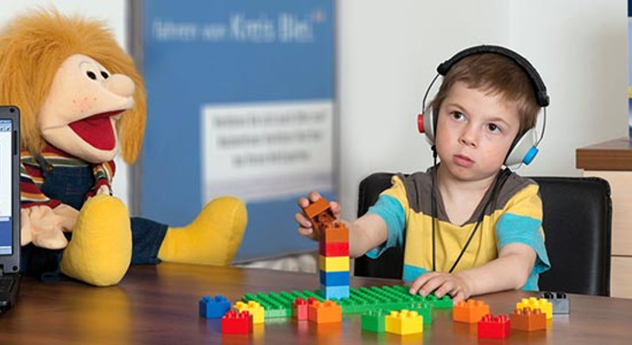
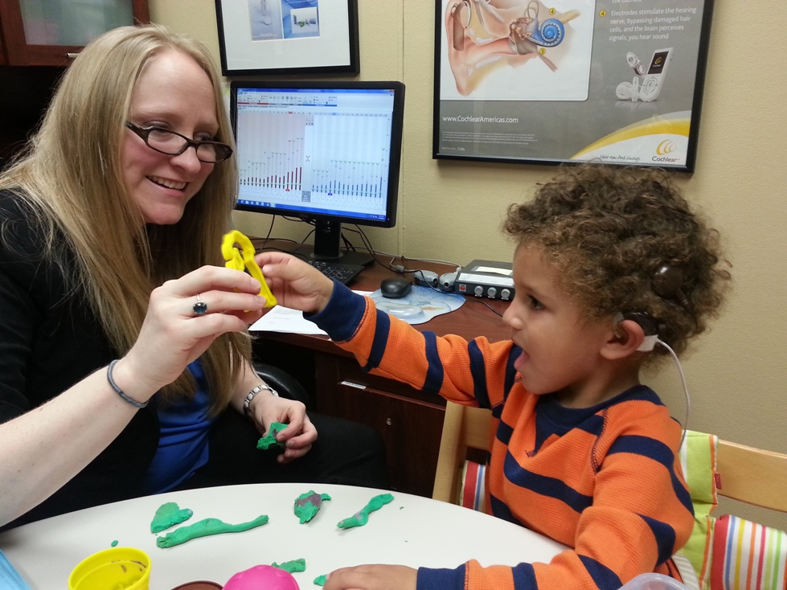
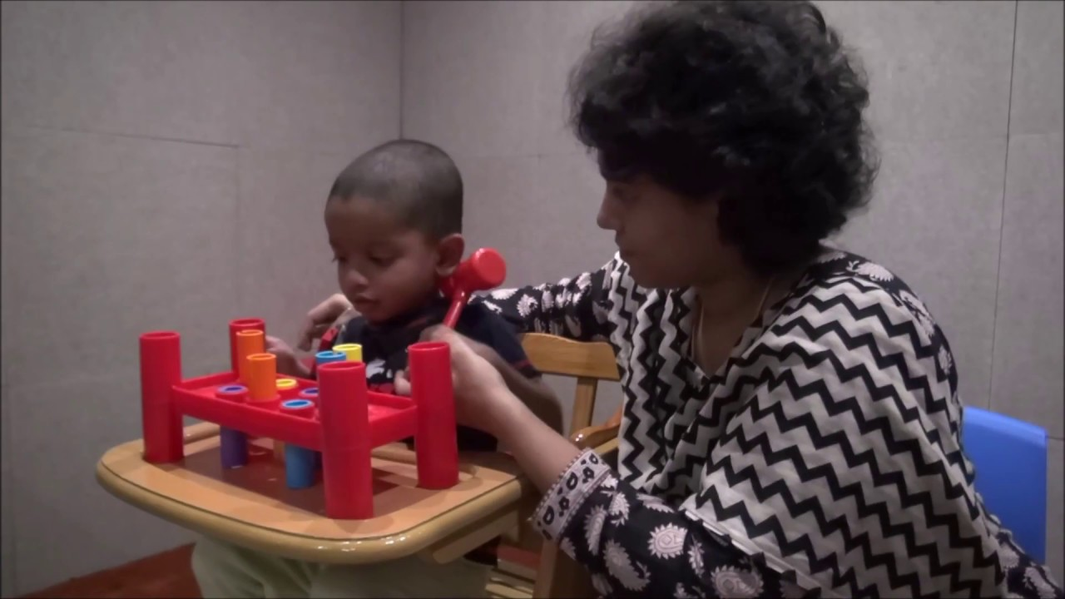
Notes:
Play audiometry uses a game or toy to get responses from student

Slide 50
Do’s
Locate a quiet room
Screen at 20 dB
Present tone for at least 3 seconds
Use pure tone
Notes:
DO find a quiet room
DO screen at 20 dB HL
DO present tone for at least 3 seconds
DO use pulsed tones if possible – they are easier to perceive than continuous tones

Slide 51
Do Not
1
2
3
Do not require students to raise right or left hand
Do not get into a pattern with your presentation of the tone
Do not give visual cues-position audiometer controls out of view
Notes:
Don’t require students to raise right or left hand (Remember: It is not recommended that you require a student to raise the hand of the ear where the tone is. Sometimes when we are close to a person’s threshold (softest sound they can hear 50% of the time), the sound is more in the middle of the head – so a child may hesitate to respond b/c they aren’t sure which ear it is in when in fact they did hear the sound.)
Don’t get into a pattern with your presentation of the tone
Don’t give visual cues-position audiometer controls out of view

Slide 52
Do Not
Do not screen ear with known hearing loss
Do not switch the headphones from one audiometer to another
Notes:
Do NOT screen an ear with known hearing loss
Do NOT switch the headphones from one audiometer to another. This changes the calibration of your machine. If you have to get your headphones repaired or replaced, your audiometer has to be re-calibrated

Slide 53
Documentation & Resources

Slide 54
Forms
Referral Form
Summary Form
Screen Form
Forms are available on http://chs-support.weebly.com/training-packets-bmi-scoliosis-vh.html
Notes:
The referral form that you send home to the parent has been revised – so be sure to get the new one off of the Weebly website
Some of these forms are used when you don’t enter your data into APSCN

Slide 55
Documentation
Data entry will be in APSCN\eSchool+ (or use the summary form if APSCN not available)
You may need to get more training/information on APSCN\eSchool+ data entry in your coop area
Notes:
Documentation
Data entry will be in APSCN/eSchool (or use the summary form if APSCN/eSchool not available)
eSchool+ will be the data entry software for public and charter schools in the future
You may need to get more training/information on APSCN/eSchool data entry in your coop area

Slide 56
Resources Parent and Student Education
Childhood Hearing Loss
https://www.asha.org/siteassets/ais/ais-hearing-loss-childhood.pdf
Recreational Firearm Noise Exposure
https://www.asha.org/siteassets/ais/ais-recreational-firearm-noise-exposure.pdf

Slide 57
The EARS Team is here to help!
If your school needs a hearing screening on a difficult to test student, the EARS team can perform a screening under contract
Every attempt will be made to complete a traditional, pure tone hearing screening first by the EARS team, as it is best practice.
However, if a standard screening can’t be completed, the EARS team has the ability to complete an OAE screening in the school setting.
Educational Audiology/Speech Pathology Resources for Schools (EARS)
An outreach program of Arkansas Children’s
Notes:
EARS is an outreach service of Arkansas Children's Hospital designed to provide educational audiology/speech language pathology for school districts, educational cooperatives, preschool programs and other educational settings in order to address the needs of students with hearing loss and other auditory disorders.
The audiology services that are provided range from managing hearing screening programs to assistance with amplification and other classroom technical assistance, as well as recommendations for accommodations/modifications for students with auditory processing disorders, cochlear implants, etc. A full range of evaluation services are available including audiological assessments, counseling/guidance for parents and hearing conservation education. Speech pathology services include specialized assessments (with a written report), classroom observations, assistance with writing appropriate goals, as well as modeling therapy with individual students.
Experienced audiologists, speech language pathologists and educators are also available to assist in the development of IFSP/IEPs and to provide focused in-service training for professionals and paraprofessionals. The services of the professionals on the EARS team can be contracted on a regular basis by the school district and other educational sites or called in on an “as needed” basis. Within the state of Arkansas, most school districts have limited or no access to onsite specialized service specific to children with auditory and listening challenges. This outreach program forms a much needed bridge to fill in the gap between identification, education and academic outcomes for students with hearing impairment.

Slide 58
Resources can be found
www.CHS-Support.weebly.com

Slide 59
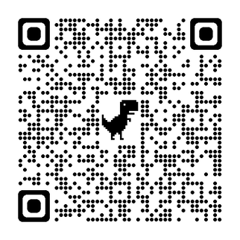
Knowledge Check

