Slide 1
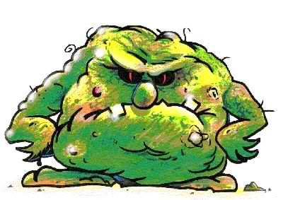
This is Germ. He makes our bodies not clean.

Slide 2
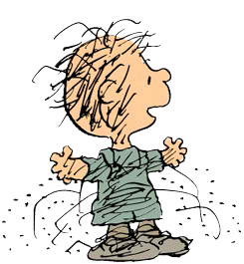
Keeping your body clean
is an important part
of keeping you healthy
and helping you feel good.

Slide 3
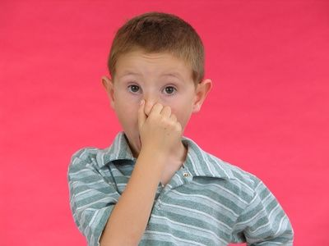
When your body is not clean,
you may smell.

Slide 4
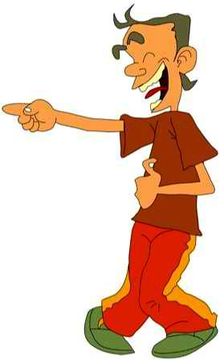
When your body is not clean,
people may make fun of you.

Slide 5
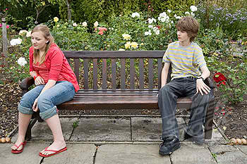
When your body is not clean,
people may not want to be by you.

Slide 6
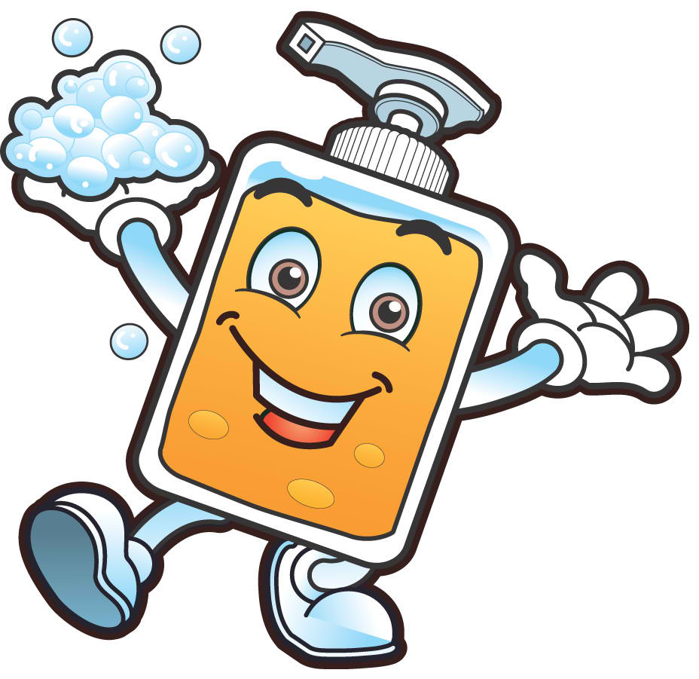
Clean bodies are very important!
Here’s how to make sure
you have a clean body…

Slide 7
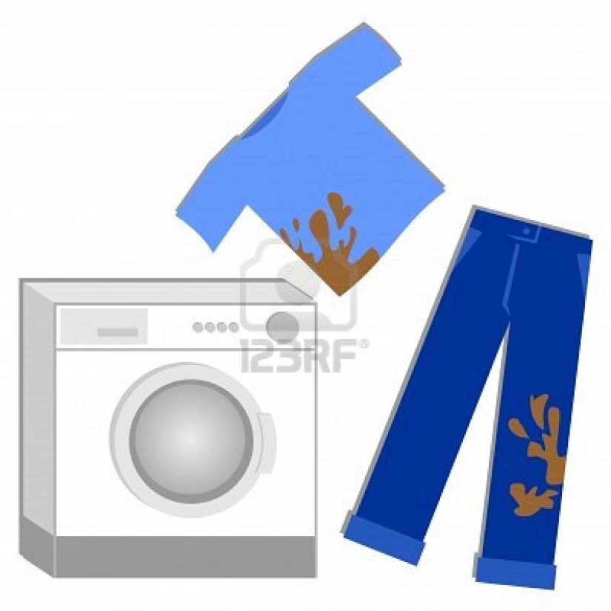
Clean Clothes
Clothes can get stained, dirty, and grubby,
so you need to change them often.
If the clothes smell or have dirt on them,
they need to be washed.

Slide 8
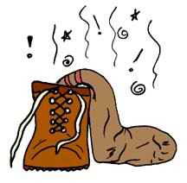
Clean Shoes
Your feet sweat and the sweat gets into your shoes and makes them smell.
Take off your shoes right when you get home and let them air out until the next day.

Slide 9
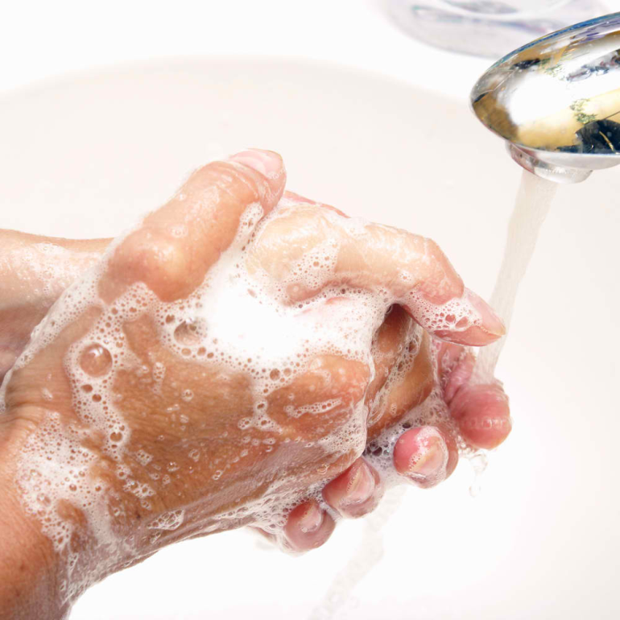
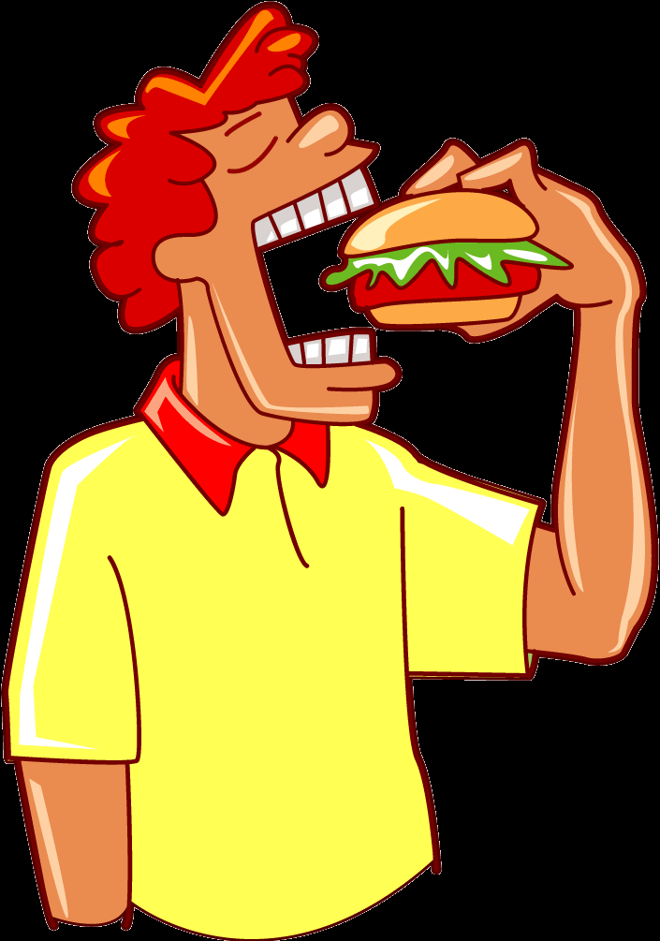
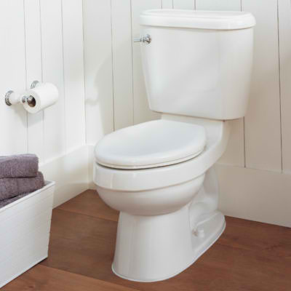
Clean Hands
Your hands touch a lot of germs and bacteria!
Wash your hands with soap and water
after using the bathroom
and before you eat

Slide 10
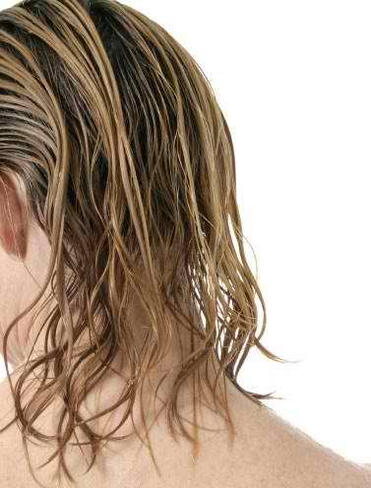
Clean Hair
Your hair can catch sweat, dirt, and oil.
This makes your hair look greasy and dirty.
You need to wash your hair regularly with shampoo and clear water.

Slide 11
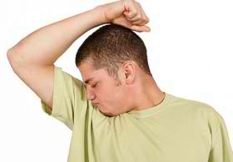
Using deodorant
When you get older,
your armpits begin to smell.
Use a deodorant under your armpits.
A shower or bath is the best thing
for stinky and dirty skin.

Slide 12
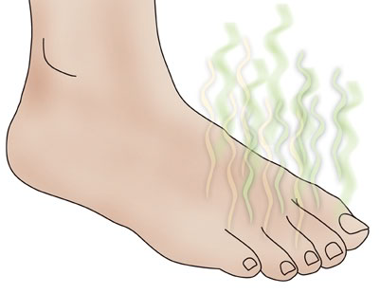
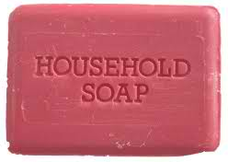
Clean Feet
Wash your feet everyday

Slide 13
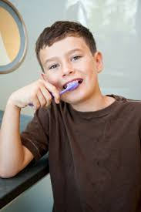
Clean Teeth
You should brush your teeth twice a day
(when you wake up, and before you go to bed)

Slide 14
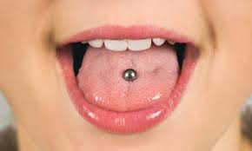
Oral Piercings
Infection, pain and swelling:
Your mouth is a moist environment, home to huge amounts of breeding bacteria
Damage to gums, teeth and fillings:
A common habit of biting or playing with the piercing can injure your gums and lead to cracked, scratched or sensitive teeth.
Nerve damage:
You may experience a numb tongue that is caused by nerve damage-usually temporary but can be permanent.
Excessive drooling. Your tongue piercing can increase saliva production.

Slide 15
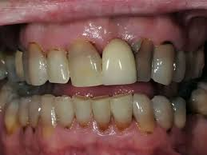
Smokeless Tobacco & Oral Health
Smokeless tobacco users can experience:
Bad breath
Teeth discoloration
Decreased sense of smell and taste
Greater risk of developing cavities
Smokeless tobacco can irritate your gums, causing gum (periodontal) disease.
Sugar is often added to enhance the flavor of smokeless tobacco, increasing the risk for tooth decay.
Smokeless tobacco typically contains sand and grit, which can wear down teeth, causing tooth sensitivity and erosion.
Warning signs

Slide 16
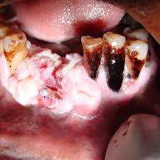
Oral Cancer and Tobacco Use
Smokeless tobacco products, just like cigarettes, contain at least 28 cancer-causing chemicals and is known to cause cancers of the mouth, lip, tongue and pancreas.
Users also may be at risk for cancer of the voice box, esophagus, colon and bladder, because they swallow some of the toxins in the juice created by using smokeless tobacco.

