Slide 1
Treating Seizures with
Nasal Rescue Medications

Slide 2
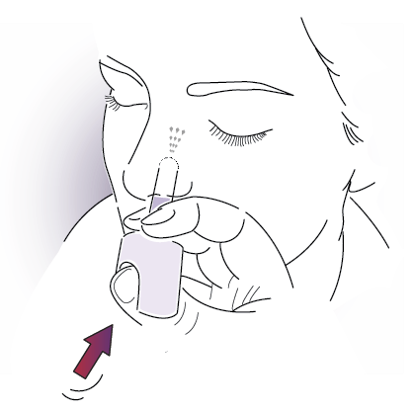
Objectives
What are nasal rescue medications?
Who can administer nasal rescue medications?
General use of nasal rescue devices
How to administer nasal rescue medications
Things to remember
Notes:
1 stays, 2 becomes who, 3 general, 4 ho to ad, 5 things to remebr

Slide 3
Nasal Rescue Medications for Seizures
Nasal rescue medications are used in children or adults who are not able to take medicines by mouth or who find this way of giving medicine more helpful
Nasal rescue medications are absorbed quickly in the nose
Seizures may stop within minutes of giving the nasal rescue medication, but the medicine will continue to work for much longer

Slide 4
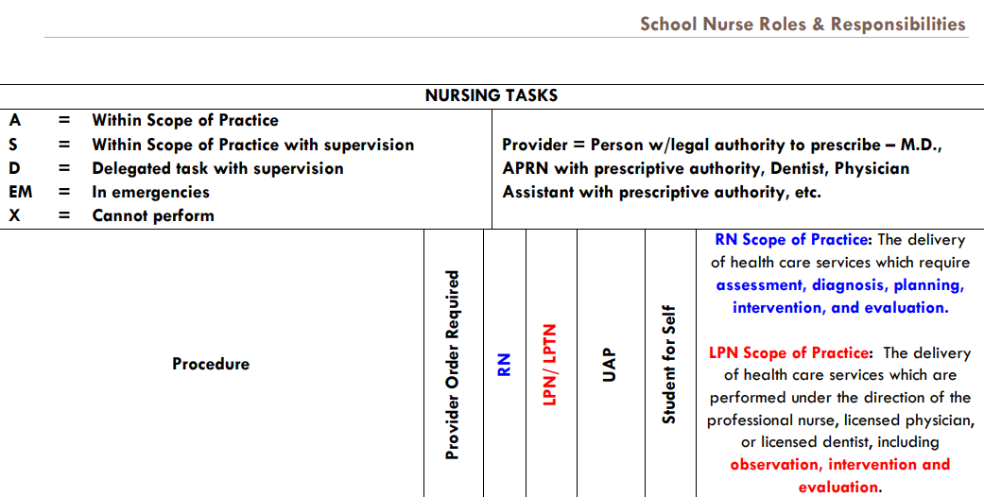
Who Can Administer Nasal Rescue Medications?
Nasal rescue medications to stop seizures may be given by:
School nurse (RN)
LPN (with supervision)
Trained school volunteer designated by the parent/guardian
A designated trained school volunteer must have been trained in medication administration and must be current in CPR/AED/FA with certification.

Slide 5
General Use of Nasal Rescue Devices
Do not open individual blister packs or test the nasal spray devices before use
Each device sprays 1 time and cannot be re-used
Nasal rescue devices do not need to be refrigerated
Keep device in a safe place, away from children
Make sure to check the expiration date and replace when out of date
After administration, follow instructions on how to dispose of the device

Slide 6
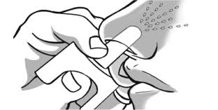
Steps to Administer Nasal Seizure Medications
Open blister pack and remove device from the box
Hold device securely with thumb on plunger
Gently insert the tip of nozzle into the nostril
Press plunger firmly to administer medication
Remove device and throw away
Place in recovery position

Slide 7
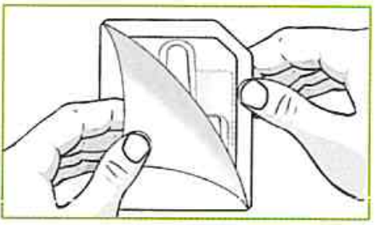
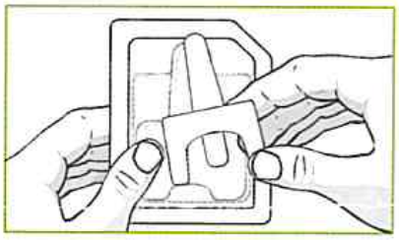
Step 1: Open blister pack and remove plunger from the box
A student may be prescribed a medication called VALTOCO (Diazepam) or NayZilam (Midazolam). If a blister pack contains two devices, give one spray into each nostril, using one device at a time.

Slide 8
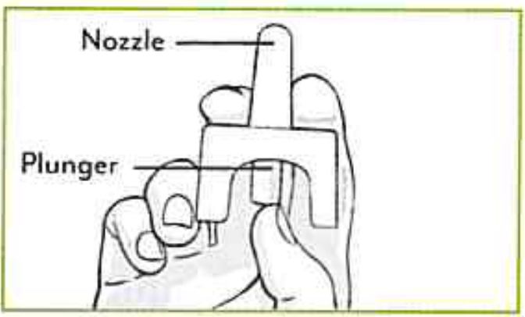
Step 2: Hold device securely with thumb on the plunger
After removing device from package:
Hold securely with thumb on bottom of the plunger and place first and middle fingers on either side of nozzle.
Single
use
Do NOT test because one device contains one spray!

Slide 9
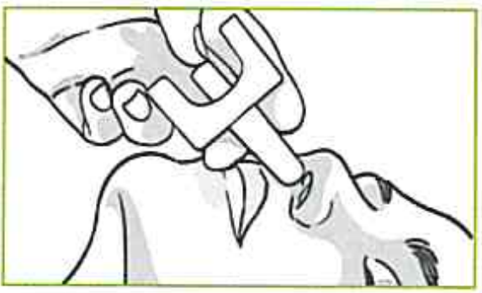
Step 3: Gently insert the tip of the nozzle into the nostril
Carefully insert tip of nozzle into one nostril until fingers rest against the student’s nose.
Medication can be given while student is laying down on their side or back.
During a seizure DO NOT hold the student’s head

Slide 10
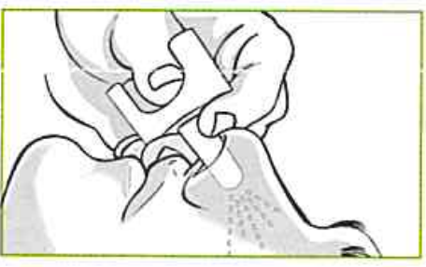
Step 4: Press plunger firmly to administer medication
In a single motion, press the bottom of plunger with your thumb to give the medication.
The student does not need to breathe deeply when you give them the medicine.

Slide 11
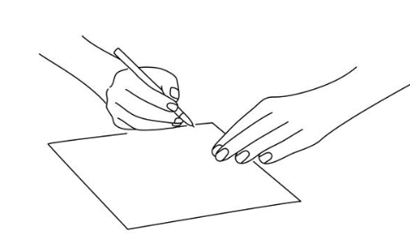
Step 5: Remove device and throw away
Remove device after giving the dose
Discard the plunger
Make note of when medication was delivered

Slide 12
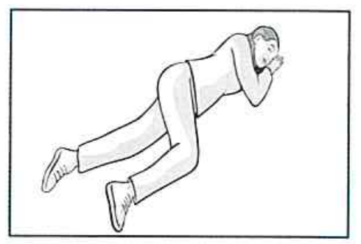
After Administration of a Nasal Seizure Rescue Medication
Move student into recovery position, on their side facing you
Watch student for any unusual seizure behavior, skin color or unusual breathing
Call for emergency help if needed

Slide 13
Review: Steps to Administer Nasal Seizure Medications
Open blister pack and remove device from the box
Hold device securely with thumb on plunger
Gently insert the tip of nozzle into the nostril
Press plunger firmly to administer medication
Remove device and throw away
Place in recovery position

Slide 14
Things to remember!
Some medication doses are divided into 2 sprays, one in each nostril
Do not ‘test’ because each device contains one spray
The student does not need to breathe deeply when you give them the medicine
Make note of when medication was delivered
After giving medication, place student on their side facing you
Call 911 if indicated by student’s emergency plan

Slide 15
References
Arkansas State Board of Nursing (Revised 2021). School Nurse Roles and Responsibilities - Practice Guidelines [Nursing Tasks]. Retrieved from https://adecm.ade.arkansas.gov/Attachments/School_Nurse_Guidelines_2021_Revision_Updated_September_2021_151522.pdf
Detyniecki , K. (2018, April 18). Nasal Rescue Medicines. Retrieved September 21, 2022, from https://www.epilepsy.com/treatment/seizure-rescue-therapies/nasal-rescue-medicines
VALTOCO. (2022). How to Give Valtoco®: 5 mg and 10 mg Dose. YouTube. Retrieved September 15, 2022, from https://www.youtube.com/watch?v=7ZoC4jJAZpE.
YouTube. (2021). Nayzilam (Midazolam intranasal) Seizure Medication Training. ValleyChildrens. Retrieved September 19, 2022, from https://www.youtube.com/watch?v=j4Z7T64JHoE.
Notes:
add image references

