Slide 1
Flu Clinic Volunteer Orientation 2023-2024
Arkansas Department of Health

Slide 2
Goals and Objectives
Provide protection against influenza
Decrease illness and hospitalizations
Decrease absentees from work and school
Decrease spread of disease
Increase herd immunity
Improve cocoon effect

Slide 3
Nursing and Volunteers
Non-ADH and ADH non-clinical
Attend orientation
Non-ADH nurses
Provide current Arkansas Nursing License
Provide picture ID
Sign Volunteer Indemnity Form
Sign HIPAA Form

Slide 4
Indications for Flu Vaccine
Any person ≥ 6 months of age wishing to reduce the likelihood of becoming ill or transmitting influenza
Inactivated Influenza Vaccine (IIV4) can be given to anyone ≥ 6 months of age, including breastfeeding and pregnant women

Slide 5
Recommendations for Inactivated Influenza Vaccine
All persons aged ≥ 6 months, unless medically contraindicated
Persons at higher risk for influenza-related complications
Health care workers* and other people who live with or care for people at higher risk to keep from spreading flu to them. This is especially true for people who work in long-term care facilities, which are home to many of the people most vulnerable to flu and COVID-19.
*Flu vaccines will not prevent COVID-19, but they will reduce the burden of flu illnesses, hospitalizations and deaths on the health care system and conserve scarce medical resources for the care of people with COVID-19.

Slide 6
People at Increased Risk of Influenza Complications
Children less than 5 and especially those younger than 2 years
Pregnant women
Adults’ age 50 years and older
Residents of long- term care (LTC) facilities
People with asthma
People with diabetes
People with heart disease and those who have had a stroke
People who are immunocompromised due to any cause
People who have HIV or AIDS or cancer
People with blood, kidney or liver disorders
People who are Alaska Natives or American Indians
People with body mass index (BMI) of 40 or more

Slide 7
People Who Are Transmission Sources
Household contacts and caregivers of:
Children ages 0-59 months
Persons 50 years old and older
Persons at high risk for complications from influenza
Health Care Providers:
People who provide home care to persons in groups at high risk
People working in health care settings include
Physicians
Nurses
Other workers in hospitals, long-term care facilities, assisted living, and outpatient-care settings
Medical emergency response workers
Students in these professions who will have contact with patients

Slide 8
To Prevent the spread of COVID-19 virus
Persons who are eligible should get vaccinated with COVID-19 vaccine
Persons should maintain a physical distance of 6 feet or greater
Persons should wash their hands regularly with soap and water or clean them with alcohol-based hand rub
Persons should avoid touching their face
Persons should cover their mouth and nose when coughing or sneezing
Persons should stay home if they feel unwell

Slide 9
2023-2024 quadrivalent influenza vaccines contain the following influenza strains:
A/Victoria/4897/2022(H1N1)pdm09-like virus.
A/Darwin/9/2021(H3N2)-like virus
B/Austria/1359417/2021 (B/Victoria lineage)-like virus.
B/Phuket/3073/2013 (B Yamagata lineage)-like virus.

Slide 10
ADH Supply of Influenza Vaccine
All inactivated flu vaccine IIV4 provided through ADH will be in pre-filled syringes or single dose vials
Flu vaccine in syringes and single dose vials provided through ADH will be quadrivalent, preservative free, and latex free
Multi-dose vials contain the preservative thimerosal

Slide 11
Dosage by Age Group
≥ 6 months: 0.5 mL IM*
*Children aged 6 months through 8 years who are receiving influenza vaccine for the first time or have not received > 2 doses before July 1, 2021, require two doses of vaccine administered ≥ 4 weeks apart. If the child turns 9 years before second influenza vaccine is due, he/she will still need the second influenza vaccine

Slide 12
Contraindications and Precautions (IIV4)
Contraindications: (IIV4)
Severe allergic reaction to any component of the vaccine*
Severe allergic reaction after previous dose of any influenza vaccine*
Egg allergy is no longer considered a contraindication.
Precautions: (IIV4)
Moderate to severe illness with or without fever
Positive COVID-19 test within prior 10 days
History of Guillain-Barré syndrome within 6 weeks of receipt of influenza vaccine *
*Requires a consultation with patient’s physician

Slide 13
Side Effects and Adverse Reactions
Inactivated Influenza Vaccine (IIV4)*
Local:
Pain, swelling and redness at the injection site
Systemic Adult:
Muscle aches, headache, fever over 99.5°F, and fatigue, arthralgia, GI symptoms, shivering
Systemic Child:
Drowsiness, headache, fever over 99.5°F, irritability, myalgia, fatigue, arthralgia, GI symptoms, shivering and loss of appetite
*Antibodies develop approximately 2 weeks after vaccination

Slide 14
Community Flu Clinics

Slide 15
Clinic Site
To ensure safe delivery of care during vaccination clinics, providers and staff should.
Follow infection prevention and control procedures.
Wear a surgical mask during the clinic.
Wear eye protection such as eye goggles or a face shield.
Use hand sanitizer between each patient, if using gloves, changes gloves and sanitize between each patient.
Ensure physical distancing of at least 6 feet between staff and patient until influenza vaccine is administered.
Locate emergency kit and first aid station at each clinic site.
A nursing coordinator will be at each clinic site for your assistance and can answer questions as needed.
Note: Eye goggles, face shields or mask should not be shared between staff.

Slide 16
Clinic Flow
Patient enters clinic/site
Route patient to screening area
Give patient current VIS (Vaccine Information Statement)
Route patient to data intake area to complete Imm-Flu Consent Form
Patient must sign and date Imm-Flu Consent Form
Route patient to a nursing station with the Imm-Flu Consent Form for vaccination

Slide 17
Forms
Vaccine Information Statements (VIS) https://www.cdc.gov/vaccines/hcp/vis/current-vis.html
Arkansas Department of Health Influenza Season--Immunization Consent form (Imm-Flu Consent Form)
To view the most up-to-date translations for Influenza, inactivated or recombinant VIS visit: Influenza, inactivated or recombinant Vaccine Information Statement (immunize.org) click on the language needed.

Slide 18
Nursing Station
Greet patient and collect Imm-Flu Consent Form with patient signature
Screen for contraindications and precautions with all questions answered
Administer the indicated vaccine
Complete the Imm Flu Consent Form and keep
Shot code
Route, site, dosage, MFG code, lot#
Nurse signature
Provide documentation of vaccination
Route patient to exit

Slide 19
Vaccine Administration
Sites:
Infants 12 months and younger: vastus lateralis (anterolateral thigh) is preferred
Young children 1 year to 3 years: anterolateral thigh is preferred. For children 1 year and older the deltoid muscle may be used if muscle mass is adequate
Adults and children 3 years and older: deltoid (upper arm) preferred, anterolateral thigh may be used
Dosage/Route:
≥ 6 months and older: 0.5 mL Intramuscular (IM)

Slide 20
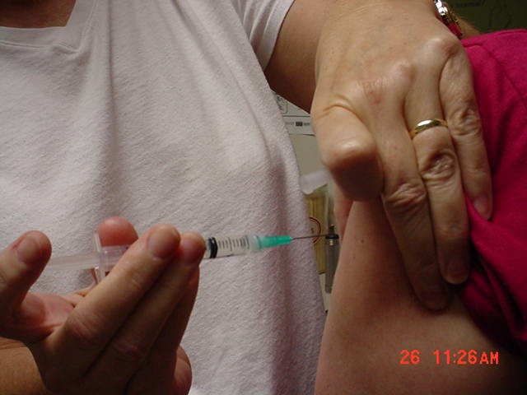
Injection Technique

Slide 21
Injection Technique (cont.)
Determine the appropriate vaccine and injection site
Prep site with alcohol wipe and cotton ball
Using a circular motion, wipe the site with alcohol from center out and allow to dry
Attach the safety needle to the prefilled syringe
Spread skin taut between thumb and forefinger or grasp tissue and “bunch up” muscle (acceptable for pediatric and geriatric patients)
Insert needle fully into muscle at a 90-degree angle and inject vaccine (do both quickly) Apply light pressure to injection site for several seconds with dry cotton ball or gauze
Dispose of syringe in sharps container

Slide 22
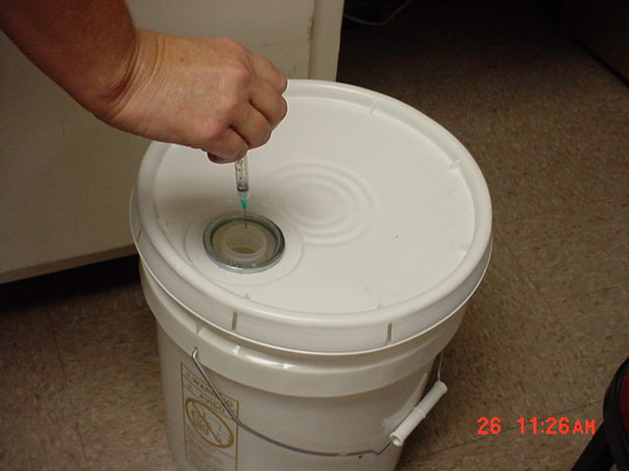
Disposal of syringe in sharps container

Slide 23
Use of Safety Needles
ADH will be using SafetyGlide safety needles for injections
Activate safety mechanism immediately after injection by pushing lever arm completely forward until needle tip is covered
Activate the safety mechanism away from self and others and discard immediately into approved sharps container

Slide 24
Vaccine Management
Influenza vaccine should be stored at 36°F to 46°F
(2°C to 8°C)
Temperatures should be documented every hour
Report out-of-range temperatures immediately
Keep storage unit container(s) closed as much as possible
No more then 10 doses of vaccine at one time should be removed from the main storage unit and prepared during an off-site clinic
Keep vaccine in storage container before administration
Do Not Store vaccine at room temperature
After the clinic closes, discard any vaccine-filled syringes if the needles have been attached

Slide 25
Standard Precautions
Good handwashing is recommended, but if soap and water are not available, you may use alcohol-based waterless cleanser between each patient (available at each nursing station)
Gloves are not mandatory unless the provider has an open lesion on hands
Gloves are available at each nursing station
If latex free gloves are required, contact the nursing coordinator

Slide 26
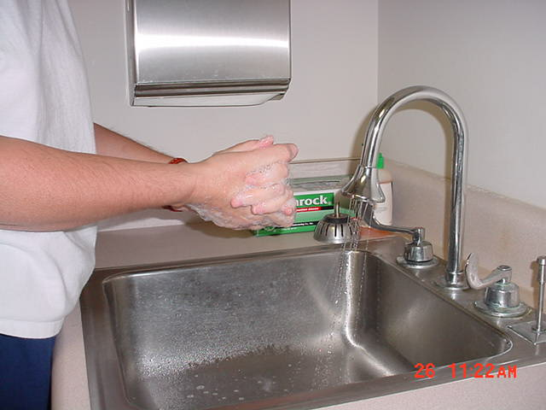
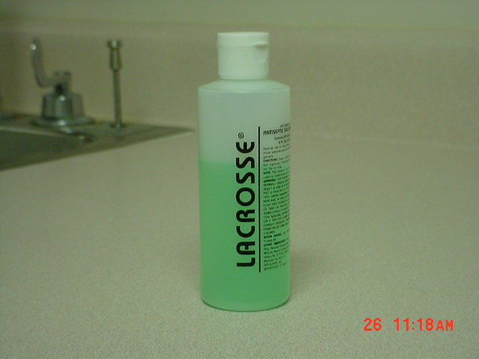
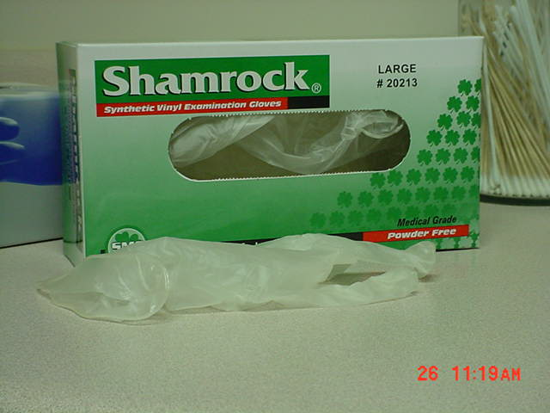
Standard Precautions (cont.)

Slide 27
Needle Safety
If a needle stick injury occurs,
report it
IMMEDIATELY
to the nursing coordinator

Slide 28
Conduct Hotwash and Debriefing with Local Health Unit and Volunteers

