Slide 1
Scoliosis Screening
Certification for
Arkansas School Nurses
2023
Updated 2023
Notes:
This training and certification of Scoliosis Screeners is the responsibility of the Certified Scoliosis Screening Instructor
Participants should be able to do a return scoliosis screening demonstration to the instructor.
With proper education and training, the number of un-necessary referrals should lessen.

Slide 2
Learning Outcomes
Learners will self-report an increase in knowledge about the importance of scoliosis screening and screening process by scoring 80% or above on the Knowledge Check.
Learners will successfully complete a return demonstration of scoliosis screening and use of a scoliometer and will verbalize any findings that require referral.
Notes:
Demonstrate how to perform the first two stages of scoliosis screening.
Differentiate between a normal spine and scoliosis and the recommendation for referral.
Explain why scoliosis screening is necessary.
Describe the documentation standards for the Scoliosis Program.
Explore diagnostic and treatment options available.
Identify financial and medical resources for referrals.

Slide 3
Arkansas Department
of Health Rules and Regulations For Scoliosis Screening Effective as of November 1, 2007
Notes:
Rules and Regulations
Arkansas State Board of Health
Training Program
Arkansas Department of Health provides an Instructor Training Course in Scoliosis Screening.

Slide 4
Act 41 of 1987 and Act 95 of 1989, As Amended
Requires that Arkansas children be screened for scoliosis in selected grades.
Requires parents to be notified at least 7 days prior to the screenings.
Letter
Handbook
Marquee
Child’s Folder
Social Media
Notes:
Who must institute and maintain a continuing scoliosis screening program:
Public elementary and secondary schools
Institutions supported by state funds providing education to minor children
Private institutions providing education to minor children

Slide 5
Rules and Regulations Updated
Rules and regulations implementing the act were adopted by the Arkansas Department of Health, filed in 1998, and revised in November 2007.

Slide 6
Exclusion to Screenings
Act 41 of 1987 states that “no child shall be screened if its parent or guardian objects to the screening in writing stating as the basis of the objection that it is contrary to the parent’s or guardian’s religious beliefs.”
Notes:
Opportunity for parents to opt out of the scoliosis screening are in the written letter to parents sent out 7 days prior to the screening date.

Slide 7
Purpose
To screen children who could have scoliosis
To refer those children who do not pass the screening or who are suspected for other abnormalities noted during the screening
Child Abuse
Self Harm
Acanthosis Nigricans
To address any spinal abnormalities to prevent further curvature
Notes:
Early detection is the key to controlling spinal deformities. The purpose of school screening is to detect scoliosis and kyphosis at an early stage when the curve is mild and may even go unnoticed. Most curves can be treated without surgery if they are detected before they become too severe. The screening process identifies students that have some physical findings that suggest a spinal curve. It does not diagnose a spinal deformity. The student with positive findings must be referred to a physician who will complete a thorough examination with x-ray and/or advanced imaging in order to confirm whether the individual has an abnormal spinal curve. The physician can then make recommendations for treatment. The goal of the screening process is to detect a student who needs to be referred at the earliest time, before an abnormal curve worsens.

Slide 8
Population
Effective November 2007
Girls are to be screened in the 6th and 8th grades only
Boys are to be screened in the 8th grade
This includes public and private schools

Slide 9
Screening Procedure
The procedure used to examine a child for scoliosis consists of evaluating the child in six positions. The forward bend technique is included in three of these positions.
Notes:
The procedure used to examine a child for scoliosis. It consists of evaluating the child in six positions. The forward bend technique is included in three of these positions.
Examine the presence or absence of an abnormality of the spine. It involves observing the person being screened from the rear, front, and side while the person is bending forward.
Forward Bend Technique: A technique used to determine the presence or absence of an abnormality of the spine. It involves observing the person being screened from the rear, front, and side while the person is bending forward.

Slide 10
Screeners
Who can perform the scoliosis screening?
Licensed Physicians
Individuals who have been trained to perform scoliosis screening by a Certified Scoliosis Screening Instructor
Screeners must be recertified every 5 years
Notes:
Screeners are not instructors and cannot teach other school nurses or staff how to conduct a scoliosis screening.

Slide 11
Scoliosis
Scoliosis is a lateral curvature of the spine, resembling an S-curve or C-curve
Idiopathic Scoliosis accounts for 80-85% of all scoliosis cases
The condition can be detected between the ages of 10 and 15 years
Girls are affected more often than boys
About 2 in 100 people have a mild form of scoliosis
Notes:
80-85% of all cases have an unknown cause and are referred to as “idiopathic scoliosis”.
It tends to run in families (is likely to have genetic influences).
This condition usually occurs and can be detected in children during the growth spurt of puberty between the ages of 10 and 15 years (most often between ages 10-12, but as late as 18 years of age)
Girls are affected by severe progression more often than boys.
About 2 in 100 people will have a mild form of scoliosis.
3 mil new cases detected in US each year
Consequences of unrecognized scoliosis may include progressive severe spinal deformity, accompanied by back pain, spinal arthritis, hip or knee pain, cosmetic deformity, and restrictive pulmonary disease.

Slide 12
Scoliosis
Scoliosis can be detected by performing a 30 second scoliosis screen
Early detection and treatment can help prevent physical and emotional disability
Rules and Regulations provide a method to assure all school age children are screened for scoliosis and necessary referrals for medical follow-up are made

Slide 13
Scoliosis Definition
Abnormal lateral curvature of the spine of 10° or more.
Rotation in the spinal column creates a side to side, “S” shaped curve when viewed from behind.
Notes:
Scoliosis is defined as an abnormal lateral curvature of the spine of 10 degrees or more.
This rotation in the spinal column creates a side to side, “S” shaped curve when viewed from behind.
Some cases worsen with time and can result in serious problems such as unsightly appearance, occasionally back pain as one ages, and in the worst cases, interference with heart and lung function.
Scoliosis is further divided into two categories: structural and functional

Slide 14
Scoliosis = Crooked
Notes:
Scoliosis (from Greek: skoliōsis meaning from skolios, "crooked")
[1][1] is a medical condition in which a person's spine is curved from side to side. Although it is a complex three-dimensional deformity, on an x-ray, viewed from the rear, the spine of an individual with scoliosis may look more like an "S" or a "C" than a straight line.

Slide 15
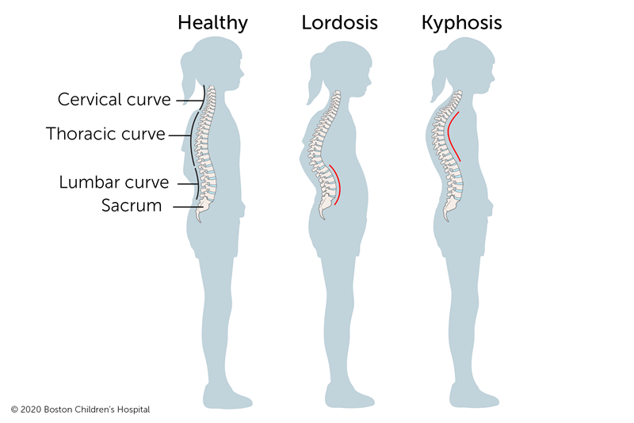
3 Types of Curvatures
Kyphosis- slight curvature is normal.
Lordosis- slight curvature is normal.
Scoliosis- lateral curvature is never normal.
Notes:
Kyphotic curves refer to the outward curve of the thoracic spine (at the level of the ribs).
Lordotic curves refer to the inward curve of the lumbar spine (just above the buttocks).
Scoliotic curving is a sideways curvature of the spine and is always abnormal.
A small degree of both kyphotic and lordotic curvature is normal.
Too much kyphotic curving causes round shoulders or hunched shoulders (Scheuermann's disease)

Slide 16
Structural Scoliosis
Idiopathic – 85%
Congenital
Neuromuscular – CP, MD
Notes:
Structural: These curves are the result of changes in the alignment in the vertebrae that are fixed. Structural curves can be distinguished from functional curves by their associated spinal twisting. This twisting results in the hump on one side of the rib cage seen when the student bends forward. Unlike poor posture, these curves cannot be corrected by learning to stand up straight.
Structural causes of scoliosis include:
Congenital (caused by vertebral anomalies present at birth). These anomalies occur in utero at 4-6 weeks of gestation. This may not be recognized until the deformity increases with age.,
Neuromuscular having developed as a secondary symptom of another condition, such as :
spina bifida
cerebral palsy
spinal muscular atrophy
physical trauma
Uneven leg lengths
Injury
Infection
tumors
Idiopathic: Idiopathic (cause unknown, there are no underlying skeletal or neuromuscular causes leading to this spinal curvature. Idiopathic scoliosis accounts for eighty-five percent of all cases of structural scoliosis.
Gender does make a difference in the time of onset because girls begin their adolescent growth spurt and reach skeletal maturity earlier than boys.
This accelerated spinal growth generally occurs from the ages of 10 to 14 for girls and 12 to 16 for boys.
Another factor that can contribute to the incidence of scoliosis in a student is a positive family history of scoliosis, suggesting a genetic predisposition.
For idiopathic scoliosis, the earlier in the growth spurt that a curve is identified, the greater the risk that the curve will worsen. For example, the immature, premenstrual girl has a higher risk of progression than an adolescent female who has already begun menses, or an adolescent boy who has developed signs of maturation such as axillary hair.
Signs to watch for are:
· One shoulder higher than the other.
· One shoulder blade higher or more prominent than the other.
· One hip higher than the other.
· The space between the arms and the body is greater on one side than on the other.
· Leaning to one side.
· The head is not centered directly above the pelvis.

Slide 17
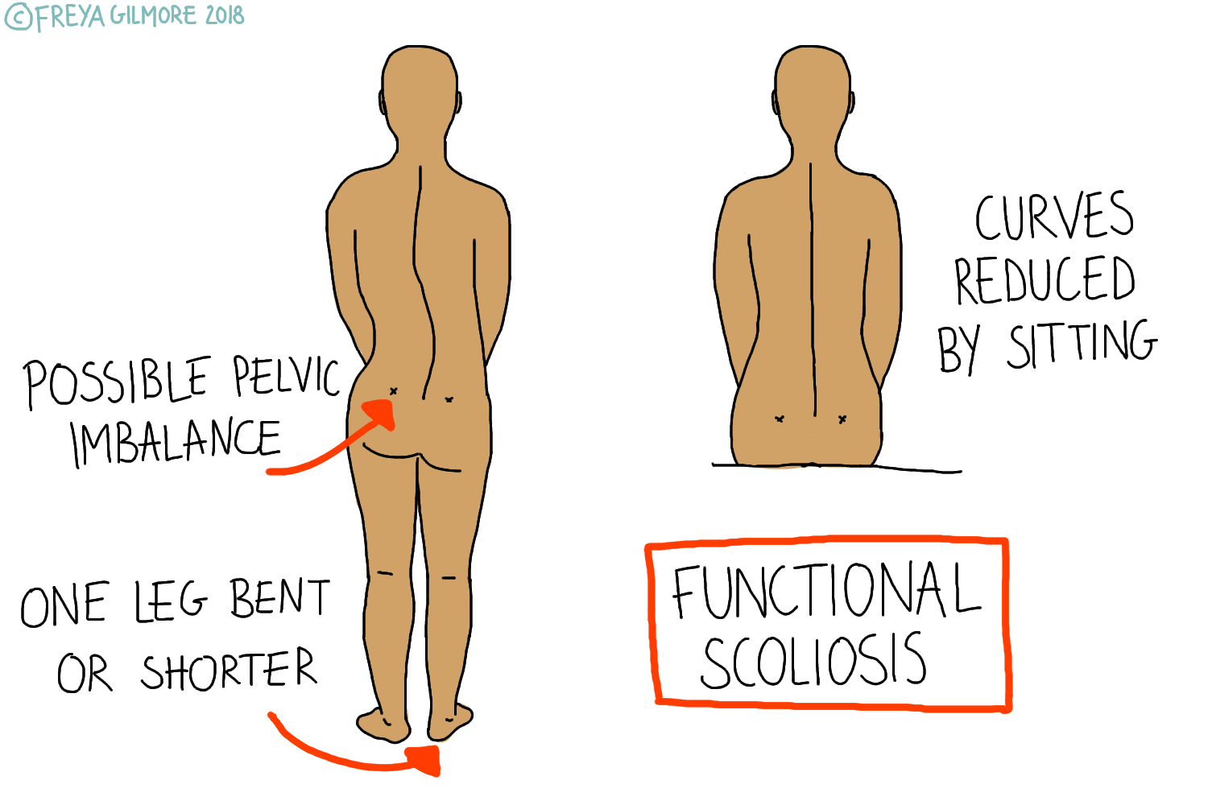
Functional Scoliosis
A structurally normal spine that appears to have a lateral curve (scoliosis).
Notes:
Functional scoliosis: A structurally normal spine that appears to have a lateral curve (scoliosis).
Nonstructural scoliosis involves a temporary change of spinal curvature. This is caused by an underlying condition such as a difference in leg length, muscle spasms, or inflammatory conditions, (e.g. appendicitis), which may produce muscle spasm.
In the functional scoliosis, fixed rotation does not occur, and the curvature is usually non-progressive. This type of scoliosis is classified into postural, which disappears on forward bending, and compensatory, which is most commonly due to a short leg.
Functional scoliosis is treated by correcting the underlying problem. The spine itself needs no treatment.

Slide 18
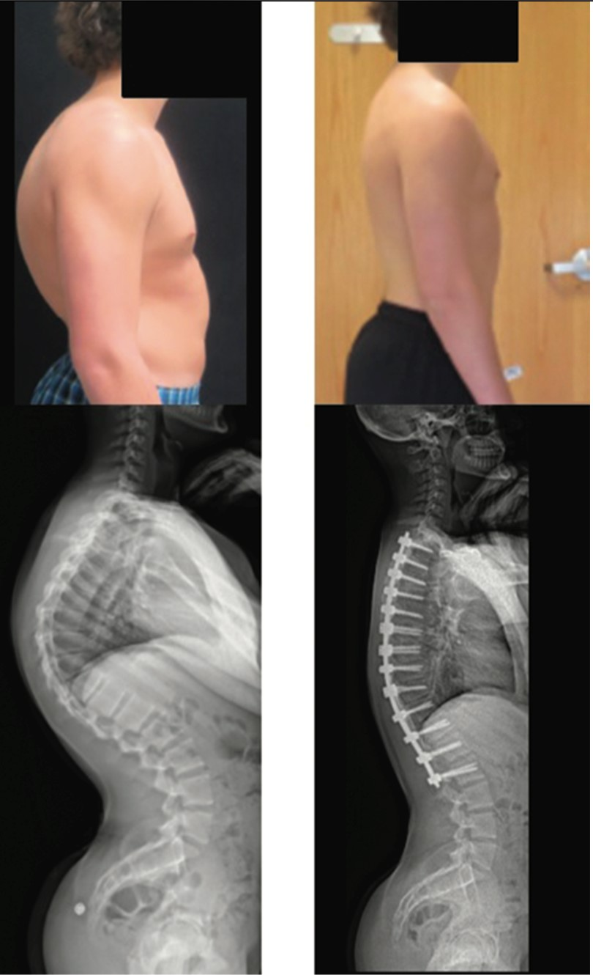
Kyphosis
An abnormal increase in normal kyphotic (posterior) curvature of the thoracic spine which can result in a noticeable round back deformity.

Slide 19
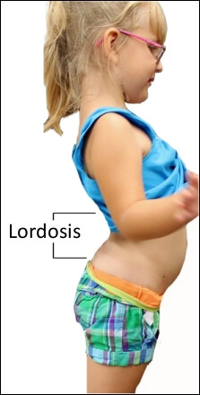
Lordosis
An abnormal increase in normal lordotic (anterior) curvature of the lumbar spine. This can lead to a noticeable “sway-back” appearance.

Slide 20
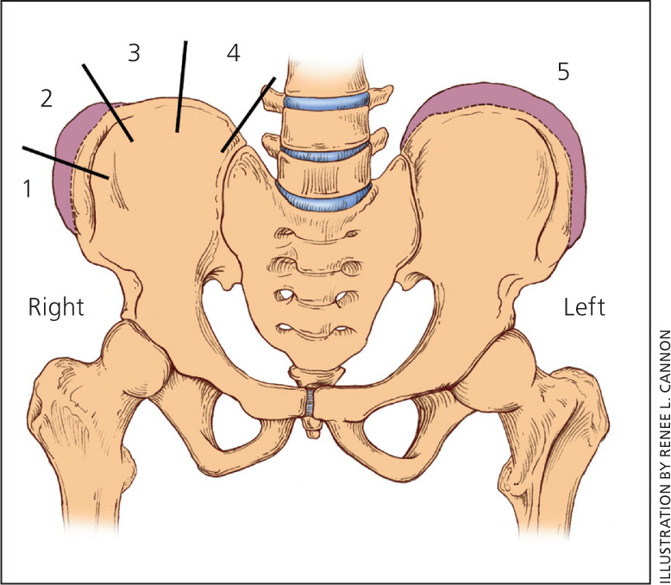
Periodic Examinations
Risser Sign
Skeletal maturity can be assessed by the
Risser sign
Notes:
Skeletal maturity can be assessed by the Risser sign, as illustrated in the drawing above. An x-ray is employed to see how far the patient's iliac epiphysis (yellow) has progressed from the anterior superior iliac spine (red).
During development, the iliac epiphysis first appears laterally and grows medially.
The stages are Risser I through Risser V, where Risser V denotes that the epiphysis has completely fused with the iliac crest and therefore skeletal maturity can be assumed.
A “0” denotes that lots of growth to come whereas a “5” means not much growth to happen.
The more growth that will happen the more at risk the child is for the curve to progressively get worse.

Slide 21
Scoliosis Screening
Procedures for
Arkansas School
Nurses
Notes:
Girls shall receive a scoliosis screening in the sixth grade and the eighth grade.
Boys shall receive a scoliosis screening in the eighth grade.
Rationale: The goal of scoliosis screening is to detect scoliosis at an early stage, when the deformity is likely to go unnoticed and there is an opportunity for a less invasive method of treatment, or less surgery, than would otherwise be the case.
The American Academy of Orthopedic Surgeons recommends screening girls at ages 11 and 13, and screening boys once at 13 or 14 years of age.
This condition usually occurs and can be detected in children during the growth spurt of puberty between the ages of 10 and 15 years.
Consequences of unrecognized scoliosis may include progressive severe spinal deformity, accompanied by back pain, cosmetic deformity, and restrictive pulmonary disease.

Slide 22
Complete Screening Procedure
Screening Procedure (five stages)
1st Stage- Scoliosis Screening Procedure
2nd Stage- Scoliometer
3rd Stage- Recommendation for Referral
4th Stage- Referral System
5th Stage- Follow-up
Notes:
The Scoliosis Screening Procedure shall be used as the first stage of screening.
If the Scoliosis Screening Procedure indicates positive findings for possible scoliosis, the Scoliometer shall be used as the second stage of screening.
If there are no positive findings in the first stage of screening, the scoliometer will not be used. This is to reduce the number of over-referrals.

Slide 23
Planning
Determine date and site, them schedule
Recruit help
Notify parents at least 7 days prior to screening
Remind students one day prior to screening
Set up room

Slide 24
Privacy
Ensure Privacy
Screen boys and girls separately
Good lighting is essential
Notes:
Privacy: Screen boys and girls separately.
Check each student individually behind a screen or in a separate room.
Screening area: Good lighting is essential.
Provide a chair for the screener, a desk/clipboard for charting results; Place masking tape on floor 4-6 feet away from screener’s chair - this is where student will stand. (Unless you're going to sit you do not need a chair)
Must have 2 adults in room – due to recent lawsuits concerning faculty and students.

Slide 25
Procedure
Screener seated or standing
Student should be 4-6 feet away
Student’s feet 2-3 inches apart, knees straight, and arms hanging loose at sides
Notes:
While screener is either seated or standing, student is to stand erect with his/her toes placed on a piece of tape four to six feet away from the screener. Weight is to be evenly distributed, hands hanging freely at side with knees straight.

Slide 26
Referral Criteria
Referrals are made on students with an abnormal screening and/or scoliometer reading of > 7°
It is highly recommended that scoliometer reading of >8° be referred to an orthopedist
Notes:
Remember this is stage three in the scoliosis screening procedures.
Recommendation for Referral
Refer a child with an abnormal screening and/or scoliometer reading of ≥ 7° to a licensed
physician. It is highly recommended that a child with a scoliometer reading of > 8° be referred to an orthopedist.

Slide 27
Screening Procedure Stage I
Position 1 – Student facing front to screener
Shoulders even
Arm spaces even
Waist creases even
Position 2 – Screener moves beside student to observe the side view
Kyphosis/Lordosis
Notes:
Position 1-
Observe is the head midline?
Are the shoulders of equal height?
Is the space between the arms and body the same?
Are the hips (waist) at equal heights?
Position 2
As student bends forward slightly is body alignment symmetrical

Slide 28
Screening Procedure Stage I
Position 3
Screener faces back of student
Shoulders even
Scapular symmetry
Arm spacing even
Waist even
Position 4- Screener stands at side of student and has student bend down (like diving into a pool)
Kyphosis
Notes:
Position 3
View student from the side
Is there exaggerated roundness of the upper back (Kyphosis)?
Is there an exaggerated arch in the lower back (Lordosis)?
Position 4 Bending forward
Is one shoulder blade higher than the other?

Slide 29
Screening Procedure Stage I
Notes:
Note obvious spinal curve
head/neck off center
elevated right shoulder
prominent right shoulder blade
arm/body space unequal
waist creases ???
Hip prominences ???

Slide 30
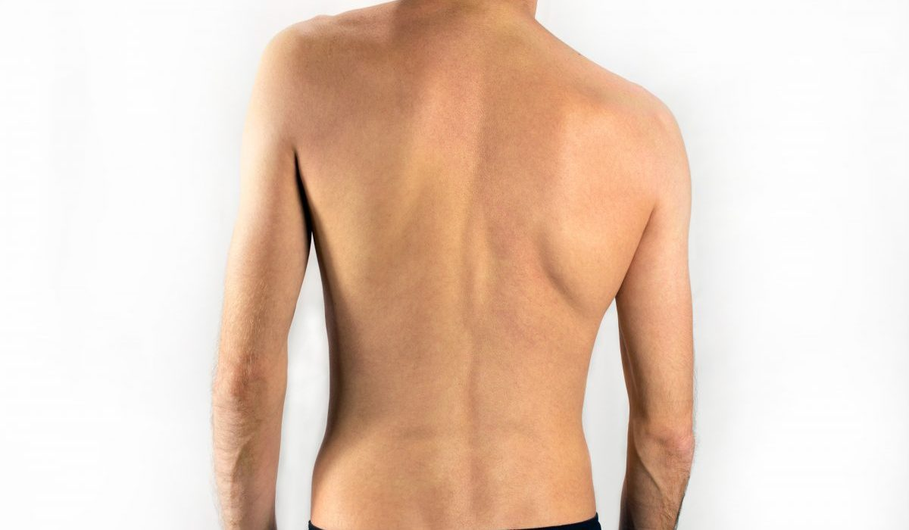
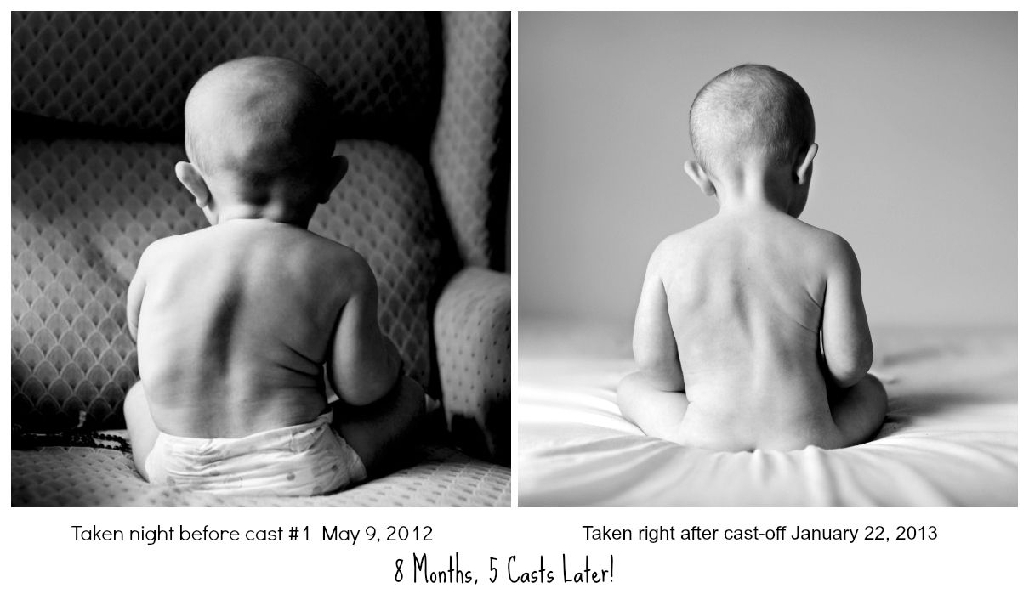
Screening Procedure Stage I
Notes:
Note obvious spinal curve
head/neck off center
elevated right shoulder
prominent right shoulder blade
arm/body space unequal
waist creases ???
Hip prominences ???
Lower spine dark area…possible café au lait spot

Slide 31
Screening Procedure Stage I
Position 5 – Student continues to bend forward, and screener is at the base of the spine
Observe any asymmetrical areas
Position 6 – Student continues to bend forward, and screener is at the head of the student
Observe any asymmetrical areas
Notes:
Position 5 Student’s back to screener
Does the student’s spins appear to curve laterally?
Position 6 Student bending forward slowly with back to screener
Observe spine for lateral curvature

Slide 32
Screening Procedure Stage I
Notes:
Position 6 note heightened right shoulder blade and curvature in student on the right.

Slide 33
Screening Procedure Stage I
Notes:
Elevated right thoracic area

Slide 34
Screening Procedure Stage 2
The second stage of screening requires use of the scoliometer
Student is in position 5 with back to screener bending forward slowly with hands together as if diving
When using a scoliometer, referral is made on students exhibiting unequal lumbar or thoracic areas of 7 degrees or greater
Notes:
The second stage of screening requires use of the scoliometer
Use of the scoliometer should make referral more accurate.
Presenter use a volunteer to quickly demonstrate each position for a brief overview, this will be in detail during the practicum.
Student is to stand erect with his/her toes placed on a piece of tape four to six feet away from the screener with feet 2-3 inches apart. With knees straight, and hands together as if diving. Student bend forward slowly at the waist. Place scoliometer so that the 0° is directly over the ridge of the spine.
When using a scoliometer, referral is made on students exhibiting unequal lumbar or thoracic areas of ≥ 7 degrees or greater.
Health care providers measure scoliosis curves in degrees:
A mild curve is less than 20 degrees.
A moderate curve is between 25 degrees and 40 degrees.
A severe curve is more than 50 degrees.

Slide 35
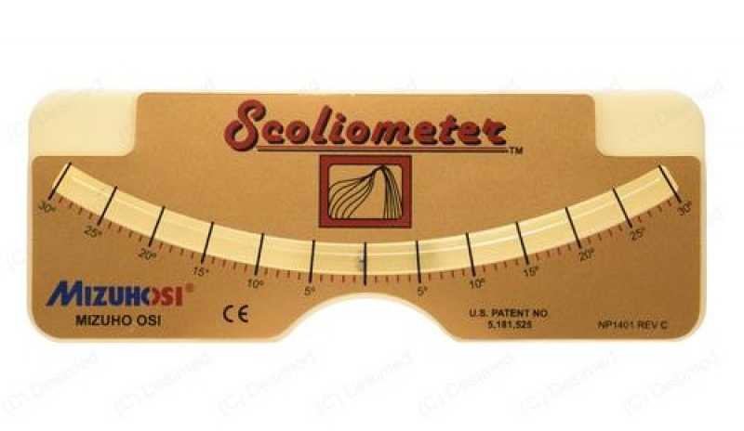
Scoliometer
Scoliometer: An instrument that measures the degree of rotation of a deformity of the back found on a routine scoliosis screening.

Slide 36
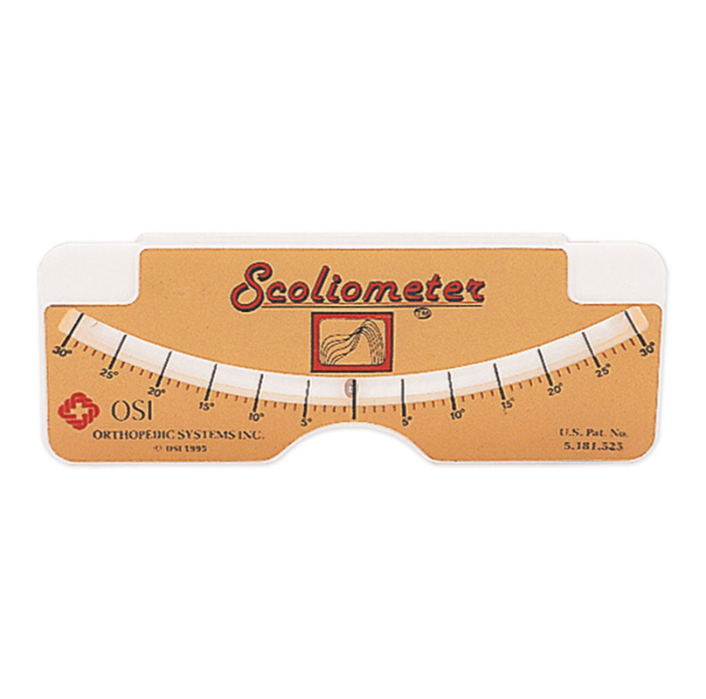
Equipment

Slide 37
Screening Demo
Notes:
Demo video from Boston Children’s Hospital

Slide 38
Follow Up
Reschedule absent students for screening within 90 days of missed screening
Reasons for all exclusions must be documented
Students referred to a physician for scoliosis screening failure that also FAIL to see a physician require contact by mail, telephone or in person at least one additional time to discuss importance of follow-up
Notes:
Follow-Up
The School shall schedule students, who were not screened because of absence, within 90 days after the missed screening.
Any reason for exclusion from the screening shall be documented.
The school shall recontact with the parents of students who failed the screening and were referred, but then missed that appointment.
This contact shall be made by letter, telephone call, or in person at least one additional time to discuss the importance of follow-up.

Slide 39
Spinal Screening Worksheet

Slide 40
Sample Letter
School: ___________________________
Date: _____________________________
Dear Parent,
Our records show that your child, ___________________________________________, had some of the signs and symptoms of scoliosis (curvature of the spine) during a routine screening on ___________________________. At that time, a letter was sent to your home with a report of our findings and a recommendation that he/she be examined by a physician.
Your child measured _________ on our screening tool. The State of Arkansas requires that all students with 7° or above be referred to a physician because of the possibility of rapid progression of the curvature.
Scoliosis, although fairly common and usually mild, can be a crippling disease and progress rapidly during the adolescent growth spurt. I have not received a letter from your doctor telling me that your child has been examined.
If money for the office visit is a problem, the State of Arkansas Children’s Medical Services does pay for an evaluation for those who qualify.
I strongly encourage you to have your child examined by a physician. If you have any questions, please contact me at the school.
Sincerely,
School Nurse

Slide 41
Report to Parent
Certified scoliosis screening instructor or school nurse shall contact the parents of a child who fails the screening by letter, telephone call, or in person to:
Explain the findings
Define and discuss scoliosis
Discuss the need for referral to a licensed physician
Notes:
The school shall provide a Scoliosis Screening Report to the parent to take to the licensed physician.

Slide 42
Scoliosis tracking and Annual Scoliosis Summary Reporting is completed on APSCN/eSchool

Slide 43
Treatment Options
Observation
Periodic medical examinations and x-rays
Bracing
Slows or stops curvature
Not a cure
Surgery
Notes:
Decisions regarding treatment are made by orthopods based on:
Spinal maturity—is the patient's spine still growing and changing? Risser sign can be used to estimate bone maturity level.
Location of curve— according to the Scoliosis Research Society, thoracic (upper spine) curves are more likely to progress than thoracolumbar (middle spine) or lumbar (lower spine) curves.
Potential for progression—patients who have large curves prior to their adolescent growth spurts are more likely to experience curve progression
MOST mild scoliosis curves don’t require treatment.
Mild curves should be monitored regularly to prevent worsening conditions.
Scoliosis more likely to worsen as long as bones are still growing-sometimes until late teens.
ONLY 30% OF CASES REQUIRE BRACING
ONLY 10% REQUIRE SURGERY

Slide 44
Bracing
Can be removed for sports, activities like bathing or swimming, and other events that are difficult to do with the TLSO-Thoracic Lumbar Sacral Orthosis
Activities must be limited to 3-4 hours a day to maintain “full time” wear schedule
Less than 16 hours a day compromises the effectiveness of the treatment; 18-20 hours a day is ideal
Nighttime devices must be worn every night, all night
Notes:
The TLSO can be removed for sports and activities, bathing, swimming, and other events that are difficult to do with the TLSO. These activities need to be kept to 3 to 4 hours a day to maintain the “full time” wear schedule. If you are getting less than 16 hours in a full time TLSO you will be compromising the effectiveness of the treatment. Keeping wear at 18 to 20 hours a day is ideal. Nighttime devices need to be worn all night every night. It should be noted that it is difficult for nighttime designs to compare in effectiveness to the full-time devices, especially in larger curves, simply because the wear schedule means less time with the curves in a corrected position.

Slide 45
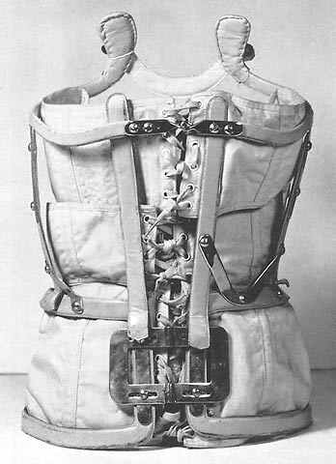
Bracing

Slide 46
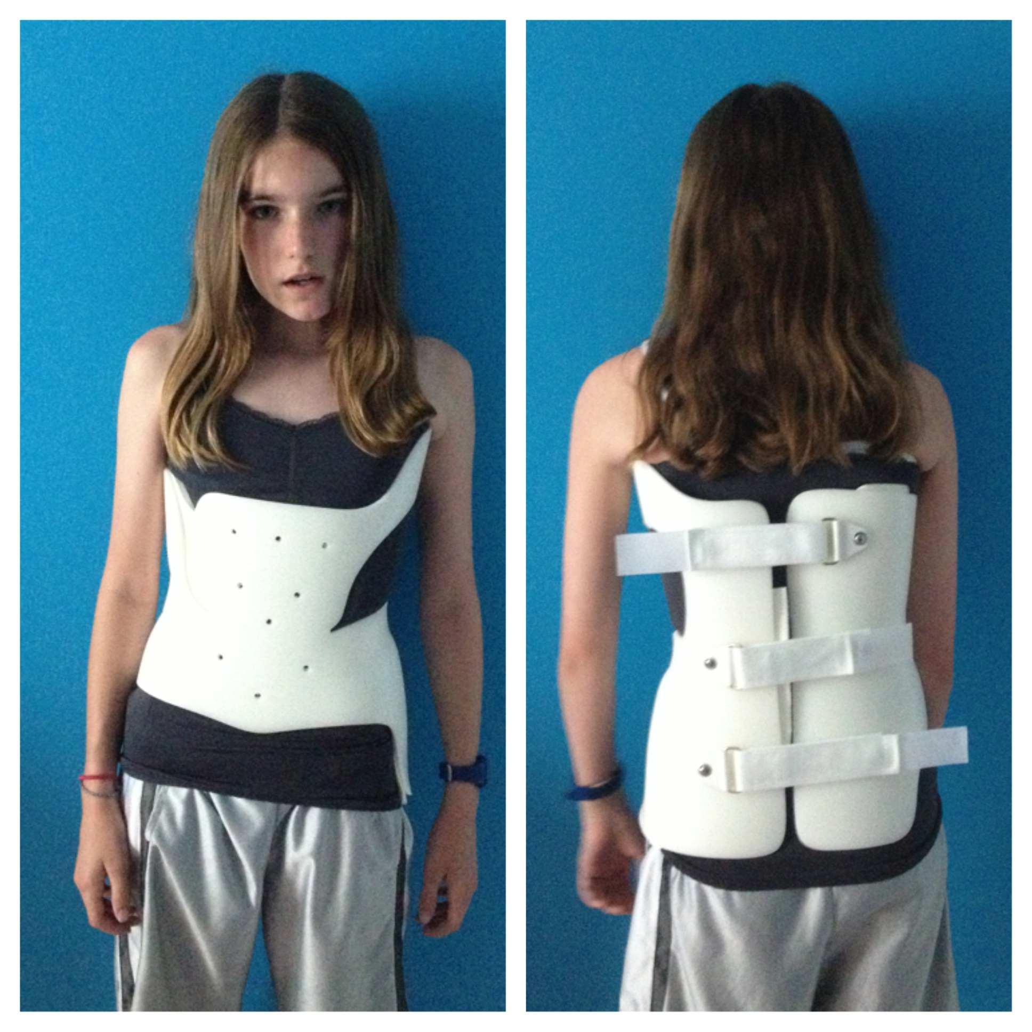
Boston Brace vs (WCR) Brace
Notes:
Rigo-Cheneau type TLSOs are a full-time device. These TSLOs focus on a 3-dimensional correction of the spine and associated deformities in an asymmetric shaped design.

Slide 47
Surgery- Spinal Fusion
Notes:
The old Harrington Rods are no longer used, the double rod system is used and no brace is required post operatively.
The most common surgery for adolescent idiopathic scoliosis is spinal fusion requiring surgical implantation of a spine system. The implant system consists of an anchor to the spine (hooks or screws), which gets attached to two rods. The system is then used to correct the curve and hold the spine in that corrected position until the spine fuses together. Only the part of the spine with scoliosis is fused. The remaining part of the spine does not undergo surgery, and the vertebrae remain mobile
Usually spinal fusion achieved by one (1) year post surgery. Rods no longer needed, but due to surgery required for rod removal, the rods are left in place.
Surgical treatment is indicated to improve the deformity and to prevent increasing deformity in the future. The most common surgical procedure is a posterior spinal fusion with instrumentation and bone graft. The term "instrumentation" refers to a variety of devices such as rods, hooks, wires and screws, which are used to hold the correction of the spine in as normal an alignment as possible while the bone fusion heals. The instrumentation is rarely removed. A number of factors influence the recommendation for surgery:
The area of the spine involved
Severity of scoliosis
Presence of increased or decreased kyphosis
Pain (rare in adolescents, more common in adults)
Growth remaining
Personal factors.

Slide 48
Surgery- Vertebral Body Stapling
Notes:
VBS is used as an alternative to bracing and spinal fusion for treatment of progressive scoliosis.
By not having to fuse the spine to correct the curvature, movement and flexibility can be maintained, allowing for preserved motion and less chance for back pain in adulthood.
or patients with progressive moderate scoliosis (less than 45°) who are still growing (girls up to age 14 and boys up to age 16), intervertebral body stapling of the convex (outer) side of the anterior spine may keep the curve from progressing.

Slide 49
Surgery- Vertebral Body Tethering
Notes:
This method preserves growth, flexibility, and may result in continuous correction of the spine over time with stiffening the spine.

Slide 50
Review- Fast Facts
A lack of calcium will not cause scoliosis
Poor posture does not cause scoliosis
Carrying a heavy book bag does not cause scoliosis
Scoliosis is not usually painful in adolescence, but can become so in adulthood
Bracing does not make the spine straight; it only slows down the curve or stops progression of the curve
Smoking does interfere with bone healing

Slide 51
Review- Fast Facts
The metal implant (spinal instrumentation) does not activate the metal detectors at airports, does not rust, and is not subject to rejection by the body
Surgery does not interfere with normal childbearing
Spinal deformities are not contagious
At present, there is no known prevention for spinal deformities
Notes:
Metal implants used for scoliosis correction are usually only needed for one year, at which time the spine has fused itself. However, because removal of the metal equipment requires another surgery, most surgeons will just leave the equipment in place as it does no harm.

Slide 52
Other Abnormalities
Child Abuse
Self Harm
Acanthosis Nigricans
Skin
Notes:
These are some other thing you are looking for when doing scoliosis screenings.

Slide 53
Suspected Child Abuse
Child Abuse defined by:
Arkansas Code 12-12-503
School nurses are mandated reporters
Reporting the suspected child abuse
Failure to report the suspected abuse
For more training on Mandated Reporting:
https://ar.mandatedreporter.org
Notes:
We are going to discuss child abuse for a few minutes.

Slide 54
Suspected Child Abuse
Child Abuse defined by:
Arkansas Code 12-12-503
Abuse can be physical or sexual. It includes non-accidental physical injury, shaking a baby, tying a child up, and giving or exposing a child to alcohol or other drugs.
Reasonable and moderate discipline (such as spanking) is generally not considered abuse, as long as it does not cause injury more serious than transient pain or minor temporary marks and is administered by a parent or guardian.
Child Abuse Hotline
1-800-482-5964
Notes:
Class C misdemeanor
Willful failure to report
Civilly liable for all damages proximately caused by that failure

Slide 55
Self Harm
Self harm- A sign of emotional distress, intentional injuring of oneself
Cutting
Hair pulling
Burning
Punching/hitting self
Anorexia Nervosa/Bulimia
Notes:
Self-harm occurs most often during the teenage and young adult years, though it can also happen later in life. Those at the most risk are people who have experienced trauma, neglect or abuse. Self-harm isn’t the same as attempting suicide.
https://www.nami.org/About-Mental-Illness/Common-with-Mental-Illness/Self-harm

Slide 56
Acanthosis Nigricans
Acanthosis nigricans (AN) is a brown to black, poorly defined, velvety hyperpigmentation of the skin. It is usually found in body folds, back of the neck, the armpits, groin, navel, forehead, and other areas.
This can be an indication of diabetes.
Notes:
Acanthosis nigricans is a brown to black, poorly defined, velvety hyperpigmentation of the skin. It is usually found in body folds,^{[1]} such as the posterior and lateral folds of the neck such as the posterior and lateral folds of the neck, the armpits such as the posterior and lateral folds of the neck, the armpits, groin such as the posterior and lateral folds of the neck, the armpits, groin, navel such as the posterior and lateral folds of the neck, the armpits, groin, navel, forehead, and other areas. It frequently manifests itself on the nape and sides of the neck but can also be found on the axillae (underarm), elbows, knuckles, knees, and groin area.
The most common cause of acanthosis nigricans is insulin resistance, which leads to increased circulating insulin levels.
Hispanics, Native Americans, and African Americans have a higher prevalence of these lesions and could be genetically predisposed and more sensitive to higher insulin levels.
This is an indication of early diagnosis of diabetes. People with acanthosis nigricans should be screened for diabetes.
With the increased rate of obesity, and the increased rate of type two diabetes in children, we are seeing this more & more.

Slide 57
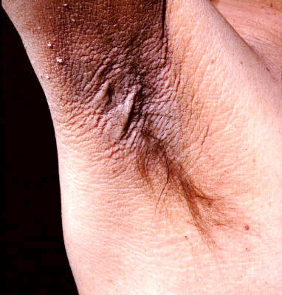
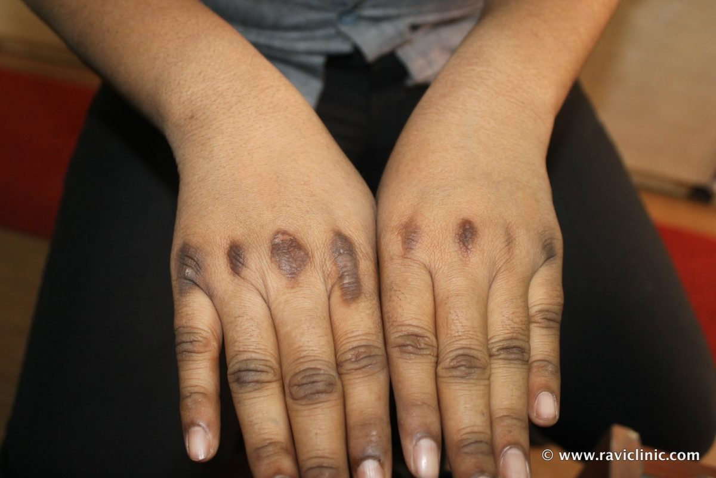
Acanthosis Nigricans
Notes:
Acanthosis nigricans is a brown to black, poorly defined, velvety hyperpigmentation of the skin. It is usually found in body folds,^{[1]} such as the posterior and lateral folds of the neck such as the posterior and lateral folds of the neck, the armpits such as the posterior and lateral folds of the neck, the armpits, groin such as the posterior and lateral folds of the neck, the armpits, groin, navel such as the posterior and lateral folds of the neck, the armpits, groin, navel, forehead, and other areas. It frequently manifests itself on the nape and sides of the neck but can also be found on the axillae (underarm), elbows, knuckles, knees, and groin area.
The most common cause of acanthosis nigricans is insulin resistance, which leads to increased circulating insulin levels.
Hispanics, Native Americans, and African Americans have a higher prevalence of these lesions and could be genetically predisposed and more sensitive to higher insulin levels.
This is an indication of early diagnosis of diabetes. People with acanthosis nigricans should be screened for diabetes.
With the increased rate of obesity, and the increased rate of type two diabetes in children, we are seeing this more & more.

Slide 58
Skin
The sun’s ultraviolet (UV) rays can damage skin in as little as 15 minutes
In the US, 35% of adults, 59% of college students, and 17% of students have reported using a tanning bed in their lifetime
Skin cancer is on the rise in youth
During the scoliosis screening, you may notice some abnormal moles
Notes:
You are also paying attention to the skin and looking for any concerning abnormalities.
https://www.cdc.gov/cancer/skin/statistics/behavior/indoor-tanning.htm
For more information, see weebly under skin cancer.

Slide 59
Skin
Acne is common in teens
Blackheads, whiteheads, pimples
Occurring on face, chest, shoulder, and back
Clogged with oil and dead skin
Simple Staph vs MRSA
Simple staph may be mild, causing mild discomfort, heat, and redness
MRSA is resistant to most antibiotics and is more serious, causing pain, redness, and possible drainage
Notes:
MRSA is the most common cause of skin and soft tissue infections.
Treatment:
Antibiotics
Drainage of abscesses
An antibiotic ointment is used if a minor skin infection develops. Antibiotics also need to be taken by mouth or given by injection if a large area of skin is infected.
Keep covered if draining.
Abscesses should be cut open by a doctor and allowed to drain, and any dead tissue must be surgically removed.

Slide 60
Referrals
Children’s Services
(formerly know as Children’s Medical Services)
Department of Human Services
Donaghey Plaza South
PO Box 1437, S401
Little Rock, AR 72203-1437
(501) 682-8292
Notes:
For families with financial concerns, children may be able to receive financial assistance from Children’s Services , Arkansas DHS,. Application for Children’s Services should be made contacted before obtaining the diagnostic work-up.
For information about assistance contact:
Children’s Services
Donaghey Plaza South
P.O. Box 1437 Slot 526
Little Rock, AR 72203-1437
Phone Number: Toll Free (800) 482-5850-ext.-22277 or (501) 682-2277

Slide 61
Referrals
Shriners Hospitals for Children
(Shreveport or St. Louis)
Contact local club/representative for application
Scimitar Shrine Temple – Little Rock 501-565-5992
Shrine 1-800-237-5055

Slide 62
Referrals
Shriners Hospitals for Children
Less than 18 years old
Copy of immunizations and birth certificate
Letter of referral from PCP
3 pictures of child’s problem
X-rays
CT
MRI

Slide 63
Resources
http://srs.org
https://rad.Washington.edu/
Individual Healthcare Plans for School Nurses (2017)
The New School Nurse Handbook (3rd Edition)
School Nursing: A Comprehensive Text (2019)

Slide 64
Resources
https://www.kidshealth.org
https://www.stlouischildrens.org
https://www.hopkinsmedicine.org
https://www.childrenshospital.org/

Slide 65
Nicolas’ Surgery
Notes:
https://www.youtube.com/watch?v=mzAWCHmKbW4
https://www.hopkinsmedicine.org/health/conditions-and-diseases/scoliosis/5-facts-about-scoliosis-every-parent-should-know

Slide 66
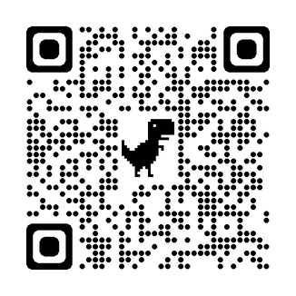
Knowledge Check

Slide 67
Thank You

