Slide 1
Renee Holmes, RN
Partners for Inclusive Communities
September 8, 2017
4th Annual Step Up Health Care Transition Conference
Little Rock, AR
Transition Resources For Young Adults And Their Families
Transition Resources For Young Adults And Their Families

Slide 2
Transitioning Into Adult Medical Services
Finding an Adult Provider-
Illinois Healthcare Transition Project
Disregard the link within the form for the Illinois Provider Directory.
http://illinoisaap.org/wp-content/uploads/FindingAdultProviders.pdf
The Medical Home Portal fro Utah
https://www.medicalhomeportal.org/living-with-child/navigating-transitions-with-your-child/transition-to-adulthood/finding-adult-health-care
Notes:
Families report finding an adult provider comfortable meeting the needs of a young adult with special healthcare needs is one of the first road blocks they find

Slide 3
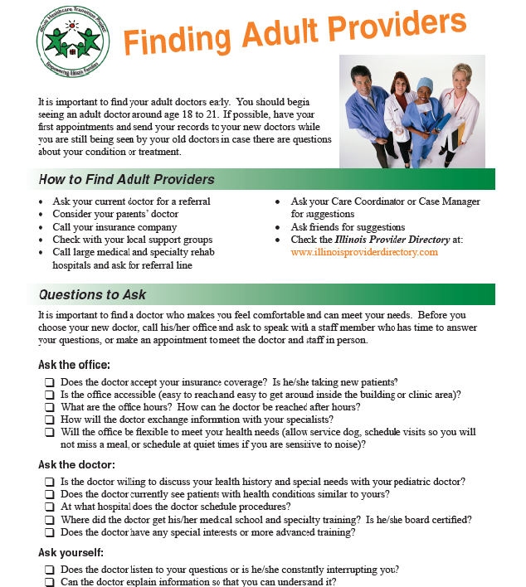

Slide 4
Transitioning Into Adult Medical Services
Since You’re Not a Kid Anymore
This is a handbook for younger teens, written for middle school students with medical and/or developmental needs.
http://www.deldhub.com/pdf/Since%20You%20are%20Not%20a%20Kid%20Anymore.pdf

Slide 5


Slide 6
Transitioning Into Adult Medical Services
Now That You’re In High School
This is a handbook for older teens. It covers many transition topics important to teens.
http://www.floridahealth.gov/AlternateSites/CMS-Kids/kids_teens/documents/highschool_booklet.pdf

Slide 7


Slide 8
Transitioning Into Adult Medical Services
Being a Healthy Adult
This is a resource for the youth and their family. This adds roll-playing activities and check lists to help families find their transition strengths.
http://rwjms.rutgers.edu/departments_institutes/boggscenter/products/documents/TransitiontoAdultHealthcare-EN-complete.pdf

Slide 9


Slide 10
Transitioning Into Adult Medical Services
Medical Notebooks
Vital Records Guide- available from DDS-CS staff, PAC representatives.

Slide 11


Slide 12
Online and Electronic Notebooks
Online Medical Notebook Templates- print and place in a 3 ring binder that will be accessible to those caring for your family member. Can print and use just the pages needed for your family. http://cshcn.org/wp-content/uploads/files/Care_Notebook/CareNotebook-AllDocuments.pdf

Slide 13
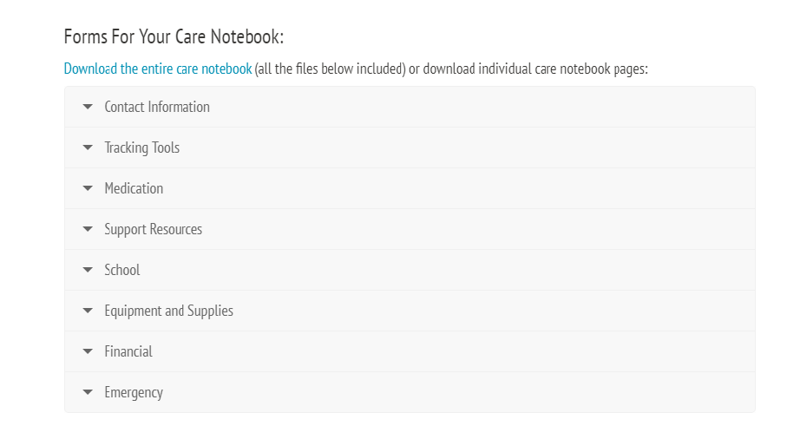

Slide 14
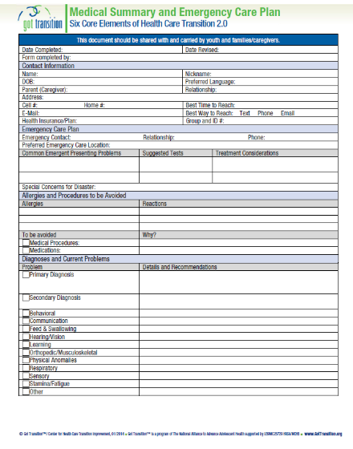
Got Transition
Medical Summary
6 page printable summary including daily care information and information needed in an emergency.
http://www.gottransition.org/resourceGet.cfm?id=227

Slide 15
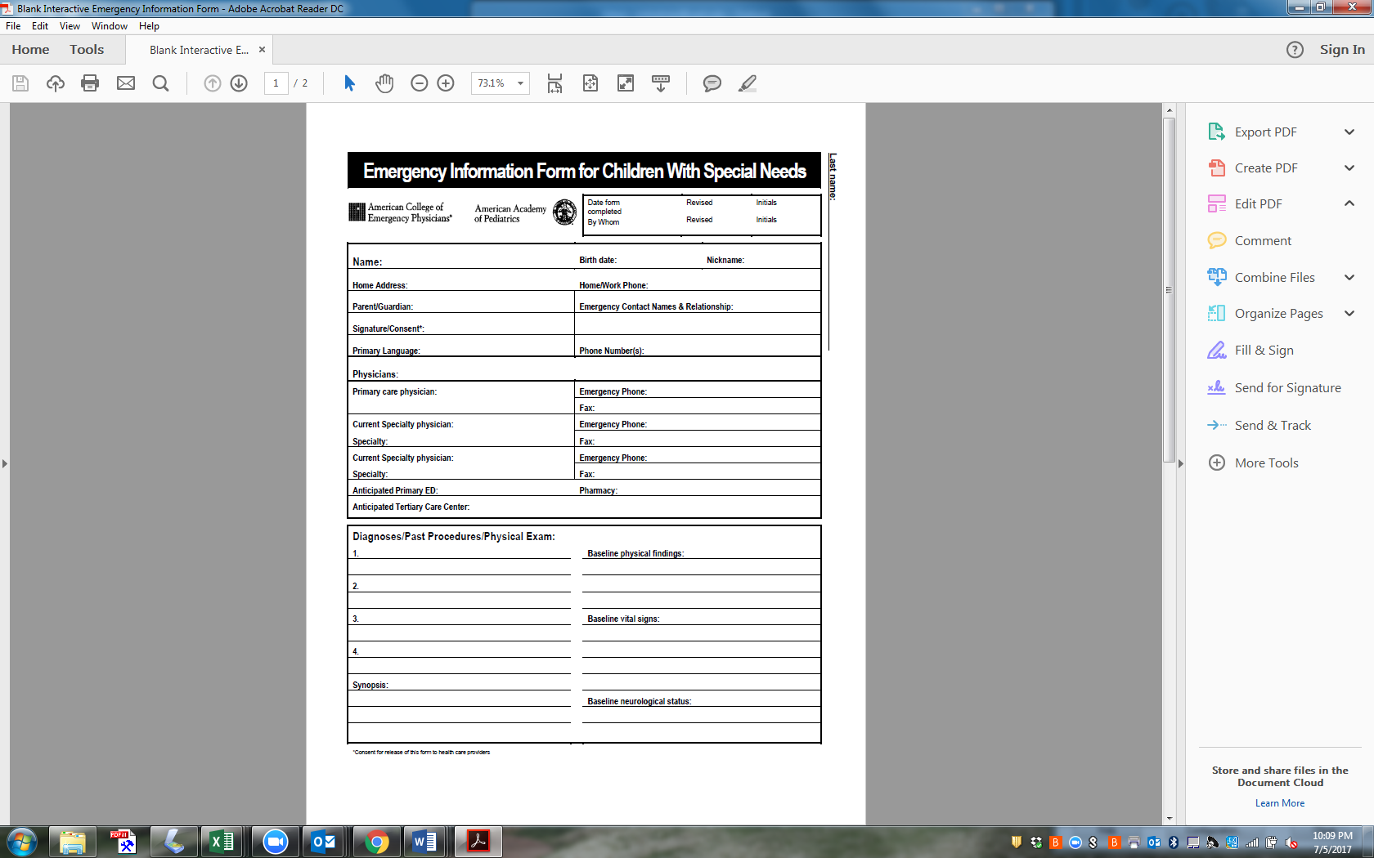
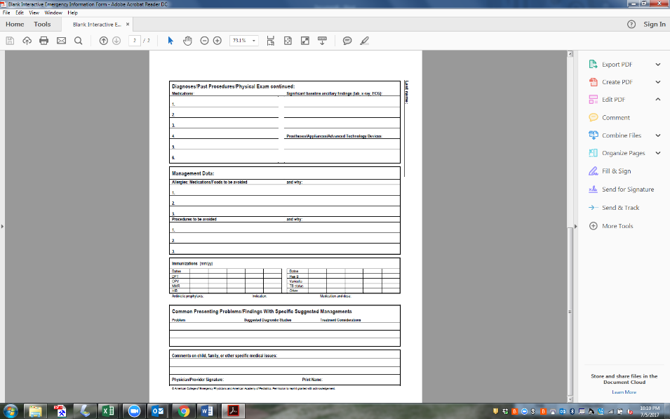
Emergency Information Sheets
Two page quick reference guide. Other resources available on the CDC site regarding emergency preparedness for individuals with special healthcare needs.
https://nebula.wsimg.com/5f62b299b82122afe6b1ea9749e34ef0?AccessKeyId=C26AE7E950867CB5F9B4&disposition=0&alloworigin=1

Slide 16
Post High School Educational Resources and Planning
Arkansas Rehabilitation Services http://ace.arkansas.gov/Pages/default.aspx
Arkansas Transition Services http://arkansastransition.com/
Many local providers offer day habilitation services before a young person’s waiver wait list number has come up. The can provide day services through other Medicaid categories.

Slide 17
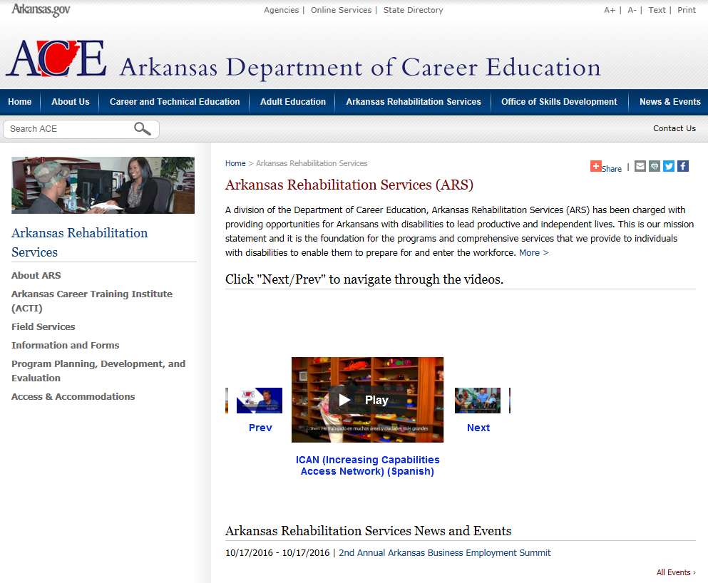
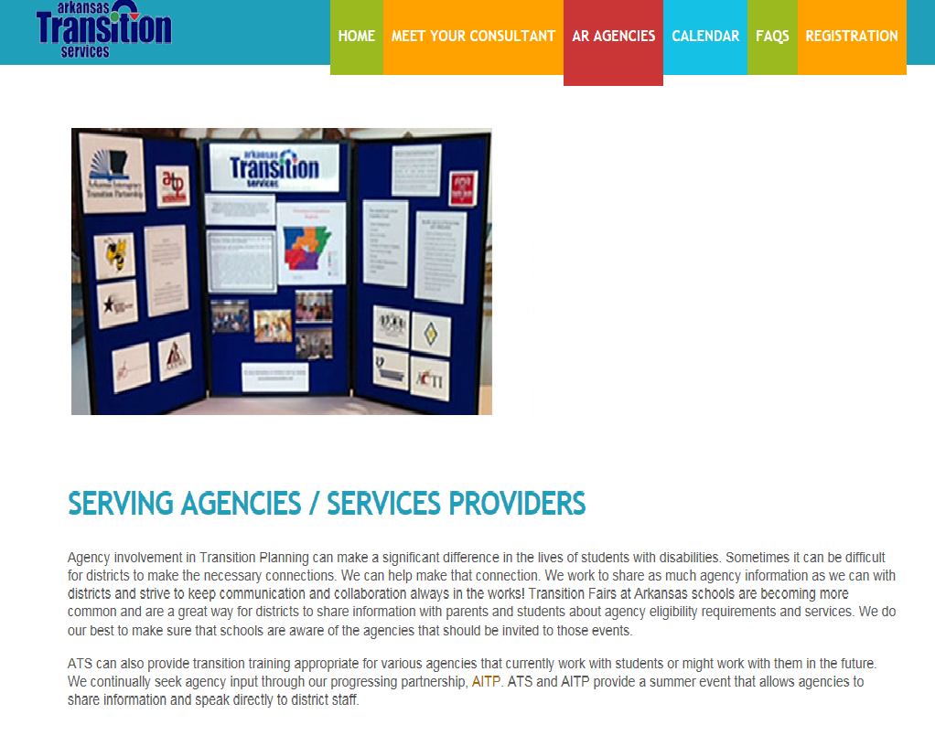

Slide 18

Post High School Educational Resources and Planning
Putting Faith to Work

Slide 19
Resources for Community Independence
Community and Employment Supports Waiver (ACS Waiver)- Intake completed by DDS/CS case managers for youth still in high school. Adult Intake and Referral for those who have completed high school. https://access.arkansas.gov/LongTermService.aspx
Independent Choices- person-driven program to direct the personal care in your home. Must be 18. https://access.arkansas.gov/LongTermService.aspx

Slide 20
Resources for Community Independence
Alternatives for Adults With Physical Disabilities- In-home services for those 21-64 years with physical disabilities. https://access.arkansas.gov/LongTermService.aspx
Living Choices- In-home services for those over 21 years old. Must meet level of need for care in a nursing facility. https://access.arkansas.gov/LongTermService.aspx

Slide 21
Resources for Individual Independence
Printable Health Passport http://flfcic.fmhi.usf.edu/docs/FCIC_Health_Passport_Form_Typeable_English.pdf

Slide 22
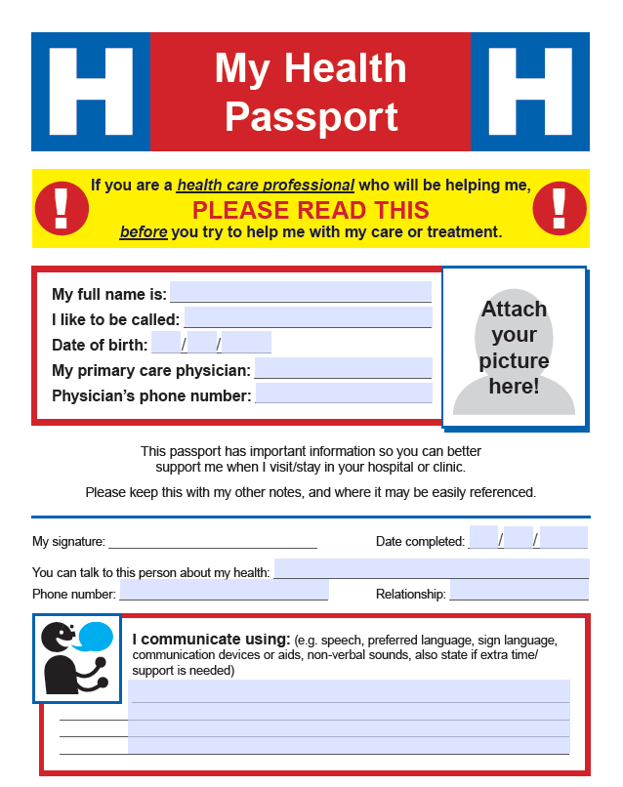

Slide 23
Resources for Individual Independence
Technology based reminders https://secure.medactionplan.com/mymedschedule/transplantexperience/
http://www.mymedicalapp.com/
Wallet Card- not used by all police departments
http://www.justdigit.org/wallet-cards/

Slide 24
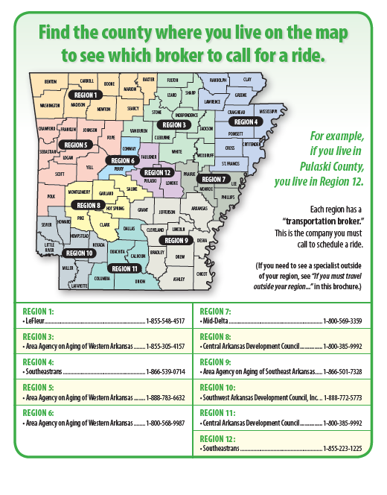
Resources for Individual Independence
Medicaid Transportation https://afmc.org/wp-content/uploads/2016/07/NETBroker-Map_Eng_Span.pdf

Slide 25

Resources for Individual Independence
Life Line phone services https://www.fcc.gov/consumers/guides/lifeline-support-affordable-communications

Slide 26
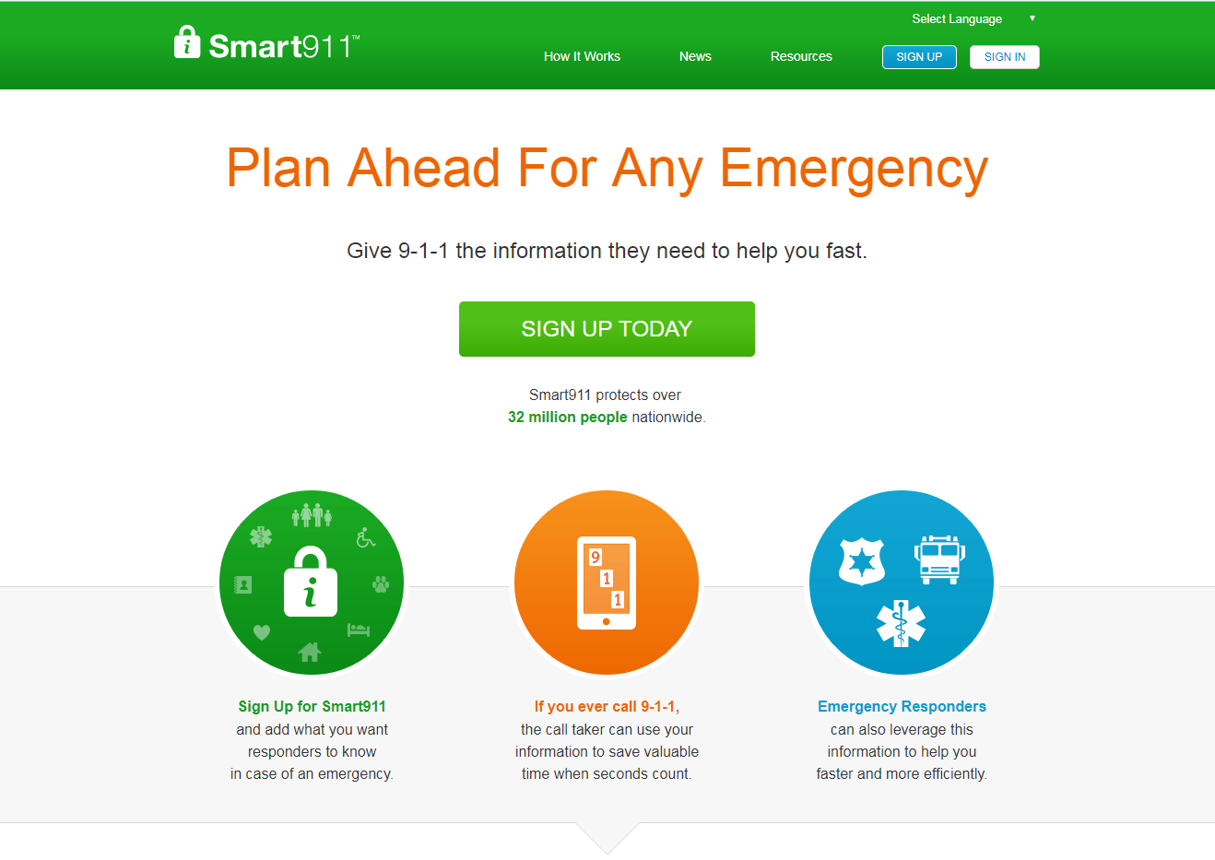
Resources for Individual Independence
Smart 911
Information is added by an individual or family and stored in the Smart 911 database

Slide 27
Medication Management
Use of technology based reminders
Use of visual schedule for daily medications
Medication boxes
Medication refills
The appropriate use of over the counter medications
Reading medication labels

Slide 28
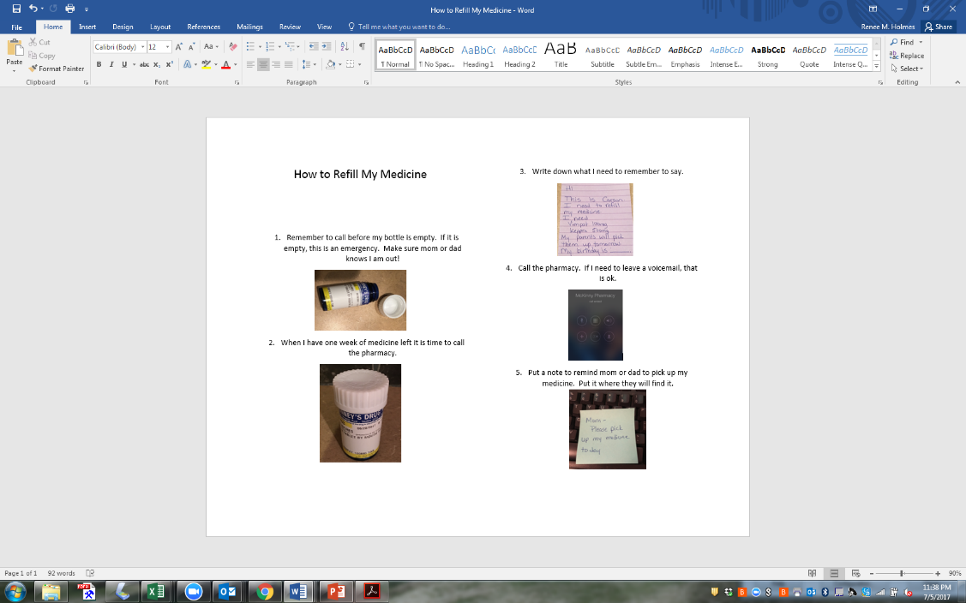
Visual Aide Used to Refill Medication

Slide 29

Behavioral Health Transition Resources
Wraparound Services http://humanservices.arkansas.gov/dbhs/Documents/Children's%20Wraparound%20Brochure.pdf

Slide 30

Behavioral Health Transition Resources
ArkSTART http://arkansasstart.org/ A division of Partners for Inclusive Communities service those with intellectual and developmental disabilities and behavioral health needs.

Slide 31

Legal Resources
Guardianship

Slide 32
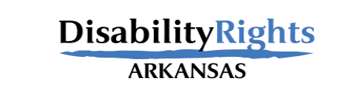
Legal Resources
Selective Service
https://www.sss.gov/QA
Legal Aid
http://www.arlegalservices.org/
Disability Rights Arkansas
https://disabilityrightsar.org/resources/

Slide 33
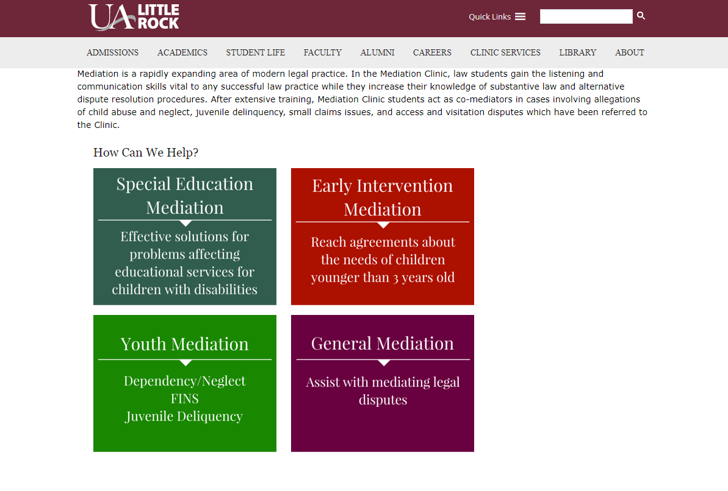
Legal Resources
UALR Mediation Clinic
Special Education Medication
Early Intervention Mediation
Youth Mediation
General Mediation

Slide 34
Insurance Transition Resources
Social Security Coverage
https://www.ssa.gov/disability/
DAC- Disabled Adult Child Medicaid for those with income over the limits allowed by SSI http://humanservices.arkansas.gov/dco/dco_docs/Quick%20Reference%20Medicaid%20Chart.pdf
ACCESS ARKANSAS https://access.arkansas.gov/Welcome.aspx

Slide 35
Sexual Health Resources for Transition
Healthy Bodies- Boys http://kc.vanderbilt.edu/healthybodies/
Healthy Bodies- Girls http://kc.vanderbilt.edu/healthybodies/

Slide 36



Slide 37

Sexual Health Resources for Transition
Relationships and Sexual Health http://www.mass.gov/eohhs/docs/dph/com-health/prevention/hrhs-sexuality-and-disability-resource-guide.pdf

Slide 38
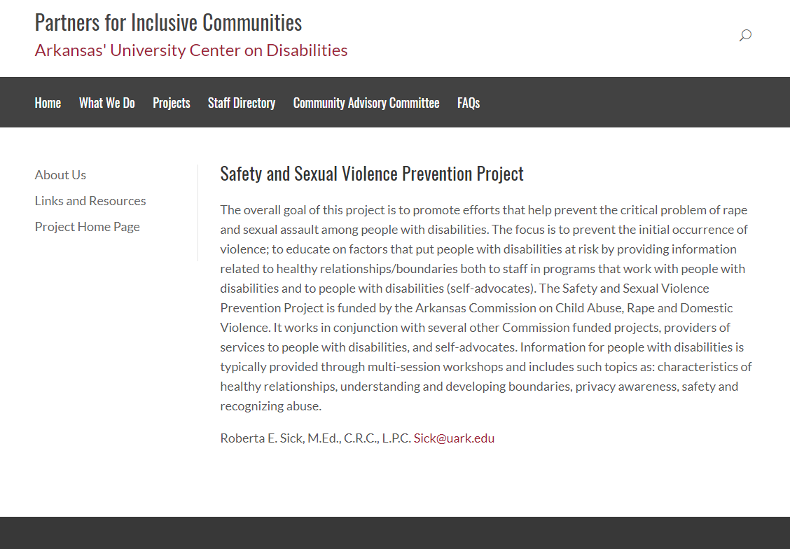
Sexual Health Resources for Transition
Trainings available regarding healthy relationships, safety and sexual violence prevention
Project of the University of Arkansas-Partner’s for Inclusive Communities

Slide 39
Other Transition Resources
Condition Specific Transition Materials
  http://www.floridahats.org/for-youth- families/
Arkansas Governor’s DD Council
http://www.ddcouncil.org/
  (Resource guides are currently being revised. When they are available they will post online.)
Parent Advisory Council Transition http://arkansaspac.org/
Forms and brochures. 2 side fliers available from DDS-CS and PAC. Online links to many other resources.

Slide 40
Other resources regardless of age
ArHipp- myarhipp.com
Provides coverage for private insurance premiums for families with both Medicaid and private insurance.
Services available through SSI and TEFRA
Division of Developmental Disabilities- Children’s Services
Arkansas tax credits for families with children with disabilities
AR1000DC- does not require doctor’s signature
AR1000RC5- does require doctor’s signature and diagnosis specific

Slide 41
Spanish Transition Resources
You’re Not a Kid Anymore
http://www.floridahealth.gov/AlternateSites/CMS-Kids/kids_teens/documents/notakidanymore_sp.pdf
Now That You’re In High School
http://www.floridahealth.gov/AlternateSites/CMS-Kids/kids_teens/documents/highschool_booklet_sp.pdf

Slide 42
Spanish Transition Resources
Being a Healthy Adult
http://rwjms.rutgers.edu/departments_institutes/boggscenter/products/documents/TransitiontoAdultHealthcare-SP-complete.pdf
Online Medical Notebook Template
http://cshcn.org/wp-content/uploads/files/Care_Notebook/CareNotebook-AllDocuments.pdf

Slide 43
Spanish Transition Resources
Printable Health Passport
http://flfcic.fmhi.usf.edu/docs/FCIC_Health_Passport_Form_Typeable_Spanish.pdf
Healthy Bodies- Boys
http://kc.vanderbilt.edu/healthybodies/Sp-index.html
Healthy Bodies- Girls
http://kc.vanderbilt.edu/healthybodies/Sp-index.html

Slide 44
Spanish Transition Resources
Arkansas Governor’s DD Council- Available to translate into multiple languages
http://www.ddcouncil.org/

Slide 45

Why transition is important

Slide 46

Renee Holmes, RN
Arkansas Autism Partnership Coordinator
EPSDT ABA Program Coordinator
ArkStart Positive Behavior Support Trainer
(479)871-2836 rmholmes@uark.edu
Partners For Inclusive Communities
322 MaiN Street
Suite 501
Little Rock, AR 72201

