Slide 1
Adrenal Insufficiency & Crisis
A Training Guide for
School Personnel

Slide 2
Learning Objectives
Updated Arkansas Law
Understand the Purpose of the Adrenal Glands
Understand the Meaning of Adrenal Insufficiency
Understand Differences Between Adrenal Insufficiency & Adrenal Crisis
Understand Medication Needs
Recognize the Signs and Symptoms
Recognize When Additional Medication May or May Not Be Needed
Important Things to Remember
How to Help Prevent a Crisis
Treatment - Oral
Treatment - Injection
Summary
References

Slide 3
A.C.A §6-18-718 (6)(18)(7)(a)(1) “Self-administration of a stress dose medication by a public school student with adrenal insufficiency while the student is at his or her public school, on his or her public school grounds, or at an activity related to his or her public school may be permitted with the authorization of the public school student's parent, legal guardian, or person standing in loco parentis and the public school student's treating physician if the public school student's parent, legal guardian, or person standing in loco parentis provides written authorization for the public school student to carry a stress dose medication while he or she is at public school, an on-site school-related activity, or an off-site school-sponsored activity.” A.C.A. § 6-18-718 (Lexis Advance through all acts of the 2021 Regular Session, First Extraordinary Session, Extended Session, and Second Extraordinary Session, including corrections and edits by the Arkansas Code Revision Commission)
Updated Arkansas Law
Note: for the purpose of this training and per A.C.A §6-18-718 (6)(18)(7)(a)(1) “stress dose medication” means oral hydrocortisone

Slide 4
A.C.A. §17-87-103 (15)(A) “The administration of an emergency dose medication to a public school student who is diagnosed with an adrenal insufficiency by volunteer public school personnel if the public school personnel are trained to administer an emergency dose medication using the appropriate delivery equipment when a public school nurse is unavailable.” A.C.A. § 17-87-103 (Lexis Advance through all acts of the 2021 Regular Session, First Extraordinary Session, Extended Session, and Second Extraordinary Session, including corrections and edits by the Arkansas Code Revision Commission)
Updated Arkansas Law
Note: for the purpose of this training and per A.C.A. §17-87-103 (15)(A) “emergency dose medication” means intramuscular hydrocortisone sodium succinate

Slide 5
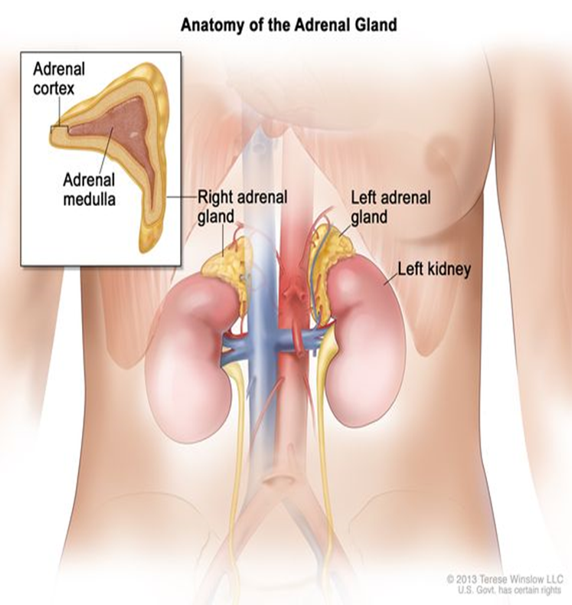
Adrenal Glands
Where are the adrenal glands?
There are two adrenal glands and
each is located on top of each kidney
Adrenal Gland Responsibilities:
Make adrenaline during times of stress
Make the steroid hormones cortisol and aldosterone.
These hormones control your heart rate, blood pressure, help fight infections, and other bodily functions

Slide 6
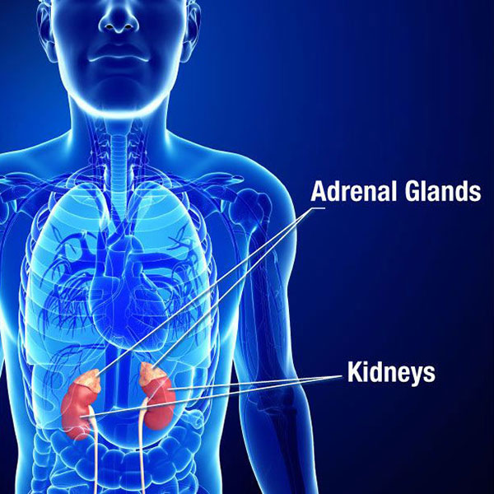
Adrenal Insufficiency
What is Adrenal Insufficiency?
Medical condition in which the adrenal glands cannot produce enough of the hormone cortisol
Cortisol is necessary for:
Maintenance of energy supply
Fluid and electrolyte balance
Control of blood pressure and blood sugar levels
Control of the body’s reaction to illness and injury
Note: Some individuals may also lack the hormone aldosterone, the hormone needed to balance the levels of sodium and potassium in the body.

Slide 7
Adrenal Insufficiency & Adrenal Crisis
Adrenal Insufficiency
Adrenal Crisis
Chronic medical condition
May be caused by disease of the adrenal or pituitary glands
May also be caused by long-term steroid use
Requires daily medication
Acute medical condition
May be caused by illness, physical injury, stress, or stopping steroid medications
Requires immediate treatment with additional oral or injectable medication
vs.
Note: Schools should have phone numbers for parents and physicians of students with adrenal insufficiency. If your student is unconscious, or hard to keep awake, assume they are having an adrenal crisis. Persistent vomiting or a serious injury such as broken bones puts one at risk for a crisis.

Slide 8
Medication Needs
Children who suffer from adrenal insufficiency are unable to produce the necessary amount of cortisol to help maintain essential bodily functions or respond to distress. As a result students will need on-going daily medication as well as additional medication during times of illness or injury.
Daily medication examples:
Hydrocortisone
Prednisolone
Dexamethasone
These medications are taken orally
Medication examples for illness/injury:
Increased/additional doses of the student’s oral daily medication
Intramuscular injections of hydrocortisone
(Solu-Cortef®)

Slide 9
Medication Needs
Refer to your student’s Health Plan for instructions regarding their prescribed medication and dosage as it contains important information for oral or injectable dosing for mild, moderate, or severe illness and/or injury. Depending upon the severity of the event the medication may be given orally or via injection.
In many cases of adrenal crisis, an oral stress dose of medication (e.g. hydrocortisone) is given, followed by a phone call to a parent/guardian to pick them up from school
In cases of serious illness or injury an emergency dose of medication (e.g. Solu-Cortef®) given via IM injection may be necessary

Slide 10
How Will I Know If My Student Needs a Dose of Medication?
Acute adrenal crisis is life threatening and needs prompt treatment. It is extremely important to seek medical attention when any of these are noticed, as it indicates your student needs a stress dose or an emergency dose.
Symptoms Include:
Pale, cold, clammy skin, shivering
Headache/dizziness
Lethargy/listlessness
Pain: abdominal, back, flank, legs
Fever/Infections
Rapid pulse and/or breathing
Nausea or vomiting/diarrhea
Neurological deficits:
behavior changes, confusion, difficulty speaking, slurred speech
Even if you are unsure, don’t hesitate to call parents or alert the school nurse. Getting extra cortisol will NOT be harmful. When in doubt, give the medication.

Slide 11
When is Medication Administered?
Stress Dose
Emergency Dose
Fever (Above 100.4º F)
Moderate illness
Moderate injury
Can be self-administered
Oral administration
Repeated vomiting
Serious injury (broken bone, head injury, etc.)
Child is unconscious
Can be administered by trained school staff
Intramuscular injection
vs.
Note: Administering medication is time-critical. Please note that the dose can be self-administered (stress dose) or administered by trained school personnel (emergency dose.) Steroid medications should be stored as directed and easily accessible.

Slide 12
Note: If your student’s illness or injury is mild you may need to consult with the school nurse or parents to discuss whether a stress dose is needed or not. Remember that physician’s orders should always be followed when administering medication.
When Do I Not Administer Medication?
Medication Administration is Not Usually Needed For:
Mild injury (Example: scraped knee)
Mild illness (Example: runny nose, cough)
Mild emotional stress

Slide 13
Note: An emergency identification bracelet can be a life saving tool
Important Things to Remember
Adrenal crises can happen anywhere
A crises can progress quickly
It is better to give medication than none at all
Young children may be more at risk because they are unable to communicate as effectively

Slide 14
How Can I Lessen the Chance of my Student Needing Emergency Treatment?
Be Mindful of:
Hot days which can increase risk of dehydration
Illnesses circulating around the school
Even when you are unsure, do not hesitate to send the student to the nurse or contact the student’s parents if you notice possible signs and symptoms of adrenal crisis
Reminder: Giving extra hydrocortisone will not be harmful. When in doubt, give the medication.

Slide 15
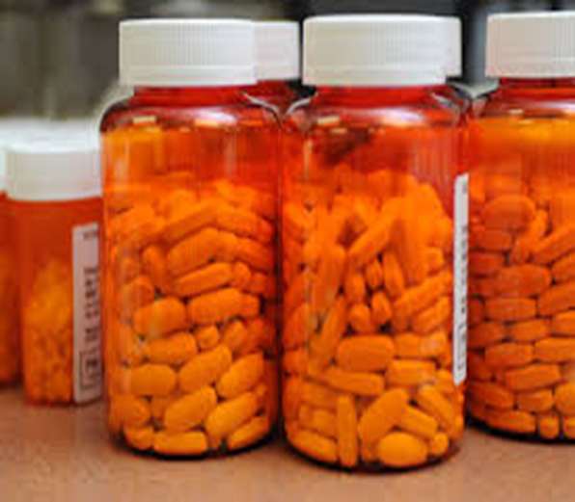
Treatment: Oral Medication
Provide dose per the student's health plan and/or prescription instructions
Oral stress dosing is for moderate illness or injury
In most cases your student will be well served by an oral stress dose and a call to a parent or guardian for the student to be picked up from school for the remainder of the
day

Slide 16
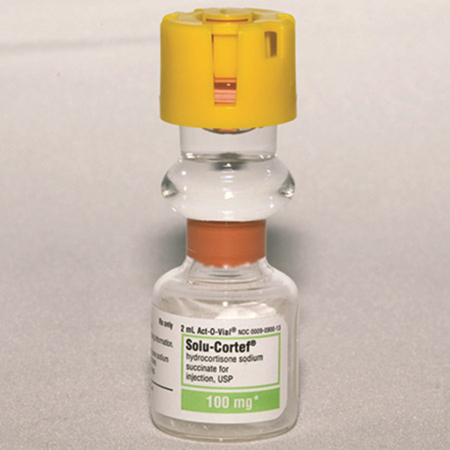
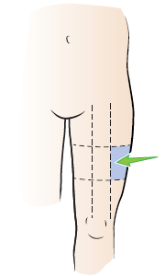
1. Wash hands 2. Assemble needed equipment 3. Mix medication in vial by pushing on top of vial to release the cork 4. Shake the vial to ensure medication is mixed (solution should be clear) 5. Use alcohol swab to clean the rubber stopper on vial 6. Remove cap from syringe needle. Insert needle into the vial. 7. Draw medication up to dose prescribed by physician (see Student’s Health Plan) 8. Replace needle cap 9. Select injection site (Outer portion of thigh, middle third section)
Treatment Instructions: Injection Preparation

Slide 17
1. Clean injection site on skin with alcohol swab 2. Remove the cap from the needle, hold the syringe like a dart 3. Spread skin of injection site while pushing down lightly 5. Quickly insert the needle into the thigh injection site, going in at a 90- degree angle 4. Hold syringe in place and fully depress plunger to inject medication 5. After injecting the medication, remove syringe, cover with injection site with gauze and apply pressure for a few seconds 6. Place syringe and needle in sharps container or unbreakable container before disposing of it 7. Ensure that 911 and parent have been called. Student may need additional medical attention.
Treatment Instructions: Injection
Resource: Children’s Hospital of Philadelphia Solu-Cortef Emergency Injection Training Video

Slide 18
Summary
Symptoms to monitor for adrenal crisis include, but are not limited to: headache, weakness, abdominal pain, dizziness, confusion, significant fatigue, nausea
Medication may be administered orally (stress dose) or via injection (emergency dose), this will be determined by the severity of the symptoms
Medication should be administered without delay when student is experiencing symptoms of adrenal crisis
A.C.A §6-18-718 states that a student experiencing an adrenal crisis may self-administer a stress dose
A.C.A. §17-87-103 states that trained school personnel may administer an emergency dose
In the case of someone having an adrenal crisis that requires an injectable stress dose:
Send someone to call 911 and the student’s parents
Stay calm as you prepare to give the injection
Give injection and wait with your student until help arrives

Slide 19
References
Children’s Hospital of Philadelphia (CHOP). (n.d.). Adrenal Insufficiency. CHOP. ​
https://www.chop.edu/conditions- diseases/adrenal-insufficiency ​
​
Colletti, Amanda et al. (2016, February) Adrenal Insufficiency: Recognizing and Managing Adrenal ​
Insufficiency in the Adrenal Insufficient Student [Powerpoint Slides]. Adrenal Insufficiency United. https://www.aiunited.org ​
​
Johns Hopkins Medicine. (n.d.). Adrenal Glands. HopkinsMedicine. ​
https://www.hopkinsmedicine.org/health/conditions-and-diseases/adrenal-glands ​
​
MediLexicon International. (2020). Adrenal insufficiency: Definition, symptoms, and ​
treatments. Medical News Today. https://www.medicalnewstoday.com/articles/adrenal-insufficiency​
​Memorial Sloan Kettering Cancer Center. (2022, January 11). How to give an emergency injection using Solu-Cortef® Act-O-Vial. Memorial Sloan Kettering Cancer Center. Retrieved May 16, 2022, from https://www.mskcc.org/cancer-care/patient-education/give-emergency-injection-using-solu-cortef-act-o-vial
National Institute of Diabetes and Digestive and Kidney Diseases. (2018, September). CRH tells the ​
pituitary to make ACTH, which in turn tells the adrenals to make cortisol. [Screenshot]. https://www.niddk.nih.gov/health-information/endocrine-diseases/adrenal-insufficiency-addisons-disease/definition-facts ​
​
WebMD. (2022, January 16). What Is Adrenal Insufficiency? WebMD. ​
https://www.webmd.com/cancer/what-is-adrenal-insufficiency ​
​
Winslow, T. (2013). Anatomy of the adrenal gland. [Online image]. National Cancer Institute. ​
https://www.cancer.gov/publications/dictionaries/cancer-terms/def/adrenal-gland​
​

