Slide 1
Always Changing Girls and Puberty
Middle School Girls

Slide 2
Today’s Class Guidelines
Don’t be afraid to ask questions
Be respectful of your peers
No personal stories
We will use appropriate medical terms

Slide 3
Class Agenda
Puberty
Video
Personal Hygiene
Healthy Bodies
Questions

Slide 4
VIDEO

Slide 5
Why is Personal Hygiene Important?
You are less likely to get sick
You will feel better about yourself
Others will enjoy having you around

Slide 6
Puberty: Female Reproductive System
Examine each breast monthly.
Become familiar with how your body feels. That way if something changes you will know.
If something feels different, tell your doctor.

Slide 7
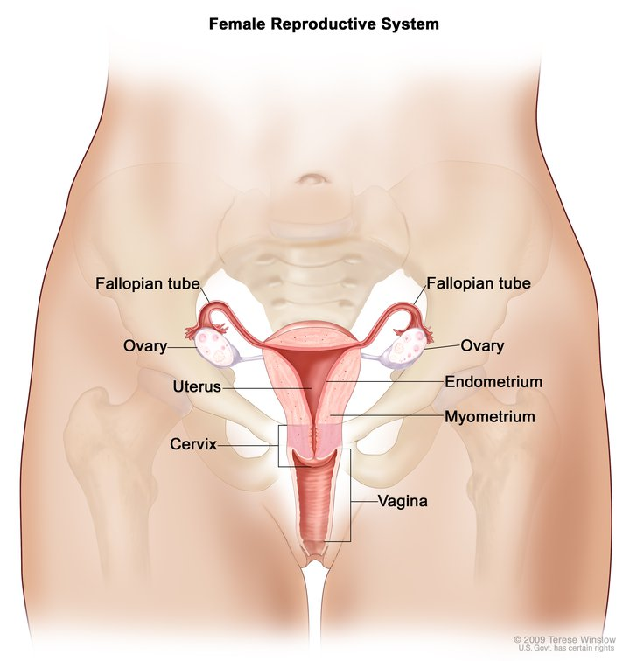
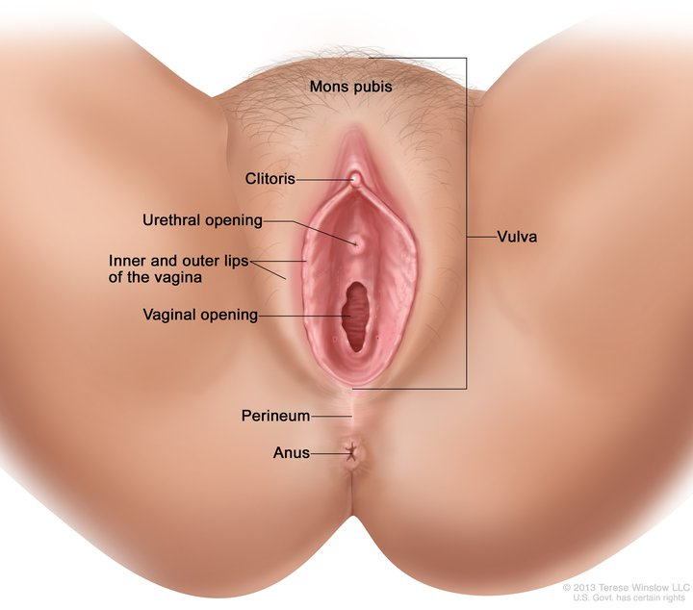
Female Reproductive System

Slide 8
Things that may happen….PMS
Premenstrual Syndrome
Happens days or weeks before
Being cranky and easily frustrated
Tearful
Tired
Cramping
Feeling full, fat or bloated

Slide 9
The PERIOD.
Also known as menstruation
Vaginal bleeding
Each menstrual cycle begins with a few days of flow
Lasts about 1-5 days every month
May not happen every month
at first….

Slide 10
FLOW?
The process where your uterus begins to shed its lining
This process is what causes vaginal bleeding aka flow
The period of time between each cycle is 24-28 days
How much?

Slide 11
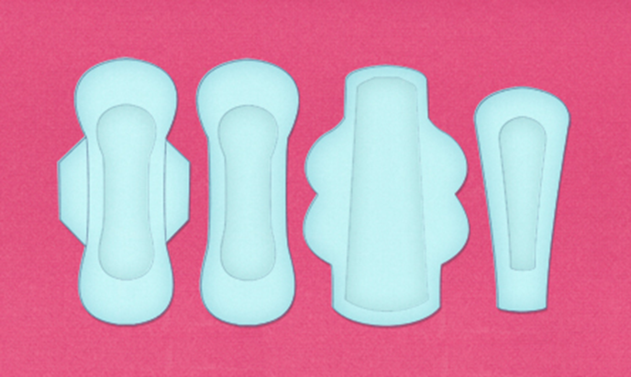
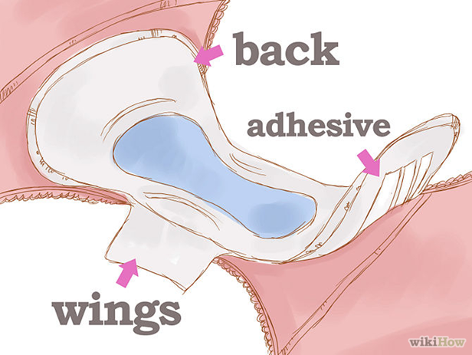
PADS:
Pads go in your underwear and have a sticky back
Change often
Dispose of them by rolling them up and putting them in toilet paper
NEVER FLUSH!!!!

Slide 12
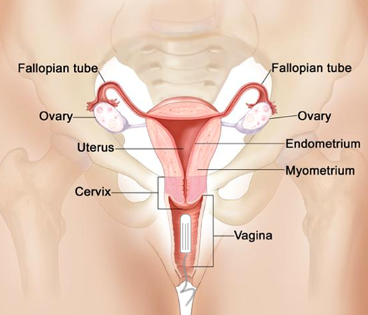
TAMPONS
Tampons are inserted into your vagina and should be changed every 4-8 hours or more often as needed.

Slide 13
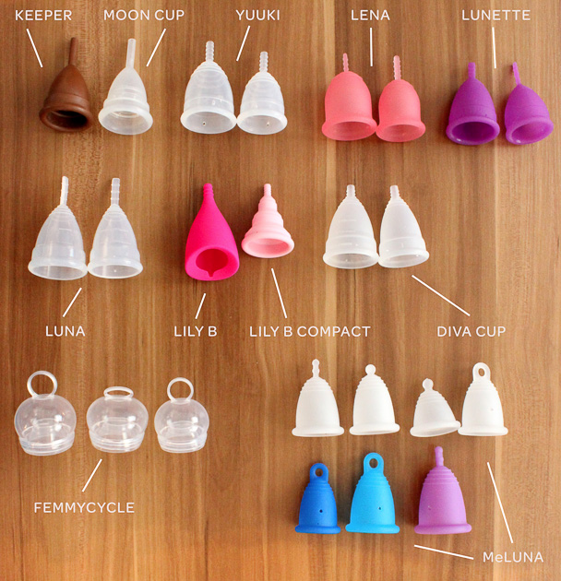
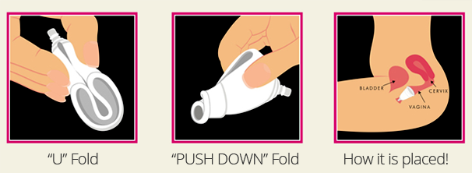
MENSTRUAL CUP:
Made of silicone or latex rubber
It forms a seal by resting on the vaginal wall
Most are reusable, but there are some that are disposable

Slide 14
Personal Hygiene
Sweating
Body produces more sweat; body odor. (2.6 million glands)
Why you sweat:
Helps to regulate body temperature.
Bathe/shower with soap daily
Change sweaty clothes.
Control underarm odor and wetness with deodorant or antiperspirant

Slide 15
Personal Hygiene
Skin Care
Oil glands become more active
Oil and dead skin cells lead to acne
Cleanse twice a day
Don’t worry; acne is a normal part of puberty, and you can do things to reduce it.

Slide 16
Personal Hygiene
Healthy Hair
Shampoo hair regularly (daily if you want to)
Shampooing helps remove dirt, oil and styling products
Massage conditioner into your hair
If hair is cut short, use sunscreen on your scalp

Slide 17
Personal Hygiene
Oral Health (care of your teeth)
Brush teeth and gums with a fluoride toothpaste at least twice a day
Floss teeth daily
See your dentist on a regular basis (Cleanings 2x per year)
Drink fluoridated water (if available)

Slide 19
Personal Hygiene
Hand Washing
The One thing YOU can do to prevent the spread of germs such as cold, flu, stomach bugs and more
Keep your fingernails trimmed
Wash hands for 20 seconds with SOAP and water:
WHEN???
Before and after eating
After using the bathroom
After sneezing or coughing
After playing with an animal
Anytime your hands are dirty

Slide 20
Personal Hygiene

Slide 21
Personal Hygiene

Slide 22
Personal Hygiene
Foot and Shoe Care
Let your shoes air dry
Wear socks to help absorb odor
Use foot powder or spray for your feet and shoes (especially if you have athlete’s foot)
Keep your toenails trimmed and clean
Inspect your feet when taking a shower or bath for cuts or abrasions (especially if you go barefoot)
Always wear shower shoes or flip-flops in gym showers
Keep shoes away from pets.

Slide 23
Healthy Bodies
Stay active
Eat nutritious foods
Good hygiene
Personal Safety
Plenty of sleep (but not in class)
Do not use drugs of any kind, including tobacco, alcohol, street (illicit) drugs, over-the-counter medication or prescription drugs

Slide 24
Who to Talk to
Family member:
Mom, Dad, Grandma, Grandpa, Uncle, Aunt, etc.
(Just make sure it is someone old enough to give you
good advice.)
Teacher, school nurse, coach, counselor
Doctor
Any trusted adult

Slide 25
Take PRIDE In Who You Are… Thank you for your attention!!!

Slide 26
Resources
Proctor and Gamble Always Changing and Growing Up Program

