Slide 1
BMI Training for Arkansas School Nurses
Obesity Prevention Education
Body Mass Index
Updated 2023
Notes:
UPDATED April 2021
Over the past three decades, too many children have adopted unhealthy eating habits and become physically inactive. Consequently, the rate of obesity among children across the country is rising at an alarming rate.
In Arkansas, nearly 38 percent of our young people are overweight or at risk for overweight.
17 years ago, leaders in Arkansas developed a unique and comprehensive approach to address childhood obesity in public schools and communities.
Act 1220 of 2003 called for improved access to healthier foods and beverages in schools, the creation of local committees to promote physical activity and nutrition and confidential reporting of each student’s body mass index (BMI) to his or her parents.
1

Slide 2
Completion Requirements
Participants are required to:
Attend in person training
Pass the Knowledge Check with an 80% or better

Slide 3
Learning Outcomes
Participants will demonstrate an increase in knowledge of obesity prevention and chronic diseases directly related to obesity by making at least an 80% on the post assessment.
Participants will demonstrate correct height and weight measurement for data collection and documentation.

Slide 4
Objectives
Discuss risk factors for childhood obesity
Explain health consequences of obesity
Demonstrate the process for appropriate height and weight measurement for children
List resources available for schools and school nurses to combat childhood obesity

Slide 5
Obesity and Overweight in Children
Obesity in children and youth refers to age and gender- specific BMI that is equal to or greater than the 95th percentile of the CDC BMI charts
Overweight/at risk for obesity in children and youth refers to a BMI that is between the 85th – 94th percentile

Slide 6
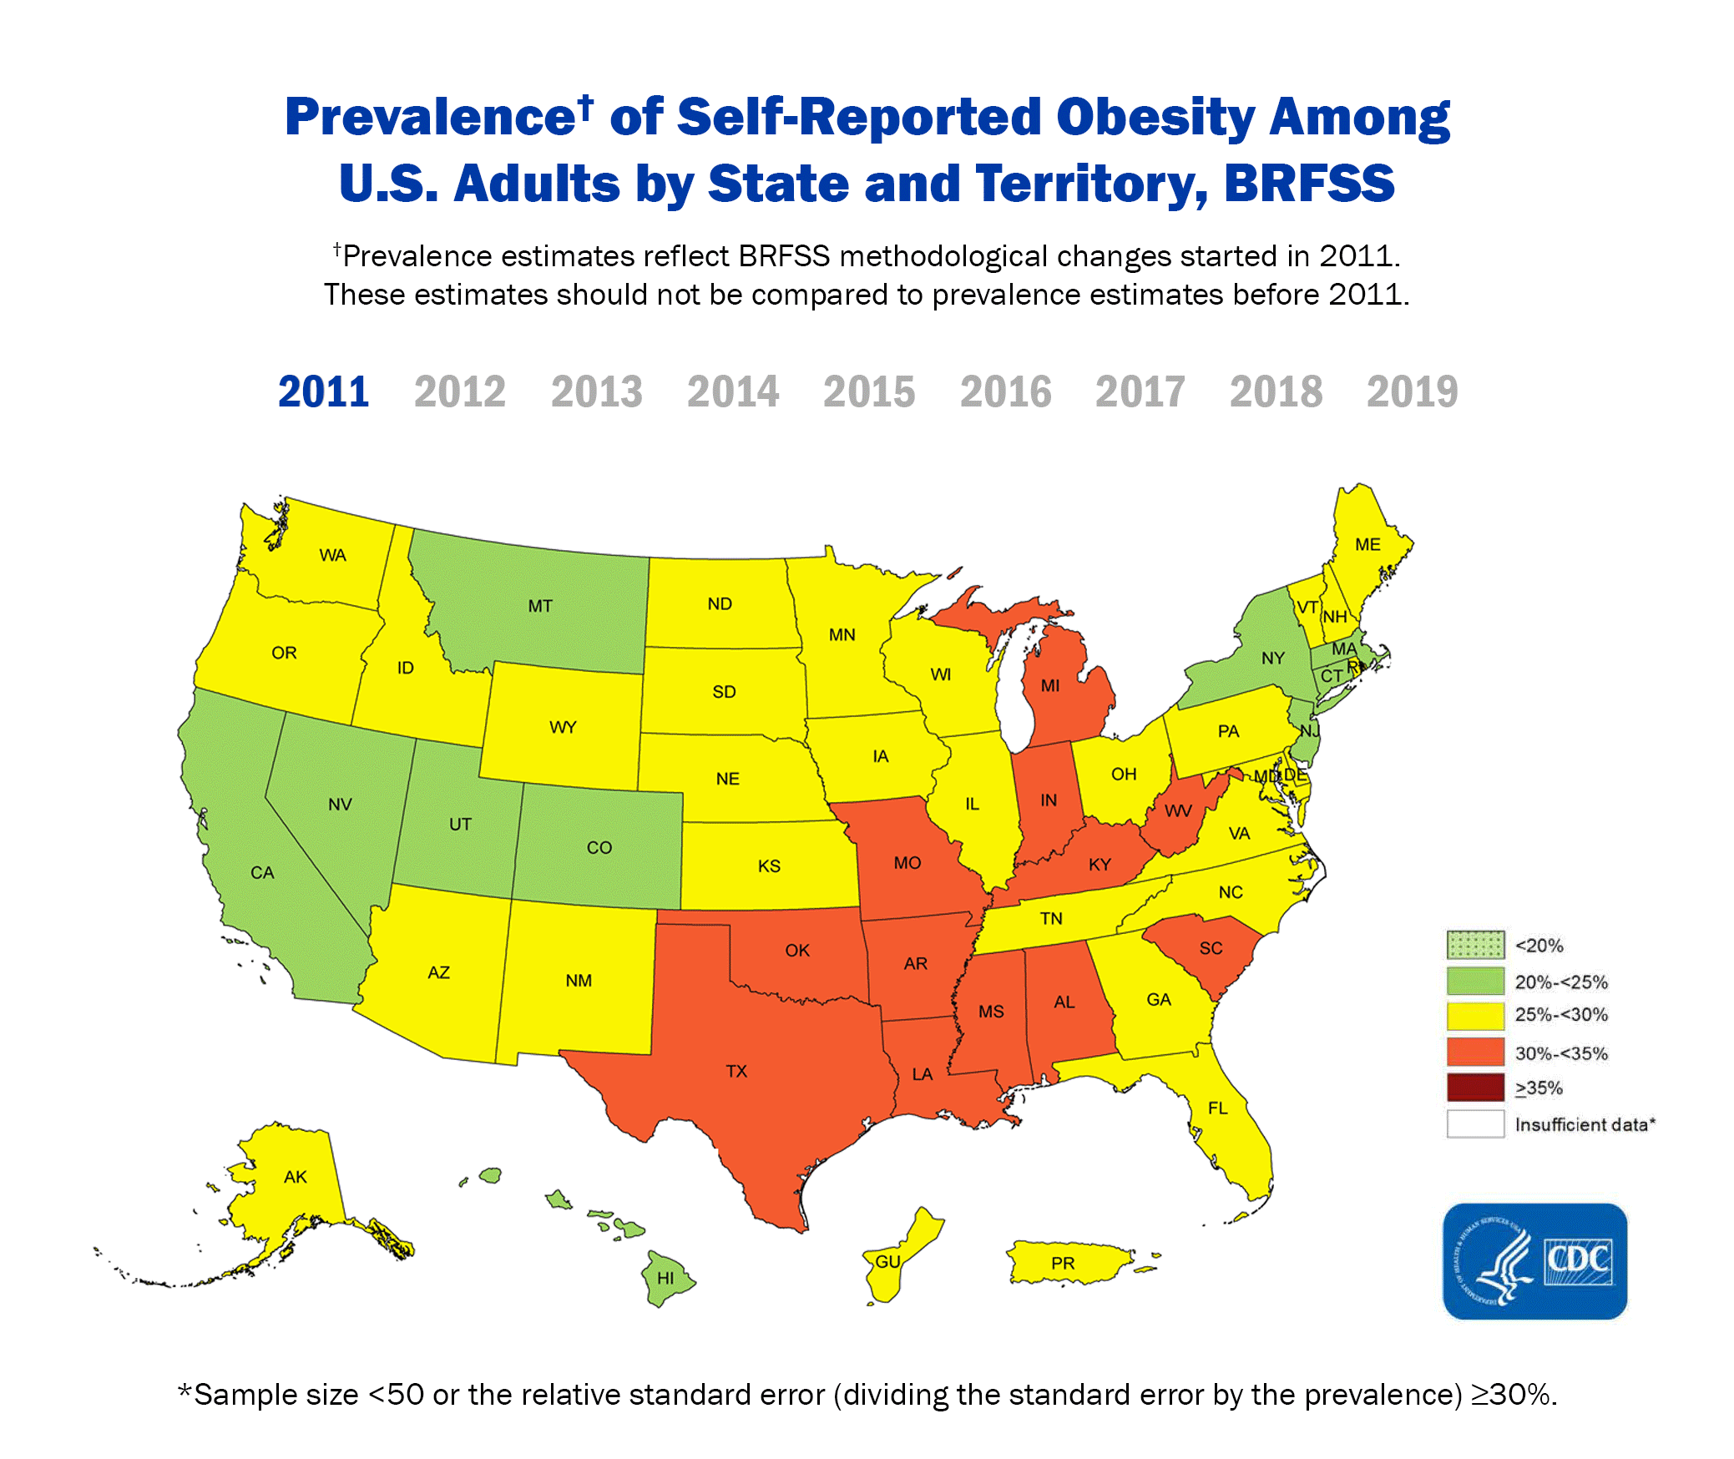
Obesity in the United States
http://www.cdc.gov/obesity/data/trendshtml
Notes:
Speaker notes:
Look for your state to see the rise over that past years. States that were less that 10% are now over 20% in just 10 years.
Where will we be in the next 10 years?
Fittest and fattest cities handout.

Slide 7
Risk Factors
Sedentary lifestyles
Calorie-dense foods
Large portion sizes
Excessive screen time low energy expenditure
Parent modeling - eating and exercise behaviors
Notes:
Speaker notes / optional:

Slide 8
Heredity and Genes
≈ 80% of children with two overweight parents will become overweight
≈ 40% of children with one overweight parent will become overweight
≈ 7–9% of children with no overweight parents will become overweight
Notes:
Speaker notes:
Children model eating behavior after adults and the family plays a powerful role in the treatment. The persistence of obesity into adulthood depends on several factors
▪ the age at which the child becomes obese ▪ the severity of the disease
Greater risk of obesity has been found in children of obese and overweight parents The presence of obesity in at least one parent (young children with 1 or 2 obese parents are at high risk of obesity in young adulthood, even if their current weight is normal (Barlow, 2007).
Children of obese parents are ten times more likely to become obese than children whose parents weigh within the normal range (National Library of Medicine, 2007).
After an obese child reaches six years of age, the probability that obesity persists exceeds 50%.
70 to 80 percent of obese adolescents will remain so as adults.
If both parents are lean, the likelihood of a child becoming obese is just 9%.
When both parents are obese, the likelihood of the child also being obese rises to 60-80% (Childhood Obesity – Advancing Effective Prevention and Treatment, 2003). http://www.iowaepsdt.org/EPSDTNews/2002/win02/obesity.htm

Slide 9
Consequences of Obesity
Physical, Psychological, Emotional, Social, Economical

Slide 10
Physical, Psychological, Emotional, Social, Economical
Cardiovascular Dz Hypertension Elevated Insulin Levels Dyslipidemia
Psychosocial Depression/anxiety Poor body image Decreased interaction with peers Behavior problems Bullying/teasing Decreased endurance
Cancer Risk Esophageal Breast Endometrial Colon/Rectal Kidney Bladder
Endocrine Disorders T2DM Acanthosis Nigricans Polycystic Ovary Syndrome Early Sexual maturation

Slide 11
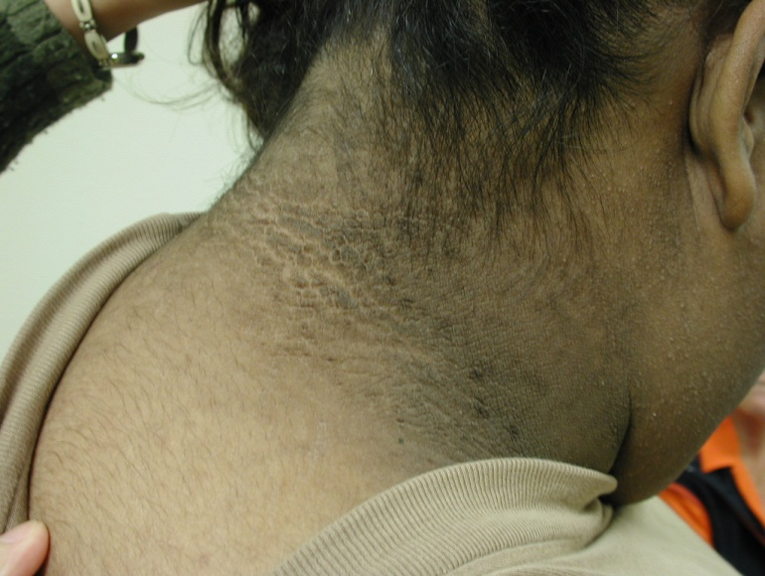
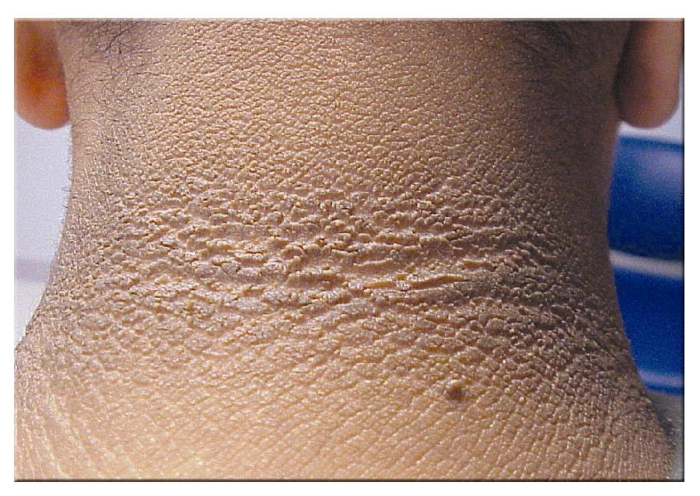
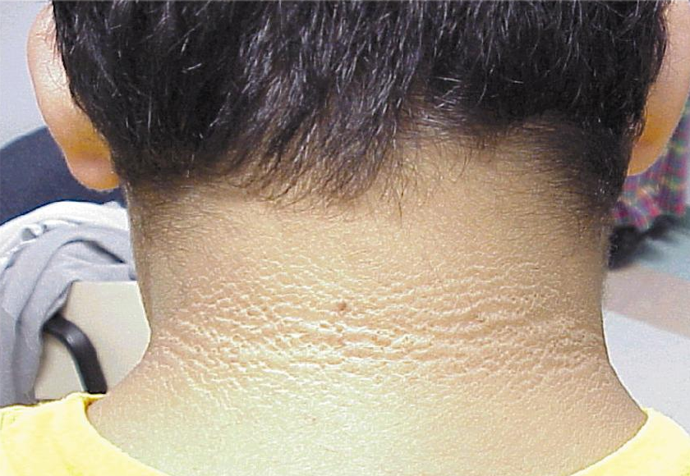
Typical Acanthosis Nigricans of the Neck
Notes:
11
AN
May begin at any age
Velvety thickening
Gray to brown to black in body creases
Neck, armpits, groin
Darker skinned people have darker lesions

Slide 12
Arkansas Initiative and Recommendation for BMI in Schools
The State’s Response to this Rising Epidemic

Slide 13
Act 1220 of 2003
Creates an Arkansas Child Health Advisory Committee
Limits access to food/beverage vending machines
Reports ALL money received from food and beverage contracts.
Convenes an advisory committee in each school district
Incorporates nutrition/physical activity goals into annual plans
Notes:
March 8, 2003 – AR Preventive Nutrition and Physical Activity Summit
UAMS—University of Arkansas for Medical Sciences
ADH—Arkansas Department of Health
ACHI—Arkansas Center for Health Improvement
ACH—Arkansas Children’s Hospital
Of 100 leaders in areas including policy, education, media, healthcare, environment, and business
Committee members may include people from the AR. Dietetic Association, AR. Academy of Pediatrics, and Family Physicians, AR Dept. of Education, Dept. of Health, AR School Food Service Association, AR. Heart Association, ACHI, AR. Parent, Teacher Association, U of A Extension Service and UAMS. They make recommendations regarding nutrition and physical activity policy to the State Board of Education and the State Board of Health.
No access for elementary school students to vending machines and limited access for middle and high school students.
Vending Machine Contracts generated revenue that could be used any way a school district wanted. School districts were concerned about the loss of revenue to the district if soda vending machines were removed. However, many school districts have found they have greater revenues with the replacement of the sodas in the machines with water and healthier choices.
Wellness (Nutrition and Physical Activity Advisory Committees (NuPAAC) to raise awareness of the importance of proper nutrition and physical activity in the school district.

Slide 14
Act 1220 of 2003 States
“Require schools to include as part of the Student Health report to parents an annual body mass index percentile by age for each student; and require schools to annually provide parents with an explanation of the possible health effects of body mass index, nutrition, and physical activity.” (in a confidential, private and accurate manner)
Notes:
The Child Health Report includes information concerning their child’s health status and risk for obesity-related illnesses, along with information to help them promote healthy eating behaviors and regular physical activity at home. Assessment information to parents and clinicians. These reports can be made available to parents at Parent/Teacher Conferences, Mail, or by request to the school office. Schools can use media outlets to notify parents of health report availability.

Slide 15
Act 201 of 2007
Students will participate in BMI assessments in K, 2, 4, 6, 8, and 10.
BMI measurements not required for students in grades 11 and 12.
Parents can provide written notice to the school if they choose to exclude their children from BMI assessments.
Community Health Nurses will work with schools to assure that proper protocol is followed during the BMI assessments.

Slide 16
Childhood BMI is gender & age specific
CHILDREN | BMI – body mass index
Underweight | BMI-for-age < 5th percentile
Overweight / at risk for obesity | BMI-for-age 85th to 94th percentile
Obese | BMI-for-age ≥ 95th percentile
Normal | BMI-for-age: 5th percentile - < 85th percentile
(CDC, 2009)
http://www.cdc.gov/nccdphp/dnpa/obesity/childhood/defining.htm
Notes:
16
In children and teens, body mass index is used to assess underweight, obese and overweight. Children's body fatness changes over the years as they grow. Also, girls and boys differ in their body fatness as they mature. This is why BMI for children, also referred to as BMI-for-age, is gender and age specific. (http://www.cdc.gov/nccdphp/dnpa/bmi/bmi-for-age.htm)
Why is BMI-for-age a useful tool?
BMI-for-Age is used for children and teens because of their rate of growth and development. It is a useful tool because BMI-for-age provides a reference for adolescents that can be used beyond puberty.
BMI-for-age in children and adolescents compares well to laboratory measures of body fat.
BMI-for-age can be used to track body size throughout life.

Slide 17
BMI for Age and Gender:
Used for children and teens because of their rate of growth and development
Provides a reference for adolescents that can track body size throughout life
Notes:
There are a number of indexes to identify overweight, but the most common marker is the BMI.

Slide 18
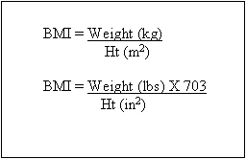
What BMI is:
Inexpensive, effective, easy-to-perform screening tool using height and weight
Not intended to be used as the sole diagnostic measure
Notes:
18
A wide body of research since the mid-1990s does show that body mass index, for both children and adults, is now an accepted measure of the causes of and possible treatments for a broad range of disorders, including not only diseases such as diabetes and heart trouble, but also seemingly less directly related conditions such as asthma.
(Health and Health Care in Schools, School Nurses, School-Based Health Centers and Childhood Overweight: A report from a roundtable meeting to explore the role of school health professionals in preventing childhood overweight Washington, DC, April 27-28, 2006).

Slide 19
Perspectives About the Use of BMI Measurement
Identify referrals and resources for children and parents
Promote policies that increases access to healthful foods and daily physical activity
Notes:
Additional Safeguards for BMI Screening Programs
1. Ensure that resources are available for safe and effective follow-up (Nihiser, 2007).
School Nurses, School-Based Health Centers and Childhood Overweight: A report from a roundtable meeting to explore the role of school health professionals in preventing childhood overweight Washington, DC, April 27-28, 2006
‘Measurements are more likely to be accurate and reliable when they are conducted by trained professionals, such as school nurses.’ (Nihiser, 2007, p 14)
The results of one study support that height and weight screening by school nurses can be private and reliable and provides an opportunity for school nurses to intervene when children are at high risk… (Stoddard, et al., 2008)
One study indicated that “mandates increased the number of school nurses measuring and reporting student BMIs as a way to influence healthy weight in school children and policies related to healthy nutrition and physical activity.” (Hendershot, et al, 2008)
BMI should not be reported if schools lack:
effective ways to refer children and their parents to resources that can help them achieve healthy body weights

Slide 20
Clinical Instruction for BMI Assessment
What to do and how to do it correctly

Slide 21
Prior to Assessment
Contact school admi and teachers
Determine date and place for assessment
Determine assessment team:
Screener
Recorder
written refusal from the parent is necessary for student to be exempt
Notes:
Parents are less likely to opt out if you are able to explain to them the importance of this screening and why it matters for their child and for the state as a whole.
May be helpful to list required screenings in your district/school policy book

Slide 22
Recommended Equipment
Step Stool- Height measurements to ensure measurement line is read at eye level
Batteries (Check type & number required)
Name Tags – children and staff
Office Supplies
Container for personal items
Notes:
22

Slide 23
Stadiometer
Measure's height
Portable or permanently affixed to wall
Provided by ACHI
Tape wood board to wall for stability
Carpenter’s triangle for headpiece
Notes:
ACHI Stadiometer is a 84” Yard Stick mounted on 86” wood board
Duct tape or blue painter’s tape may be used to stabilize stadiometer to the wall. Blue painter’s tape is finish friendly.
Shorr Measuring Board Stadiometer is gold standard—top of line; sturdy; durable because handcrafted out of solid wood. Collapsible. Offers accurate measurement due to wide wooden head piece that reduces chances for measurement error caused when harrower head piece is used.

Slide 24
Scales
Tanita HD-314
Portable
Measures up to 330 lbs
Digital read-out
Tanita HD-351
Portable
Measure up to 440 lbs
Digital read-out
Previous weight is visible
Notes:
24
Colored tape placed over previous weight readout for confidentiality

Slide 25
Standard Weight
A standard weight should be used to test the scale for accuracy (NOTE: do not use non-standard weight such as bag of sugar)
If the readout is more than ½ pound off, then change the batteries in the scale
If the readout is still more than ½ pound off, DO NOT use the scale

Slide 26
Day of Assessment
Equipment
Calibration of scales
Station set up
Preparation of child
Data collection forms
Notes:
26
Equipment needed is scales, stadiometer, stool, misc.
Accuracy of scales must be checked each day prior to assessment
Stations should be set up on a hard surface floors/avoiding carpet
Children should have shoes off, pockets empty, correct identification.
Standardize weights for checking accuracy
At the beginning of each measurement day at the school, accuracy of the scales will be required
A known standardized weight must be placed on each scale.
This weight (reading on the scale) should be logged on the calibration log.
If the recorded weight is more than half a pound higher or lower than the standard weight, the measurement should be
repeated and rerecorded. If the recorded weight maintains more than half a pound different from the calibration
weight, then batteries should be changed. If this does not correct the problem, then scale should not be used for
assessments.

Slide 27
Assessment Team
Screener
Recorder
May have multiple screening stations
Notes:
27
Any assessment team member MUST have BMI certification.
Screener—person actually assessing the Height and Weight
Recorder—person who writes down student heights and weights or enters measurements into database

Slide 28
Before Assessment Begins
Remove
Remove as much outerwear as possible
Remove
Remove shoes (barefoot or wearing socks)
Empty
Empty pockets; remove jewelry and other objects
Remove
Remove eyeglasses (to visualize Frankfort Plane)
Remove
Remove hair barrettes, ties or rubber bands

Slide 29
BMI Screening
Measure in rotational order:
1st Height
Weight
2nd Height
Notes:
Because measurement of height requires greater skill to perform correctly, two measurements are recommended to reduce error.

Slide 30
Height Measurement
Child stands with back or other body part touching the board with body straight
Legs are together and body weight is evenly distributed on feet
Arms hang freely by side, palms facing thighs
Position should be verified from FRONT and LEFT of body
Position head in Frankfort Horizontal Plane
Notes:
30
Frankfort Plane—imaginary line passing through the external ear canal and across the top of the lower bone of the eye socket, immediately under the eye

Slide 31
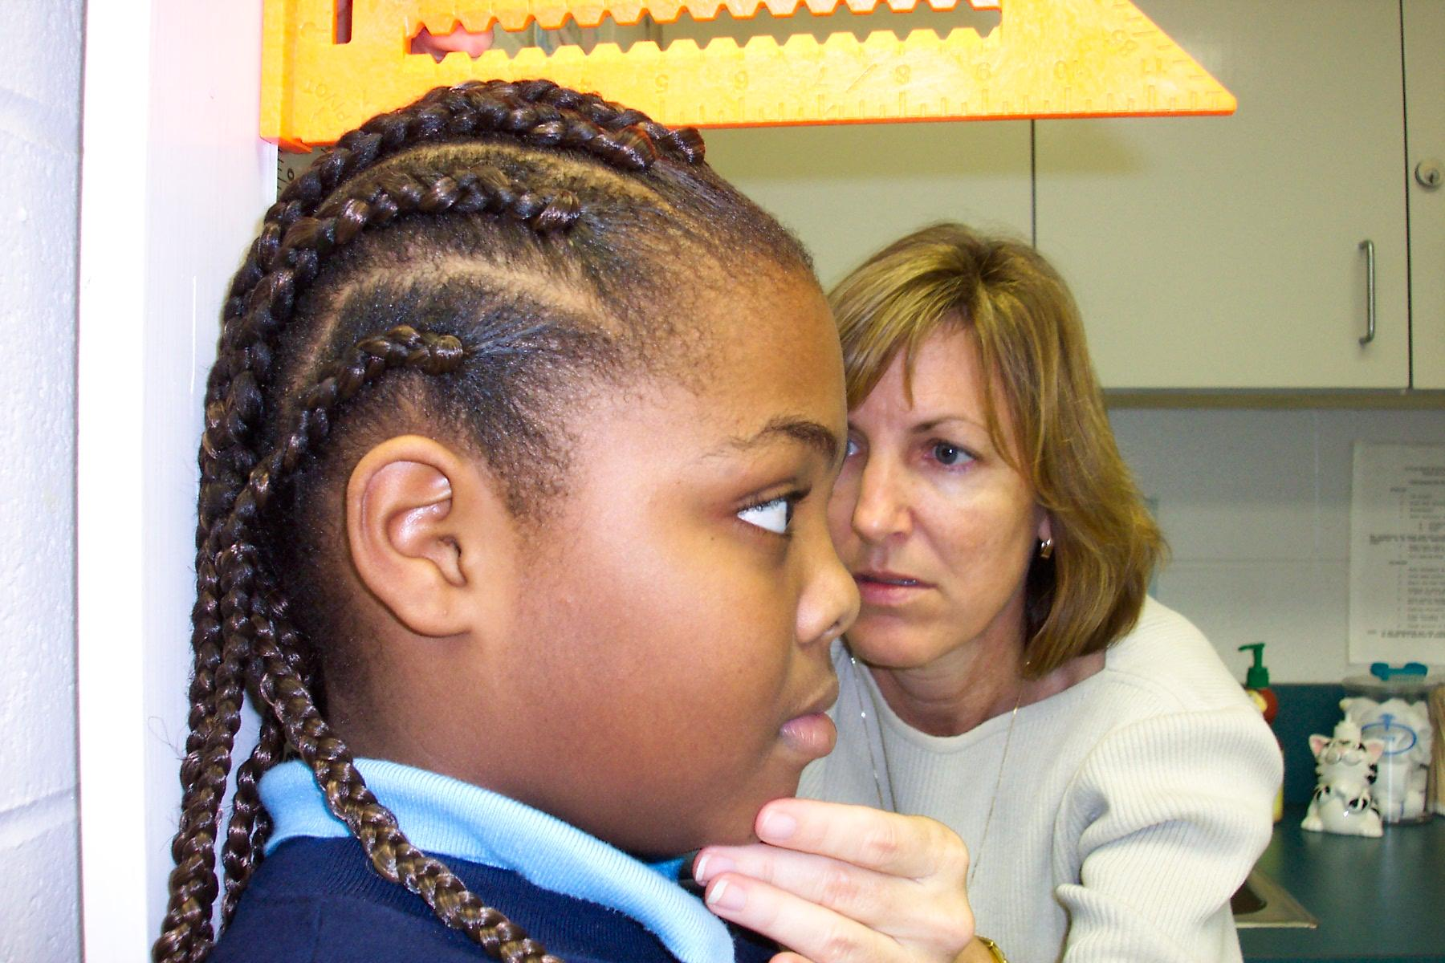
Frankfort Plane
Notes:
31
Frankfort Plane—imaginary line passing through the external ear canal and across the top of the lower bone of the eye socket, immediately under the eye

Slide 32
Height Measurement
Child inhales deeply and holds breath WITHOUT moving head or body
Movable headpiece is brought to superior point on head with hair compressed
Height is recorded to the nearest 1/8th inch
Greater than one inch difference between two height measurements requires re-measurement
Notes:
32

Slide 33
Notes:
33
Carpenter’s Square—an instrument for ensuring a level reading of height

Slide 34
Recording Process for Height Measurement
Measurer takes first height
Recorder calls number back to measurer
Recorder records number in space indicated for “1st Height”
Notes:
34
Take first height and call out number to recorder
Recorder calls number back to confirm correct reading.
Recorder records number on data collection form or directly into web-entry system (space indicated for “1st Height”).

Slide 35
Weight Measurement Procedure
“Zero” the scale if digital
Measurer has child step up on the center of the scale and stands facing the back of the scale (confidentiality) and indicates to recorder that child is “ready”
Body weight is evenly distributed on feet
Head is up and facing straight ahead
Notes:
35
Child is asked to step up backwards onto the scale and stand still over the center of the scale with body weight evenly distributed between both feet.
In order to ensure confidentiality and to prevent the child from seeing his/her weight, it is REQUIRED that that the child step on the scale backward away from the readout.
Arms should hang freely by the sides of the body with palms facing thighs.
Child should hold head up and face forward

Slide 36
Weight Recording Process
Recorder obtains read-out number on scale and records number in space indicated for “Weight”
Weight is recorded to nearest 0.2 pounds (or appropriate unit for the scale)
NOTE: The reading for weight measurement is NOT called out by the measurer or recorder to ensure CONFIDENTIALITY.
Notes:
36
Measurer positions child on scale and indicates to recorder that child is “ready”.
Recorder obtains read-out number on scale and records number on data collection form
Two height measurement reduces error and increases accuracy of the BMI.

Slide 37
2nd Height Recording Process
Measurer re-measures 2nd height
Recorder checks two sets of height measurements to ensure they are within one-inch of each other
The second height will be the one converted to decimal form and entered in eSchool
Notes:
37
Recorder checks two sets of height measurements to determine if more than a one-inch difference exists between the two heights.
Height measurement is more subject to error, and is not generally considered to be sensitive data, those measurement readings are called out by the measurer and recorder to increase the overall accuracy of height measurements.

Slide 38
Height measurement Discrepancy
If the first set of measurements is greater than one inch difference, a second set of height measurements should be taken. This would be for the 3rd Height and 4th Height
If the 3rd and 4th Height is still greater than one inch, then the child’s assessment is considered “Unable to be Assessed”
Use the reason code “HT” in the notes field to indicate this result

Slide 39
Paper Forms
ACHI Calibration Log
Height and Weight Data Collection
Form used during the screening to record statistics
Available in Cognos
Data Entry Guide Card
Notes:
39
The top form is required for the nurse to keep on record for at least five years
The Data collection form is just a helpful and recommended tool to actually keep record of the heights, weights and comments from screening the students (this does not have to be kept for 5 years)
The card will be talked about in a few slides, will want to print and have accessible

Slide 40
Scale Accuracy/Testing Log
Required to verify the accuracy of each scale
Scales verified day of scheduled measurement
Scales should be placed in exact location where measurements will take place prior to being verified
Once verified, do not move scales
Verification with at least one known weight
Notes:
40
Formally called the ACHI Scale Calibration Log or ACHi Scale Accuracy LogVerification Steps:
“Zero” the scale, if digital model
Place standard or known weight in center of scale
Record scale reading in appropriate column for known weight used
(three known weights of increasing heaviness recommended, but one know weight is sufficient)
If using more than one weight, repeat the steps until all of the know weights have been used.
If the recorded scale reading is more than half a pound higher or lower than the know weight, measurement should be repeated and re-recorded (on next line of the form). If scale reading remains more than half a pound different from known weight, then that scale should not be used for measurements that day. For metric unit scale, verification should be no more than 0.2 kg higher or lower than know weight.

Slide 41
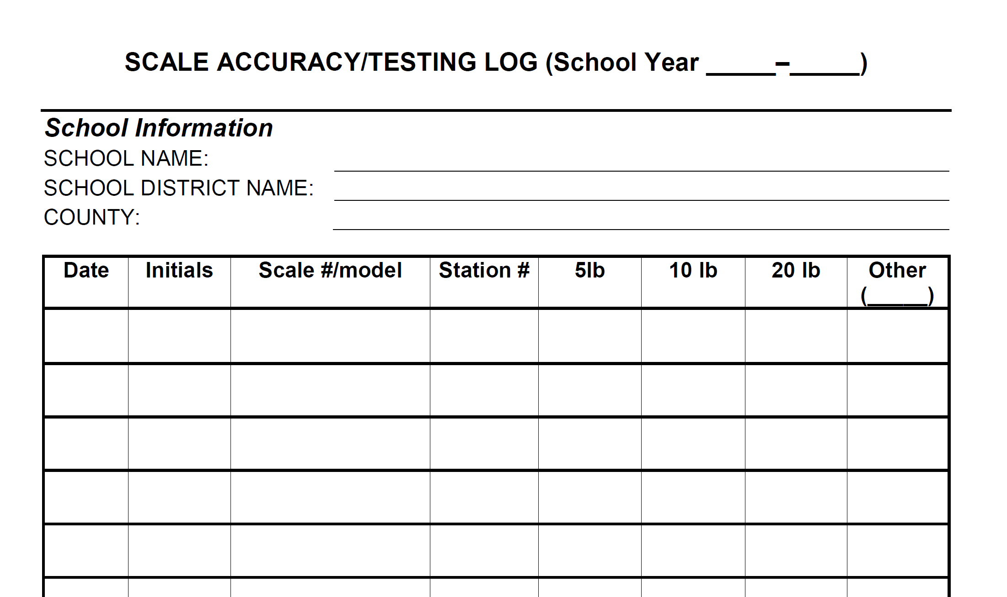
Scale Accuracy/Testing Log
Notes:
41
Can retrieve this form from www.achi.net to print off and keep in a specific place for at least 5 years

Slide 42
BMI Data Collection Form by Grade
Notes:
42
This form can be found in cognos within eschool and can be printed by homeroom or grade depending on which students you are screening. This is what your recorder will use to keep record of the height/weight of students in alphabetical order and will make it significantly easier to input data into eSchool.
You could have the tool card with you during the screening in order to use the Unable to Access codes in the comment box (this will just make data entry that much easier for the students without a height and weight measurement)

Slide 43
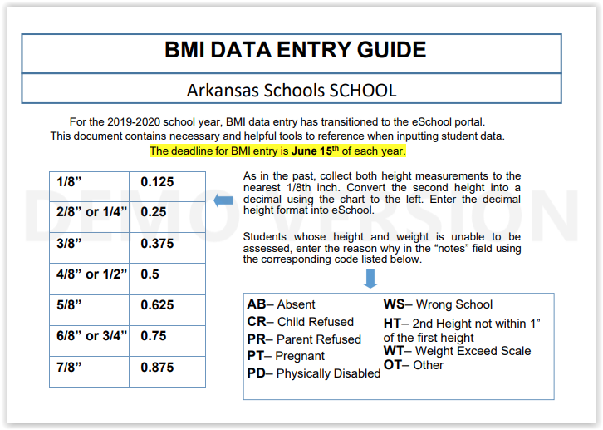
Notes:
This is the card that each nurse should receive and hopefully have readily available for when they are entering the BMI data.
The conversion chart will help with the height conversions and the codes will be used in the notes section for students who are unable to be accessed.
43

Slide 44
References
ACHI
www.achi.net
Arkansas Dept of Health
www.healthy.arkansas.gov
Community Health Specialist
www.chs-support.weebly.com
Notes:
Forms can be found on ACHI website
ACHI website has the local school district BMI results

Slide 45
Other Resources
Alliance for Healthier Generation www.healthiergeneration.org
Action for Healthy Kids www.actionforhealthykids.org
Arkansas Coalition for Childhood Obesity Prevention www.arkansasobesity.org
Notes:
45

Slide 46
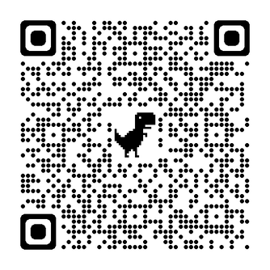
Knowledge Check

