Slide 1
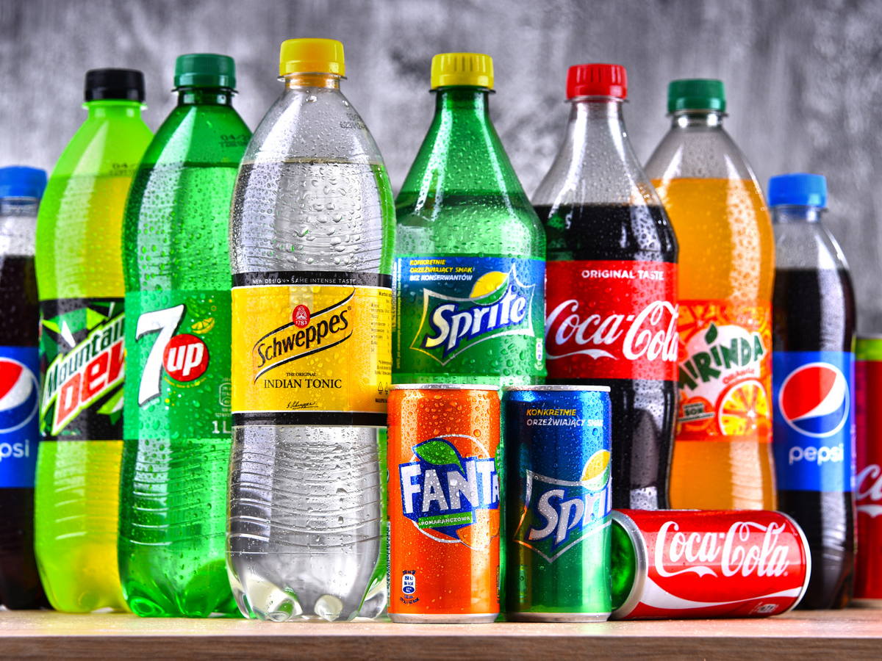
Rethink Your Drink

Slide 2
Objectives:
Determine how beverages can affect health
Assess the amount of sugar in popular beverages
Identify healthier drink options
Notes:
Today, we are going to determine how what we drink can affect our health. We are going to assess the amount of sugar in popular beverages and identify healthier drink options.

Slide 3
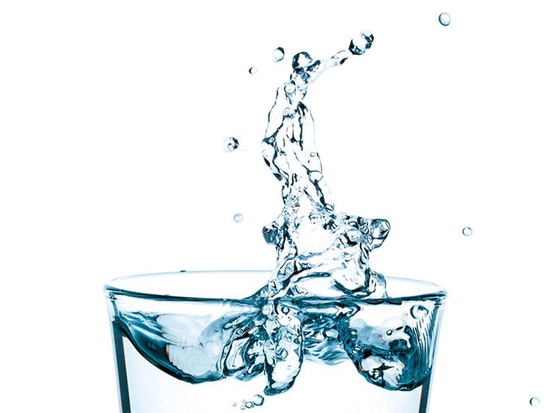
What Do You Drink?
Notes:
Start a discussion among students by asking the following questions:
“What do you drink when you’re thirsty?”
(Let students give you several answers)
“Do you ever stop to consider how what you drink affects your health?”

Slide 4
Why “Rethink” Your Drink?
SUGAR CAN…
increases the risk of heart disease, obesity, high blood pressure, and inflammation
affect the appearance of your skin, drains your energy, and could harm your teeth.
affect your mood, cause joint pain, cause acne, and may lead to diabetes.
Notes:
Sugar sweetened beverages refers to all beverages with added sugars including carbonated soft drinks, juice drinks, sports drinks, and flavored and enhanced waters

Slide 5
Overweight and Obesity
Added sugars, especially in drinks, are linked to higher calorie intake
Leads to overweight and obesity
Notes:
We drink a lot of calories and don’t realize it
We are a lot less active today than in the past
43% of the increase in daily calories Americans consumed between 1977 and 2001 came from sugar-sweetened beverages alone
Sleep deprivation is linked to obesity. Caffeinated beverages are linked to shortened sleep duration, particularly in adolescents

Slide 6
Health Consequences of Obesity
Heart Disease
Type 2 Diabetes
Hypertension
Sleep Apnea
Gallstones
Depression
Low Self-Esteem
Notes:
These are just a few of the physical and psychosocial health consequences of obesity.

Slide 7
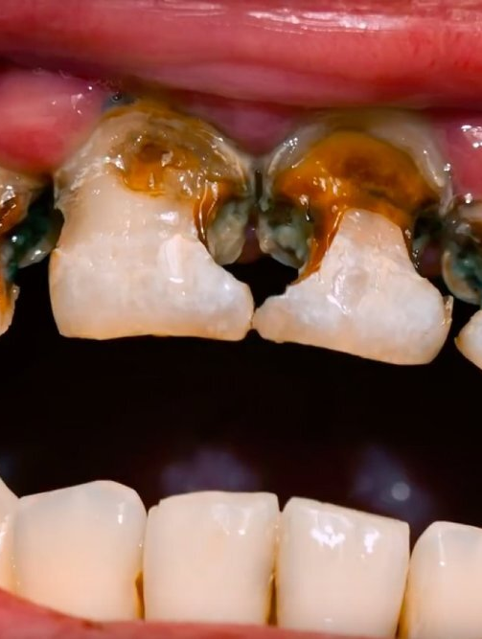
Sugar and Tooth Decay
Sugar mixes with bacteria in the mouth to make acid
Acid breaks down tooth enamel which leads to tooth decay
Notes:
A diet high in sugar can lead to tooth decay.
“Tooth decay is the process that results in a cavity (dental caries).
It occurs when bacteria in your mouth feed on the sugars in the food/beverages you consume, making acids that eat away at teeth. If not treated, tooth decay can cause pain, infection, and tooth loss.
You can easily prevent tooth decay by brushing and flossing your teeth regularly, seeing your dentist for teeth cleaning and checkups, and avoiding foods and beverages that are high in sugar.” (www.webmd.com)

Slide 8
Beverages and Bone Health
You build 92% of your bone mass by age 18
Children and teens who drink sugar sweetened beverages instead of milk often have lower calcium intakes
Low calcium intakes can lead to osteoporosis and broken bones in adulthood
Notes:
Phosphoric acid in sodas
Phosphorus is an important bone mineral
A disproportionate amount of phosphorus compared to the amount of calcium could lead to bone loss
Experts debate that that phosphorus amounts in chicken/cheese is higher than that found in sodas
Caffeine has been shown to interfere with calcium absorption
Will see more studies on this

Slide 9
Water
Is the Best Beverage for Staying Hydrated
Is an Essential Nutrient
Zero Calories
Carries Nutrients Through the Body
Notes:
Water is the best choice for quenching thirst and staying hydrated
Water is one of the essential nutrients…..essential nutrients must be supplied from an outside source because they cannot be made by the body in sufficient amounts.
Water is the ultimate diet drink because it contains no calories.
Our body needs water to function….carries nutrients between cells and organs; maintains body temperature.
Water makes up 60% of body weight
Most adults need 8-10 cups of fluid per day
Not getting enough fluid can lead to dehydration which causes headache, fatigue, blood pressure changes, and irregular heart beat

Slide 10
Milk
Healthy Beverage Choice
Contains 9 Essential Nutrients
Important for Healthy Bones and Teeth
Choose Low-Fat Products
Notes:
Milk is a healthy beverage.
Milk contains vitamins and other nutrients.
Helps build strong bones and teeth.
Milk also contains calories, so choosing low-fat or fat-free milk is a good way to reduce your calorie intake and still get the nutrients that milk contains.
1 cup fat-free (skim), low-fat (1%) = 100 calories
Reduced fat (2%) = 120 calories
Whole = 160 calories
Note: Flavored/Unflavored milk provide the same amounts of calcium, phosphorus, protein, riboflavin, and vitamin D.

Slide 11
Fruit Juice
Good Beverage Option
Choose 100% Juice, No Sugar Added
Read Labels to Avoid Juice Imposters
Notes:
100% fruit juice is a healthy option because it supplies water and other nutrients, but excessive juice consumption can mean intake of too many calories and too much sugar. (American Academy of Pediatrics recommends that intake be limited to 8-12 oz for children ages 7-18 and 4-6 oz for children 6 and younger)
100 % fruit juice contains natural sugar……fructose or fruit sugar.
100% juice can be counted towards the recommended daily servings from the Fruit Group, but the Dietary Guidelines advise that most Fruit Group amounts come from whole fruit for more fiber.
Read labels to avoid juice drinks, beverages, and cocktails that contain added sugars.
A lot of debate right now on fruit juice and recommendations.
Refer to The Weight of the Nation

Slide 12
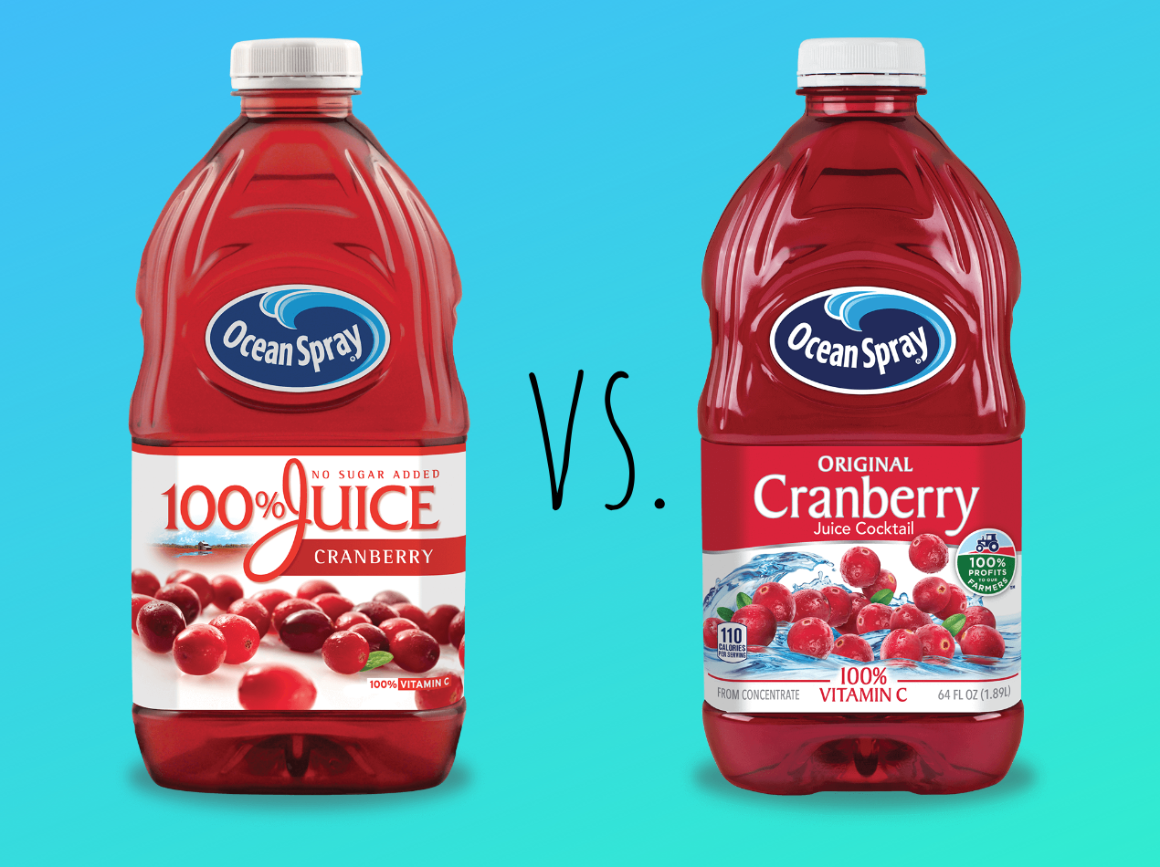
100% Fruit Juice vs. Juice Cocktail
100% Juice
Juice Cocktail
15.2 oz Bottle
210 Calories
48 Grams of Sugar
15.2 oz Bottle
220 Calories
54 Grams of Sugar
Sugar content is about the same, the main difference is where the sugar comes from: fruit or added sugar?
Notes:
100 % Apple Juice
Serving Size 8 oz – about 2 servings per bottle
48 Grams of Sugar = 12 Teaspoons of Sugar
Blueberry Juice Cocktail
8 oz serving – about 2 servings per bottle
54 Grams of Sugar = 13.5 Teaspoons of Sugar

Slide 13
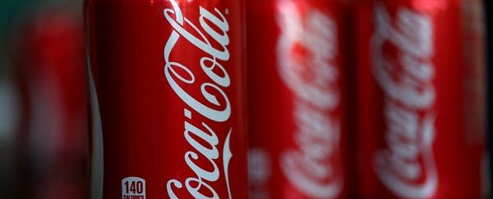
SODA
Contain about 90% water
Sweetened with sugar
Don’t supply significant amounts of nutrients
People who drink soft drinks consume more calories than those who do not
Notes:
Regular sodas are sweetened with sugar usually in the form of high fructose corn syrup.
Except for water and for carbohydrates in the form of sugars, sodas don’t supply significant amounts of nutrients.
Replace nutrient dense drinks

Slide 14
Coke
12 oz Can
140 Calories
39 Grams of Sugar
10 Teaspoons of sugar
If You Drank One of These Every Day for a Year, You Could Gain 15 Pounds!
Notes:
4 Grams of Sugar = 1 Teaspoon of Sugar
3500 Calories = 1 Pound
USDA recommends that people should consume no more than 40 grams of sugar per day (10 teaspoons)
American Heart Association recommendations for added sugars:
5 teaspoons for women
9 teaspoons for men
3 teaspoons for children
1 Can = 1 serving
39 Grams of Sugar = 10 Teaspoons of Sugar

Slide 15
Fanta Orange
12 oz Can
160 Calories
44 Grams of Sugar
11 Teaspoons of sugar
If You Drank One of These Every Day for a Year, You Could Gain 17 Pounds!
Notes:
1 Can = 1 Serving
44 Grams of Sugar = 11 Teaspoons of Sugar

Slide 16
Sprite
12 oz Can
140 Calories
38 Grams of Sugar
9.5 teaspoons of sugar
If You Drank One of These Every Day for a Year, You Could Gain 15 Pounds!
Notes:
1 can = 1 serving
38 Grams of Sugar = 9.5 Teaspoons of Sugar

Slide 17
Dr Pepper
20 oz Bottle
250 Calories
64 Grams of Sugar
16 teaspoons of sugar
If You Drank One of These Every Day for a Year, You Could Gain 26 Pounds!
Notes:
Serving size 1 cup – 2.5 servings per bottle
64 Grams of Sugar = 16 Teaspoons of Sugar

Slide 18
Mountain Dew
20 oz Bottle
290 Calories
77 Grams of Sugar
19 teaspoons of sugar
If You Drank One of These Every Day for a Year, You Could Gain 30 Pounds!
Notes:
8 oz serving size (2.5 per bottle), 110 calories per serving, 31 grams sugar per serving
77 Grams of Sugar =19 Teaspoons of Sugar

Slide 19
Diet Sodas
Contain about 99% water
Zero Calories
Sweetened with saccharin, aspartame, and other alternative sweeteners
Notes:
Diet sodas are still a significant source of caffeine.
Acid content is damaging to teeth
There is some evidence that their sweet taste can stimulate overeating

Slide 20
Sports Drinks
Rebalance electrolytes, carbohydrates, and sodium
Research suggests that athletes participating in activities for 60 minutes or longer benefit from sports drinks
There is no evidence to support the use of sports drinks for activities of less than 60 minutes
Contain added sugars
Notes:
As many as 62% of teens consume at least one sports drink per day.
Most common ingredients are water, sugar (mostly in the form of HFCS), sodium, potassium and flavorings.
Sports drinks are intended to keep you hydrated and supplied with energy when doing exercise, however most athletes don’t need a sports drink unless they’ve exercised for an hour or more. High-intensity workouts /endurance sports
There is no evidence to support use of these beverages for activities of less than 60 minutes.
Youth Risk Behavior Surveillance Survey: Fewer than 1 in 5 (18%) high school students participated in at least 60 minutes/day of physical activity on each of the 7 days before the survey.
Water is the optimal drink for most people during/after exercise.
They are not recommended as a regular beverage.
Watch for high sugar content which leads to high caloric value. Unnecessary consumption is linked to excess weight gain in both adults and children

Slide 21
Powerade
32 oz Bottle
200 Calories
56 Grams of Sugar
14 teaspoon of sugar
If You Drank One of These Every Day for a Year, You Could Gain 21 Pounds!
Notes:
8 oz serving (4 servings per bottle), 50 calories per serving, 14 grams sugar per serving
Note: Calories and grams of sugar are basically the same for Gatorade and Vitamin Water
www.us.powerade.com
56 Grams of Sugar = 14 Teaspoons

Slide 22
Energy Drinks
High in caffeine
Usually contain supplements, vitamins, or herbs
Usually high in calories due to sugar content
Caffeine-Sugar Jolt leads to crash
Notes:
30-50% of U.S. teens are consuming energy drinks
In 2009, US consumption was 354.5 million gallons
In 2008, adolescents and young adults (12-24) accounted for more than $3 billion in annual sales
Functional beverages: marketed as performance enhancers, that improve attention and reaction time, and prevent fatigue
Main ingredients: water, sugar, caffeine, supplements, vitamins, or herbs
Caffeine amounts range from 144-500 mg in 16 oz. 20 oz cola 57 mg
FDA has to have proof that a supplement is unsafe or mislabeled before they can restrict or band a product…not subject to premarket approval by the FDA
“The term energy drink refers to a beverage that contains caffeine in combination with other ingredients such as taurine, guarana, and B vitamins, and that claims to provide its consumers with extra energy. This term was created by companies in the beverage industry and is not recognized by the FDA or USDA.”

Slide 23
Red Bull
8.4 oz Can
110 Calories
27 Grams of Sugar
6.75 teaspoons of sugar
If You Drank One of These Every Day for a Year, You Could Gain 11 Pounds!
Notes:
1 serving per 8.4 oz can
Contains Taurine
80 mg caffeine per 8.4 oz can
250% DV for Vitamin B6
Other Red Bull products include:
Sugar Free Red Bull
Red Bull Cola
Red Bull Energy Shots
www.redbullusa.com
27 Grams of Sugar = 7 Teaspoons of Sugar

Slide 24
MONSTER
16 oz Can
200 Calories
54 Grams of Sugar
13.5 teaspoons of sugar
If You Drank One of These Every Day for a Year, You Could Gain 21 Pounds!
Notes:
Note: Amounts above are for Monster Energy Drink
8 oz serving size (2 per can), 100 calories per serving, 27 grams sugar per serving
Energy Blend: L-Carnitine, Glucose, Caffeine, Gaurana, Inositol, Glucuronolactone, Maltodextrin
Also contains Taurine and Panax Ginseng
Wide variety of Monster brand drinks available.
www.monsterenergy.com
54 Grams Sugar = 14 Teaspoons of Sugar

Slide 25
ROCKST R
16 oz Can
280 Calories
62 Grams of Sugar
15.5 teaspoons of sugar
If You Drank One of These Every Day for a Year, You Could Gain 29 Pounds!
Notes:
Note: Amounts above are for Original Rockstar Energy Drink
8 oz serving size (2 servings per can), 140 calories per serving, 31 grams sugar per serving
Energy Blend: Taurine, Ginkgo Biloba Leaf Extract, Caffeine (80mg), Guarana Seed Extract, Inositol, L-Carnitine, Panax Gingseng Extract, Milk Thistle Extract
Other Rockstar Energy Drinks include:
Sugar Free
Zero Carb
Juiced-Mango
Juiced-Guava
Juiced-Pomegranate
Punched
Punched-Citrus
Energy Cola
Recovery
Roasted
Energy Shots
Energy Gum
www.rockstar69.com
62 Grams of Sugar = 16 Teaspoons of Sugar

Slide 26
Reign Total Body Fuel
16 oz Can
- 0 Calories
-300 mg of Caffeine
1 Cup of Coffee has 95mg
1 Cup of Tea has 26mg
20oz Mt Dew has 91mg
Notes:
8 oz servings size(2 servings per can), 110 calories per serving (230 calories for the whole can), 29 grams of sugar per serving
100 mg caffeine in 8 oz serving and 197 mg caffeine in 16 oz
Sugar-free version available
58 Grams of Sugar = 14.5 Teaspoons of Sugar

Slide 27
AMP
16 oz Can
-220 Calories
-58 Grams of Sugar
If You Drank One of these Every Day for a Year, You Could Gain 23 Pounds!
Notes:
8 oz serving size (2 servings per container), 110 calories per serving, 29 grams of sugar per serving
71 mg caffeine per serving
58 Grams of Sugar = 14.5 Teaspoons of Sugar

Slide 28
Starbucks Triple Shot
15 oz Can
-210 Calories
-29 Grams of Sugar
225mg of Caffeine
Notes:
8 oz serving size (2 servings per container), 130 calories per serving, 33 grams of sugar per serving
87 mg caffeine per serving
Sugar-free version available
66 Grams of Sugar = 16.5 Teaspoons of Sugar

Slide 29
Tea
Contains phytonutrients that act as antioxidants
Enjoy fresh brewed tea and go easy on sweeteners
Watch the sugar content in commercial teas
Notes:
Tea can be a healthy beverage as long as you watch the sugar content.
Antioxidants in tea may help protect body cells from damage done by free radicals. (Expect to see more research in the future on the health benefits of tea)
Fresh brewed tea is the best option and you can control the sugar content.
Commercial teas are often contain high amounts of sugar.

Slide 30
Gold Peak Sweet Tea
16.9 oz
270 Calories
24 Grams of Sugar
Notes:
8 oz serving size (3 servings per can), 90 calories per serving, 23 grams sugar per serving
69 Grams of Sugar = 17 Teaspoons of Sugar
www.drinkarizona.com

Slide 31
McDonald’s Sweet Tea
32 oz Cup
230 Calories
38 Grams of Sugar
9.5 teaspoons of sugar
Notes:
59 Grams of Sugar = 15 Teaspoons of Sugar

Slide 32
Coffee
Active area of research
Plain cup of coffee has only 2 calories
Extras pack on the calories:
Heavy Whipping Cream: 52 Calories
Table Sugar: 49 Calories
Half-and-Half: 20 Calories
Fat-Free Milk: 5 Calories
Notes:
Calories in one tablespoon of the extras

Slide 33
McCafe Caramel Frappe
12 oz Cup
-450 Calories
-57 Grams of Sugar
14 teaspoons of sugar
If You Drank One of These Every Day for a Year, You Could Gain 47 Pounds!
Notes:
156 Grams of Sugar = 14 Teaspoons of Sugar

Slide 34
McCafe Iced Mocha
12 oz Cup
-280 Calories
-35 Grams of Sugar
8.75 teaspoons of sugar
If You Drank One of These Every Day for a Year, You Could Gain 27 Pounds!
Notes:
28 Grams of Sugar = 7 Teaspoons of Sugar

Slide 36
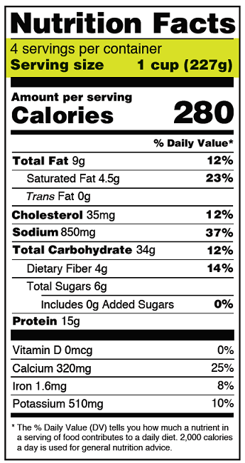
How much calories and sugar is in the entire bottle?
How many Servings?
4
How many calories?
280 X 4 = 1,120
How much sugar?
6g X 4= 24g
How many teaspoons of sugar?
1 teaspoon = 4G
4 /24= 6 teaspoons

Slide 37
Questions?

Slide 38
References
Centers for Disease Control and Prevention
National Dairy Council
Eat Smart Move More South Carolina
The Health Professional’s Guide to Popular Dietary Supplements (3rd Edition)
Complete Food and Nutrition Guide
( 3rd Edition)
www.webmd.com
www.eatright.org
www.marininstitute.org
www.mayoclinic.com

Slide 39
For Teachers Only…..

Slide 40
Emerging Trend: Relaxation Drinks
Opposite of energy drinks
Promise to help people unwind
Packaging is marketed to young people
Catchy names: iChill, Mary Jane’s Relaxing Soda, Drank, Vacation in a Bottle, Blue Crow
Usually contain a variety of herbs and other ingredients....valerian root, rose hips, melatonin, kava, etc
Notes:
Note: Valerian root (functional claims: enhances sleep; reduces stress and anxiety) is an approved food additive and rose hips are labeled GRAS, but not all ingredients have been cleared by the FDA and don’t need to be in order to be available.
www.abcnews.com
Kava: Pacific Islands—used for centuries
-banned in Switzerland, Germany, and Canada
-FDA released Consumer Advisory Warning in March 2002 regarding hepatic toxicity of kava supplements

Slide 41
SIPPIN SYRUP
16 oz Bottle
240 Calories
60 Grams of Sugar
If You Drank One of These Every Day for a Year, You Could Gain 25 Pounds!
Notes:
8 oz serving size (2 per bottle); 120 Calories per serving; 30 grams sugar per serving
Proprietary Calming Blend: Chamomile Extract, Lavender Extract; Valerian Root Extract, L-Theanine, Melatonin, Rose Hips Extract, Hops Extract,
St. John’s Wort Extract, Skullcap Extract, and Kava Kava Extract
Sippinsyrup.com
60 Grams of Sugar = 15 Teaspoons of Sugar

Slide 42
Energy Drinks and Alcohol
Caffeine masks alcohol’s intoxicating effects
JAMA: “Wide-Awake Drunkenness”
Promotes risky behavior

Slide 43
Which Contain Alcohol?

Slide 44
Which Contain Alcohol?

