Slide 1
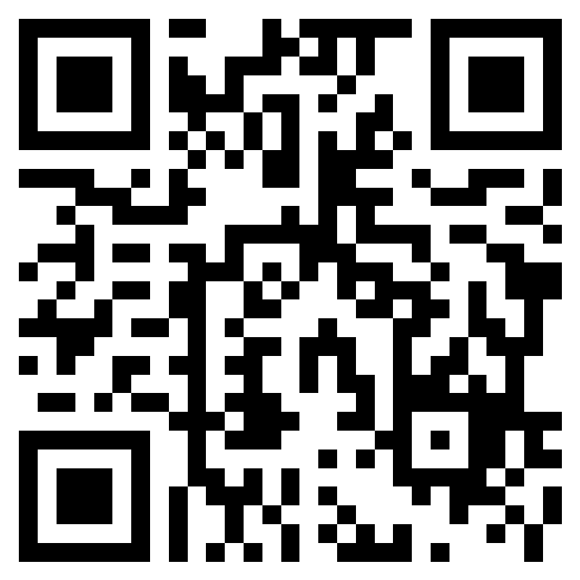
Asthma Management for Students at School
Kim Cobb, M.A., RRT-NPS, AE-C
Arkansas Children’s Asthma Program Coordinator
In order to obtain nursing continuing professional development contact hours, you must…
Complete the entire program.
Complete post-test after each module with a score of 85% or greater.
Complete the evaluation at the end of the program.
No contact hours will be awarded after August 1, 2023
Course Activity Overview:
After completion of 10 self-paced modules through Turning Point, learners will increase their knowledge about new asthma guidelines/protocols to manage asthma in school aged children and increase their confidence level in their ability to implement a student’s asthma action.
Topics include:
Comprehensive review of asthma
Current inhaled medications for treatment and delivery devices.
Inhaler technique review
2020 updates to the asthma management guidelines including SMART therapy
Emergency use of albuterol in the school setting
Trigger avoidance strategies
Utilization of the written asthma action plan
Arkansas Children’s is approved as a provider of nursing continuing professional development by the Midwest Multistate Division, an accredited approver by the American Nurses Credentialing Center’s Commission on Accreditation.
This activity provides 2.6 contact hours.
No conflicts of interest were identified for any member of the planning committee, presenter or any author of the program content.
Scan the QR Code or
Click here to register

