Slide 1
Be the Beat!

Slide 2
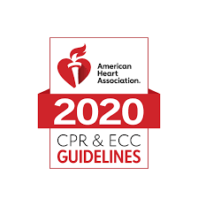
Learning Outcomes
Requirements of Act
AHA guidelines on Hands Only CPR/AED
Resources

Slide 3
Act 1016
ACT 1016
Rules and Regs
To require cardiopulmonary resuscitation instruction in public high school health and safety classes.
Public school student in grades 9-12 shall be trained in quality psychomotor skill based in CPR before the student graduates from high school.
The purpose of these Rules is to establish the requirements and procedures for governing school-based Automated External Defibrillator (AED) devices and Cardiopulmonary Resuscitation (CPR) programs in Arkansas Public Schools.
Notes:
Note: The younger you teach this to your students (9th grade vs waiting till their last few weeks in 12th grade), the more people you have on your campus ready and trained to help. Students are very resilient and can-do remarkable things when just given a little knowledge to save a life. This is great for health classes and falls right into the framework.

Slide 4
Steps of CPR/AED- Hands Only
Step 1
Scene Safety
Find the problem
Step 2
Call 911
Get AED
Step 3
Start CPR
Use AED as soon as it arrives

Slide 5
Step One: Scene Safety and Find the Problem
Scene Safety
Find the Problem
Universal Precautions
Be aware of danger for yourself
Unsafe places may be a busy road, area where power lines are down, or a room with smoke or fumes
Assess the ill or injured person
Is the person moving?
Is the person breathing?

Slide 6
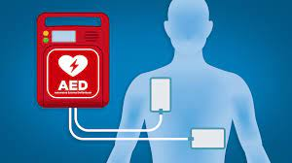
Step Two: Call 911 and get the AED
Calling 911
AED
Call 911
Tell dispatcher the emergency
Your location
How many is injured
Follow the dispatchers' directions
Send some one to get the AED
Start Chest compressions
If you are alone, Leave ill person and get AED

Slide 7
Step Three: Start CPR and Use the AED
Start CPR
AED
Place the heel of one hand on the center of chest
Keep your arms straight
Lean over person and press down
Rate 100-120 minute
Depth 2 inches
Do not stop once you have started
Turn AED on
Follow AED prompts
Remove pads
Cut clothing and bare the chest
Apply Pads
Analyzing heartrate- DO NOT touch patient
Shock if Advised- Continue CPR
Notes:
3 reasons you would stop CPR
EMS or another trained person arrives
Signs of life: breathing, conscious
You physically can not do CPR any more
The scene becomes unsafe

Slide 8
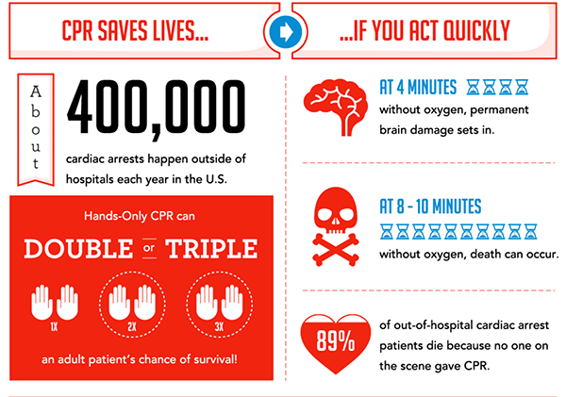
Notes:
Why we perform Hands Only CPR

Slide 9
When teaching a class
Scene safety
How and when to call 911
Have students practice compressions first
Watch for hand placement, rate, rhythm. Are there arms locked, are they up and over the ill person?
Introduce AED, demonstrate what the real AED looks and sound like. Ask student how many you have on campus and where the are located.
Put it together from beginning
Pair up in teams and practice from top to bottom.
Have students practice a full two minutes
Notes:
Review scene safety with them. If they are in danger, they can’t help someone. Never put your own life at risk.
Give examples: EMS must wait for police or fire to tell them the scene is safe for them to enter.
When calling 911, how long does it for EMS to arrive? Ask why they think that. Clarify that it could be as short as 10 minutes but could be as much as 45 minutes (adjust to your location). You can’t count on help being there in 5 minutes
When students are preforming compressions, I tell them their heart is like a sponge. When you press down, you are pressing the blood out, when you come up on the chest, you are letting the blood refill in the heart. You are acting like their pump when their own heart can’t pump the blood.
There is a CPR in Action -3D that demonstrates this. https://chs-support.weebly.com/cpr-for-hs-students.html

Slide 10
Definitions
Cardiac Arrest: Heart stops beating.
Unresponsive: Person does not talk, move, or respond when talked to or shaken.
Hands Only CPR: Compression only, for anyone 8 years of age or older.
AED: Automated External Defibrillator. This computer device will analyze your heart rhythm and give a shock, if needed, to restart the heart.

Slide 11
Resources- Videos and Power Point
Community Health Specialist- Support Webpage

Slide 12
Supplies You Will Need
Manikins
Prefer 2 students to one manikins (if not 1:1)
Trainer AED
School AED (for demonstrations only)
SCSC has supplies you can check out.
Form is on the website
https://chs-support.weebly.com/

Slide 13
Legal Concerns
Good Samaritan Laws
Four key elements in good Samaritan laws are:
Permission of ill/injured person when possible.
Care given in appropriate (non-reckless) manner.
Person covered by good Samaritan laws was NOT the one who caused an accident.
Care was being given because it was an emergency and trained help had yet to arrive.
Protecting the person’s privacy
Keep private things private.
If you are at school, you are under FERPPA
Notes:
The Good Samaritan Act is a law which protects any volunteer giving aid to an injured person in an emergency situation. The Good Samaritan Law offers legal protection in the form of exemption from lawsuits and liability, acting as a safeguard to those who help another in a real emergency, life-or-death situation.

Slide 14
Notes:
Thank you.

