Slide 1
VISION SCREENING CERTIFICATION FOR ARKANSAS SCHOOL NURSES
Updated 2023
Notes:
Welcome to the 2023 updated Vision Screening Certification for Arkansas Nurses
1

Slide 2
Learning Outcomes
Participants will self-report an increase in knowledge of early detection and treatment for eye abnormalities related to school- aged children by passing the post-assessment with a score of 80% or higher.
Participants will demonstrate correct vision screening protocol, complete data collection, documentation, and referral.
Notes:
Assess knowledge of the vision law and responsibilities.
Explain the importance of vision screening.
Identify the components of a vision screening and the pass/fail criteria for each.
Demonstrate operation of the approved vision screening instruments.
List age-appropriate vision screening procedures.
Identify components of the referral, follow-up and reporting process
Assess knowledge of the vision law and responsibilities.
Explain the importance of vision screening.
Identify the components of a vision screening and the pass/fail criteria for each.
Demonstrate operation of the approved vision screening instruments.
List age-appropriate vision screening procedures.
Identify components of the referral, follow-up and reporting process

Slide 3
Act 1438 of 2005
An Act To Mandate Eye And Vision Screening Procedures And Tests For Children
ADE Rules Governing Eye & Vision Screening Report in AR Public Schools https://dese.ade.arkansas.gov
Arkansas Laws and School Health www.chs-support.weebly.com
Notes:
This law was passed in 2005 and in 2006 a committee met to write the rules and regulations.
This law applies all public and charter schools.
Who to screen: pre-k, K, 1,2,4, 6, 8 Transfers- Referral from parent, teacher at any grade
What tests to perform: Observation, (distance visual acuity using a wall chart and plus lens visual acuity using wall chart and +2.00 lens) Lateral MB far, Vertical Muscle Bal far, Lateral MB near, fusion far, fusion near and color perception test)
What vision screening instruments we need to perform each of these tests
When to do rescreens,(one month) when to refer a student (any part of screening the student fails except color perception)
Parent has 60 days to comply
That the report must be mailed or given directly to the parent or guardian
If the parent or guardian doesn’t take the child for the examination they are to be reported to the ADE
If the student has had an eye examination conducted by an ophthalmologist or optometrist in the last 6 months, is not required to have another examination if they provide evidence in the form of a certificate signed by the optometrist or ophtalmologist
Tell what forms we are to use: screening form, parent/doctor form & form to report results of screening and exam (this is reported in APSCN)

Slide 4
Importance
One in 20 preschoolers has a vision problem.
One in 5-10 school-aged children has a vision problem.
Impaired vision can seriously impede learning.
Early identification and treatment can prevent or at least alleviate many vision problems.
Notes:
4
Review the points above….kids can’t learn if they have a vision deficit
In a classroom of 20 students, statistically 2-4 students will have a vision impairment.

Slide 5
Purpose
To screen a large number of children in a short amount of time.
To separate those children likely to have vision problems from those not likely to.
To refer those children who do not pass the screening or who are suspect for vision problems.
Notes:
5
Even though we are moving the students thru quickly, we must have a quality screening program and must follow the protocols that have been established….

Slide 6
Landmarks of Visual Development
4-12 wks
Binocular fixation
12-20 wks
20/200
44 wks-12 mo
20/50 - 20/100
Full binocular vision
Amblyopia may develop
6 -18 mo
Convergence developed
18 mo-2 yrs
Accommodation developed
20/40
2-3 yrs
20/30
5 yrs
Min. potential for amblyopia
6 yrs
Approaches 20/20
Notes:
6
Eyes begin to develop at 5 weeks of gestation and stop developing at age 13 years.
Point out the developmental red flag: amblyopia at approximately 12 months of age. The child may have intermittent problems with muscle balance and control but by 12 months this should not continue to happen. Amblyopia is defined as visual impairment without apparent organic pathology. Amblyopia should be identified as early as possible (after 12 months of age) and referred ASAP; however, we have students that present in school with this problem and it needs to be addressed at that time. Delayed recognition of amblyopia can result in permanent damage.
Legal blindness is a term that describes central vision acuity that is 20/200 or less in good eye after correction.

Slide 7
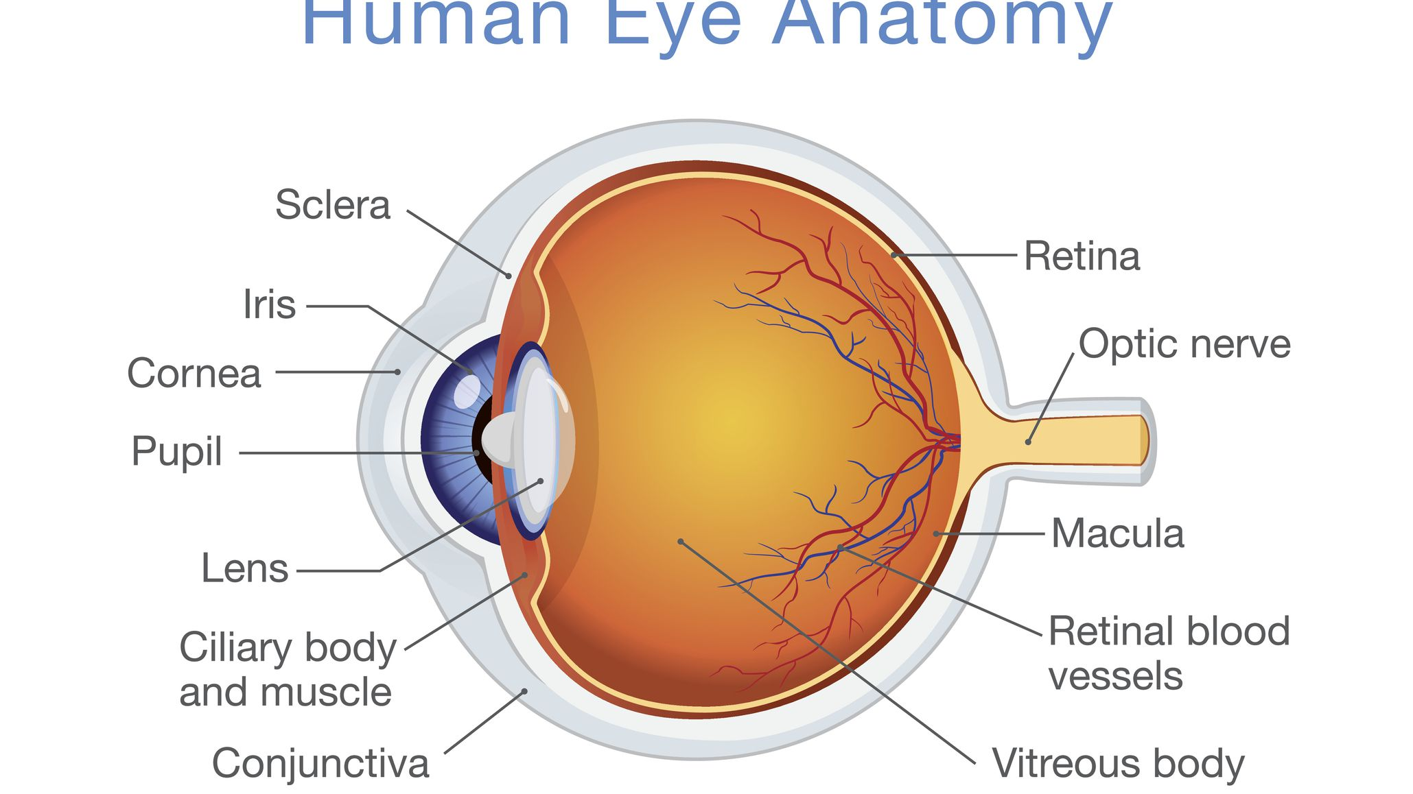
Parts of the Eye
Notes:
7
The eye collects light from the visible world and converts it to nerve impulses. The optic nerve transmits these signals to the brain, which forms an image-know as sight.
Eyelid is the skin covering structure that protects the front of the eye, limits the light entering the eye and spreads tears over cornea (lubrication).
OUTER LAYER:
Conjunctiva is the membrane lining the back of the lids and the front of the eye except for the cornea.
Sclera or “white of the eye”(tough,white opaque membrane) and attaches to the muscles.
Cornea is the clear thin, dome-shaped tissue that lets in light, by bending rays. Its function is focus.
MIDDLE LAYER or vascular tunic:
Iris is the color portion of the eye that adjusts the size of the pupil
Pupil is the opening in the center of the iris and responsible for controlling the amount of light in by dilating or restricting. The Iris and Pupil are compared to shutter of a camera,controlling light and focusing images.
Lens clear part of the eye behind the iris. It is an olive-shaped structure with NO blood vessels. By adjusting its size shape and size, the lens can change the focus. It partners with the cornea as principal optical structures to help focus light on the retina, allowing the eye to focus on both far and near objects.
Aqueous humor is a water like fluid that fills the anterior and posterior chambers of the eye located in front of the lens, and is produced by the ciliary body.
MIDDLE VASCULAR LAYER:
Choroid lines the eyeball and contains vascular system that nourishes the retina The anterior part of the choroid passes through the ciliary body.
Ciliary body contains muscles that suspend the lens and facilitate accommodation.
INNER NERVOUS LAYER:
Vitreous humor is located between the lens and retina and is a clear gel that fills the inside of the eye. It gives the eye its shape and keeps the retina in place.
Macula Lutea is responsible for central vision, which is the sharpest vision.
Optic nerve consists of over 1 million nerve fibers and cells that carry visual messages from the retina to the brain.
Six extraocular muscles control eye movement in the bony orbit. The muscles to both eyes work together to create simultaneous movement.
HOW THE EYE WORKS IN SUMMARY:
The eye works like a camera. The iris is the aperture that controls the amount of light rays reaching the cornea and lens, and the retina works as the film. Bending of the light rays by the cornea and lens serves to create a sharp images on the retina. These images trigger nerve impulses, and then are transmitted to the brain where the images are perceived and interpreted.

Slide 8
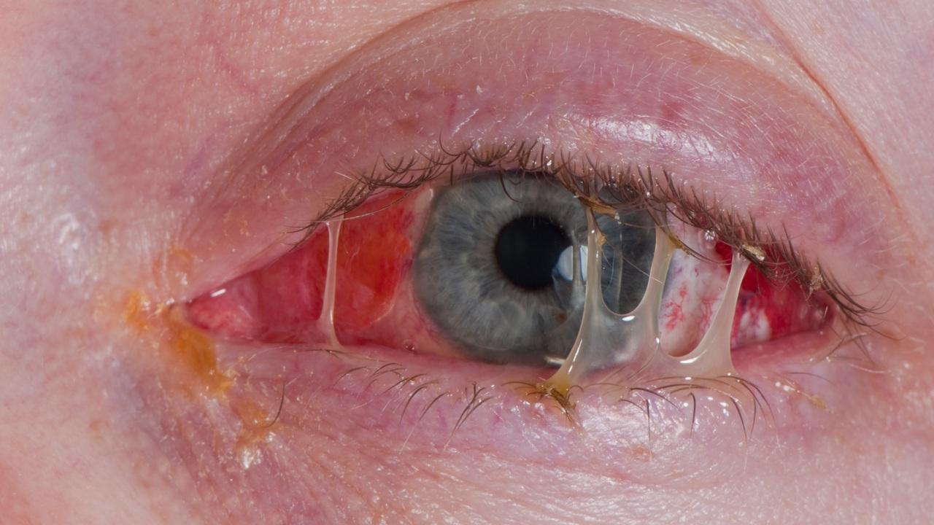
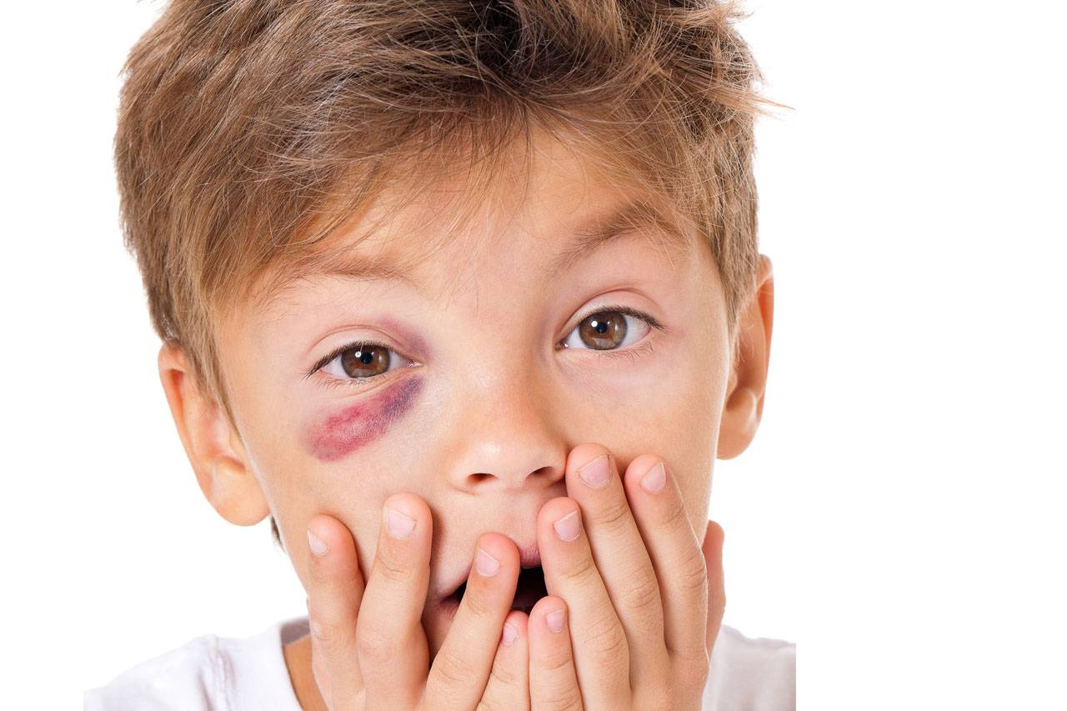
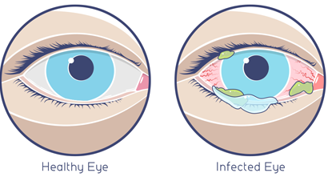
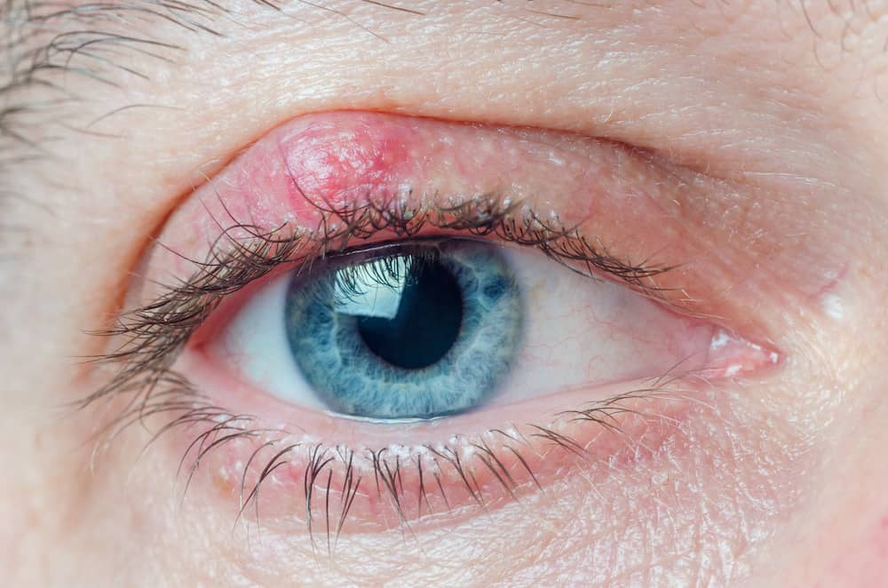
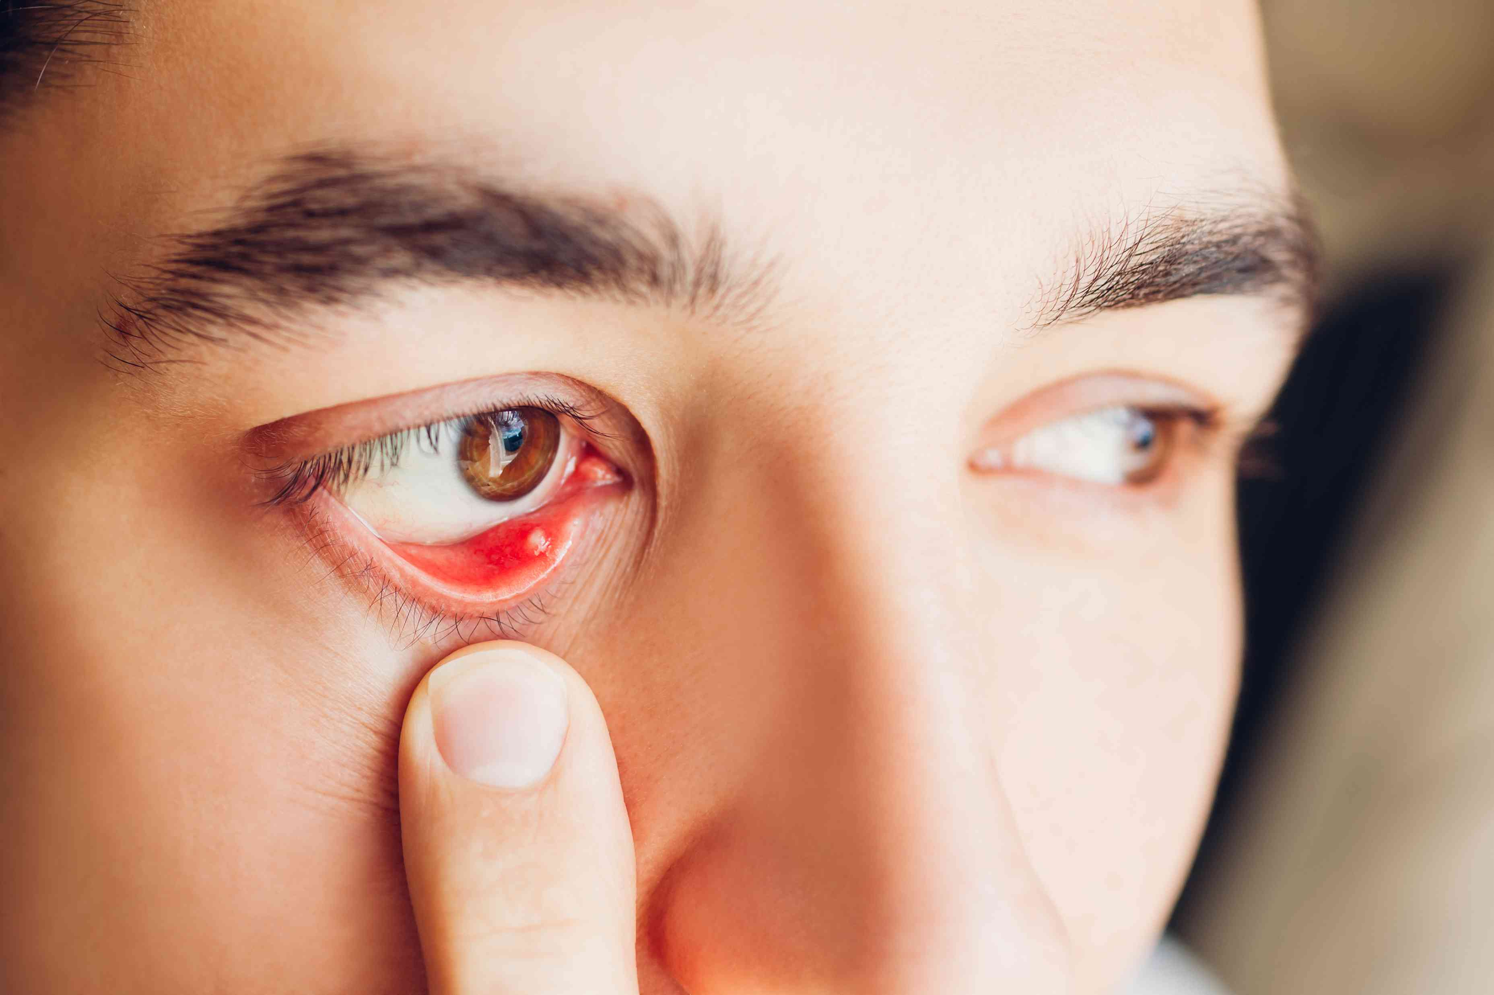
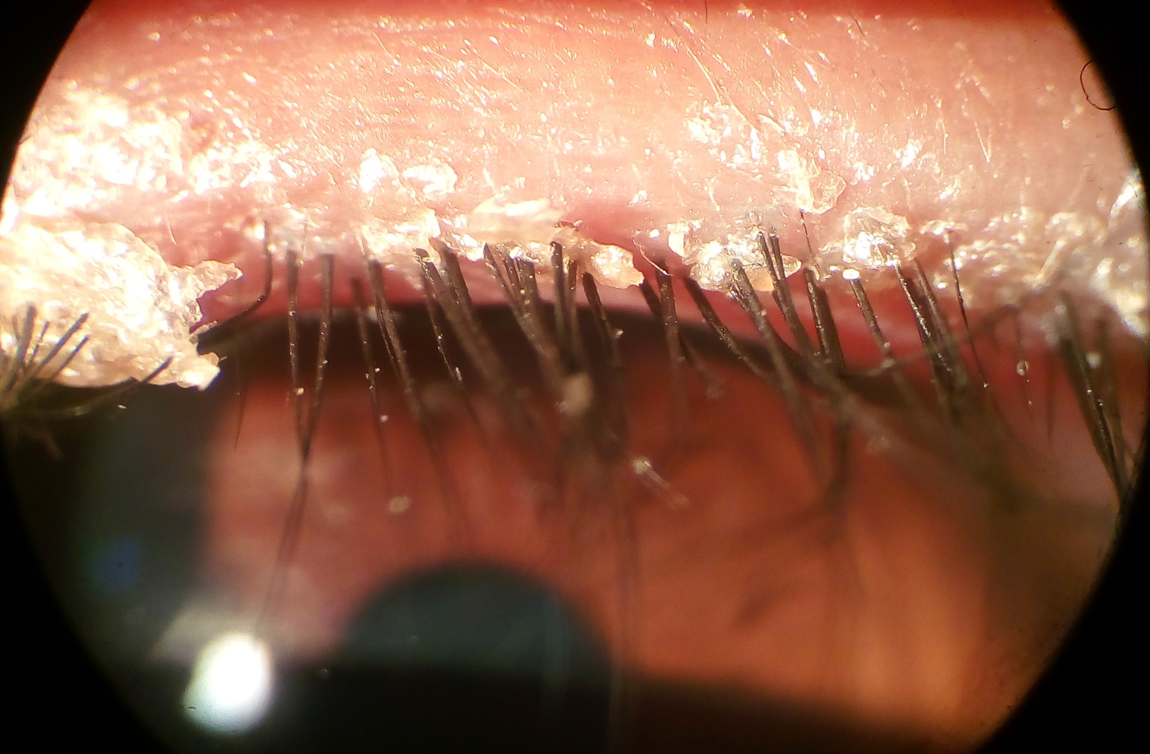
Common Ocular Abnormalities
Notes:
Swelling, itching, redness and drainage

Slide 9
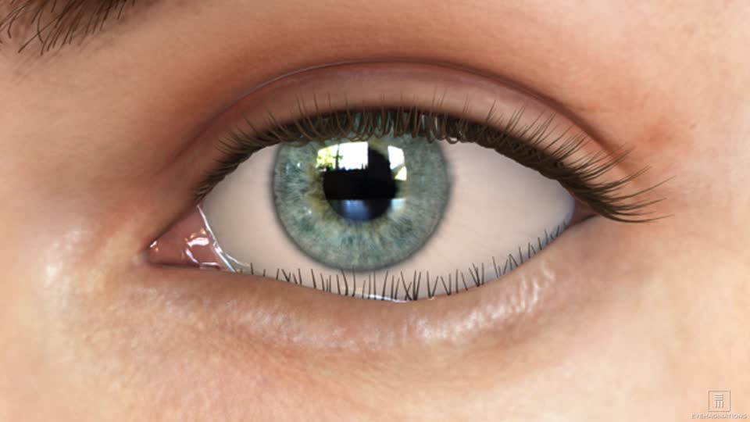
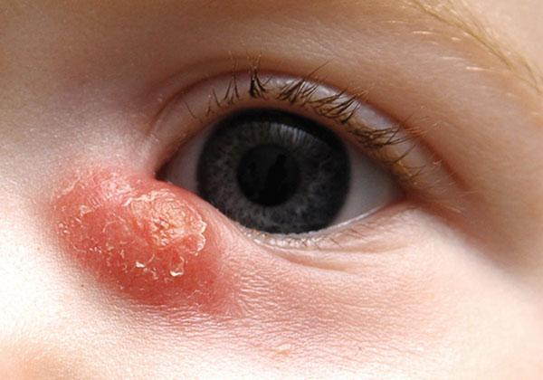
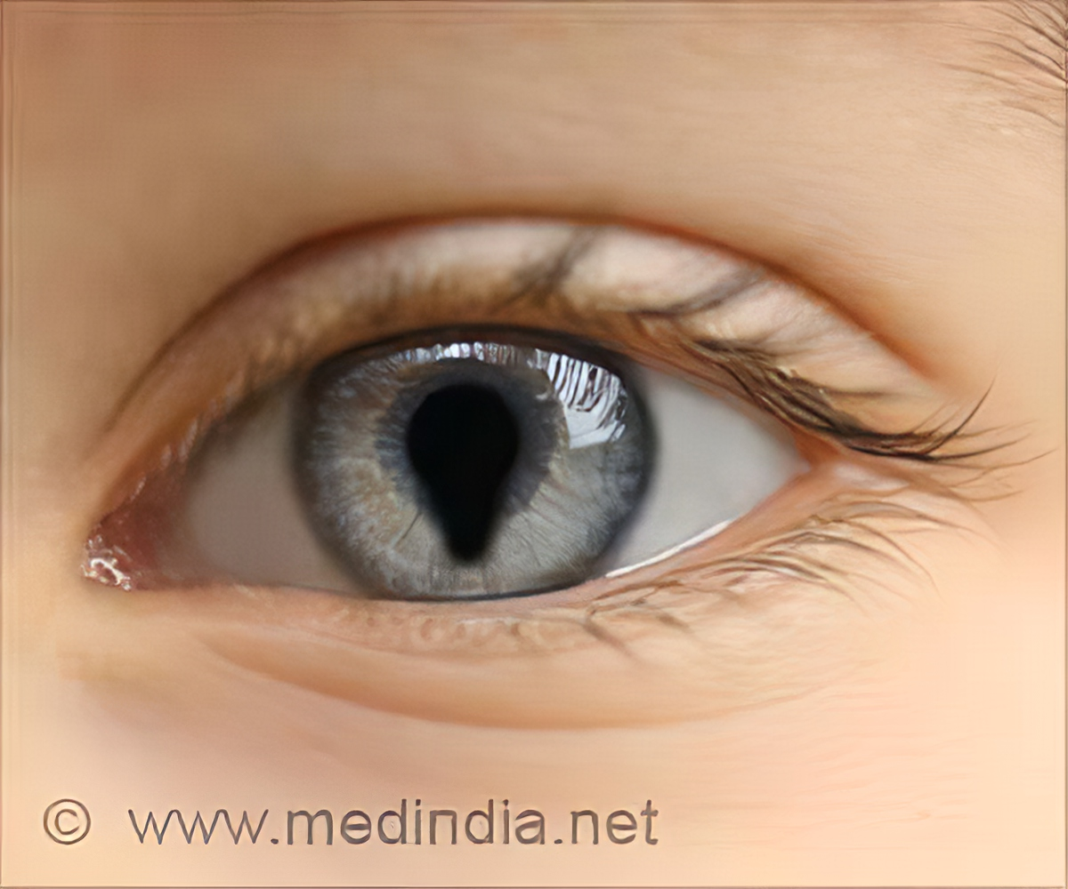
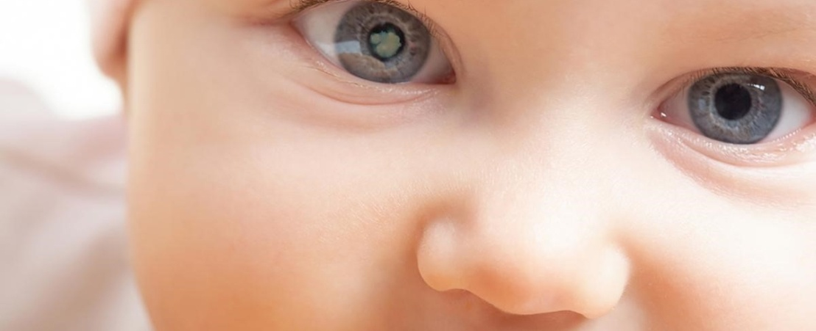
Common Ocular Abnormalities
Notes:
9
Entropion is a condition in which your eyelid, usually the lower one, is turned inward so that your eyelashes rub against your eyeball, causing discomfort.
May lead to corneal ulceration or scarring

Slide 10
Common Muscular Abnormalities
Tropia
Eyes which are always improperly aligned
Phoria
Eyes which have a tendency to misalign when fusion is interrupted
Notes:
10
Tropia caused by unequal muscle tone…convergent (eso, turns in), divergent (exo, turns out) or vertical (hyper, hypo); deviation from parallelism does not vary with ocular movement ( if upward, always upward)…fixated at the same degree without variation.
Phoria is deviation of one eye from parallelism with the other…nonparalytic, muscle imbalance is overcome by the CNS tendency to fuse the images from each eye…May be associated with fatigue, stress, focus, or emotion.
Phoria becomes apparent when the CNS is unable to maintain fusion

Slide 11
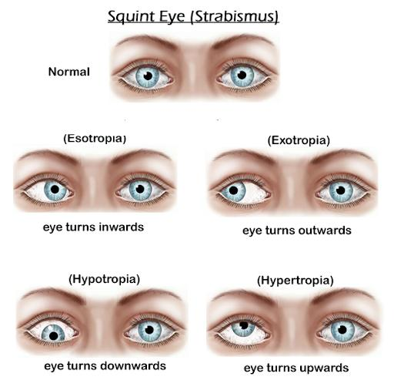
Notes:
11
Note right eye turns inward

Slide 12
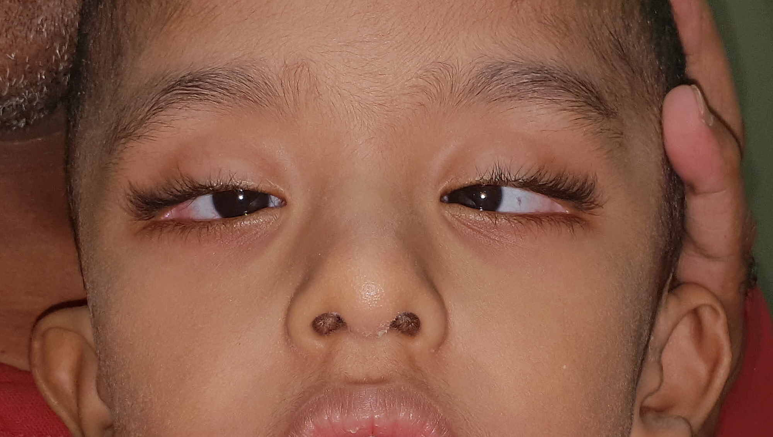
Bilateral Esotropia
Notes:
12
Both eyes turn inward

Slide 13
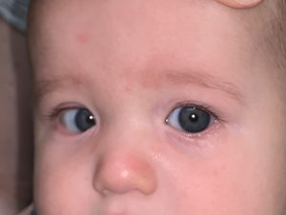
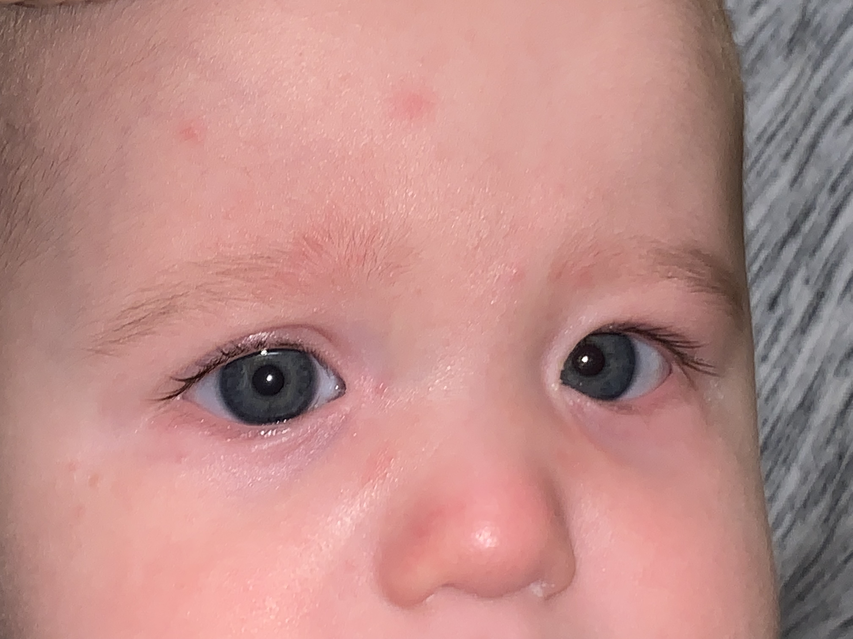
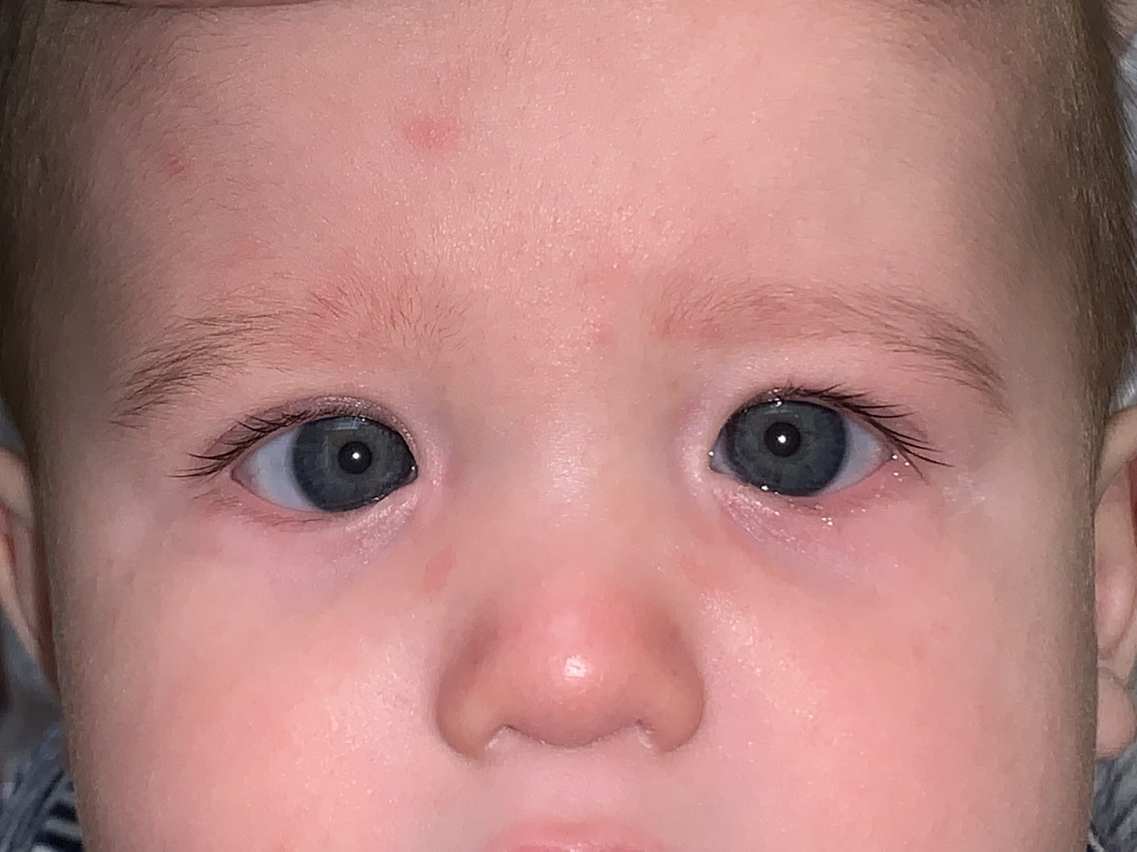
Pseudostrabismus
Notes:
13
Pseudoesotropia describes the condition in which a patient has the illusion of esotropic strabismus (inwardly deviated eye misalignment) despite accurately aligned visual axes.
Corneal light reflux-Normal eyes are symmetrical and centered.
Images 1, 2, & 3 from Right to Left: The pseudoesotropia almost always appears worse when the child is in side gaze (images 1 and 3). Image 2 demonstrates, when looking straight ahead, most of the medial conjunctiva or white portion of the eye, is covered up by the epicanthal folds. The corneal light reflex, in all three photos, is symmetric and centered within the pupil.

Slide 14
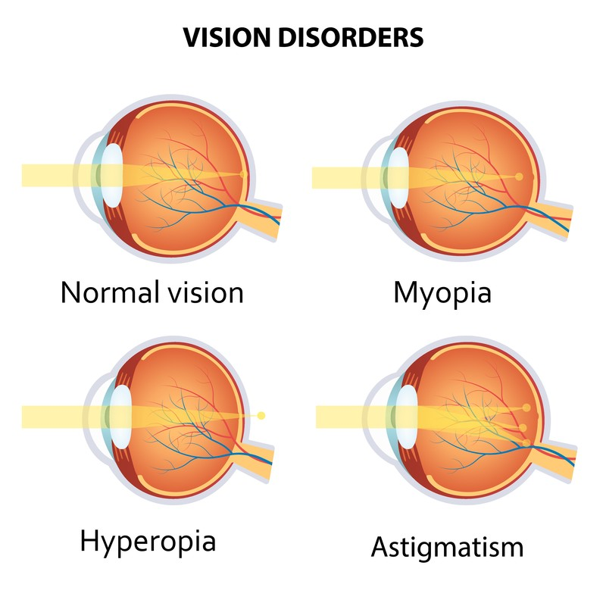
Refractive Errors
Myopia (Nearsightedness)
Hyperopia (Farsightedness)
Astigmatism
Notes:
14
Three types of refractive errors
We will discuss each

Slide 15
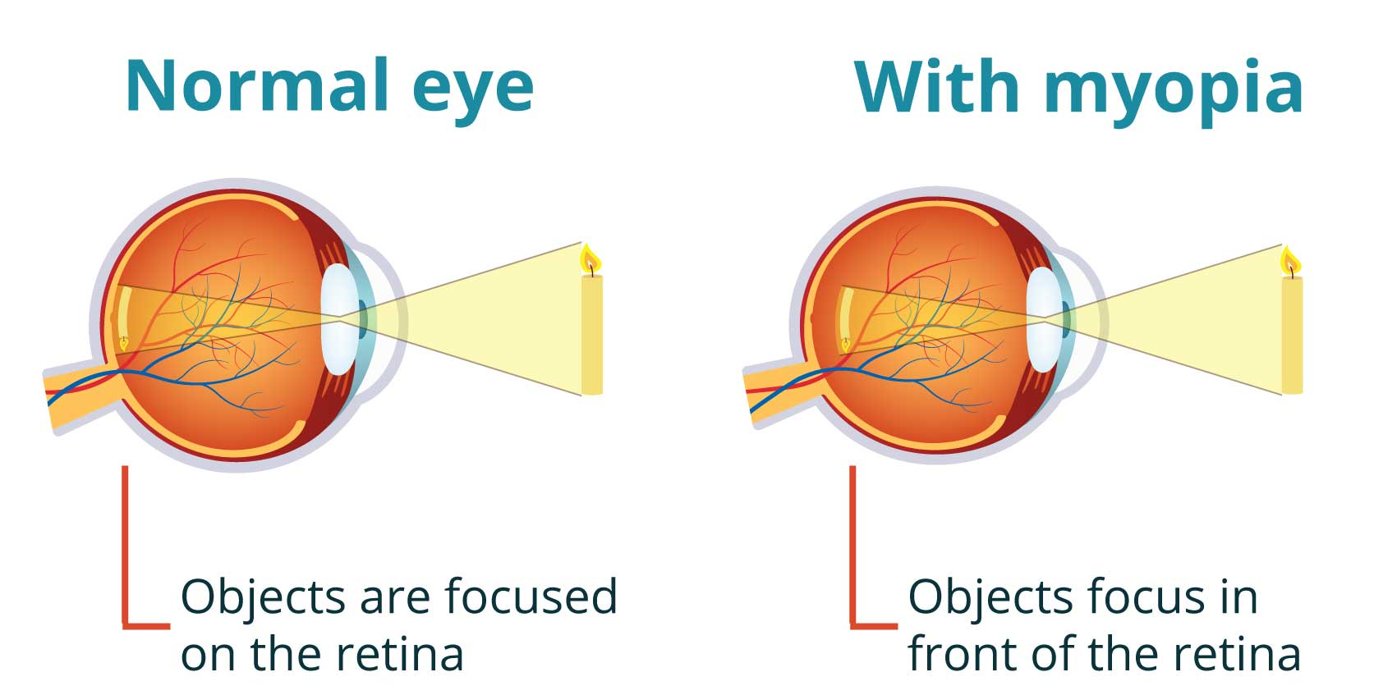
Myopia- Nearsighted
Notes:
15
This is a long eye ball. Image focuses in front of the retina…because the refractive power of the eye is too strong
"minus" lens for correction
Note the distance from side to side is greater than the distance top to bottom

Slide 16
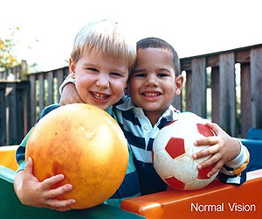
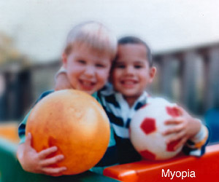
Myopia
Notes:
Board work would be difficult for this student.

Slide 17
Notes:
Nearsighted view
Ball is clear but the flag is blurry
Problem in classroom is reading the blackboard

Slide 18
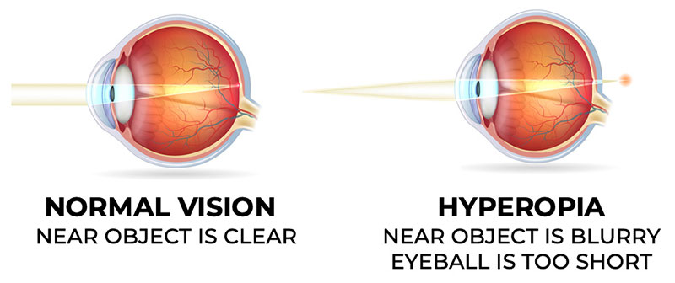
Hyperopia- Farsighted
Notes:
18
Short eyeball
Most common refractive error… image focuses behind retina or refractive power of eye is too weak…"plus" lens for correction
Note the distance from side to side is less than the distance top to bottom
Students can have multiple things going on……….. Farsigntedness in one eye, nearsightedness in the other, astigmatism too!!

Slide 19
Hyperopia

Slide 20
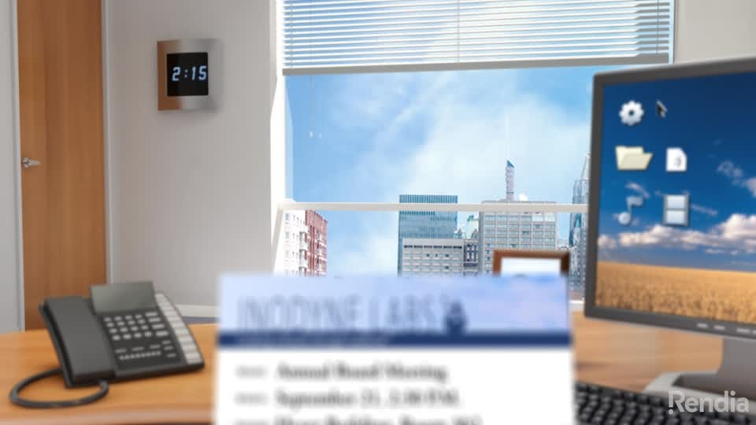
Notes:
Farsighted view
Note card is blurry but buildings are clear
This student would have difficulty with close work (reading a book or laptop/pad).
Problem in classroom is reading the text or doing paperwork

Slide 21
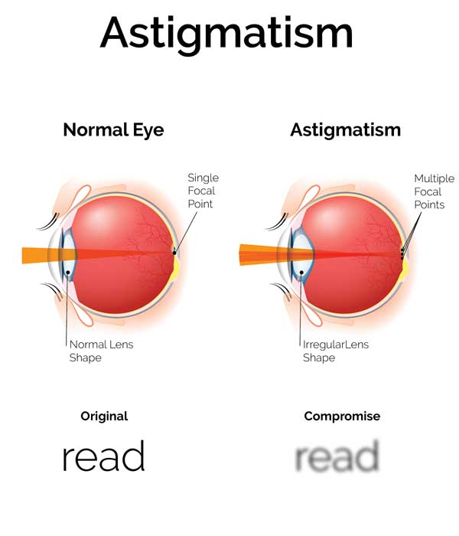
Notes:
Unequal refraction of light rays
Curve of the cornea is more acute, not smooth eye ball is more oval than round
Distorts both shape and size of objects

Slide 22
Astigmatism

Slide 23
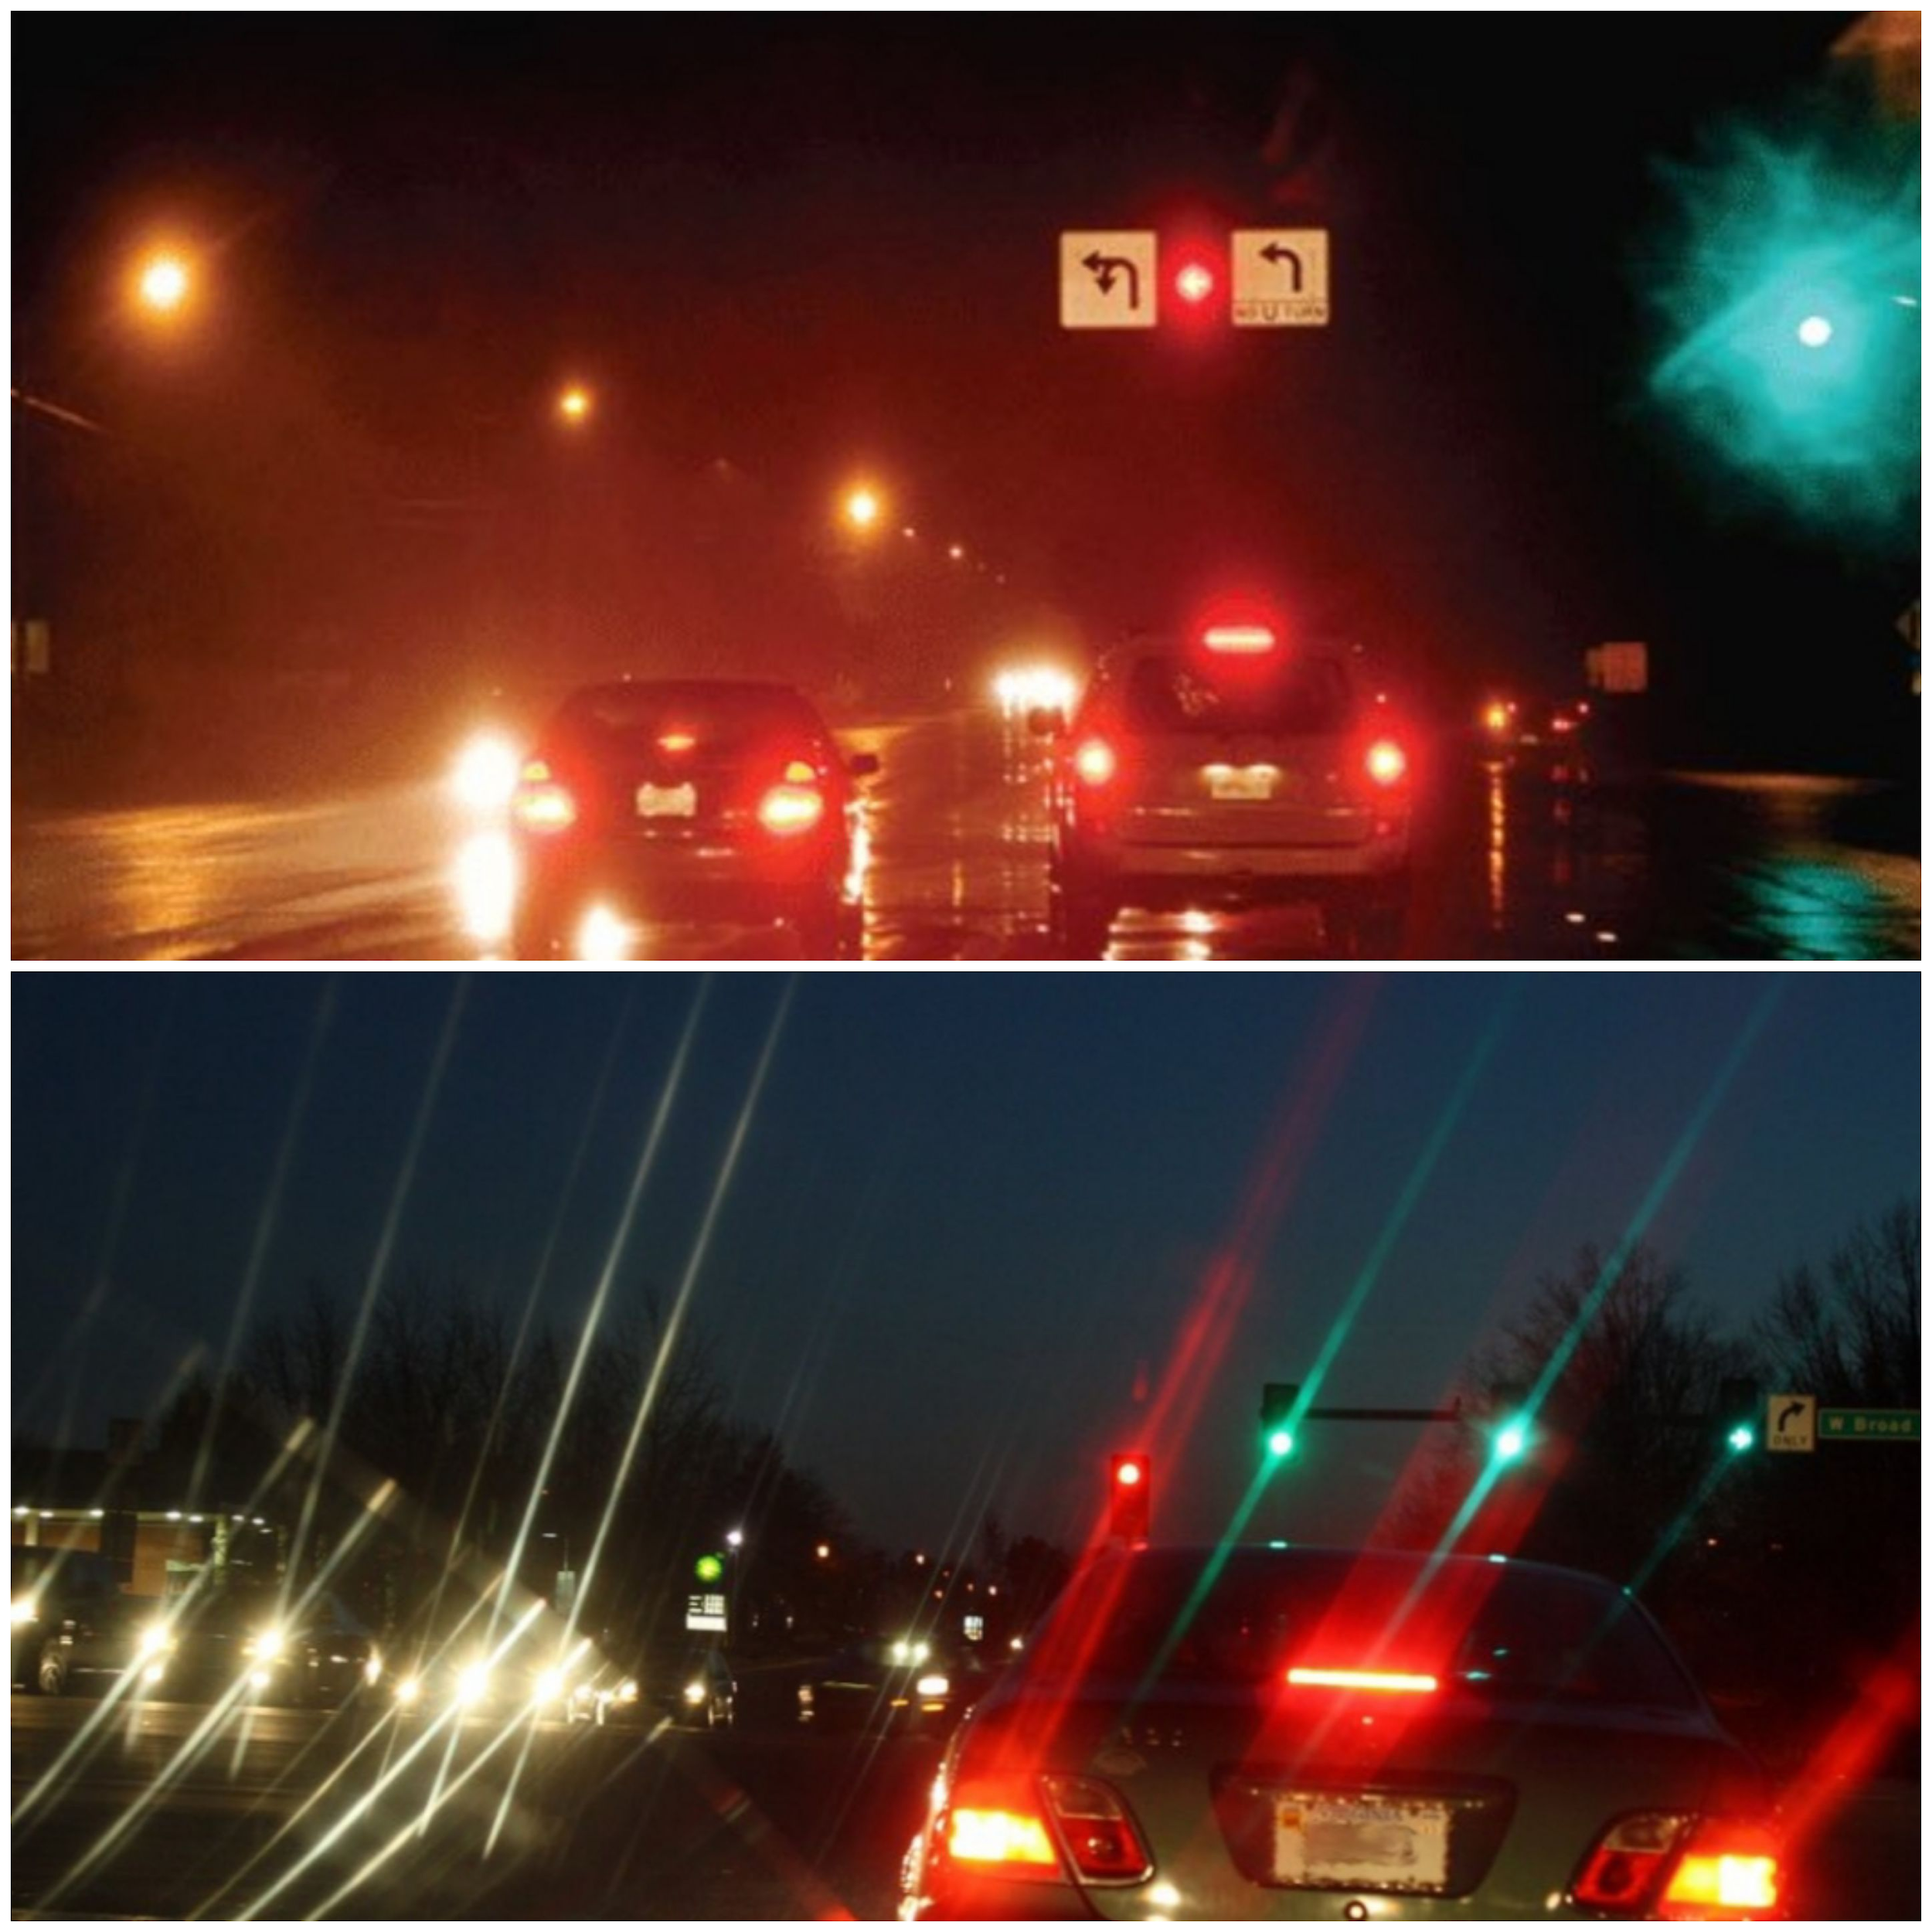

Slide 24
Amblyopia
Vision that cannot be corrected to better than 20/40
Unilateral or bilateral
Brain suppresses poor image
Normal appearance
Reversible if detected and treated early
Notes:
24
It is very important that these children receive treatment as soon as possible. Remember when I talked about the visual development and I said at 12 months there is potential for the development of amblyopia.
Amblyopia is reduced visual acuity due to cortical suppression of the image in the deviating eye to avoid confusion and dip/lop/ia or (double vision)
Amblyopia- the eye and the brain are not working together. Amblyopia is also known as lazy eye but Amblyopia is not a muscle problem. This is a brain problem.
the term lazy eye is often confused with strabismus.
Because children in most cases have a normal appearance the amblyopia may not be detected by a doctor. If a child with ambyopia also has strabismus, then the amblyopia is more likely to be detected.
Organic causes are usually not reversible

Slide 25
Amblyopia
Predisposing Factors
Poor clarity
Cataract
Poor focus
Nearsightedness
Farsightedness
Astigmatism
Poor aim
Strabismus
Treatment
Clearing the media
Cataract removal
Focusing the image
Corrective lenses
Correcting aim
Occlusion therapy
Drops
Notes:
25
How do we treat it?
Point out predisposing factor and matching treatment
Atropine drops may be used to blur the “good” eye, forcing the weaker eye to work harder.

Slide 26
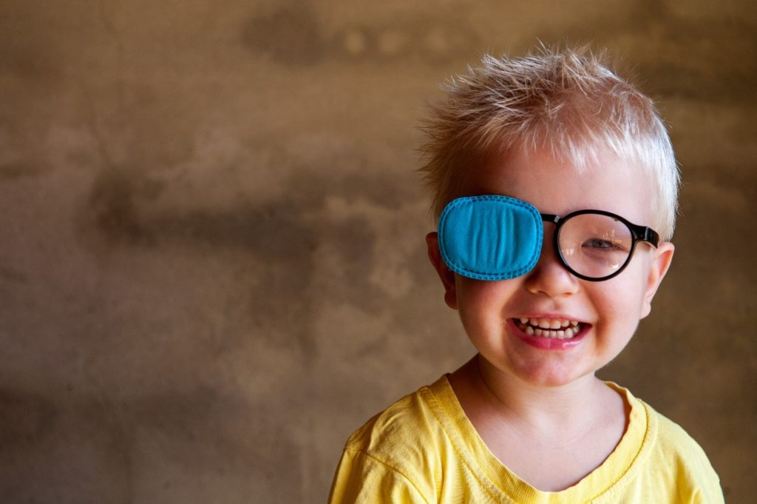
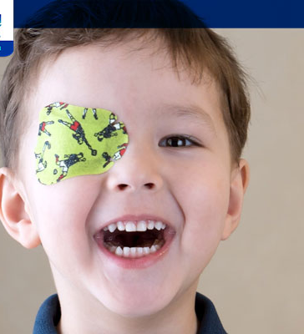
Amblyopia Therapy
Notes:
26
Type of patching
By patching the good eye, the brain is forced to use the other eye
Notice this child is wearing glasses. It is possible for a student to have refractory problems as well as ambylopia

Slide 27
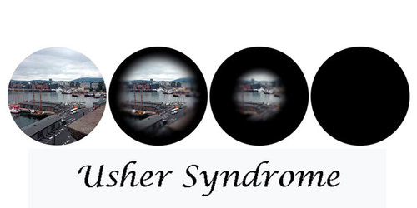
Usher’s Syndrome
Hearing Loss and Retinitis Pigmentosa
Screen children with hearing loss
Notes:
27
Usher syndrome is a rare genetic disorder primarily characterized by deafness due to an impaired ability of the inner ear and auditory nerves to transmit sensory (sound) input to the brain (sensorineual hearing loss) accompanied by retinitis pigmentosa, a disorder that affects the retina and causes progressive loss of vision.
Usher syndrome type 1 is characterized by profound hearing loss in both ears at birth (congenital deafness) and balance problems.
Usher syndrome type 2 is characterized by moderate to severe hearing loss in both ears at birth.
Usher syndrome type 3 is characterized by later onset hearing loss, variable balance (vestibular) dysfunction and RP that can present between the second and fourth decade of life. Balance issues occur in approximately 50% of individuals with Usher syndrome type 3.

Slide 28
Vision Screening Procedures for Arkansas School Nurses

Slide 29
Population
Grades:
Pre K, K, 1, 2, 4, 6, 8
Transfer students
Special Education
Referrals
Notes:
Pre K is only 4 year olds on a school campus and going to Kindergarten.
Referrals can be from teachers, aides, or parents.
Transfer students who have been screened in their previous school during the current school year do not have to be rescreened at the new school. Schools may request the transfer student’s vision screening from his/her school that was completed within the current school year.

Slide 30
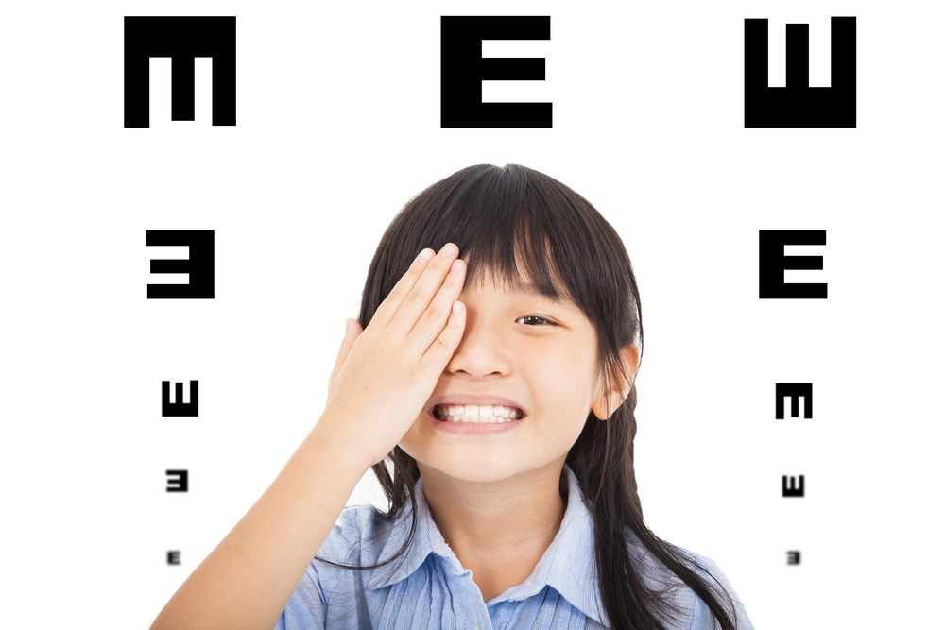
Procedure
Notes:
30
The following is the protocol that school nurses follow during vision screening.
This is the only screening procedures we follow. We do not have a functional screening test. If the student cannot pass the screening test or is unable to be screened due to a disability, the student must be referred.

Slide 31
Observation
Appearance
Behavior
Complaints
Notes:
31
Observations is with and without glasses. Vision screening must be performed by a nurse that is trained through this training.
We will address each of these.

Slide 32
Appearance
Whites
Iris
Pupil
Lids
Lashes
Immediate
Notes:
32
Whites-not yellow, red or other color
Are the irises the same color
Note pupil size/symmetry
Eyelids- do they droop?
Lashes- Are they pointing up or down into the eye, any drainage?
Cornea/lens….oblique lighting can help identify opacities
Do you note any of the problems or diseases reviewed earlier???

Slide 33
Behavior
Head tilt or turn
Blinking or rubbing
Avoiding close work
Squinting/frowning
Closing or covering eye
Reading problems
Frustration/poor attention
Notes:
33
Has the classroom teacher/parent reported any of these behaviors?

Slide 34
Complaints
Headaches
Nausea
Dizziness
Burning or itching
Blurring
Notes:
34
Has the student been to the nurse with frequent complaints?

Slide 35
Visual Acuity
Screen one eye at a time
If a child wears glasses, perform the screening with the child wearing the glasses
Student must be able to read 75% of the 20/30 line. Any eye with vision of less than or equal to 20/40 shall result in a screen failure
Notes:
35
Snellen Chart will be used for this part of the screening. When using the snellen chart, you will screen one eye at a time and with corrective lenses (if they have RX lenses)

Slide 36
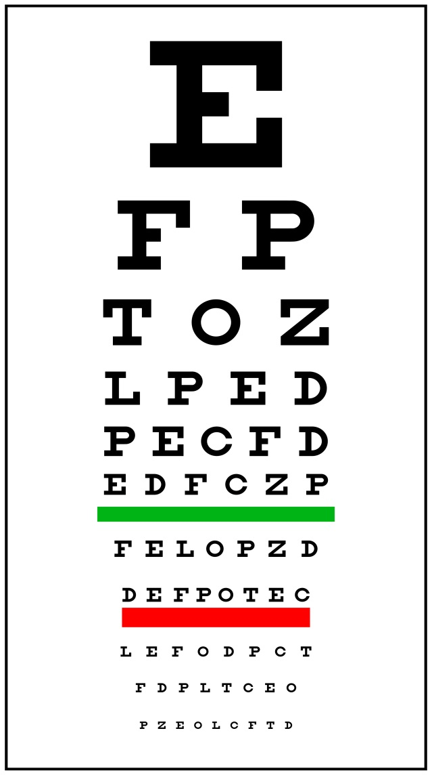
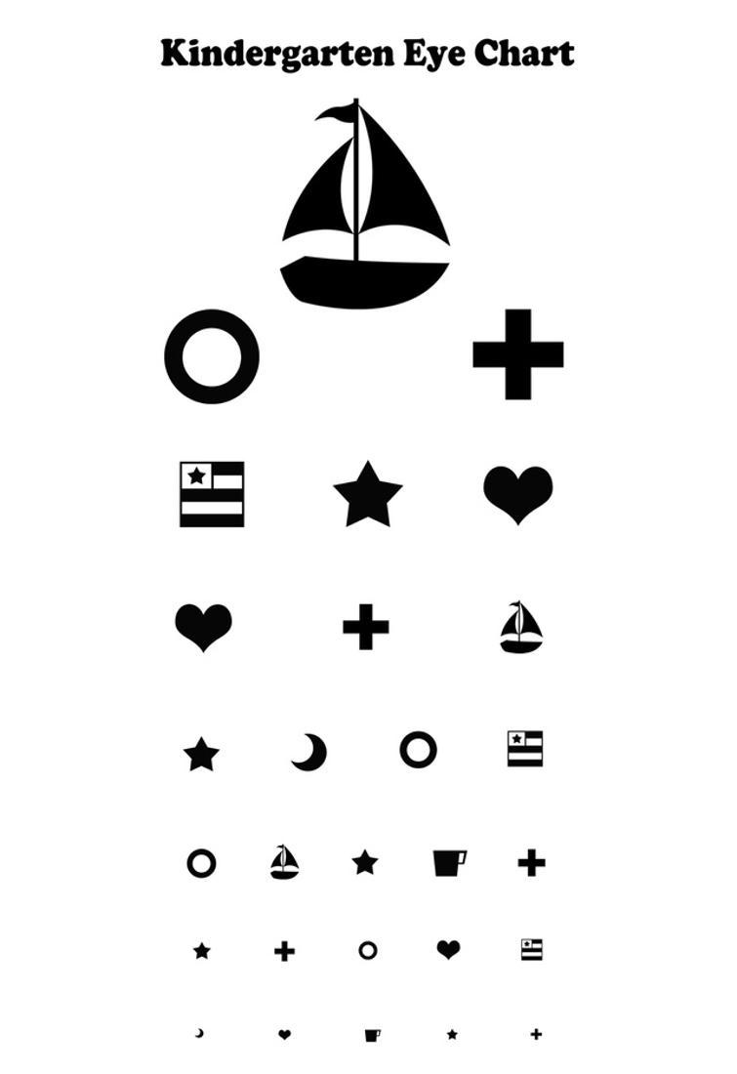
Wall Charts
Notes:
Snellen 20’ wall chart and Age appropriate charts.
During the live event, your instructor will give you some tips on using the snellen chart.
36

Slide 37
Wall Charts
Two types of Snellen Eye Charts
20 feet
10 feet
Age Appropriate Chart
Allen Chart/Tumbling E’s
Pre-literate children/non-English speaking
Notes:
Snellen Chart: 20 or 10 feet depending on which chart you are using.
Be sure to use a 10 foot chart if you do not have a space large enough to use a 20 foot chart.
Begin with the right eye, and cover the left and have the student read the (20/30) line.
then switch to the left eye and cover the right repeating the process
Passing is 4 correct

Slide 38
Plus 2 (+2.00) Visual Acuity
Test for extreme farsightedness
Perform exactly as the distance visual acuity except:
Test with a +2.00 lens
Any eye that improves 2 lines of vision with the +2.00 lens in front of eye shall result in a screen failure
Notes:
38
When administering this test, the correct response is “it IS blurry”… when you use the +2.00 lens. You can also ask “does the glasses make it better or worse?”…If the student is able to read a few letters, this is not a failure.The student must read 2 lines better to fail. You will check each eye if they are able to read the 2 lines better.

Slide 39
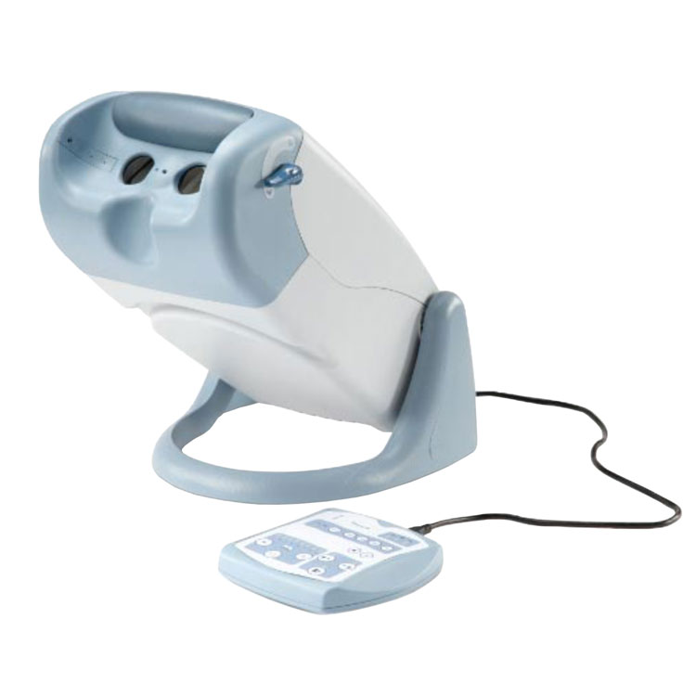
Vision Machines
Titmus
Optec
Keystone
Autorefractor
Notes:
These are the approved vision screeners. Titmus and Optec are the most common machines we see. There are still a few Keystone still in use.

Slide 40
Lateral & Vertical Muscle Balance-(Titmus & Optec)
Right eye on; left eye off
Give instructions:
“Here is a box. I will throw a red ball. Tell me where the ball lands.”
Turn left eye on
Need immediate answer
If not, repeat test
To pass the child should report the ball landing ‘in the box’ or ‘on the line’
Notes:
40
The ball in the box is a test for lateral and vertical muscle balance. This test will be given at Near and Far. You start with the left eye on, which they will see a box, then you will turn the right eye on (the ball) to see where it lands in the box.
Far- ball must land in the box or if you have an A and B box, it must land in the A box
Near-ball must land in the box or if you have an A and B box, it can land in either the A or B box

Slide 41
Ball in Box- (Near and Far)
FAR: Ball must land in A box only (Titmus 2)
NEAR: Ball can land in either box A or B
Notes:
Machine is in far mode; right eye on. Give instructions to tell where the ball lands. You turn on left eye. Answer must be immediate, if not repeat test.
During the FAR test: the Ball must land in the “A” box (Titmus 2)
During the NEAR test: the Ball can land in the “A” or “B’ box (Titmus 2)

Slide 42
Lateral Muscle Balance- (Near) Keystone
Use slide labeled ‘Lateral phoria – use at near point’ (place at the near point)
Again a row of numbers (2 -10) and an arrow are present
A response of the arrow pointing between 4.5 and 6.5 is a screen pass – outside this is a screen failure
Notes:
42
Test for phoria

Slide 43
Lateral Muscle Balance- (Near) Keystone
- 1 2 3 4 5 6 7 8 9 10 -
fail
fail
pass
Notes:
43
Pass is 6,5,or 4
Fail if answer is 8-10 or 1-2
Rescreen if 3 or 7

Slide 44
Lateral Muscle Balance-
(Far) Keystone
Right eye on; left eye on
Place slide ‘Lateral Phoria – use at far point’
Give instructions
“Here is a row of numbers, 1 to 15, and an arrow/pointer. What number does the arrow point most closely to?”
Need immediate answer
If not, repeat test
To pass the child should report the arrow pointing to a number(s) between 8 and 11. Any other answer is a screen failure
Notes:
44
Keystone
If you have a keystone machine, you can test for lateral muscle balance using a row of numbers. You are to ask, where does the arrow land? You will need the immediate answer. It should be between the 8-11

Slide 45
Lateral Muscle Balance-
(Far) Keystone
- 1 2 3 4 5 6 7 8 9 10 11 12 13 14 15 -
fail
fail
pass
Notes:
45
Test for phoria
Pass is 8, 9, 10
Fail 12-15 or 1-6
Rescreen if answer 11 or 7

Slide 46
Vertical Muscle Balance-
(Far) Keystone
Performed at ‘far’
Keystone
Right eye sees a column of figures with a central circle and 2 figures above and below
Left eye sees a horizontal line
To pass the child should see the line passing through the circle or just above or below the circle
Notes:
Vertical muscle Balance, the line should pass through the center of the ball

Slide 47
Vertical Muscle Balance-
(Far) Keystone
Pass
Notes:
Right eye sees a column of figures with a central circle and 2 figures above and 2 figures below.
Left eye sees a horizontal line.
To pass the child should see the line passing through the circle or just above or below the circle.
Passing is yellow line through red ball
Rescreen If yellow line on top or bottom edge of red ball

Slide 48
Binocular or Fusion
Test each eye and then both together
Test in far and near position
Notes:
48
This test both eyes ability to work together…
Both eyes are on

Slide 49
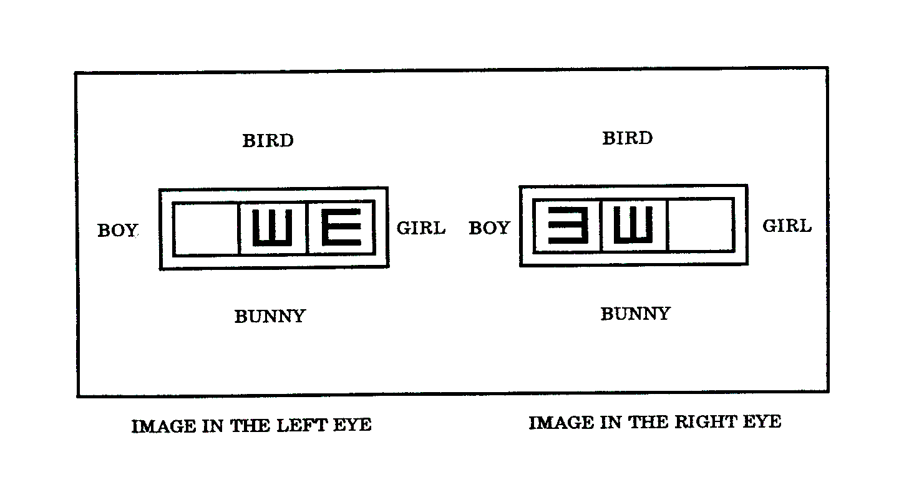
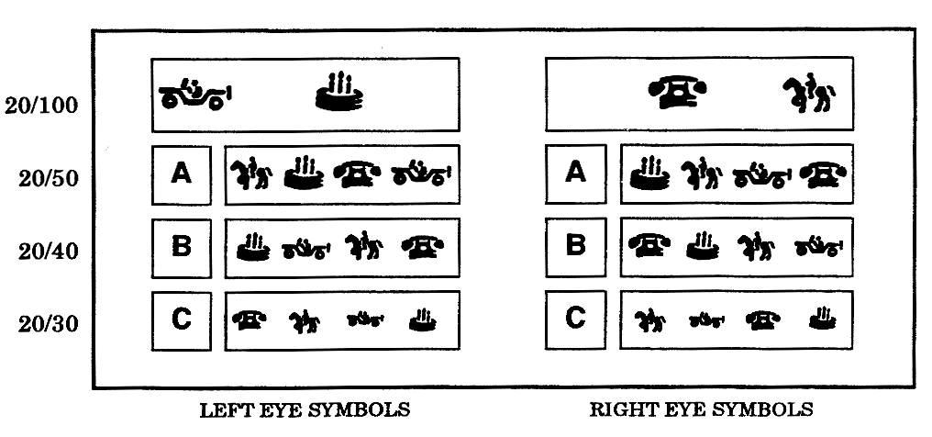
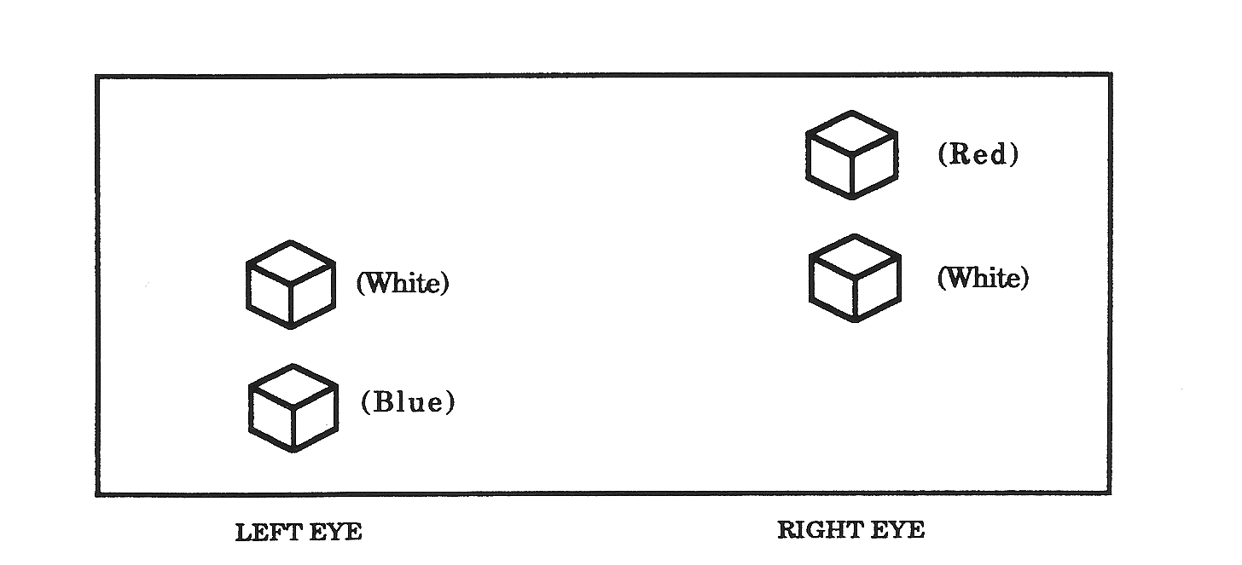
Binocular or Fusion
A correct response with this screen is for the child to see three E’s with both eyes ‘on’
A correct response with this screen is for the child to see
four symbols when both eyes are ‘on’.
A correct response with this screen is for the child to see
3 cubes when both eyes are ‘on’.
Notes:
49
Both eyes on Pass criteria is correctly identifying the direction of all three Es….child should say the first E is (pointing left, or toward boy), the second E is (pointing up or toward bird) and the third E is (pointing right or toward the girl)

Slide 50
Binocular Vision
Keystone
Right eye
Left eye
red
white
white
blue
A correct response with this screen is for the child to see 3 circles with both eyes. The circles should be in a vertical line or only minimally separated (if minimally separated it is acceptable to see 4 circles).
Notes:
50
Pass criteria is seeing three circles
Cubes merge and superimpose white over white so that the picture is three cubes in vertical order ( red, white, blue) child does not have to identify colors….only three cubes not two or four

Slide 51
Binocular Vision
Keystone
red
red
red
white
white
white
blue
blue
blue
pass
pass
pass
A correct response with this screen is for the child to see 3 circles with both eyes. The circles should be in a vertical line or only minimally separated (if minimally separated it is acceptable to see 4 circles).
Notes:
51
Pass criteria is seeing three balls
Cubes merge and superimpose white over white so that the picture is three balls in vertical order ( red, white, blue) child does not have to identify colors….only three cubes not two or four
Again if white circles are minimally separated, or child can bring them together, pass them

Slide 52
Binocular Vision
Keystone
FAIL
Four circles widely separated is a screen failure.
Notes:
52
Pass criteria is seeing three balls
Fail is 2 ball or 4 balls
*Pass if 4 balls if they are close together, or can “bring them together”
Cubes merge and superimpose white over white so that the picture is three cubes in vertical order ( red, white, blue) child does not have to identify colors….only three cubes not two or four

Slide 53
Autorefractor
Autorefractor may be used on any student.
The instrument must check:
Distance vision (acuity)
Both lateral and vertical muscle balance
The other tests required by law (fusion, color) must be completed using the standard screening methods, if possible.
Notes:
This screening replaces Wall Chart, 2+ lens, and muscle balance only. School nurse will still need attempt “fusion” screening and color screening if possible.
***IF USING AUTOREFRACTOR IT MUST BE NOTED IN ESCHOOL***

Slide 54
Autorefractor
The districts who choose to utilize an automated testing instrument to conduct the vision screening, must use the following protocol:
• If students fail with the automated instrument, they must be re-screened with the standard school screening method when possible.
• When a referral is made using the automated instrument, it must be entered into the eSchool data reporting system.
• The screening printout/reading of the automated instrument SHALL NOT be given to the parent.

Slide 55
Color
Performed with both eyes open
Use a standard instrument slide or a standard handheld red/green color testing card
To pass the student should be able to read/recognize 75% of the numbers or objects presented
Notes:
Student should not miss more than 25% of cards
If you use the printed color slides use slides 1-7. The first slide is a conditioning slide. They should be able to see at least 4 out of six slides (slides 2-7).
Be sure to print these slides with a good color printer. You can laminited it also.
If student fails color, be sure to let parents and teacher know. This is not a referral for color failure.

Slide 56
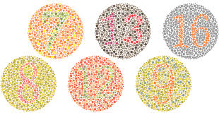
Color

Slide 57
Re-Screening Procedures for Arkansas School Nurses
Notes:
57
Rescreen in one month
Parent has 60 days to provide you with proof of examination
If a child does not receive an appropriate examination, as evidenced by a certificate signed by an optometrist or ophthalmologist acknowledging the examination, then the public school or charter school where the child is registered shall report the child to the Department of Education.

Slide 58
Why Rescreen?
Cuts down on over-referral
Adds validity and parent confidence
Improves follow-up
Saves time by decreasing amount of follow-up needed
Notes:
58
This is current practice and needs to be emphasized!!!
Over referral is a major problem because a rescreen exam was not performed….some students do not perform well in mass screenings and need the opportunity to work with the nurse in a quiet atmosphere and with one on one attention, slower pace…
Rescreen all tests that the student failed on the initial screening

Slide 59
Referral
Immediate referral if does not pass:
Observation (Appearance)
Re-screen within one month if student does not pass:
Visual Acuity
+2.00 test
Instrument screenings
Refer any student who does not pass any part of the re-screen
Color vision failure does not require a referral
Notes:
59
This is the referral criteria….note rescreen in 30 days
For instance, you have a child with phoria, that is an automatic referral
Or if you have a child with “pink eye” that is an automatic referral but then after the infection was gone you could do the exam
You probably wouldn’t refer pink eye to an optometrist or ophthalmologist because of insurance (also primary dr. could treat)

Slide 60
Tips
Observation with glasses on and off
Glasses on for wall chart
Glasses on for machine screening
Keep child’s head in place on machine, no peeking with “good” eye!
Adjust machine to child’s height
Room may need to be darkened for Autorefractor use.
Notes:
60
*if student wears glasses all of the time, test with glasses at wall chart,
if student only wears glasses for reading, try testing with glasses on for the plus lens test
May need to hold child’s head in place when machine testing
If you have the benefit of having help with your screenings, have someone stand at the wall chart and point at the letters or symbols
Make copies of the symbols and have teachers or volunteers practice with students
For pre-k or k students, may ask student to stand for vision screening at machine
Have copies of the symbols near you and have students point to the pictures that they are being asked to identify by the person at the wall chart
Student nurses in a RN program that have received this training can help with your vision screening. They can do the wall charts. You should do the observation and machine screening. They could also do the color test if you are using the booklets or pictures.
Color testing-if you are using color slides or the color booklets that have numbers and you are testing a student that doesn’t know their numbers, you can ask them to identify the number by tracing the number with their finger
Plan to spend more time with the younger students because they have difficulty understanding what you are asking them to do or may understand but have difficulty expressing their answers
May need to let child sit on your lap, use a step stool, kneel in chair, whatever it takes to get the child in good position to read the cards in the machine…

Slide 61
Suggestions for Screening
NOT the first week of school
Children entering school for the first time
Have 90 days to screen
Need time to adjust to school environment
Don’t wait too long
Cold and Flu season
Need time for follow-up
Recommend screening in September
Start with older children
Special Education students may need to be screened within 45 days depending on their IEP
Notes:
The reason for screening older students first is because they will be easier to screen. They have been through the screening before and know what to expect. This will give you time to get seasoned before you begin with the younger students.
Special education students- we always called them the “blue sheets” because they were printed on blue paper
These screenings need to be completed in a timely manner. You do not need to wait 4 weeks to rescreen these students. The special education teacher needs the results of the screening as soon as possible to submit the paperwork for the students to receive special education services.

Slide 62
Data Entry
Vision screening data is entered into eSchool+
Data queries will be pulled on June 15th
Training for eSchool+ will be provided at your Ed. Cooperative
No forms needed except for screening form
Parent Notification/Doctor Report Form will be generated through eSchool+

Slide 63
Data Entry
https://adesandbox.arkansas.gov/iframe?v=NmE2MTcyMTgxMjZhY2UyYTM5MzMyZDk3OTVmOTE3ZmI
https://chs-support.weebly.com/eschool.html

Slide 64
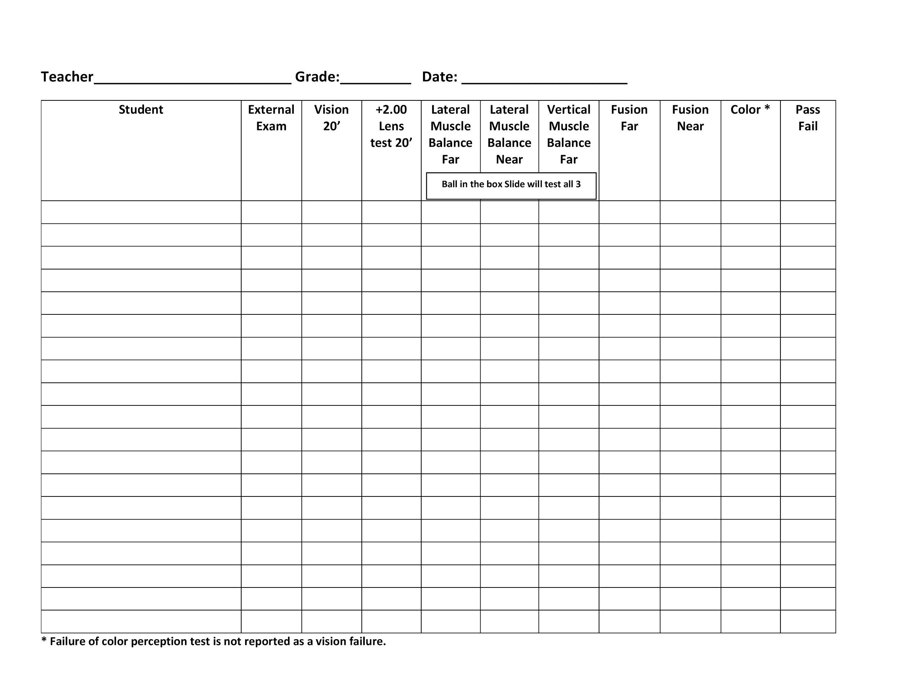

Slide 65
Vision Machine Repair
BSI--Jack Stone --in Little Rock
(501) 416-1232
2M Medical Solutions- West Memphis, Rogers (870) 735-0604

Slide 66
RESOURCES
Examinations and Eye glasses https://www.brandonburlsworth.org/
Medicaid Reimbursement: https://dese.ade.arkansas.gov/Offices/learning-services/school-health-services/arkansas-medicaid-in-the-schools
Notes:
Participating Wal Mart stores
Parents income less than $50,000.00
No Medicaid or AR KIDS FIRST

Slide 67
Special Education Referrals
Service requests are submitted on-line at https://arksped.k12.ar.us/
Click on Direct Services to access CIRCUIT and begin process.
Submission of necessary documentation
Consultation by trained professionals
Notes:
When service requests for students identified with visual impairments along with the necessary documentation have been received, a referral to Educational Services for the Visually Impaired will be generated. This service is provided without charge through the Special Education Unit of the ADE. Consultation is offered by trained professionals, dually certified in both vision education as well as orientation and mobility.
CIRCUIT- When a medical report from a ophthalmologist or optometrist indicates that a student’s vision is 20/70 or less in the better eye with correction or that a student’s visual field is 20 degrees or less, a request for vision consultation/services should be submitted to CIRCUIT.

Slide 68
Referral to Special Education Services for the Visually Impaired
When a medical report from a ophthalmologist or optometrist indicates that the student’s vision is 20/70 or less in the better eye with correction or that the student’s visual field is 20 degrees or less, a request for vision consultation/services should be submitted to CIRCUIT.
Notes:
https://arksped.k12.ar.us/sections/CIRCUIT.html
https://sites.google.com/wscstarfish.com/esvi
68

Slide 69
Resource
Arkansas School for the Blind
PO Box 668
Little Rock, AR. 72203
1-800-362-4451
501-683-5104

Slide 70
Resources
All resources can be found
on TRAIN and
www. CHS-Support.weebly.com
Notes:
National Eye Institute National Institute of Health

Slide 71
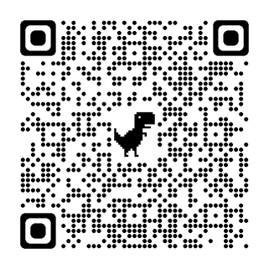
Knowledge Check

