Slide 1
Youth Suicide Prevention Arkansas Department of Health Hometown Health
Notes:
This presentation is an updated Suicide 101.
It is for grades 7-12 grades

Slide 2
We need to talk
Talking about suicide is hard
Our goal is to prevent suicide
Notes:
Suicide is a difficult subject that can be upsetting for some people to discuss. Let the audience know that it’s ok to step out if needed. Students should go with a teacher or staff member so we can make sure they’re ok.
“If you start to feel overwhelmed or emotional during this presentation, it’s ok to step out. Let a teacher know that you need to step out, so we can make sure you’re ok.”
Talking about suicide can be hard. It might feel uncomfortable or upsetting, especially for those who’ve lost someone to suicide. If you start to feel overwhelmed or emotional during this presentation, it’s ok to step out.
Our goal is to prevent suicide deaths. Today, we’ll be talking in-depth about the impact, risk factors, and warning signs of suicide. You’ll learn how to help if you think someone is suicidal. We’ll also go over some great resources that are free and available 24/7.
Even if it feels uncomfortable at times, it’s really important that we have this conversation today, because it might save a life.

Slide 3
Suicide can be prevented
Each of us has a role to play in preventing suicide
Notes:
Suicide affects entire communities. When someone dies by suicide, they leave behind people who knew them and cared about them. For friends and loved ones, the loss can be profoundly painful. But this heartbreak is not inevitable: suicide can be prevented. Today you’ll learn how you can help prevent suicide deaths.
Source: Substance Abuse and Mental Health Services Administration (SAMHSA) What is Suicide and Suicidal Behavior? | SAMHSA

Slide 4
Suicide Prevention
Commit
617
The best language to use to discuss suicide
The impact of suicide in our state
Myths and facts about suicide
988
Signs that someone is thinking of suicide
What to do if you think someone might be suicidal
Where to find help
Notes:
Most people who are suicidal exhibit one or more warning signs. As I mentioned earlier, recognizing these signs and taking action can help save a life. Today, you’ll learn about the risk factors and warning signs associated with suicide and what to do if you think someone is in danger. We’ll also discuss some myths and facts about suicide and the resources that are available if you or someone you know is at risk for suicide.
Source: Substance Abuse and Mental Health Services Administration (SAMHSA) What is Suicide and Suicidal Behavior? | SAMHSA
In the 2017 legislative session, Act 811 was passed, mandating the Arkansas Department of Health to create and maintain a Suicide Prevention Lifeline. We are the first call center that is staffed by full time employees in a state health department. We began answering phones 12/11/2017.
On average, for ages 0 – 17, we answer about 50 calls monthly.

Slide 5
Words Matter
When referring to suicide, choose your words carefully
Credit: MindFrame National Media
Notes:
OurWordsMatter_Guidance Cards_Final_260423.indd (imgix.net)
Notes:
Our words matter to those struggling with thoughts of ending their own lives. And in a world where silence or insensitivity often makes matters worse, we should talk about our language.
Avoid using the phrase “committed suicide”. It implies sin or crime – we “commit” crimes. We suggest more objective phrasing, like ‘died by suicide’, ‘ended their life’, ‘took their life’.
If
Avoid words that could sound judgmental or increase stigma. Language that glamorizes or sensationalizes suicide is also harmful.
Here are some examples of preferred and non-preferred language for talking about suicide.
we are using the right language, talking about suicide may be easier.

Slide 6
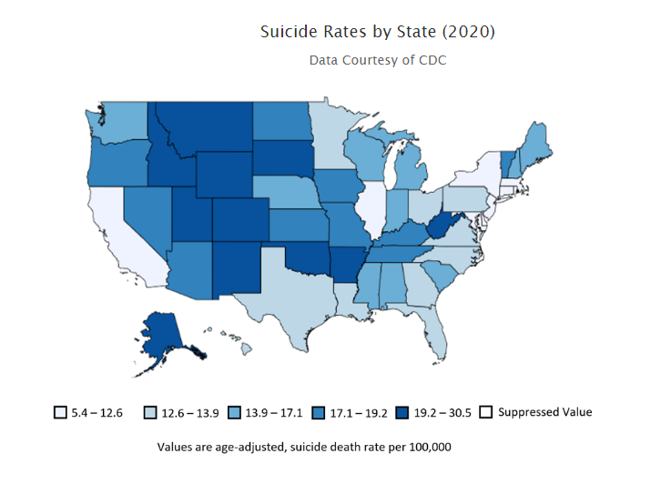
Suicide in the United States
In 2020, suicide was the 12th leading cause of death for all ages combined
For people under the age of 35, suicide was among the top three leading causes of death
In 2021, suicide claimed the lives of 48,183 people in the United States, which is around one death every 11 minutes
Sources: Suicide Prevention | Suicide | CDC ; National Institute of Mental Health based on data from the CDC. NIMH » Suicide (nih.gov)
Notes:
Source: Suicide Prevention | Suicide | CDC
National Institute of Mental Health based on data from the CDC. NIMH » Suicide (nih.gov)
According to the Centers for Disease Control and Prevention (CDC) WISQARS Leading Causes of Death Reports, in 2020:
Suicide was the twelfth leading cause of death overall in the United States, claiming the lives of over 45,900 people.
Suicide was the second leading cause of death among individuals between the ages of 10-14 and 25-34 , the third leading cause of death among individuals between the ages of 15-24, and the fourth leading cause of death among individuals between the ages of 35 and 44.
There were nearly two times as many suicides (45,979) in the United States as there were homicides (24,576).

Slide 7
Suicide in Arkansas
In 2021, 617 people died by suicide in Arkansas
Suicide is the leading violent cause of death in Arkansas
Between 2010 and 2020, more than twice as many people in our state died by suicide than by homicide
Suicide Prevention Arkansas Department of Health | WISQARS Leading Causes of Death Reports (cdc.gov)
Notes:
Sources:
Arkansas Department of Health, Suicide Prevention Arkansas Department of Health
CDC data report from WISQARSTM : 20 Leading Causes of Death, Arkansas, 2010 - 2020, All Races, Both Sexes, retrieved from WISQARS Leading Causes of Death Reports (cdc.gov) on 7/10/23.

Slide 8
Suicide in Arkansas
From: American Foundation for Suicide Prevention, based on data for the year 2020 from the CDC.
For more information, visit ASFP.org.
Notes:
NOTE:
This number includes anyone that has died by suicide in the state (residents and non-residents)

Slide 9
Suicide Myths vs. Facts
Adapted from SAMSHA

Slide 10
Myths vs. Facts
There are many myths surrounding suicide
Notes:
Myths are harmful
Myths can lead people to think they can’t give or receive help in a suicide crisis

Slide 11
Myth or Fact?
“Suicides happen without warning.”
MYTH
Notes:
<Make the statement and let the audience decide if the statement is a myth or a fact.>
Most teens who attempt or die by suicide have shared their plans or their feelings of distress with at least one other person. These communications are not always obvious, so it is important to know the key risk factors and warning signs of suicide.

Slide 12
Myth or Fact?
“Asking someone about suicide could give them the idea.”
MYTH
Asking can be the first step in helping them to choose to live.
Notes:
<Make the statement and let the audience decide if the statement is a myth or a fact.>
Asking someone if they’re suicidal will not give them an idea that they haven’t thought about already.
Most suicidal people are truthful and relieved when questioned about their feelings and intentions.

Slide 13
Myth or Fact?
“It’s best to keep someone’s suicidal feelings a secret.”
MYTH
Notes:
<Make the statement and let the audience decide if the statement is a myth or a fact.>
Whether it’s your own suicidal thoughts or someone else’s, reach out to a trusted adult for help.
Never, ever keep suicidal thoughts and feelings a secret. Don’t promise or assure the person that you’ll do so.

Slide 14
Myth or Fact?
“People who talk about suicide don’t actually kill themselves.”
MYTH
Notes:
<Make the statement and let the audience decide if the statement is a myth or a fact.>
“Do
People who are thinking about suicide usually find a way to communicate their pain to others. The person may even tell you outright that they’re suicidal. If this happens, believe them. Take their statements seriously and find a trusted adult who can help.
More often, people will communicate their distress by speaking indirectly about their intentions. We’ll talk more about this in the coming slides.
n’t be afraid to ask the question. Most suicidal people will admit to their feelings if questioned directly.”

Slide 15
Why does it happen?
There is no single underlying cause for suicide
Notes:
Source: American Foundation for Suicide Prevention, Risk factors, protective factors, and warning signs | AFSP
Often, there are many different factors that converge together to create a profound sense of hopelessness and despair.

Slide 16
These are called risk factors
Stressful life events, anxiety, depression, social isolation, and trauma can all contribute to the development of suicidal thoughts or behaviors
Notes:
Sources:
Substance Abuse and Mental Health Services Administration: What is Suicide and Suicidal Behavior? | SAMHSA
American Foundation for Suicide Prevention: Risk factors, protective factors, and warning signs | AFSP
While none of these things alone can predict suicide, each one increases the chances that someone may become suicidal

Slide 17
Risk Factors
Mental health conditions like depression or bipolar disorder
Feelings of hopelessness, loneliness, and isolation
Using alcohol, tobacco, marijuana or other drugs
History of trauma or abuse
Loss of a close relationship
Any previous suicide attempt
Recent death of a loved one, especially if they died by suicide
Notes:
Notes:
Risk Factors: They can’t cause or predict a suicide attempt, but they’re important to be aware of. Signs that someone is thinking about suicide are NOT always obvious. It’s important to know what the warning signs are so that we are more likely to recognize them if the situation arises.
Sources:
Substance Abuse and Mental Health Services Administration: What is Suicide and Suicidal Behavior? | SAMHSA
American Foundation for Suicide Prevention: Risk factors, protective factors, and warning signs | AFSP

Slide 18
Warning Signs
Talking about or making plans for suicide
Expressing hopelessness about the future
Displaying severe or overwhelming emotional pain or distress
Changes in behavior, like:
withdrawal from or changing social connections/situations
Changes in sleep (increased or decreased)
Anger or hostility that seems out of character or out of context
Recent increased agitation or irritability
Notes:
Notes:
Risk Factors: They can’t cause or predict a suicide attempt, but they’re important to be aware of. Signs that someone is thinking about suicide are always obvious. It’s important to know what the warning signs are so that we are more likely to recognize them if the situation arises.
The warning signs for suicide are slightly different for adults than for youth. To learn more about suicide warning signs in adults, visit https://www.samhsa.gov/mental-health/suicidal-behavior.
Sources:
Substance Abuse and Mental Health Services Administration: What is Suicide and Suicidal Behavior? | SAMHSA
American Foundation for Suicide Prevention: Risk factors, protective factors, and warning signs | AFSP
Source: Substance Abuse and Mental Health Services Administration, What is Suicide and Suicidal Behavior? | SAMHSA

Slide 19
Verbal warning signs are things that people say that let others know they are thinking about suicide
Direct
or
Indirect
Notes:
If someone explicitly tells you they want to kill themselves, that is
a Direct Verbal Warning.
Indirect Verbal Warnings are when someone hints that they might be thinking about suicide but doesn’t say it outright.

Slide 20
“I’ve decided to kill myself.” “I wish I were dead.” “I’m going to end it all.” “If ____ doesn’t happen, I’ll kill myself.”
Direct vs Indirect
Verbal Warning Signs
Direct
Indirect
“I’m tired of life, I just can’t go on.”
“My family is better off without me.”
“Who cares if I’m dead anyway.”
“I wish I didn’t exist.”
“I won’t be around much longer.”
“Pretty soon you won’t have to worry about me.”

Slide 21
How can I help?

Slide 22
If you think that someone might be suicidal, ask them directly:
Ask the question.
“Are you thinking about suicide?”
Notes:
Source: How The 5 Steps Can Help Someone Who is Suicidal - #BeThe1To

Slide 23
Ask The Question
You could say:
“I have a feeling you might be thinking about suicide. Are you thinking about suicide?”
“Sometimes people in certain situations feel suicidal. Have you been thinking about killing yourself?”
If the person is reluctant, be persistent; “It seems like something is bothering you. This is important to me, and I care about you.”
If you can’t ask the question, find someone else who can.
ASK
Not sure?
Don’t wait!
Ask the question.
Notes:
Source: How The 5 Steps Can Help Someone Who is Suicidal - #BeThe1To
BeThe1To was created by the 988 Suicide and Crisis Lifeline, which is funded by SAMHSA & administered by Vibrant Emotional Health.

Slide 24
Listen
Listen without judgment
Show compassion and empathy
Take their answers seriously
Listen for any potential reasons they might have for staying alive and help them focus on those reasons
BE THERE
Being there for someone with thoughts of suicide
is life-saving.
Notes:
Source: How The 5 Steps Can Help Someone Who is Suicidal - #BeThe1To
BeThe1To was created by the 988 Suicide and Crisis Lifeline, which is funded by SAMHSA & administered by Vibrant Emotional Health.
Ask about their reasons for feeling hopeless and allow them to talk freely. Give them your complete attention.
Let your friend have time to tell you what they are thinking. It’s important not to interrupt or dismiss what they are saying.

Slide 25
Keep Safe
“Do you have a plan to kill yourself?”
Keep them safe by putting time and distance between the person and their chosen method.
Never promise your friend that you will keep their secret. You could say “I care about you, and I want you to get help”.
Don’t try to help your friend alone – reach out to an adult you trust, like a pastor, school counselor, teacher, coach or school nurse.
KEEP THEM SAFE
Call or text 988 for immediate help.
Notes:
Source: How The 5 Steps Can Help Someone Who is Suicidal - #BeThe1To
BeThe1To was created by the 988 Suicide and Crisis Lifeline, which is funded by SAMHSA & administered by Vibrant Emotional Health.
Ask if they’ve thought about how they would do it and if they already have the means in place.
Find an adult to remove your friend’s “means” (i.e. gun, pills, etc.). Try not to leave your friend alone once you have determined they are at risk.

Slide 26
Help Them Connect
Don’t just ask your friend to get help – bring the help to them
Stay with your friend and make sure they get connected to someone who can help
Help them develop a safety plan they can use if they start having thoughts about suicide
HELP THEM CONNECT
Offer hope
Notes:
Source: How The 5 Steps Can Help Someone Who is Suicidal - #BeThe1To
BeThe1To was created by the 988 Suicide and Crisis Lifeline, which is funded by SAMHSA & administered by Vibrant Emotional Health.
Offer to call the 988 Lifeline with them or take them directly to a counselor, teacher, pastor, parent, school nurse, or other trusted adult.
Remind them that seeking help isn’t a sign of weakness or anything to be embarrassed or ashamed about.

Slide 27
Follow Up
After you’ve connected your friend to someone who can help, it’s important to follow-up regularly and see how they’re doing
Send a text, give them a call, or visit in person to let them know you care
Even a small gesture of kindness can make a difference
FOLLOW UP
Find out why this can save a life at BeThe1To.com.
Notes:
Source: How The 5 Steps Can Help Someone Who is Suicidal - #BeThe1To
BeThe1To was created by the 988 Suicide and Crisis Lifeline, which is funded by SAMHSA & administered by Vibrant Emotional Health.
Checking in with your friend can help reduce their risk of suicide by increasing their feelings of connectedness and showing them that they’re not alone.

Slide 28
Things to Remember
You are NOT alone
Teenage years are tough
EVERYONE needs a trusted adult to talk to
Who is yours?
Notes:
Spend a minute on this slide.
Teenagers need to know they are not alone, and these years are hard. They are going through a lot of changes emotionally and physically.
A lot of our teen face trauma from their early childhood.
Everyone needs someone to talk to.
Who is their trusted adult? Do you know their number? If you didn’t have your phone, could you still call them?
Asking for help is not a weakness but a strength.

Slide 29
Helpful Resources

Slide 30
988
If you are struggling, call or text the Lifeline at 988
It’s free, confidential, and available 24/7
You can also reach the Lifeline via chat at http://988lifeline.org/chat

Slide 31
www.BeThe1To.com
visit
for resources,
success stories, and more
information about how you can help.
Notes:
The BeThe1To campaign was created by the 988 Suicide and Crisis Lifeline, which is funded by the Substance Abuse and Mental Health Services Administration & administered by Vibrant Emotional Health.

Slide 32
Most major social media platforms have processes in place to assist a user in crisis. The steps for reporting are slightly different for each platform, so it’s important to know what the steps are for each social media platforms you use. You can learn more about how to help someone on social media at https://988lifeline.org/help-someone-else/safety-and-support-on-social-media/
Support on
Social Media
Notes:
<Note: Instructions for specific social media platforms were not included in this presentation, because this audience may be as knowledgeable or more knowledgeable about using this technology as the person presenting. Also, social media companies make changes frequently, and if specific information is included in this PowerPoint, it may become obsolete before the presentation can be updated. Encourage the audience to familiarize themselves with the process for seeking support on social media for all of the platforms they currently use and reiterate the importance of reaching out if they’re concerned that someone might be thinking of suicide.>

Slide 33
Helpful Technology
Having a plan in place can help you stay safe.
The MY3 Support Network
app helps you stay connected with people you can reach out to when you’re struggling with tough emotions
or having thoughts of suicide.
The Suicide Safety Plan app helps you create a custom safety plan that you can follow when you feel like having thoughts of suicide. can guide you through difficult moments and keep you safe.
Notes:
MY3: This app lets you define your network of people who can help when you’re having thoughts of suicide, and it helps you create a plan to stay safe.
Suicide Safety Plan: “You can customize your own warning signs that a crisis may be developing, coping strategies for dealing with suicidal urges, places for distraction, friends and family members you can reach out to, professionals you can call, methods of making your environment safe, and your own important reasons for living.”

Slide 34
988
When in doubt, call or text
You can also reach the Lifeline via chat at http://988lifeline.org/chat
Notes:
If you only remember one thing that we talked about today, remember 988. It’s free and available 24/7. Whether you’re calling for yourself or a friend, the 988 Lifeline can help.

Slide 35
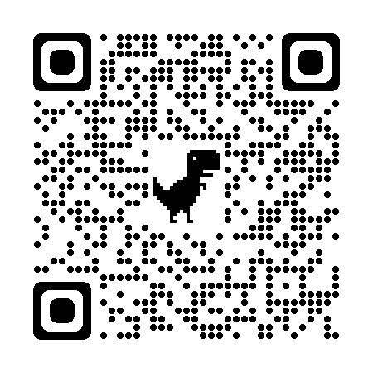
Thank You!
Thank you for your participation today
Each county in Arkansas has a Local Health Department
For more information or to find out about services near you, please scan the QR Code

